Slide 1
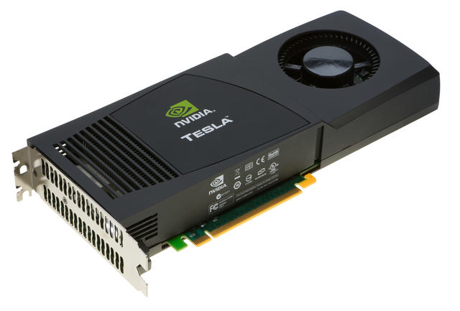
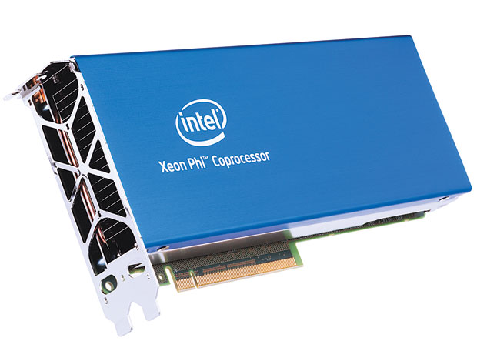
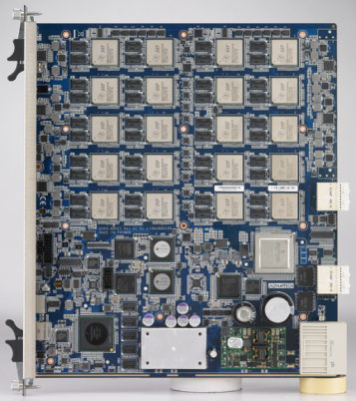
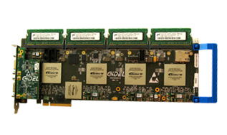
Heterogeneous and Reconfigurable Computing Lab
Mission: Develop practices and tools to harness emerging processing technologies
Emerging technologies address current limitations, e.g.:
  100 quadrillion ops/sec limit for large-scale computers
  Mobile processors can’t execute computer vision and machine learning tasks in real time while maintaining acceptable power envelope
Manycore Processors:
Digital Signal Processors:
Programmable Logic:

Slide 2
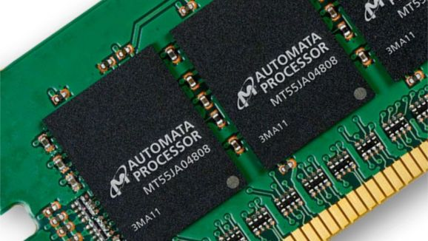
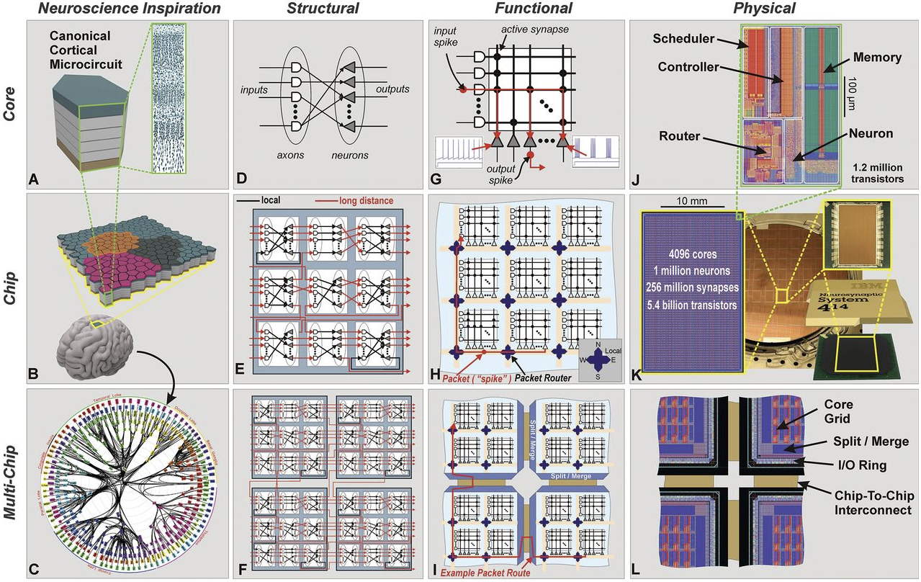
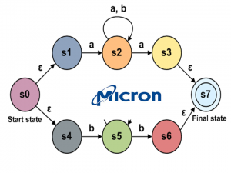
Emerging Technologies
Micron Automata Processor:
IBM Neurosynaptic Processor

Slide 3
Contact Information
Lab:
  Swearingen 3D15
Jason D. Bakos:
  Swearingen 3A45
  jbakos@sc.edu
Current Ph.D. students:
  Zheming Jin
  Fan Zhang
  Yang Gao
  Jordan Bradshaw
  Konstantin Rubin
  Ivan Panchencko
  Rasha Karakchi
  Subhendu Chakrabarti
Current undergraduate students:
  Lacie Cochran
  Daniel Clements
  Jonathan Freed

