Slide 1
Heterogeneous and Reconfigurable Computing Lab
Lab Director: Jason D. Bakos

Slide 2
Heterogeneous and Reconfigurable Computing Group
Objective: develop technologies to improve computer performance
Processor Generation | Max. Clock Speed (GHz) | Max. Numberof Cores | Max. RAM Bandwidth (GB/s) | Max. Peak Floating Point (Gflop/s) | Max. L3 cache (MB)
Core (2006) | 3.33 | 4 | 25.6 | 107 | 8
Penryn (2007) | 3.33 | 4 | 25.6 | 107 | 8
Westmere (2010) | 3.60 | 6 | 25.6 | 173 | 12
Ivy Bridge (2013) | 3.70 | 6 | 25.6 | 355 | 15
Broadwell (2015) | 3.80 | 6 | 25.6 | 365 | 30

Slide 3
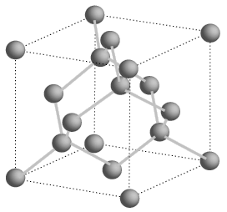
Moore’s Law?
Processor Generation | Transistor size (nm) | Number of transistors (millions)
Core (2006) | 65 | 105
Penryn (2007) | 45 | 228
Westmere (2010) | 32 | 382
Ivy Bridge (2013) | 22 | 624
Broadwell (2015) | 14 | 1300
Cannonlake (2017) | 10 | 2600
?? (2020) | 7 | 5200
?? (2022) | 5 | 10400
?? (2025) | 3 | 20800
?? (2027) | 1 | 41600
Si atom spacing = 0.5 nm

Slide 4
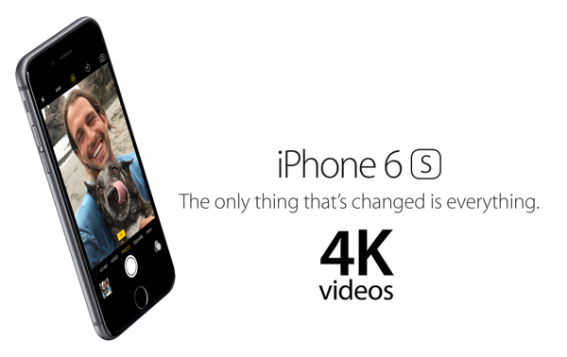
New Capabilities
What about iPhone 6s 4K video?
What about XBox One graphics?

Slide 5
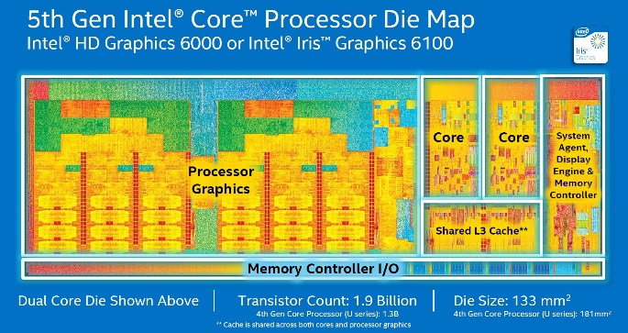
All Modern CPUs are Heterogeneous

Slide 6
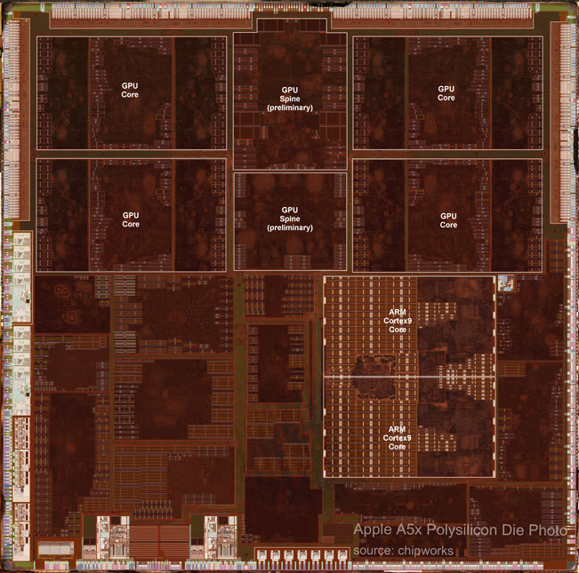
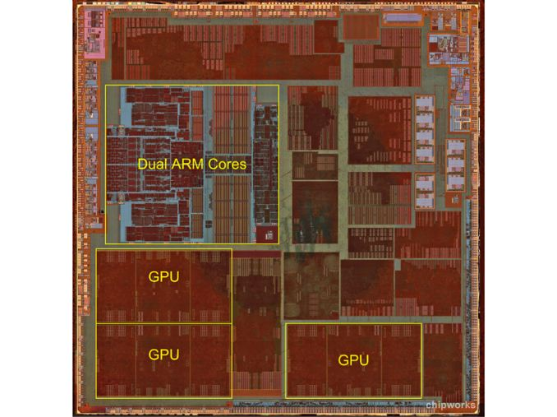
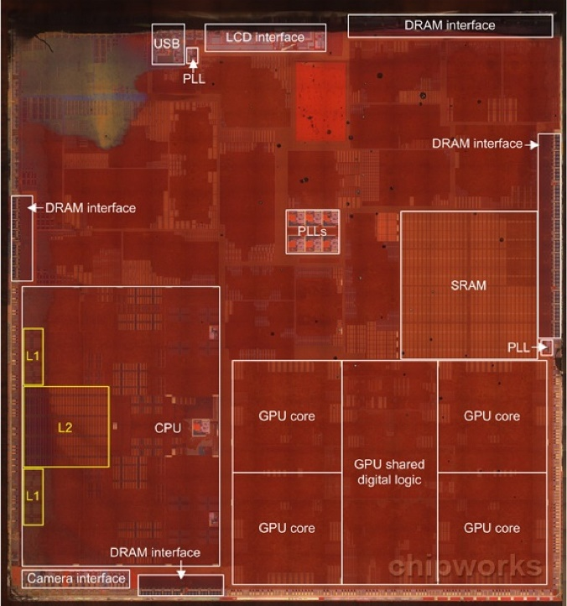
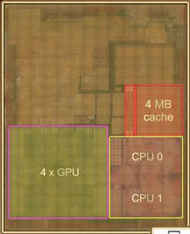
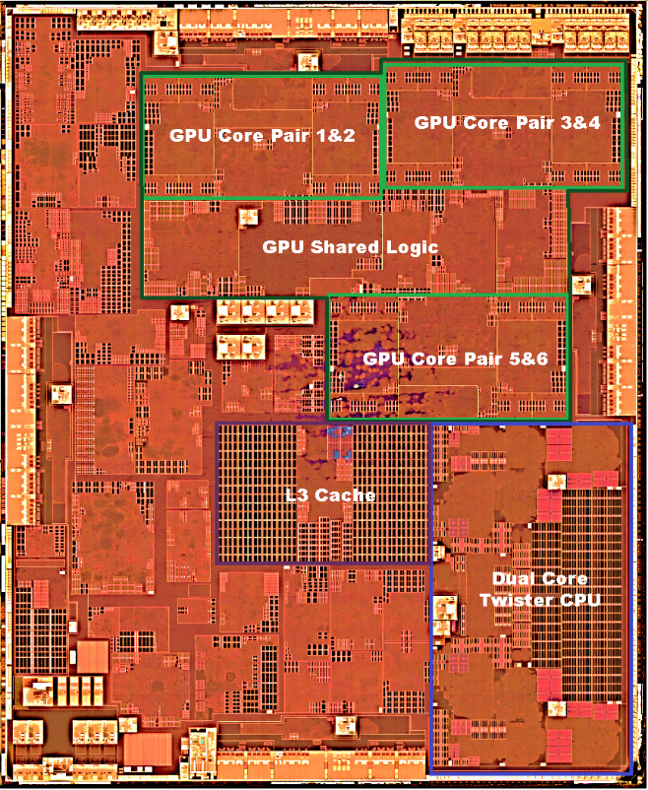
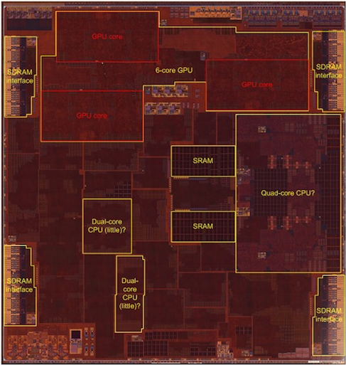
All Modern CPUs are Heterogeneous
Apple A5x
Apple A6
Apple A7
Apple A8
Apple A9
Apple A10

Slide 7
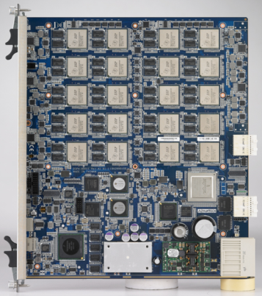
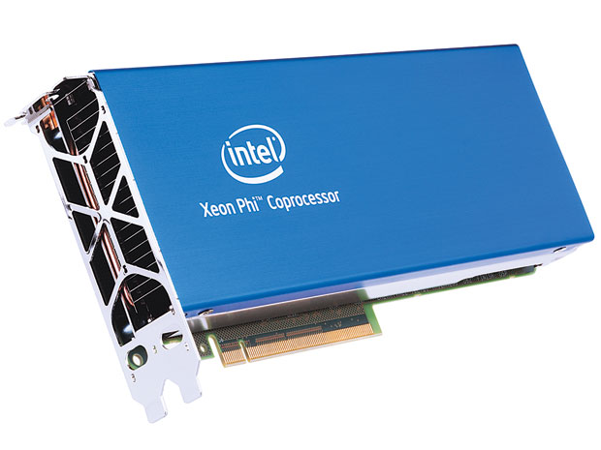
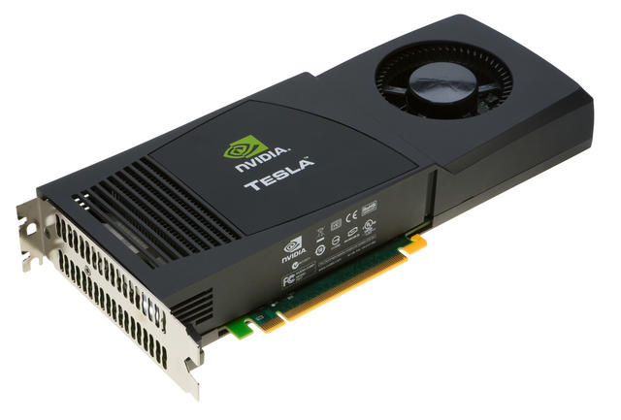
Heterogeneous and Reconfigurable Computing Lab
We’re in good shape for graphics and video
What about scientists, engineers, and computational finance?
For these, we need emerging processing technologies
Digital Signal Processors:
Manycore Processors:
Our work:
Applications
Development tools

Slide 8
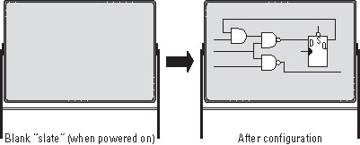
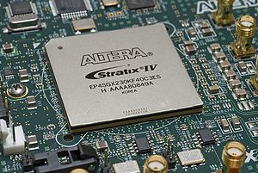
Field Programmable Gate Arrays (FPGAs)

Slide 9
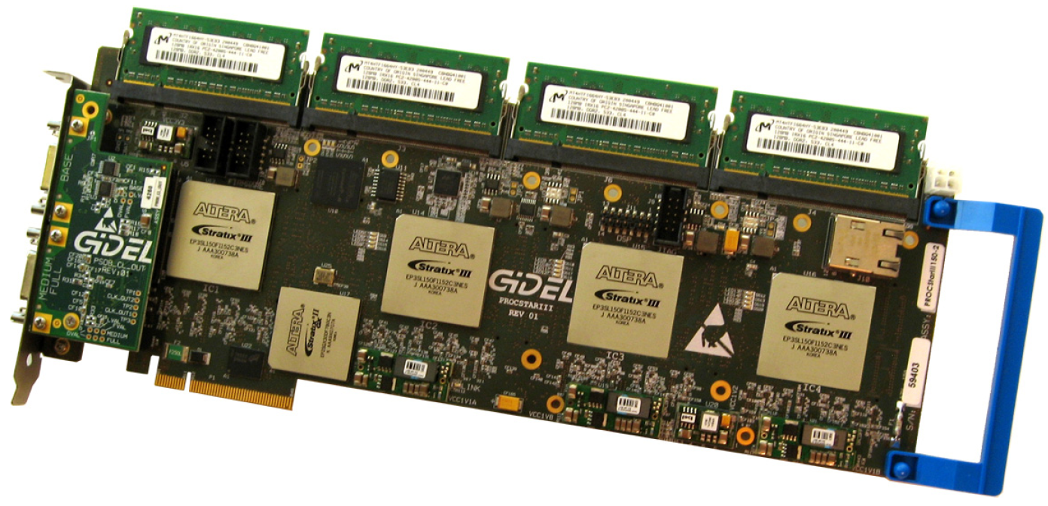
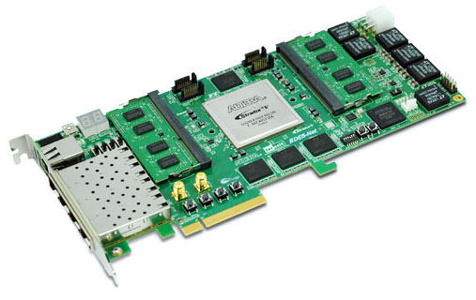
Heterogeneous Computing with FPGAs
Convey HC-1

Slide 10
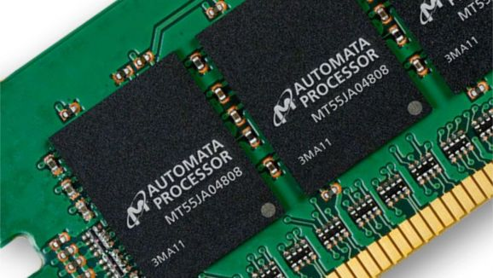
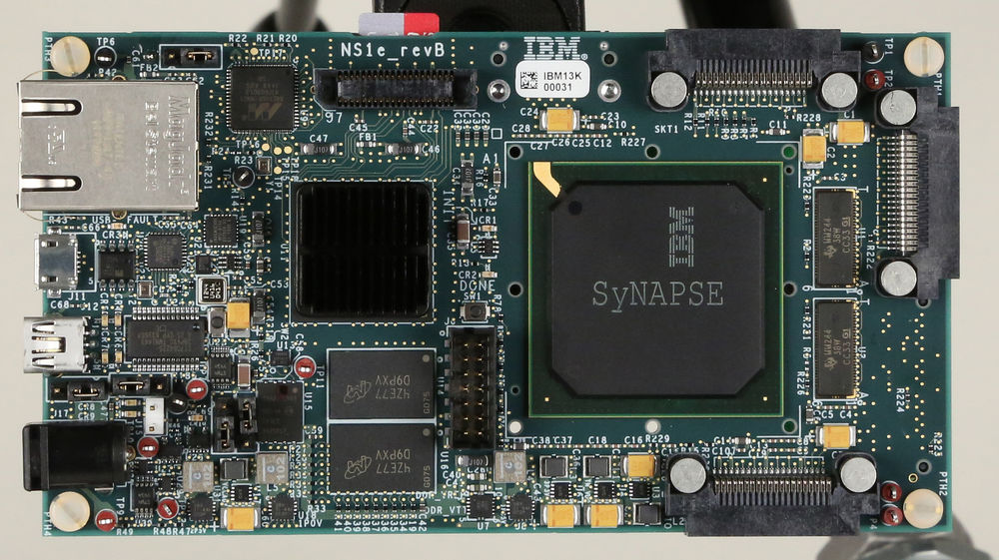
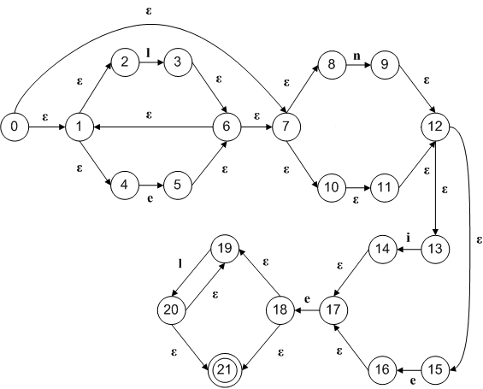
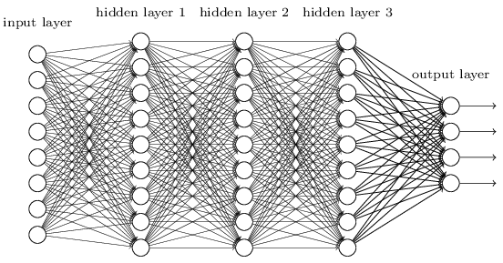
Emerging Technologies: Processor-in-Memory
Micron Automata Processor:
IBM Neuromorphic Processor

Slide 11
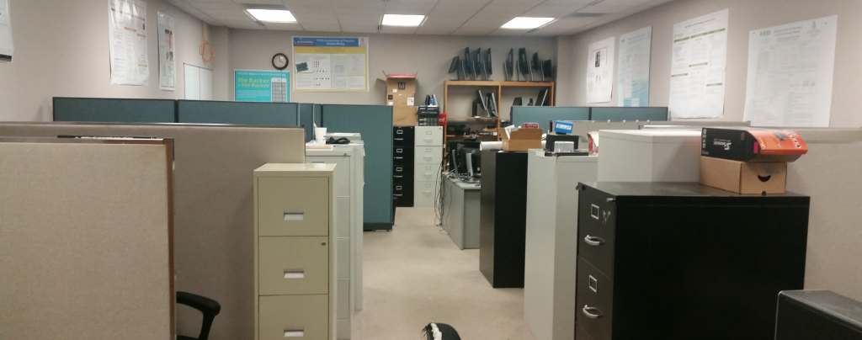
Contact Information
Lab:
Swearingen 3D15
Office:
Swearingen 3A45
jbakos@sc.edu
Graduate Students:
Madushan Abeysinghe
Lacie Cochran
Rasha Karakchi
Ivan Panchenko
Konstantin Rubin
Undergraduate Students:
Charles Daniels
Joshua Livingston
Viraj Patel
Scottie Scott
Manal "Mae" Khawaja

