Slide 1
Seven Minute Madness: Heterogeneous Computing
Dr. Jason D. Bakos

Slide 2
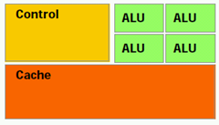
Computer Architecture Trends
Goal: extract maximum performance from serial code
Instruction re-ordering
Speculative execution
Multiple issue
Branch prediction
Large, multi-level caches
Onus is on processor and compiler to extract performance from code
Results in large control unit and cache

Slide 3
Computer Architecture Trends
Multicore architecture:
Allows programmer to extract performance
CPU
Memory

Slide 4
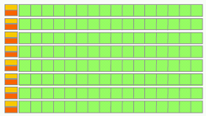
Computer Architecture Trends
Special purpose processor
Small control and cache
Devote maximum area to ALUs
Shifts onus to programmer to get performance
Requires careful programming—only practical for expensive computations
Examples: GPU, Cell, FPGA

Slide 5
Heterogeneous Computing
General purpose CPU + special-purpose processors in one system
Host Memory
CPU
QPI
PCIe
On board
Memory
X58
Co-processor
~25 GB/s
~25 GB/s
~8 GB/s (x16)
?????
~150 GB/s for GeForce 260
host
add-in card

Slide 6
Heterogeneous Computing
Example:
Application requires a week of CPU time
Offload computation consumes 99% of execution time
49% of code
initialization
0.5% of run time
“hot” loop
99% of run time
1% of code
Kernel speedup | Application speedup | Execution time
50 | 34 | 5.0 hours
100 | 50 | 3.3 hours
200 | 67 | 2.5 hours
500 | 83 | 2.0 hours
1000 | 91 | 1.8 hours
49% of code
clean up
0.5% of run time
co-processor

Slide 7
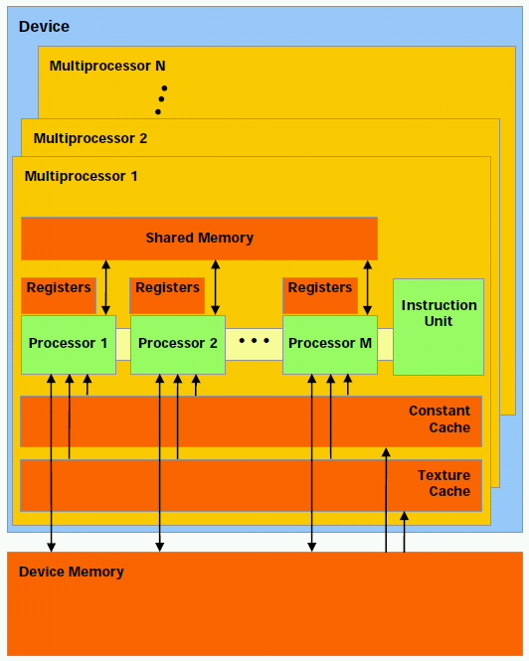
NVIDIA GT200 GPU Architecture
30 “streaming multiprocesors”
Simple cores:
In-order execution, no: branch prediction, spec. execution, multiple issue, context switches
No cache (just 16K programmer-managed on-chip memory)
One active instruction at a time
Can execute 32 threads in parallel per SM if no branch divergence

Slide 8
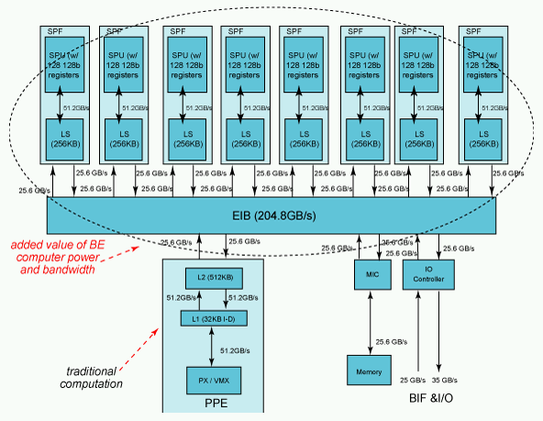
IBM Cell/B.E. Architecture
1 PowerPC, 8 small processors
Programmer must manually manage 256K memory and threads invocation on each SPE
Each SPE includes a vector unit like the one on current Intel processors
128 bits wide

Slide 9
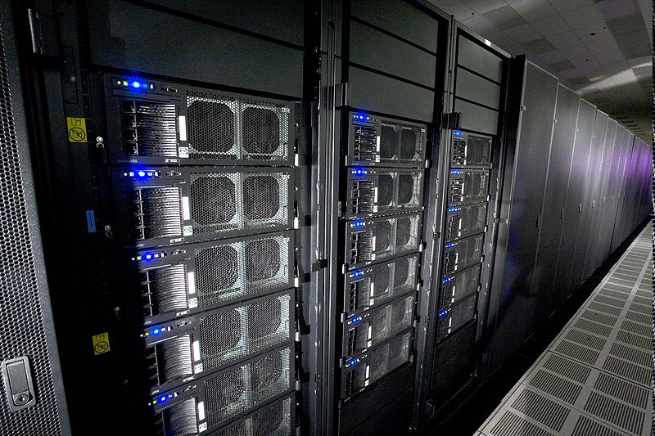
Heterogeneous Computing now Mainstream: IBM Roadrunner
Los Alamos, fastest computer in the world
6,480 AMD Opteron (dual core) CPUs
12,960 PowerXCell 8i GPUs
Each blade contains 2 Operons and 4 Cells
296 racks

Slide 10
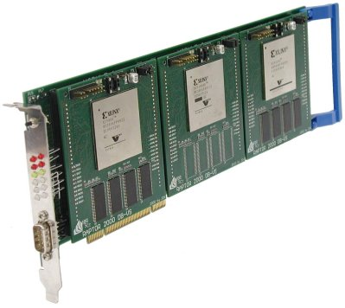
Heterogeneous Computing with FPGAs

Slide 11
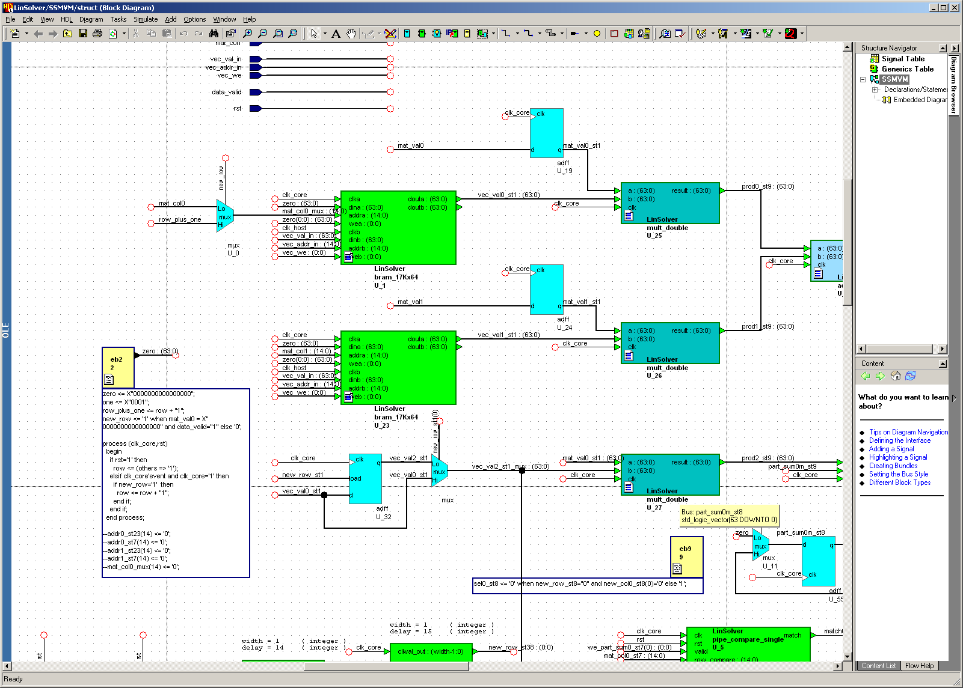
Programming FPGAs

Slide 12
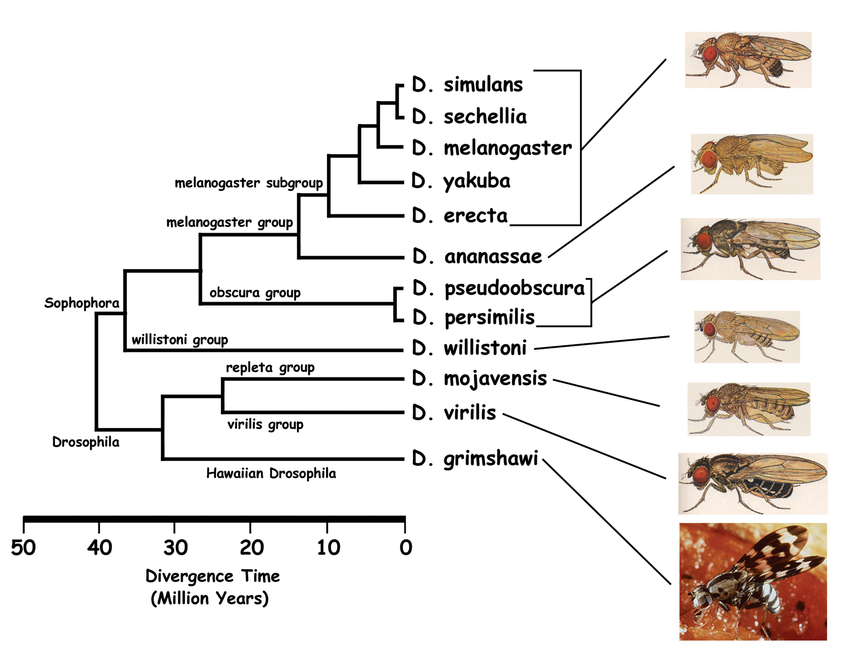
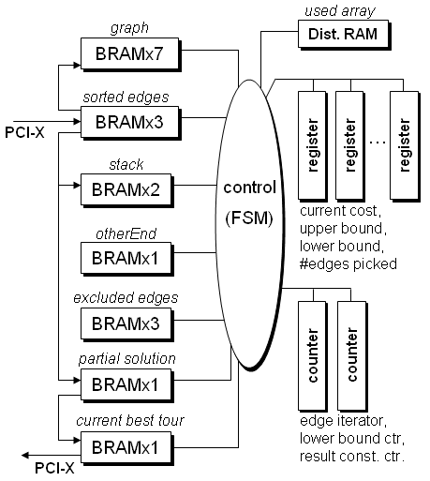
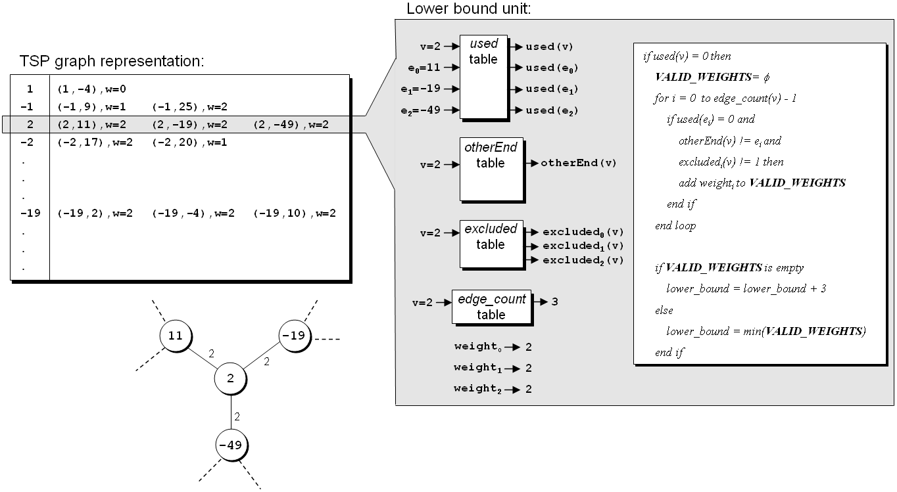
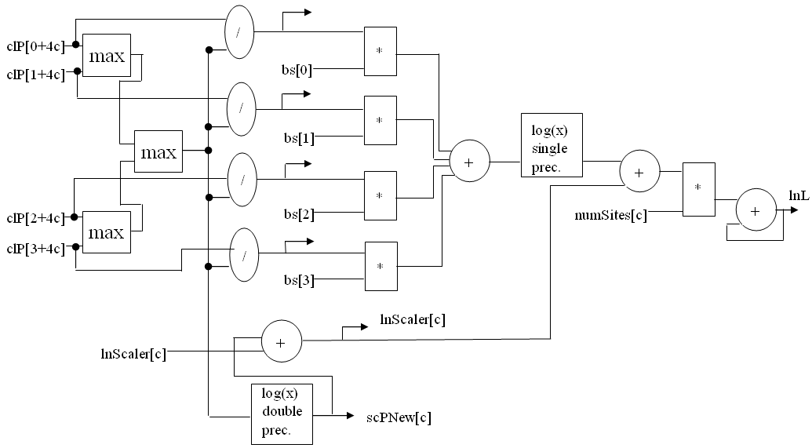
Our Projects
FPGA-based co-processors for computational biology
Tiffany M. Mintz, Jason D. Bakos, "A Cluster-on-a-Chip Architecture for High-Throughput Phylogeny Search," IEEE Trans. on Parallel and Distributed Systems, submitted.
Stephanie Zierke, Jason D. Bakos, "FPGA Acceleration of Bayesian Phylogenetic Inference," BMC Bioinformatics, submitted.
Jason D. Bakos, Panormitis E. Elenis, "A Special-Purpose Architecture for Solving the Breakpoint Median Problem," IEEE Transactions on Very Large Scale Integration (VLSI) Systems, Vol. 16, No. 12, Dec. 2008.
Jason D. Bakos, Panormitis E. Elenis, Jijun Tang, "FPGA Acceleration of Phylogeny Reconstruction for Whole Genome Data," 7th IEEE International Symposium on Bioinformatics & Bioengineering (BIBE'07), Boston, MA, Oct. 14-17, 2007.
Jason D. Bakos, “FPGA Acceleration of Gene Rearrangement Analysis,” 15th Annual IEEE International Symposium on Field-Programmable Custom Computing Machines (FCCM'07), April 23-25, 2007.

Slide 13
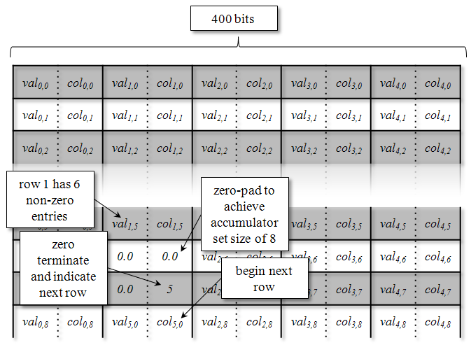
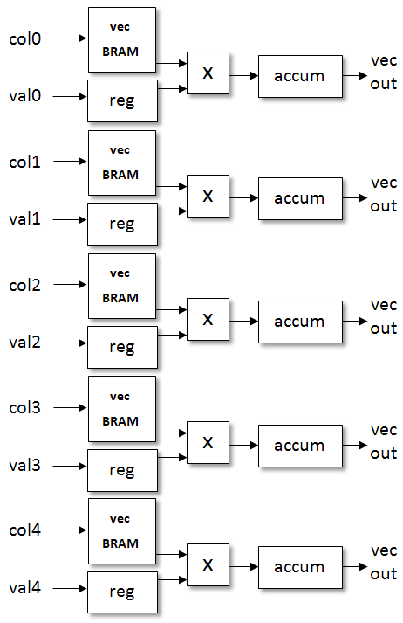
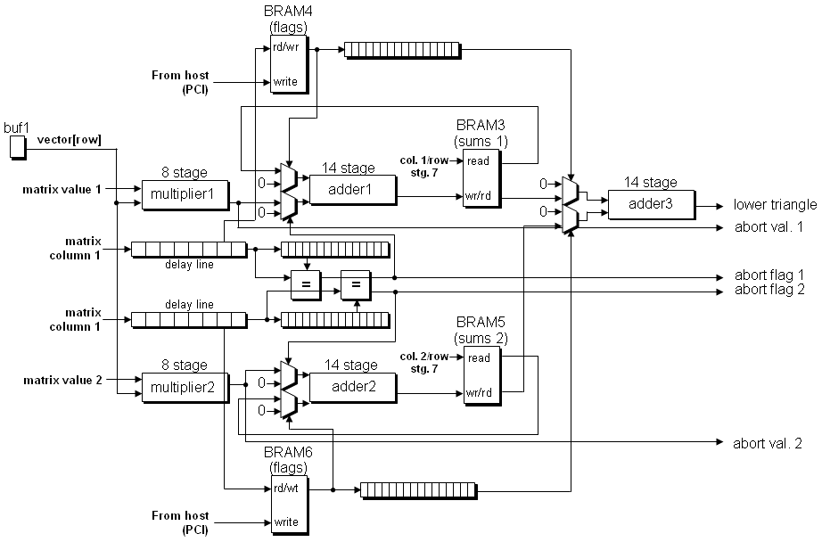
Our Projects
FPGA-based co-processors for linear algebra
Krishna.K. Nagar, Jason D. Bakos, "A High-Performance Double Precision Accumulator," IEEE International Conference on Field-Programmable Technology (IC-FPT'09), Dec. 9-11, 2009.
Yan Zhang, Yasser Shalabi, Rishabh Jain, Krishna K. Nagar, Jason D. Bakos, "FPGA vs. GPU for Sparse Matrix Vector Multiply," IEEE International Conference on Field-Programmable Technology (IC-FPT'09), Dec. 9-11, 2009.
Krishna K. Nagar, Yan Zhang, Jason D. Bakos, "An Integrated Reduction Technique for a Double Precision Accumulator," Proc. Third International Workshop on High-Performance Reconfigurable Computing Technology and Applications (HPRCTA'09), held in conjunction with Supercomputing 2009 (SC'09), Nov. 15, 2009.
Jason D. Bakos, Krishna K. Nagar, "Exploiting Matrix Symmetry to Improve FPGA-Accelerated Conjugate Gradient," 17th Annual IEEE International Symposium on Field Programmable Custom Computing Machines (FCCM'09), April 5-8, 2009.

Slide 14
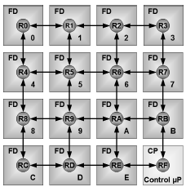
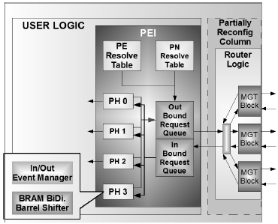
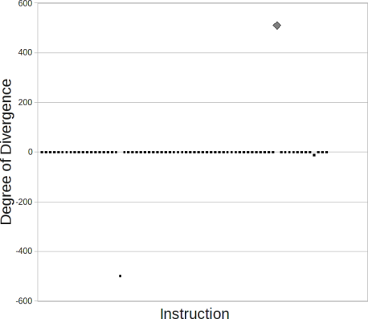
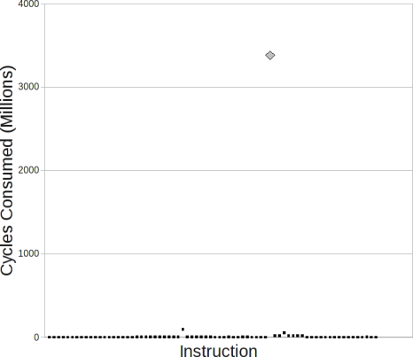
Our Projects
Multi-FPGA System Architectures
Jason D. Bakos, Charles L. Cathey, E. Allen Michalski, "Predictive Load Balancing for Interconnected FPGAs," 16th International Conference on Field Programmable Logic and Applications (FPL'06), Madrid, Spain, August 28-30, 2006.
Charles L. Cathey, Jason D. Bakos, Duncan A. Buell, "A Reconfigurable Distributed Computing Fabric Exploiting Multilevel Parallelism," 14th Annual IEEE International Symposium on Field-Programmable Custom Computing Machines (FCCM'06), April 24-26, 2006.
GPU Simulation
Patrick A. Moran, Jason D. Bakos, "A PTX Simulator for Performance Tuning CUDA Code," IEEE Trans. on Parallel and Distributed Systems, submitted.

Slide 15
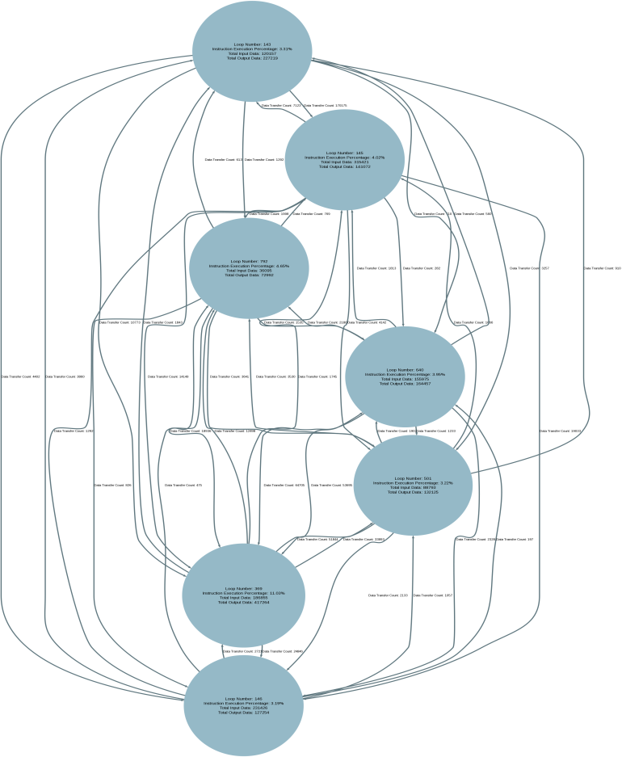
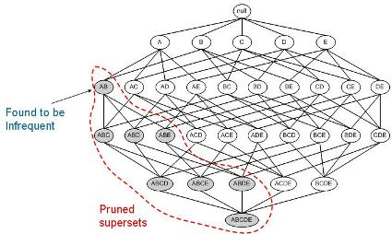
Most Recent Projects
Task Partitioning for Heterogeneous Computing
GPU and FPGA Acceleration of Data Mining

Slide 16
Contact Information
Jason D. Bakos
Office: 3A52
E-mail: jbakos@sc.edu
http://www.cse.sc.edu/~jbakos
Heterogeneous and Reconfigurable Computing (HeRC) Lab:
Lab: 3D15
http://herc.cse.sc.edu
Course
Spring 2010: CSCE 212, section 001 (TTH 11:00)

