Slide 1
Seven Minute Madness: Heterogeneous Computing
Dr. Jason D. Bakos

Slide 2
CPU Design
FOR i = 0 to 1000
C[i] = A[i] + B[i]
Core 1
Core 2
CPU
Control
ALU
ALU
Control
ALU
ALU
ALU
ALU
ALU
ALU
time
L1 cache
L1 cache
Copy part of A onto CPU
L2 cache
L2 cache
Copy part of B onto CPU
ADD
ADD
ADD
ADD
L3 cache
Copy part of C into Mem
Copy part of A onto CPU
Copy part of B onto CPU
ADD
ADD
ADD
ADD
Copy part of C into Mem
…

Slide 3
Co-Processor Design
FOR i = 0 to 1000
C[i] = A[i] + B[i]
GPU
cache
ALU
ALU
ALU
ALU
ALU
ALU
ALU
ALU
Core 1
cache
ALU
ALU
ALU
ALU
ALU
ALU
ALU
ALU
Core 2
cache
ALU
ALU
ALU
ALU
ALU
ALU
ALU
ALU
Core 3
cache
ALU
ALU
ALU
ALU
ALU
ALU
ALU
ALU
Core 4
cache
ALU
ALU
ALU
ALU
ALU
ALU
ALU
ALU
Core 5
cache
ALU
ALU
ALU
ALU
ALU
ALU
ALU
ALU
Core 6
cache
ALU
ALU
ALU
ALU
ALU
ALU
ALU
ALU
Core 7
cache
ALU
ALU
ALU
ALU
ALU
ALU
ALU
ALU
Core 8

Slide 4
Heterogeneous Computing
Combine CPUs and coprocs
Example:
Application requires a week of CPU time
Offload computation consumes 99% of execution time
49% of code
initialization
0.5% of run time
“hot” loop
99% of run time
2% of code
Kernel speedup | Application speedup | Execution time
50 | 34 | 5.0 hours
100 | 50 | 3.3 hours
200 | 67 | 2.5 hours
500 | 83 | 2.0 hours
1000 | 91 | 1.8 hours
49% of code
clean up
0.5% of run time
co-processor

Slide 5
Heterogeneous Computing
General purpose CPU + special-purpose processors in one system
Host Memory
CPU
QPI
PCIe
On board
Memory
X58
Co-processor
~25 GB/s
~25 GB/s
~8 GB/s (x16)
?????
~150 GB/s for GeForce 260
host
add-in card

Slide 6
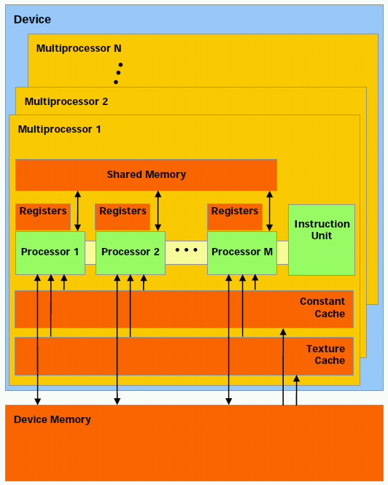
NVIDIA GT200 GPU Architecture
30 “streaming multiprocesors”
Simple cores:
In-order execution, no: branch prediction, spec. execution, multiple issue, context switches
No cache (just 16K programmer-managed on-chip memory)
One active instruction at a time
Can execute 32 threads in parallel per SM if no branch divergence

Slide 7
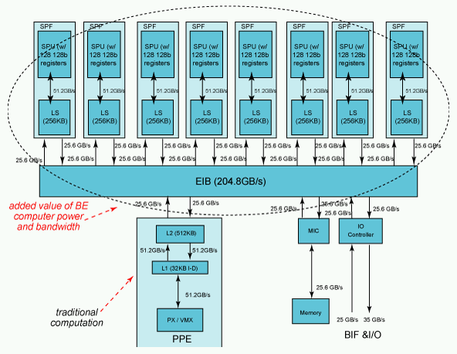
IBM Cell/B.E. Architecture
1 PowerPC, 8 small processors
Programmer must manually manage 256K memory and threads invocation on each SPE
Each SPE includes a vector unit like the one on current Intel processors
128 bits wide

Slide 8
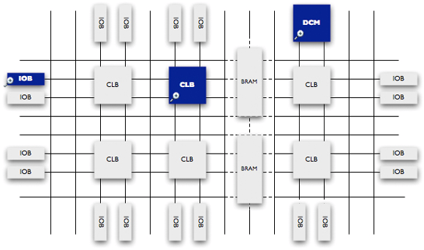
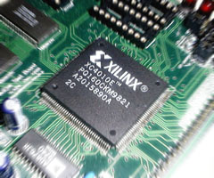
Field Programmable Gate Arrays

Slide 9
Research Problems
How well do certain types of (scientific) programs run on heterogeneous machines? What benefit should we expect?
How do you modify an arbitrary program to run on a heterogeneous machine?
What is the best way to design coprocessors? How can we make them faster and easier to program?
What is the best way to design heterogeneous machines? How do we interconnect the CPU and coprocessors?

Slide 10
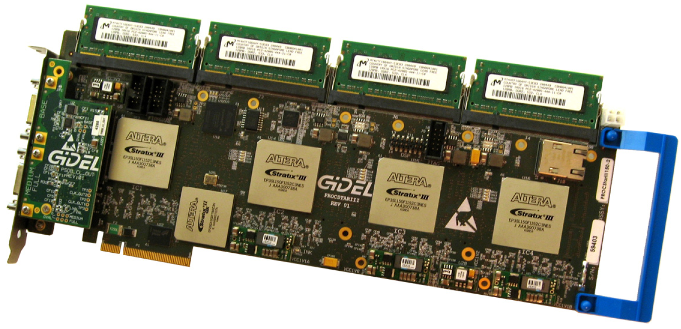
Heterogeneous Computing with FPGAs
Annapolis Micro Systems
WILDSTAR 2 PRO
GiDEL PROCSTAR III

Slide 11
Heterogeneous Computing with FPGAs
Convey HC-1

Slide 12
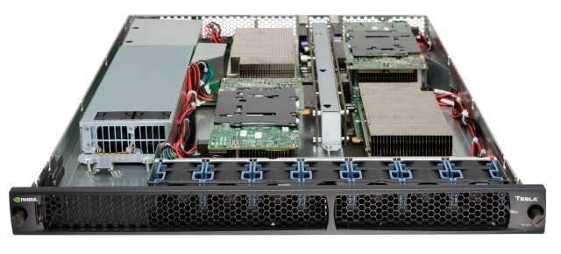
Heterogeneous Computing with GPUs
NVIDIA Tesla S1070

Slide 13
Programming GPUs
GPU code:
kernel function vector_multiply (vector v1, vector v2, vector v3) {
/* declare arrays in on-chip memory */
on_chip_vector temp1,temp2,temp3;
/* copy inputs from off-chip to on-chip in parallel */
temp1[my_thread_number]=v1[iteration count x number_of_threads + my_thread_number];
temp2[my_thread_number]=v2[iteration count x number_of_threads + my_thread_number];
/* perform parallel multiply */
temp3[my_thread_number]=temp1[my_thread_number]* temp2[my_thread_number];
/* copy outputs from on-chip to off-chip in parallel */
v3[iteration count x number_of_threads + my_thread_number]= temp3[my_thread_number];
}
CPU code:
copy v1 from cpu memory to gpu memory
copy v2 from cpu memory to gpu memory
invoke vector_multiply on GPU with 100 threads
copy v3 from gpu memory to cpu memory

Slide 14
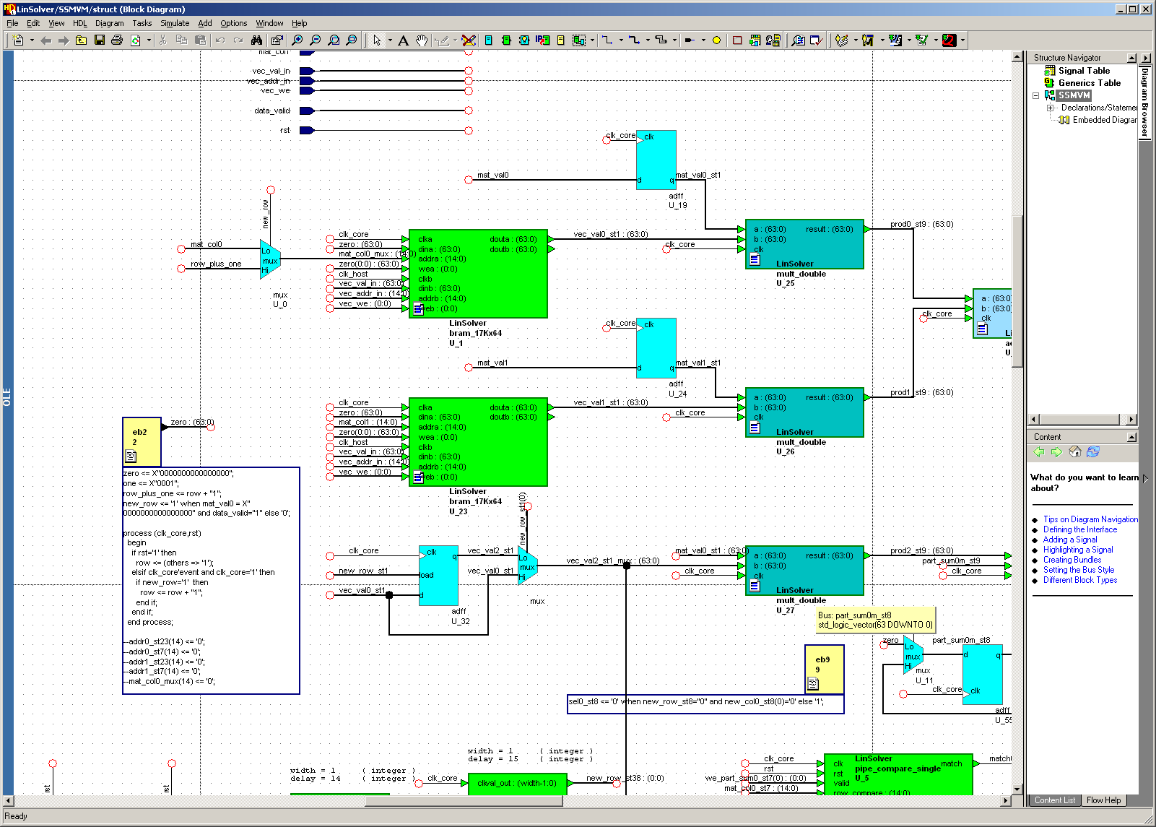
Programming FPGAs

Slide 15
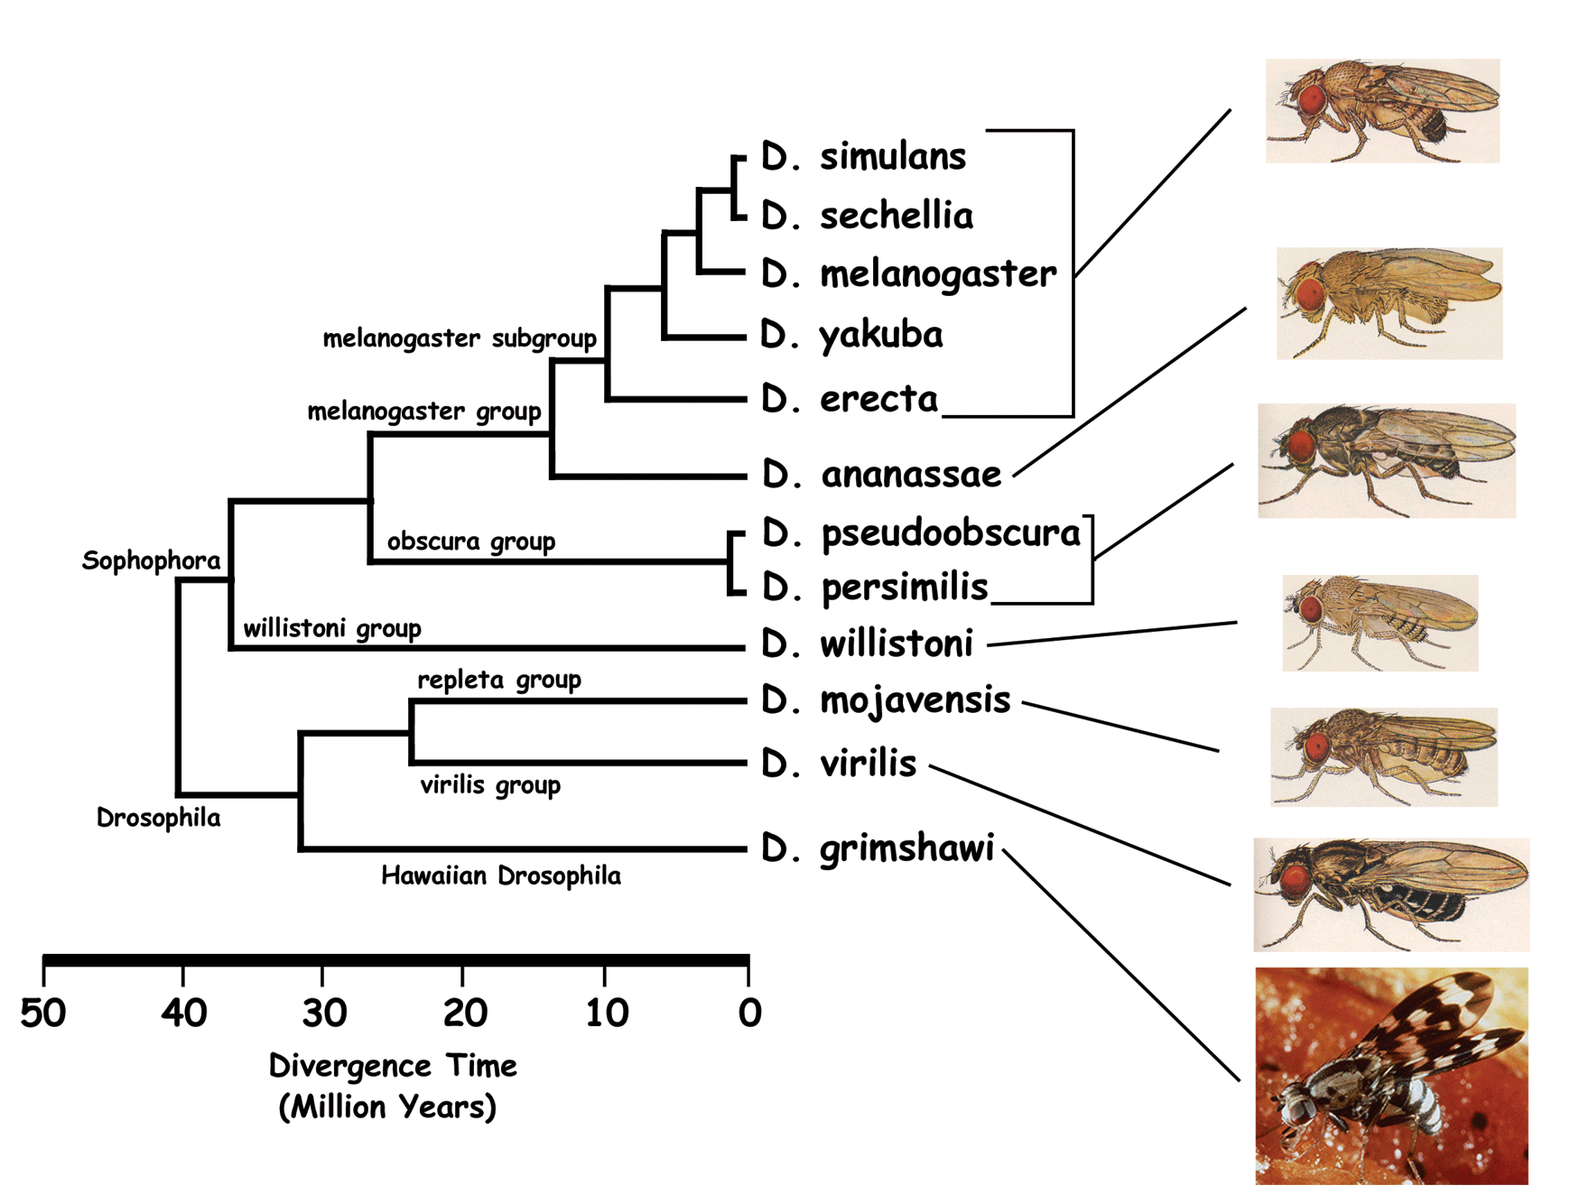
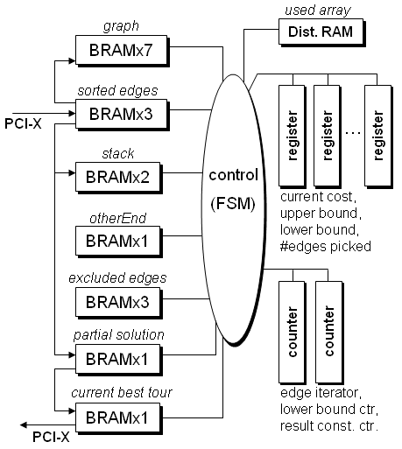
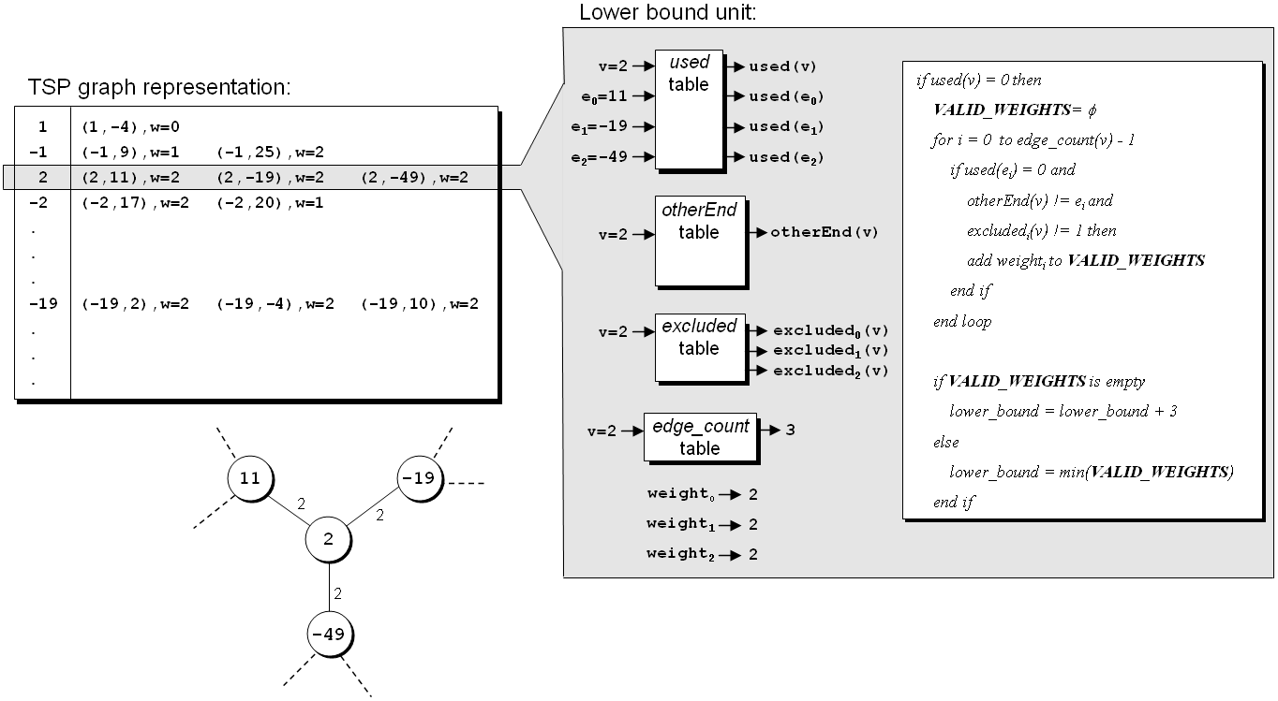
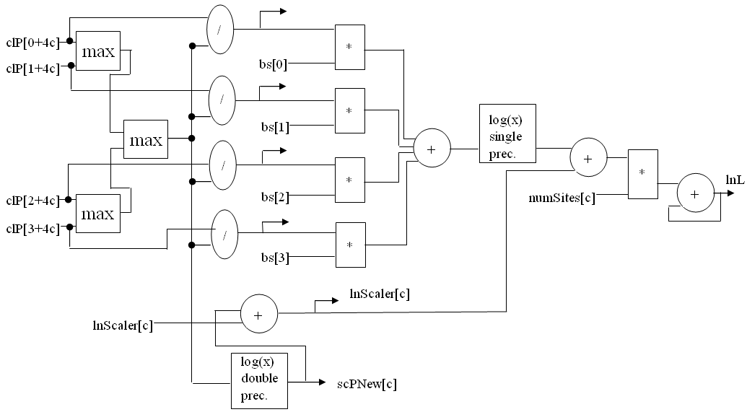
Our Projects
FPGA-based co-processors for computational biology
Tiffany M. Mintz, Jason D. Bakos, "A Cluster-on-a-Chip Architecture for High-Throughput Phylogeny Search," IEEE Trans. on Parallel and Distributed Systems, to appear.
Stephanie Zierke, Jason D. Bakos, "FPGA Acceleration of Bayesian Phylogenetic Inference," BMC Bioinformatics, BMC Bioinformatics 2010, 11:184.
Jason D. Bakos, Panormitis E. Elenis, "A Special-Purpose Architecture for Solving the Breakpoint Median Problem," IEEE Transactions on Very Large Scale Integration (VLSI) Systems, Vol. 16, No. 12, Dec. 2008.
Jason D. Bakos, Panormitis E. Elenis, Jijun Tang, "FPGA Acceleration of Phylogeny Reconstruction for Whole Genome Data," 7th IEEE International Symposium on Bioinformatics & Bioengineering (BIBE'07), Boston, MA, Oct. 14-17, 2007.
Jason D. Bakos, “FPGA Acceleration of Gene Rearrangement Analysis,” 15th Annual IEEE International Symposium on Field-Programmable Custom Computing Machines (FCCM'07), April 23-25, 2007.

Slide 16
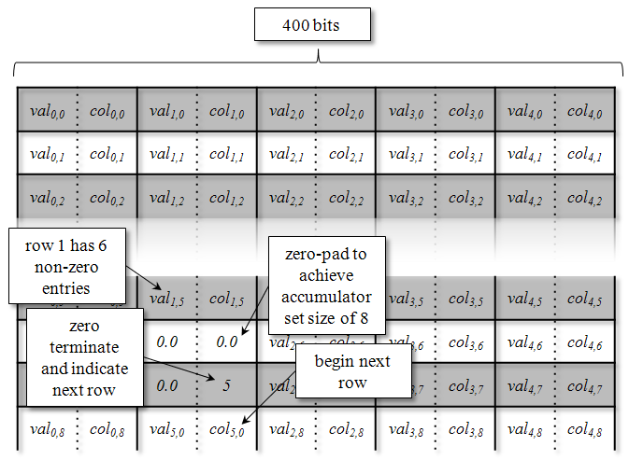
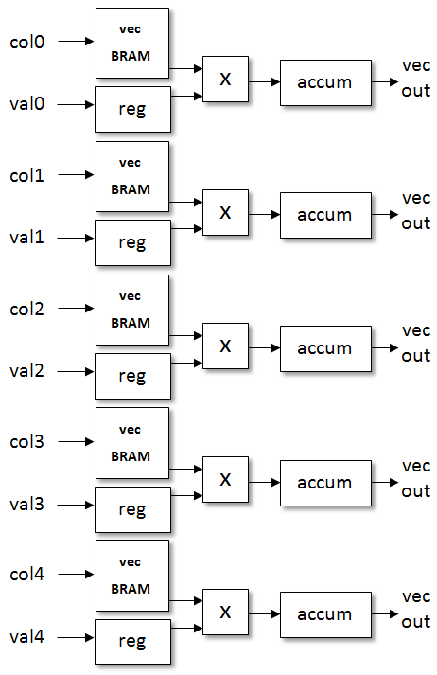
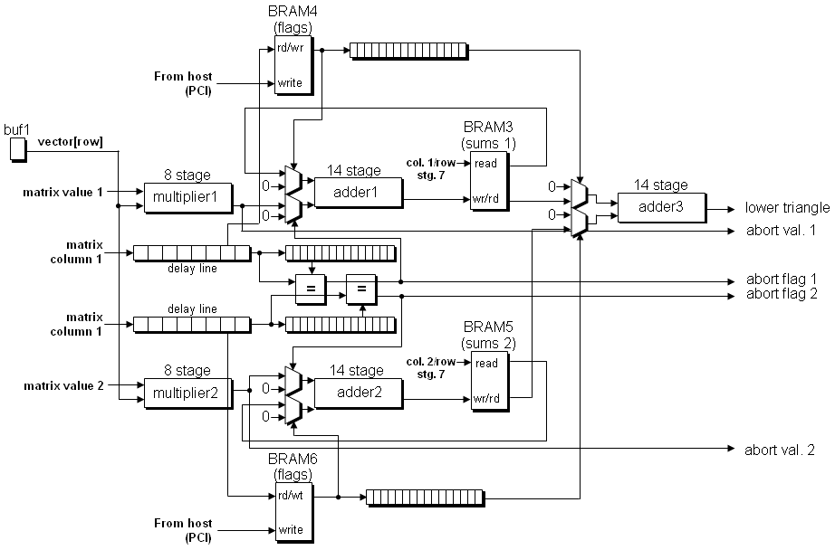
Our Projects
FPGA-based co-processors for linear algebra
Krishna.K. Nagar, Jason D. Bakos, "A High-Performance Double Precision Accumulator," IEEE International Conference on Field-Programmable Technology (IC-FPT'09), Dec. 9-11, 2009.
Yan Zhang, Yasser Shalabi, Rishabh Jain, Krishna K. Nagar, Jason D. Bakos, "FPGA vs. GPU for Sparse Matrix Vector Multiply," IEEE International Conference on Field-Programmable Technology (IC-FPT'09), Dec. 9-11, 2009.
Krishna K. Nagar, Yan Zhang, Jason D. Bakos, "An Integrated Reduction Technique for a Double Precision Accumulator," Proc. Third International Workshop on High-Performance Reconfigurable Computing Technology and Applications (HPRCTA'09), held in conjunction with Supercomputing 2009 (SC'09), Nov. 15, 2009.
Jason D. Bakos, Krishna K. Nagar, "Exploiting Matrix Symmetry to Improve FPGA-Accelerated Conjugate Gradient," 17th Annual IEEE International Symposium on Field Programmable Custom Computing Machines (FCCM'09), April 5-8, 2009.

Slide 17
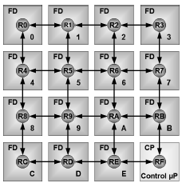
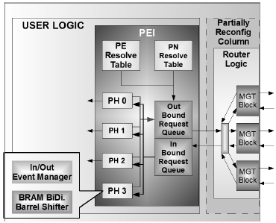
Our Projects
Multi-FPGA System Architectures
Jason D. Bakos, Charles L. Cathey, E. Allen Michalski, "Predictive Load Balancing for Interconnected FPGAs," 16th International Conference on Field Programmable Logic and Applications (FPL'06), Madrid, Spain, August 28-30, 2006.
Charles L. Cathey, Jason D. Bakos, Duncan A. Buell, "A Reconfigurable Distributed Computing Fabric Exploiting Multilevel Parallelism," 14th Annual IEEE International Symposium on Field-Programmable Custom Computing Machines (FCCM'06), April 24-26, 2006.

Slide 18
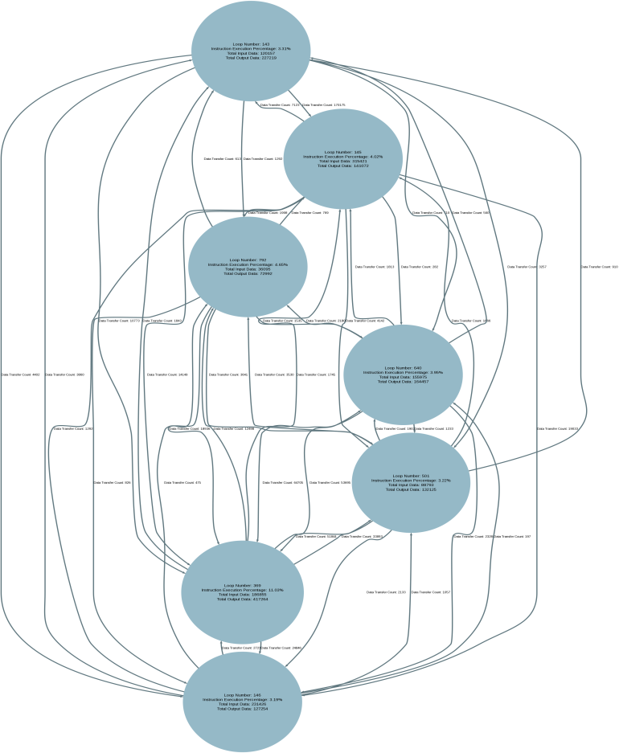
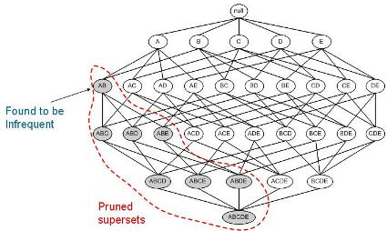
Most Recent Projects
Task Partitioning for Heterogeneous Computing
GPU and FPGA Acceleration of Data Mining
GPU Acceleration of Logic Synthesis
1. Ibrahim Savran, Jason D. Bakos, "GPU Acceleration of Near-Minimal Logic Minimization," 2010 Symposium on Application Accelerators in High Performance Computing (SAAHPC'10), July 13-15, 2010.

Slide 19
Contact Information
Jason D. Bakos
Office: 3A52
E-mail: jbakos@sc.edu
http://www.cse.sc.edu/~jbakos
Heterogeneous and Reconfigurable Computing (HeRC) Lab:
Lab: 3D15
http://herc.cse.sc.edu

Slide 20
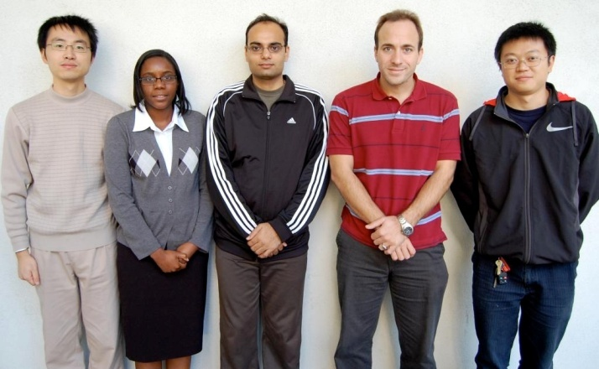
Our Group
Tiffany Mintz
Krishna Nagar
Jason Bakos
Yan Zhang
Zheming Jin
Heterogeneous and Reconfigurable Computing Group
http://herc.cse.sc.edu

