Slide 1
OpenVX Graph Acceleration
Madushan Abeysinghe, Jesse Villarreal,
Lucas Weaver, Jason D. Bakos
Heterogeneous and Reconfigurable Computing Group

Slide 2
TI C66 Digital Signal Processor
execution flow
for (i=0;i<n;i++) {
…
}
compiler
stage 0
stage 1
stage 0
prolog
stage 2
stage 1
stage 0
stage 3
stage 2
stage 1
stage 0
stage 3
stage 2
stage 1
stage 3
stage 2
epilog
ADD
MULT
ADD
NOP
MULT
ADD
NOP
NOP
LW
LW
NOP
NOP
LW
NOP
SW
NOP
VLIW
stage 3
iteration internal
Func. Unit 1A
Register file A
Func. Unit 2A
Circular buffer
Func. Unit 3A
Func. Unit 1B
Load/
Store A
Func. Unit 2B
Register file B
Func. Unit 3B
Load/
Store B

Slide 3
OpenVX Framework
OpenVX is a standardized, cross platform framework to aid in development of accelerated computer vision, machine learning, and other signal processing applications.
OpenVX allows the programmer to define an application using a graph-based programming model
Nodes: highly optimized kernels for the specific architecture
Edges: represents data flow
Code-portable and Performance-portable !

Slide 4
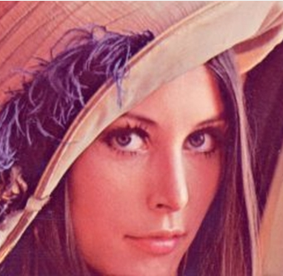
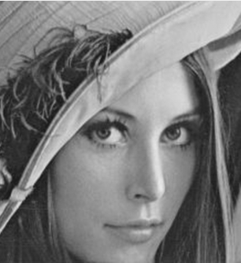
OpenVX/BAM on ADAS TDA2x
OpenVX: pixel-by-pixel vision primitives
vxColorConvertNode
vxGaussian3x3Node
vxChannelExtractNode

Slide 5
OpenVX and BAM (current work)

Slide 6
OpenVX and BAM (current work)
(out)
(process)
(in)

Slide 7
DMA and Scratchpad
time
input ping buffer
tile n+1
tile n+1
tile n+1
input pong buffer
tile n
tile n
tile n
tile n+2
tile n+2
tile n
tile n
output ping buffer
tile n-1
tile n+1
tile n+1
tile n-1
tile n-1
output pong buffer
tile n
tile n
tile n+2
tile n
processor
trigger
process tile n
idle
trigger
process tile n+1
idle
trigger
process tile n+2
DMA controller
idle
write tile n-1 to DRAM
read tile n+1 from DRAM
idle
write tile n to DRAM
read tile n+2 from DRAM
idle
write tile n+1 to DRAM
max(trigger+compute,trigger+DMA)
max(compute,DMA)

Slide 8
Performance Factor 1: Tile Size
2.11X
1.58X
best compute
best DMA
best max(DMA,compute)

Slide 9
Performance Factor 2: Scratchpad Access Pattern
DRAM -> scratchpad (A)
DRAM -> scatchpad (E)
scatchpad -> DRAM (F)
scratchpad -> DRAM (B)
vxColorConvertNode
ex. time = X
vxGaussian3x3Node
ex. time = Z
DRAM -> scratchpad (C)
vxChannelExtractNode
ex. time = Y
scratchpad -> DRAM (D)
time = max(C+D,Y)
scratchpad buffers: 2, size = scratchpad/4

Slide 10
Performance Factor 2: Scratchpad Access Pattern
DRAM -> scratchpad (A)
DRAM -> scatchpad (E)
scatchpad -> DRAM (F)
scratchpad
vxColorConvertNode
ex. time = X
vxGaussian3x3Node
ex. time = Z
scratchpad
vxChannelExtractNode
ex. time = Y
time = max(A+D,(X+Y)/λ)
scratchpad -> DRAM (D)
scratchpad buffers: 3, size = scratchpad/6

Slide 11
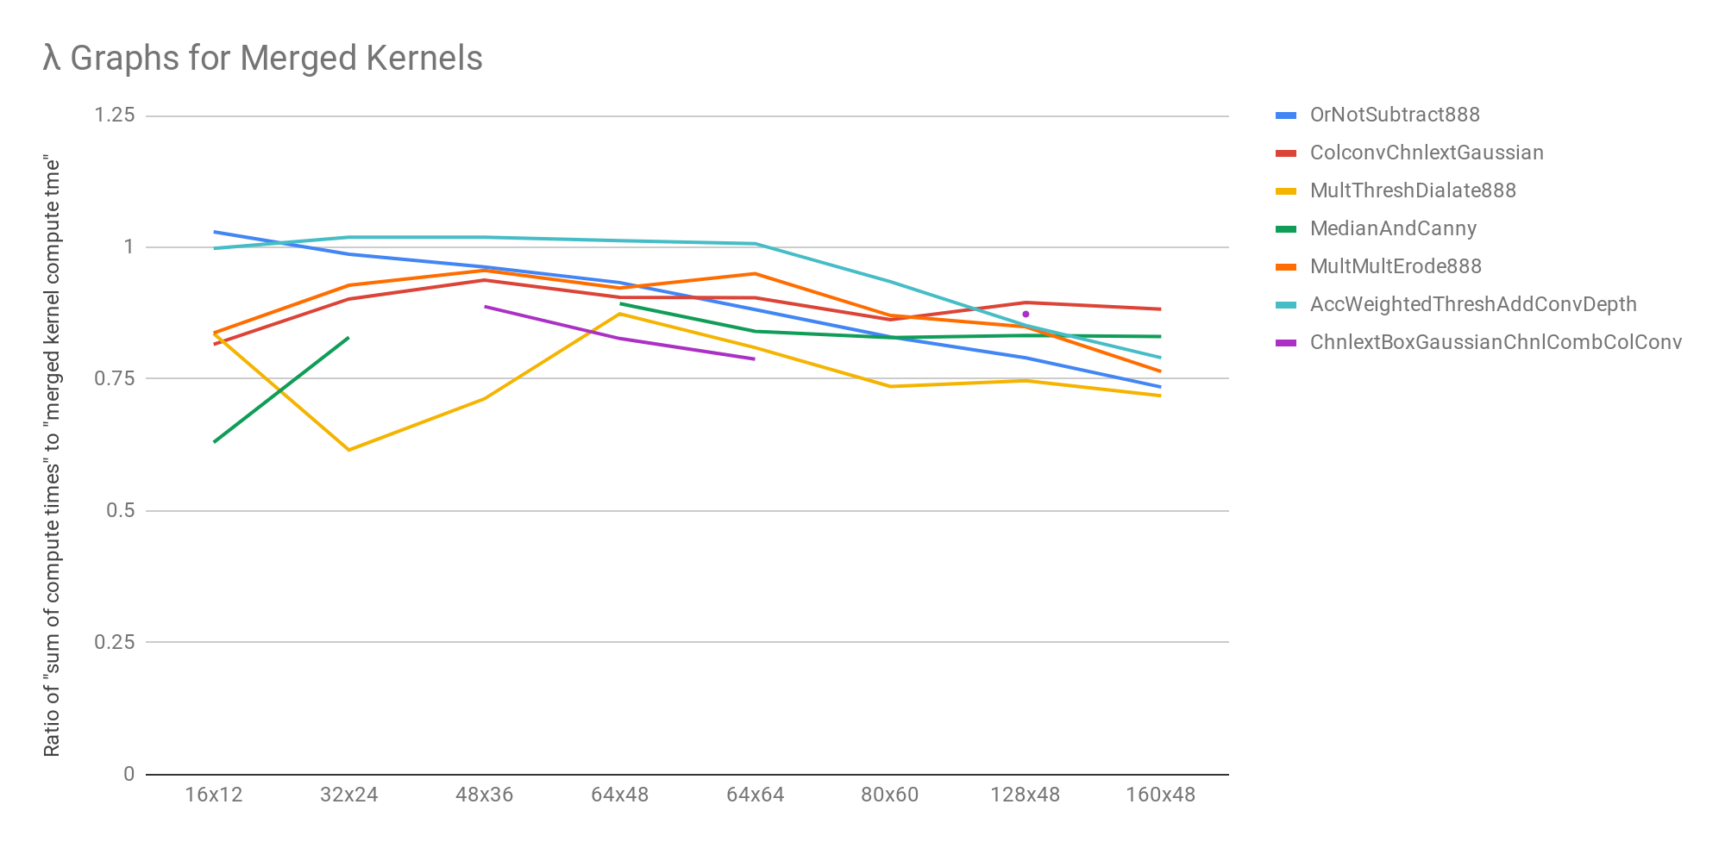
Lambda
λ Values for Merged Kernels (Observed)

Slide 12
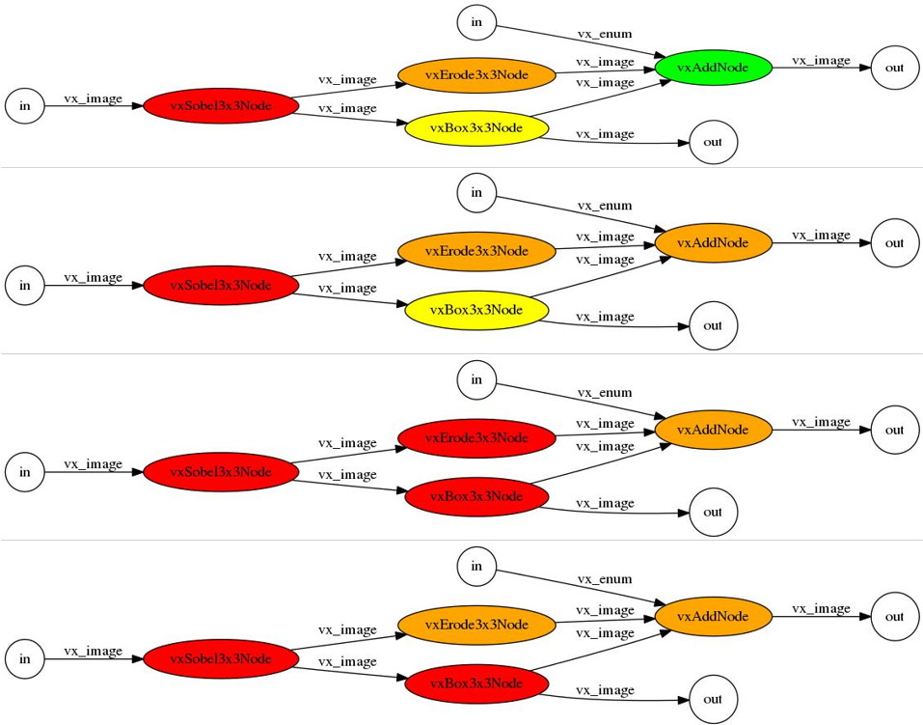
Graph Partitioning
$$B_{n}=\sum_{k=0}^{n−1}{\left(\begin{matrix}n−1 \\ k\end{matrix}\right)}B_{k}$$
$$B_{0}=1$$
B₆ = 203
B₇ = 877
B₈ = 4140
B₉ = 21147
B₁₀ = 115975
B₁₁ = 678570
B₁₂ = 4213597

Slide 13
Performance Considerations
Problem:
Group size determines:
Number of DMA transactions
Maximum tile size
Lambda
Tile size determines:
DMA bandwidth
Compute throughput
Approach:
Train memory performance model and compute model to optimize grouping and tile size together

Slide 14
DMA/Memory System Performance Model
Characterize:
19 kernels (originally 35), 25 tile sizes, all possible pixel depths (per kernel)
1460 total test cases (culled from 2819 original tests)
Features:
input tile width, height in pixels (TIW, TIH)
output tile width, height in pixels (TOW, TOH)
total input, output width (tile width x pixel size x number of inputs) (TTIW, TTOW)
total input, output size, TTIW*TIH (TIS, TOS)
number of inputs, outputs (NI, NO)
pixel depth (PD)
stencil neighborhood width, height (SNW, SNH)
Best accuracy: TTIW, TIH, TTOW, TOH

Slide 15
Performance Models
DMA: linear interpolant model of DMA b/w
Find nearest 5 observations
Calculate weights
$w_{i}=\frac{\frac{1}{{distance}_{i}}}{\sum_{j}{\frac{1}{distance_{j}}}}$
Calculate weighted average
RMS training error = 32 MB/s
RMS testing error = 248 MB/s
Range = 189 MB/s to 4.33 GB/s
Compute: lookup kernel names and nearest tile WxH prod
in_width=8,
out_width=6,
in_height=48,
out_height=46
356 MB/s
in_width=16,
out_width=14,
in_height=48,
out_height=46
8.5
723 MB/s
w=.17
6.3
w=.23
in_width=16,
out_width=8,
in_height=48,
out_height=48
6.3
in_width=16,
out_width=10,
in_height=48,
out_height=42
w=.23
616 MB/s
8.0
w=.18
8.0
w=.18
in_width=16,
out_width=16,
in_height=48,
out_height=48
in_width=8,
out_width=8,
in_height=48,
out_height=48
742 MB/s
423 MB/s

Slide 16
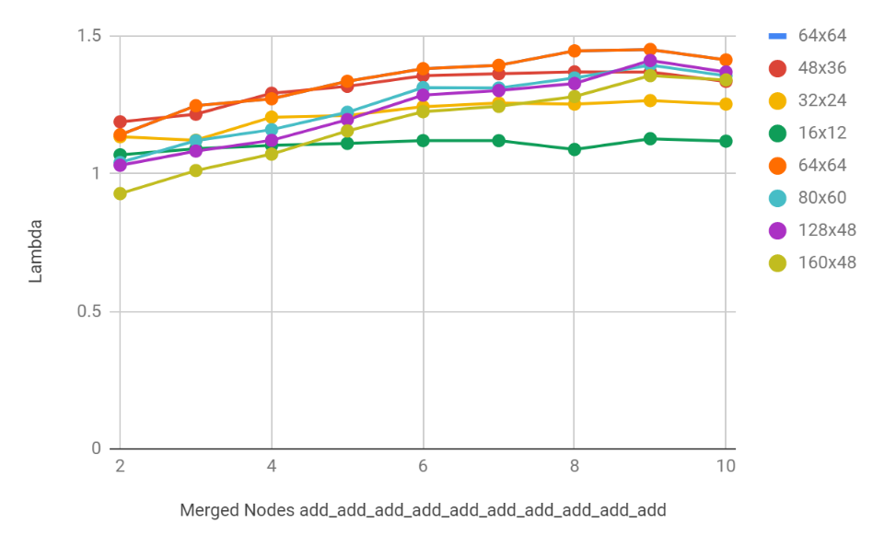
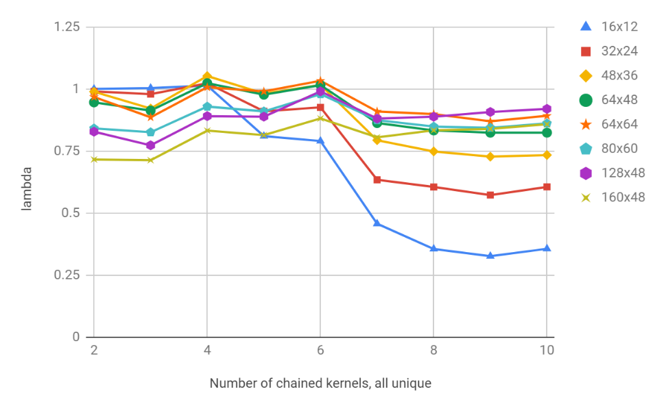
Lamdba Model
Lamdba vs graph size: same kernel
Lamdba vs graph size: unique kernels
Lambda value depends on number of kernels and number of unique kernels
Used a piecewise interpolated model
RMS error = 0.03 for training set of 43 test graphs

Slide 17
Model Accuracy and Performance
0.13 cycles/pixel
(compute)
0.44 cycles/pixel
(compute)
0.25 cycles/pixel (compute)
Compute bound:
0.81 cycles/pixel
DMA bound:
3 x 1600x1200x1 DMA @ 4.33 GB/s @ 750 MHz
0.48 cycles/pixel

Slide 18
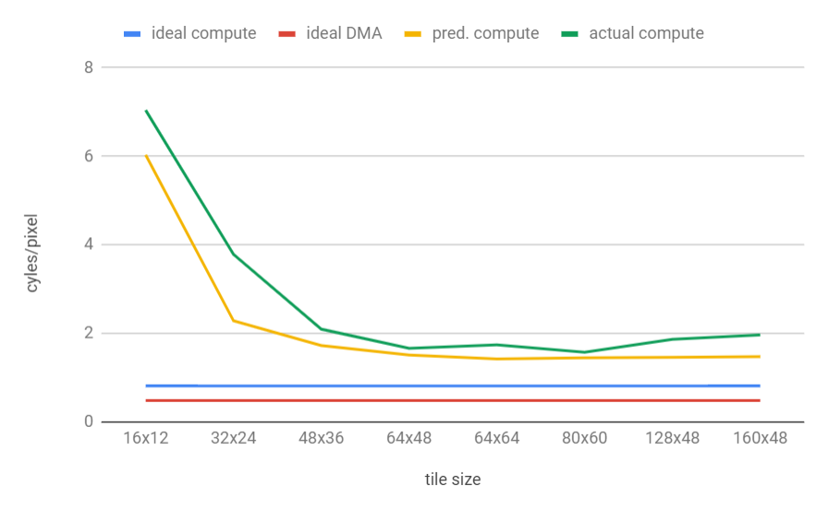
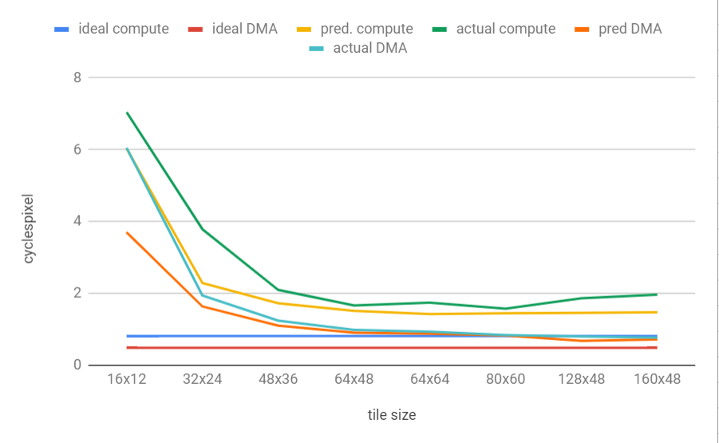
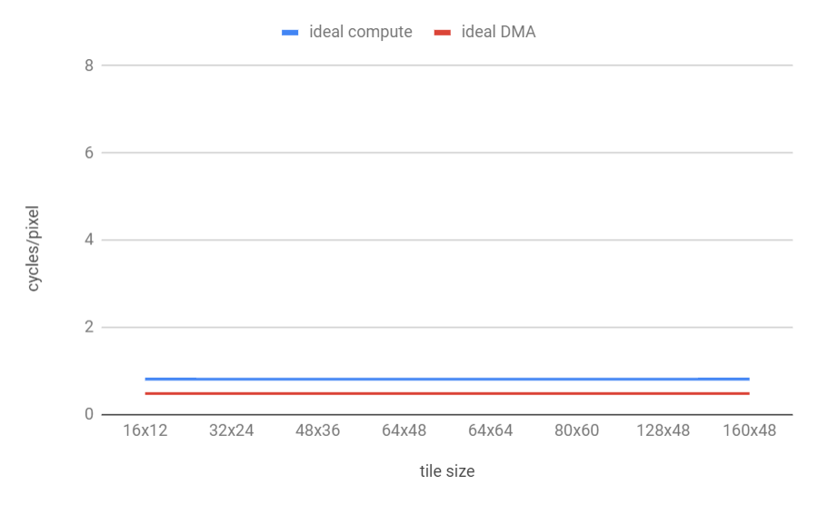
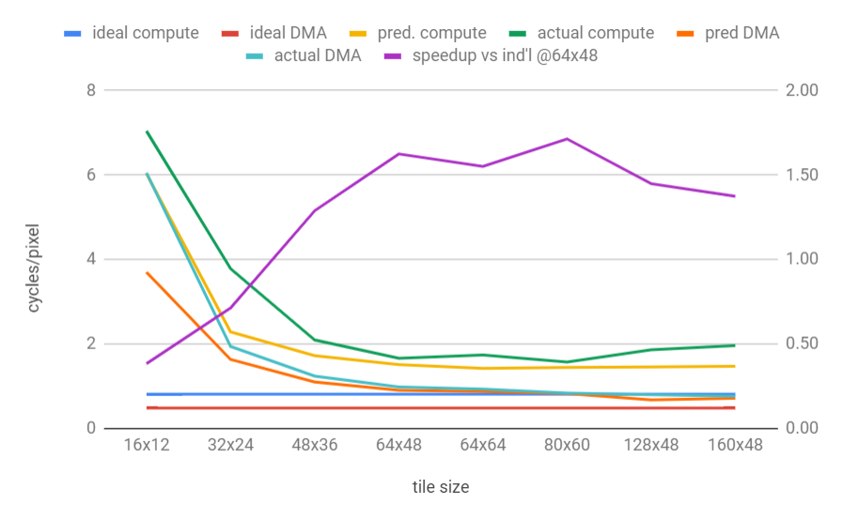
Impact of Tile Size on Merged Kernels
1.71

Slide 19
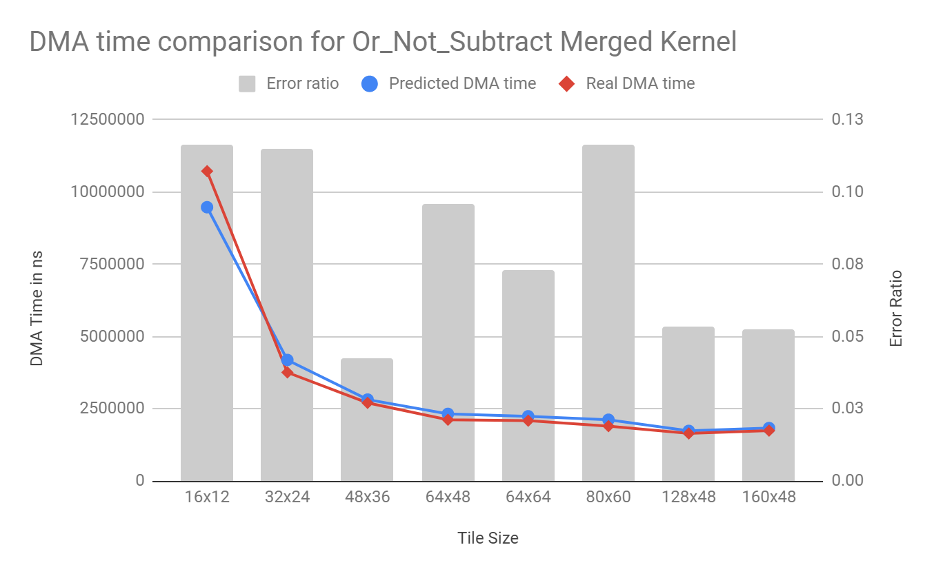
Model Accuracy

Slide 20
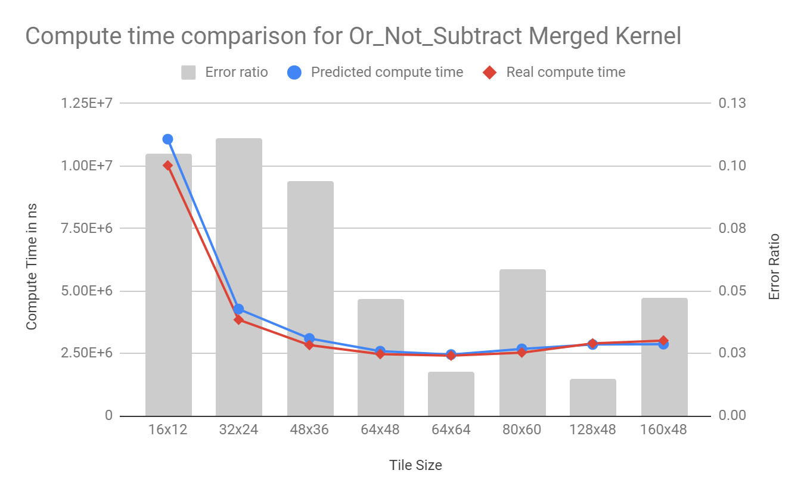
Model Accuracy

Slide 21
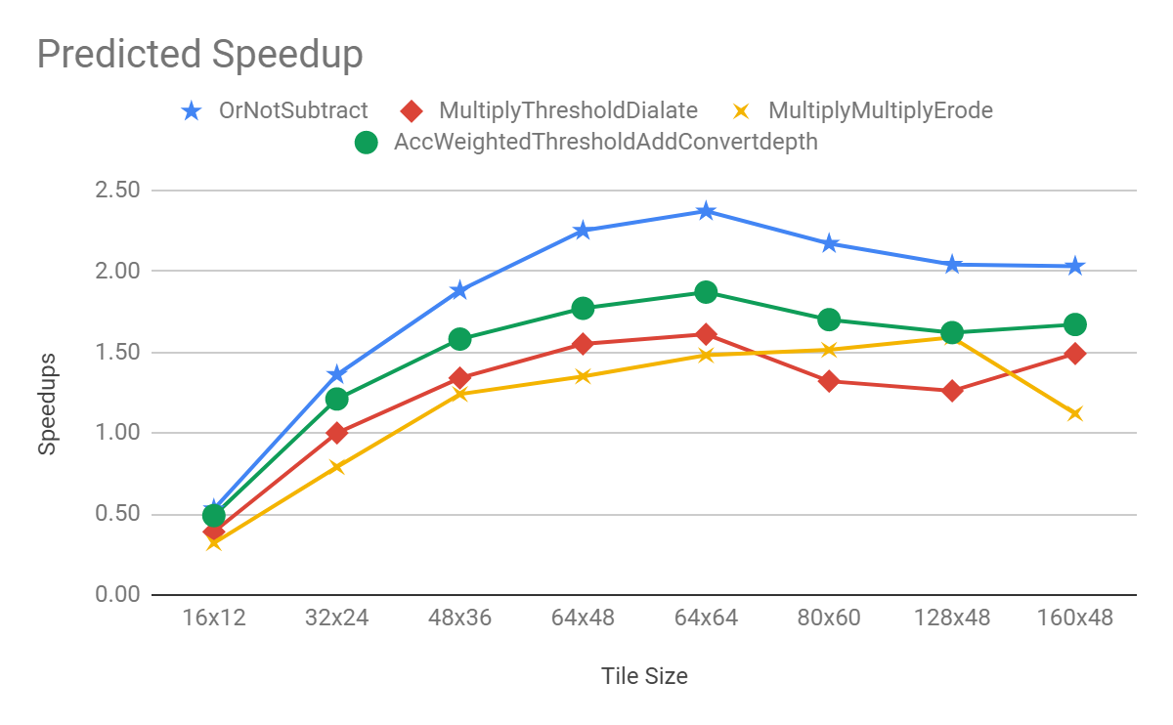
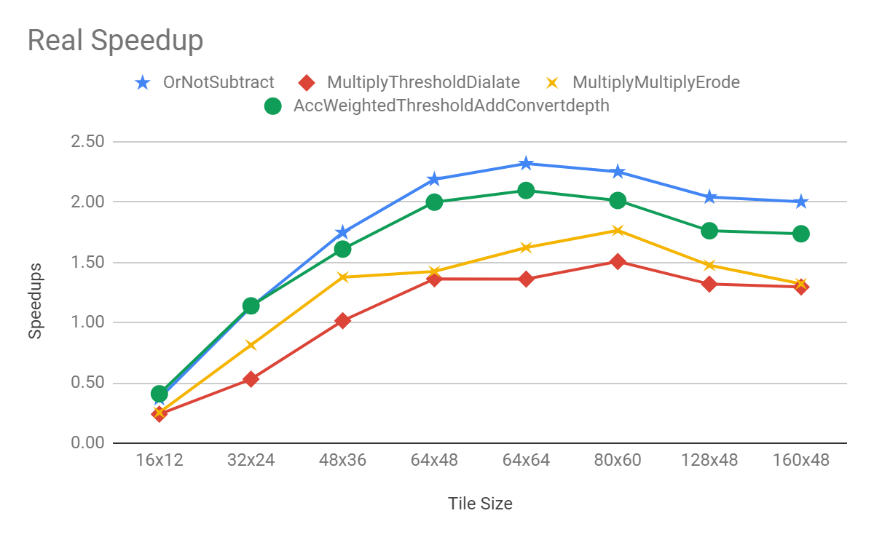
Speedups
Comparison of Predicted and Real Speedups Speedups

Slide 22
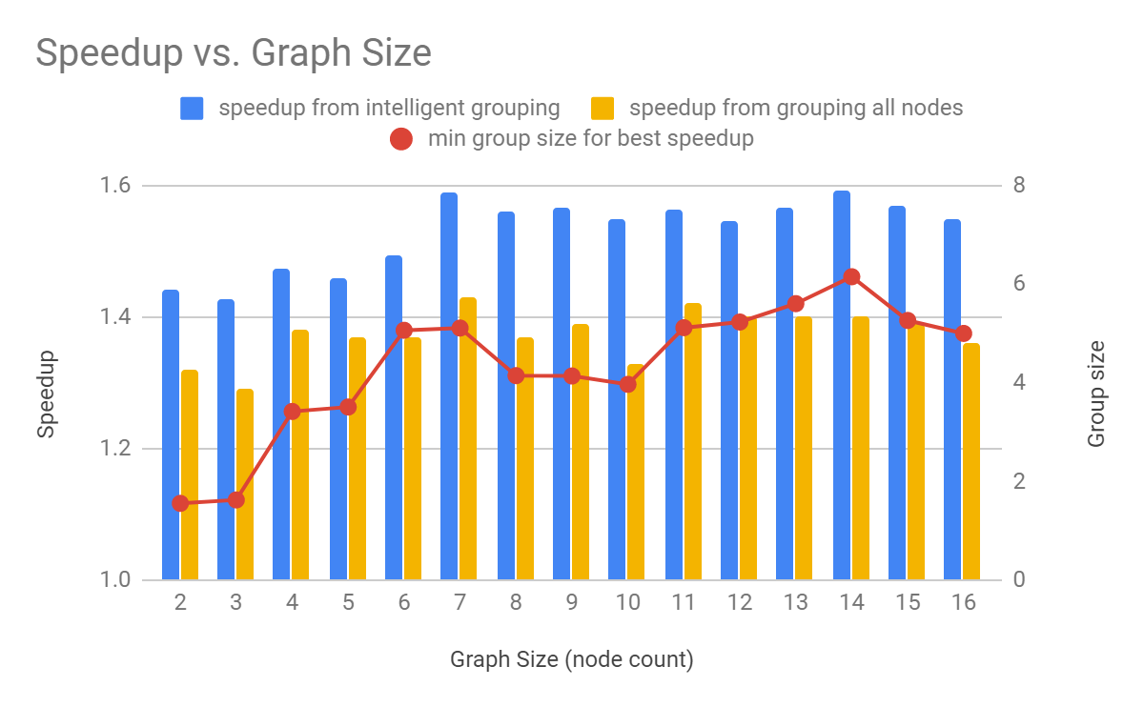
Randomly Generated Graphs
For each graph
For each grouping
For each allocable tile size (constrained by scratchpad capacity)…
Find predicted speedup (vs individual nodes with 64x48 tiles)

Slide 23
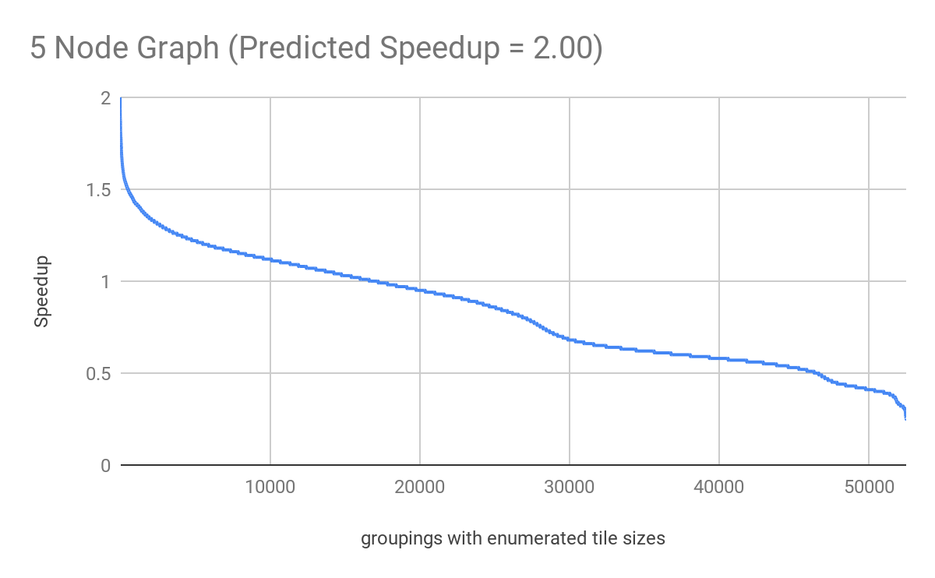
Speedup Distribution
Speedups above 1.5 = 0.95%
Speedups between 1 and 1.5 = 30.74%
Speedups below 1 = 68.30%

Slide 24
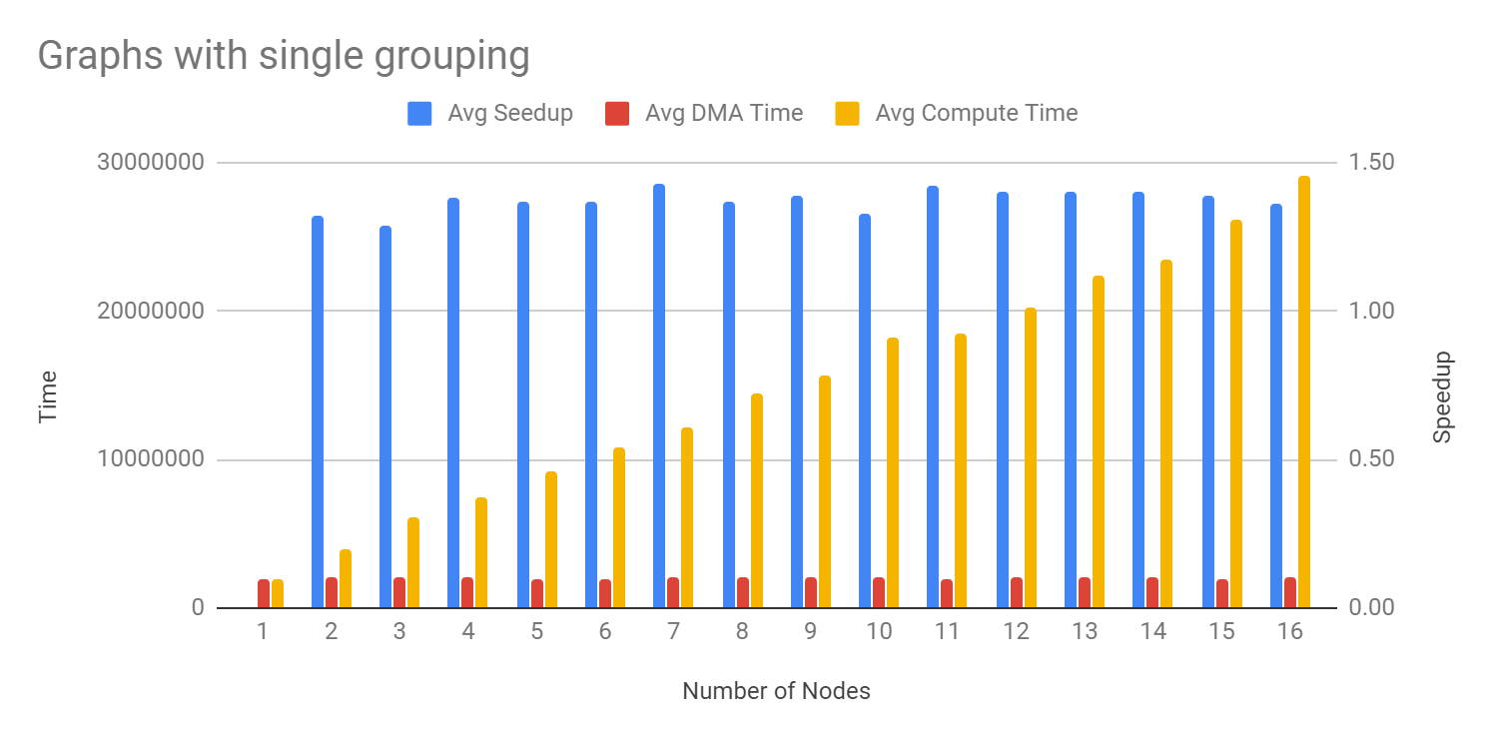
Compute/DMA Makeup

Slide 25
Conclusions
Performance models for DMA time and compute time for OpenVX graphs on C66 DSP
Accurate to within ~10 to 15%
When used to automatically group random graphs, achieves a speedup of ~1.5 to 2
Future Work:
Develep models to predict performance from merging the loops for each OpenVX kernel

Slide 26
Thank you!
Questions?

