Slide 1



An Overlay Architecture
for Pattern Matching
Rasha Karakchi, Charles Danial, Jason Bakos
Computer Science and Engineering

Slide 2
Pattern Matching
Patterns: ex. threat signatures,
network addresses,
genomic seq.
preprocess
(slow)
TCAM
Bloom filter
Automata
input sequence
pattern matches
(fast)

Slide 3
Nondeterministic Finite Automata (NFA)
Recognize pattern: “ababc”
Input | Active States
 | 0
a
b
a
b
c
0
1
2
3
4
5

Slide 4
Nondeterministic Finite Automata (NFA)
Recognize pattern: “ababc”
Input: “a”
Input | Active States
 | 0
a | 0,1
a
b
a
b
c
0
1
2
3
4
5
tracking pattern “a”

Slide 5
Nondeterministic Finite Automata (NFA)
Recognize pattern: “ababc”
Input: “ab”
Input | Active States
 | 0
a | 0,1
b | 0,2
a
b
a
b
c
0
1
2
3
4
5
tracking pattern “ab”

Slide 6
Nondeterministic Finite Automata (NFA)
Recognize pattern: “ababc”
Input: “aba”
Input | Active States
 | 0
a | 0,1
b | 0,2
a | 0,1,3
a
b
a
b
c
0
1
2
3
4
5
tracking pattern “a”
tracking pattern “aba”

Slide 7
Nondeterministic Finite Automata (NFA)
Recognize pattern: “ababc”
Input: “abab”
Input | Active States
 | 0
a | 0,1
b | 0,2
a | 0,1,3
b | 0,2,4
a
b
a
b
c
0
1
2
3
4
5
tracking pattern “ab”
tracking pattern “abab”

Slide 8
Nondeterministic Finite Automata (NFA)
Recognize pattern: “ababc”
Input: “ababa”
Input | Active States
 | 0
a | 0,1
b | 0,2
a | 0,1,3
b | 0,2,4
a | 0,3
a
b
a
b
c
0
1
2
3
4
5
tracking pattern “aba”
lost track

Slide 9
Nondeterministic Finite Automata (NFA)
Recognize pattern: “ababc”
Input: “ababab”
Input | Active States
 | 0
a | 0,1
b | 0,2
a | 0,1,3
b | 0,2,4
a | 0,3
b | 0,4
a
b
a
b
c
0
1
2
3
4
5
tracking pattern “abab”

Slide 10
Nondeterministic Finite Automata (NFA)
Recognize pattern: “ababc”
Input: “abababc”
Input | Active States
 | 0
a | 0,1
b | 0,2
a | 0,1,3
b | 0,2,4
a | 0,3
b | 0,4
c | 0,5 (accept)
a
b
a
b
c
0
1
2
3
4
5
accept

Slide 11
Applications
Hamming distance
Brill tagging rules
Protein Motif signatures
Sequential Pattern Mining

Slide 12
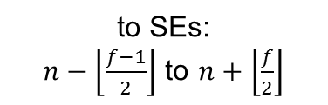
State Element (SE)
a
b
a
b
c
a
b
a
b
c
To output priority encoders
Other SEs
Shift in
256x1 RAM
counter
Input buffer
64Kx8
start
report
to SEs:
$n−\left\lfloor \frac{f−1}{2}\right\rfloor$ to $n+\left\lfloor \frac{f}{2}\right\rfloor$
…
Active
(f = 6 here)
Activation from predecessors
n
To successors
Shift out
$$bw={freq}_{clock}∙{SEs}_{num}∙{SEs}_{\%active}∙f∙\%succ$$

Slide 13
Runtime Behavior
FIB = fill input buf.
R = reconfigure
IBF = input buf. flush
OBF = output buf. flush
Encoders
256x1 RAM
Input buffer
64Kx8
Input buffer
64Kx8
Output buffer
start
Output buffer
start
report
counter
report
Active
…
Active
…
Activation from predecessors
n
To successors
time
x (#states/#SEs)
FIB
R
IBF
OBF
…
R
IBF
OBF
FIB
R
IBF
…
x input_size/64K

Slide 14
Overlay Configurations
SEs (K) | f
4 | 103
8 | 44
12 | 25
16 | 12
20 | 6
24 | 3
Fmax (MHz) | Max. B/W* for 25% a.s. (GB/s)
152 | 1866
136 | 1427
122 | 1091
121 | 692
119 | 426
112 | 240
Encoders | Max. Report cycles | Max. report rate (GHz)
16 | 100% | 2.4
32 | 50% | 2.2
48 | 33% | 2.0
64 | 25% | 1.9
80 | 20% | 1.9
96 | 17% | 1.8
R (μs)
21
31
43
53
67
74
Through- Put 24K states (MB/s) | Through- Put 128K states (MB/s)
14 | 3
27 | 5
32 | 6
36 | 9
31 | 9
67 | 11

Slide 15
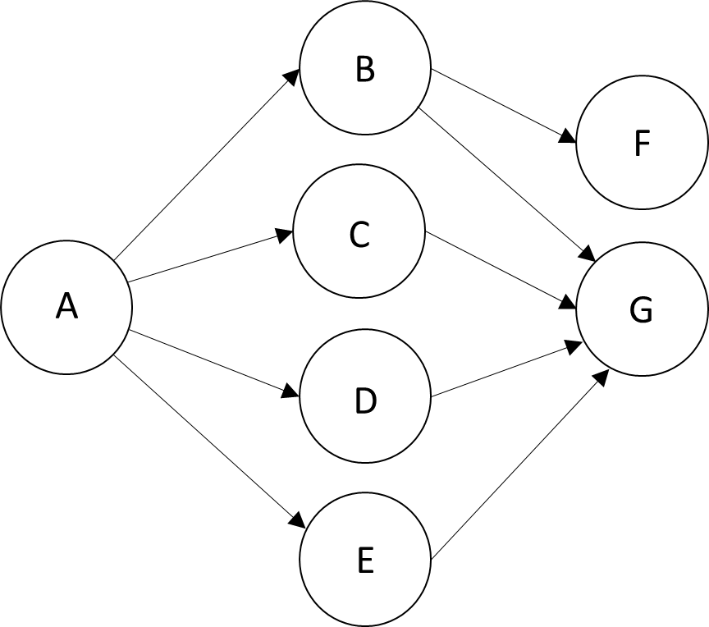
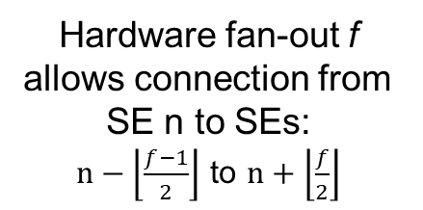
Physical Mapping
Hardware fan-out f allows connection from SE n to SEs:
$n−\left\lfloor \frac{f−1}{2}\right\rfloor$ to $n+\left\lfloor \frac{f}{2}\right\rfloor$
Assume f = 9
  [n-4 to n+4]
SE Mapping:
7! = 5040 possible mappings
f | valid mappings
5 | 0
6 | 24 (0.5%)
7 | 48 (1%)
8 | 372 (7%)
State | SE
A | 0
B | 1
C | 2
D | 3
E | 4
F | 5
G | 6

Slide 16
Performance Results
Benchmark | # states | Minimum Hardware Fan-out Achieved | Overlay | #R/ buffer | Through put (MB/s)
Brill | 26668 | 40 | 8K | 4 | 20
ClamAV | 49538 | 18 | 12K | 5 | 13
Levenshtein | 2784 | 17 | 12K | 1 | 63
Hamming | 11346 | 21 | 12K | 1 | 63
SPM | 100500 | 8 | 16K | 5 | 10
EntityResolution | 95136 | 62 | 4K | 19 | 3
RandomForest | 75340 | 12 | 16K | 5 | 15
PowerEN | 40513 | 29 | 8K | 5 | 16
Snort | 69029 | 60 | 4K | 17 | 5
Fermi | 40783 | 8 | 16K | 2 | 24
Protomata | 42061 | 42 | 8K | 6 | 13
DotStar | 96438 | 4 | 20K | 5 | 12
* iNFAnt on Nvidia Titan Xp ** Nmcart, 4 threads on i5-4440@3.1 GHz

Slide 17
Performance Results
Benchmark | # states | Minimum Hardware Fan-out Achieved | Overlay | #R/ buffer | Through put (MB/s)
Brill | 26668 | 40 | 8K | 4 | 20
ClamAV | 49538 | 18 | 12K | 5 | 13
Levenshtein | 2784 | 17 | 12K | 1 | 63
Hamming | 11346 | 21 | 12K | 1 | 63
SPM | 100500 | 8 | 20K | 5 | 11
EntityResolution | 95136 | 62 | 4K | 19 | 3
RandomForest | 75340 | 12 | 16K | 5 | 15
PowerEN | 40513 | 29 | 8K | 5 | 16
Snort | 69029 | 60 | 4K | 17 | 5
Fermi | 40783 | 8 | 20K | 2 | 21
Protomata | 42061 | 42 | 8K | 6 | 13
DotStar | 96438 | 4 | 20K | 5 | 12
Through put (MB/s) | Ave. act. states | iNFAnt (GPU) * | Hyperscan (CPU) ** | Speedup
20 | 14 | 7 | 1 | 3
13 | 4 | 4 | 14 | 0.9
63 | 88 | 38 | 1 | 1.7
63 | 240 | 18 | 10 | 3.5
10 | 6331 | 0.5 | 0.1 | 20
3 | 10 | 4 | 1 | 0.8
15 | 968 | 2 | 0.5 | 7.5
16 | 31 | 53 | 10 | 0.3
5 | 98 | 14 | 0.4 | 0.4
24 | 3854 | 2 | 1 | 12
13 | 19 | 5 | 1 | 2.6
12 | 3 | 40 | 10 | 0.3
* iNFAnt on Nvidia Titan Xp ** Nmcart, 4 threads on i5-4440@3.1 GHz

Slide 18
Current/Future Work
Hide input buffer flush latency with output buffer flush
SAT-solver based mapping algorithm
Scale up to larger FPGAs and faster memory (DDR4/HBM2)

