Slide 1
FPGA Acceleration of Phylogeny Reconstruction for Whole Genome Data
Jason D. Bakos
Panormitis E. Elenis
Jijun Tang
Dept. of Computer Science and Engineering
University of South Carolina
Columbia, SC USA

Slide 2
Talk Outline
FPGAs and high-performance reconfigurable computing
Initial target application: gene rearrangement analysis
Hardware design and experimental results

Slide 3
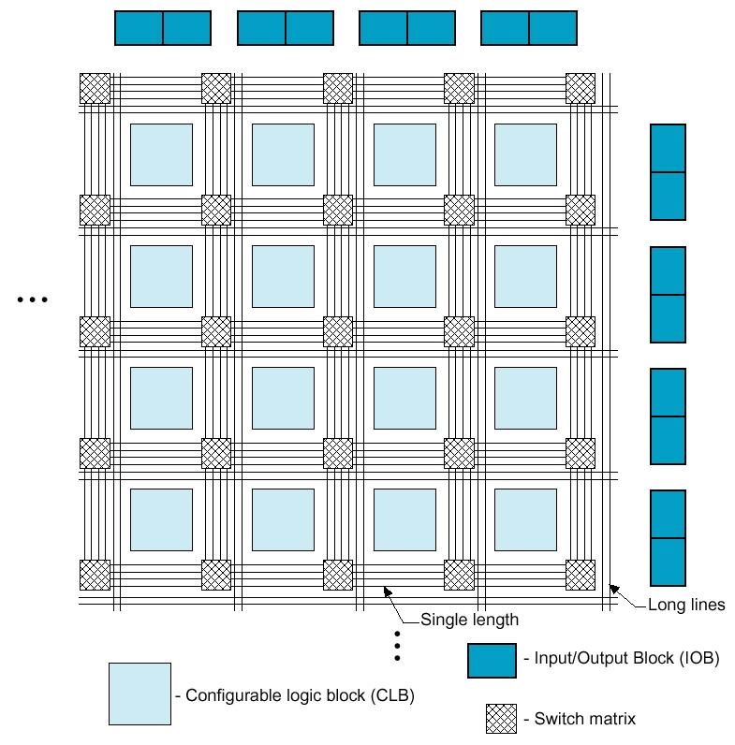
High-Performance Reconfigurable Computing
HPRC:
Use FPGA as co-processor
Example:
Application requires a week of CPU time
One computation consumes 99% of execution time
Kernel speedup | Application speedup | Execution time
50 | 34 | 5.0 hours
100 | 50 | 3.3 hours
200 | 67 | 2.5 hours
500 | 83 | 2.0 hours
1000 | 91 | 1.8 hours
Replaces software
Exploits parallelism

Slide 4
HPRC: Requirements, Pros, Cons
Application criteria:
computationally expensive
has a bottleneck computation
bottleneck computation is parallelizable
…and has low I/O and storage requirements
Advantages of HPRC:
Cost
FPGA card => ~ $15K
128-processor cluster => ~ $150K
+ maintenance + cooling + electricity + recycling
Disadvantage for HPRC:
Programming the FPGA

Slide 5
Programming an FPGA
Requires large-scale digital logic design
Instance and interconnect logic and memories
Especially difficult for control-dependent computations
Even worse…
To achieve performance:
Finely parallelize algorithm across FPGA resources
Our solution:
Develop a pre-designed library of kernels for computational biology
Develop a design tool that uses this library to generate accelerators

Slide 6
Talk Outline
FPGAs and high-performance reconfigurable computing
Initial target application: gene rearrangement analysis
Hardware design and experimental results

Slide 7
Target Application
Gene rearrangement analysis
Evolution analysis using gene order data
Assumes gene-rearrangement model for evolution, i.e.:
Inversion
g₀ g₁ g₂ g₃ g₄ g₅ g₀ g₁ –g₄ –g₃ –g₂ g₅
Transposition
g₀ g₁ g₂ g₃ g₄ g₅ g₀ g₂ g₃ g₄ g₁ g₅
Transversion
g₀ g₁ g₂ g₃ g₄ g₅ g₀ –g₄ –g₃ –g₂ g₁ g₅

Slide 8
Reconstruction Method
Maximum parsimony:
Search for tree with minimum number of rearrangement events
Direct-optimization method:
To evaluate a fixed tree…
Label all internal vertices with gene orders
Initialize and iteratively refine until the labels converges
Measure edge lengths using distance estimator
…
,
,
…

Slide 9
Median
Median computation used to label internal vertices
Find M that minimizes
d(A,M) + d(B,M) + d(C,M)
for some distance measure d()
For gene rearrangement data:
Optimal solution is NP-hard in “diameter” of inputs:
d(A,B) + d(A,C) + d(B,C)
A
B
d(A,M)
d(B,M)
M
d(C,M)
C

Slide 10
Execution Behavior
1
Execution Time Ratio for Labeling
0
Evolution Rate of Inputs
Application behavior depends on evolution rate of inputs
Execution time ratio for median computations:
Asymptotically approaches 100% with diameter of input set
Median adopted as kernel computation

Slide 11
Breakpoint Median
Construct a fully connected graph containing all g and –g for each gene
w(g,-g) = -∞
Initialize all other weights to be 3
For each adjacency gh in the three genomes, decrement weight between vertex –g and h
Solve TSP
+
-
+
-
1
2
1
2
A = -1 +2 -4 -3
B = -1 -2 +3 +4
C = -2 +3 +4 +1
cost = -∞
cost = 0
cost = 1
cost = 2
-
+
-
+
+
-
+
-
4
3
4
3
-
+
-
+
Edges not shown have cost = 3
An optimal solution corresponding to genome +1 +2 -3 -4

Slide 12
Breakpoint Median Algorithm
Optimal solution is feasible due to small graph
Algorithm:
Represent TSP graph as a list of edges
Test every possible valid combination of edges
Implemented as a branch-and-bound search
Upper bound is the best tour found so far
Lower bound is computed using a greedy algorithm
Loop that inspects each vertex in TSP graph
Accumulates lower bound value (based on search state)
Performed each time an edge is added or deleted from solution state
Requires nearly 100% of median execution time (bottleneck)

Slide 13
Example Breakpoint Median
sorted edge list:
(-3,4,w=0)
(2,3,w=1)
(1,2,w=2)
(-1,-2,w=2)
(1,-2,w=2)
(-2,-4,w=2)
(-1,3,w=2)
(-1,-4,w=2)
(1,-4,w=2)
used
1 => 0
-1 => 0
2 => 0
-2 => 0
3 => 0
-3 => 0
4 => 0
-4 => 0
otherEnd
1 => -1
-1 => 1
2 => -2
-2 => 2
3 => -3
-3 => 3
4 => -4
-4 => 4
1 -1
2 -2
3 -3
4 -4
cost = 0
used
1 => 0
-1 => 0
2 => 0
-2 => 0
3 => 0
-3 => 1
4 => 1
-4 => 0
otherEnd
1 => -1
-1 => 1
2 => -2
-2 => 2
3 => -4
-3 => 3
4 => -4
-4 => 3
1 -1
2 -2
3 -3
4 -4
pruned
used
1 => 0
-1 => 0
2 => 1
-2 => 0
3 => 1
-3 => 1
4 => 1
-4 => 0
otherEnd
1 => -1
-1 => 1
2 => -2
-2 => -4
3 => -4
-3 => 3
4 => -4
-4 => -2
cost = 0
1 -1
2 -2
3 -3
4 -4
cost = 1

Slide 14
Example Breakpoint Median
sorted edge list:
(-3,4,w=0)
(2,3,w=1)
(1,2,w=2)
(-1,-2,w=2)
(1,-2,w=2)
(-2,-4,w=2)
(-1,3,w=2)
(-1,-4,w=2)
(1,-4,w=2)
used
1 => 0
-1 => 0
2 => 0
-2 => 0
3 => 0
-3 => 0
4 => 0
-4 => 0
otherEnd
1 => -1
-1 => 1
2 => -2
-2 => 2
3 => -3
-3 => 3
4 => -4
-4 => 4
1 -1
2 -2
3 -3
4 -4
cost = 0
used
1 => 0
-1 => 0
2 => 0
-2 => 0
3 => 0
-3 => 1
4 => 1
-4 => 0
otherEnd
1 => -1
-1 => 1
2 => -2
-2 => 2
3 => -4
-3 => 3
4 => -4
-4 => 3
used
1 => 1
-1 => 0
2 => 1
-2 => 0
3 => 0
-3 => 1
4 => 1
-4 => 0
otherEnd
1 => -1
-1 => -2
2 => -2
-2 => -1
3 => -4
-3 => 3
4 => -4
-4 => 3
1 -1
2 -2
3 -3
4 -4
exclude edge (2,3)
1 -1
2 -2
3 -3
4 -4
cost = 0
cost = 2
used
1 => 1
-1 => 0
2 => 1
-2 => 1
3 => 0
-3 => 1
4 => 1
-4 => 1
otherEnd
1 => -1
-1 => 3
2 => -2
-2 => -1
3 => -1
-3 => 3
4 => -4
-4 => 3
used
1 => 1
-1 => 1
2 => 1
-2 => 1
3 => 1
-3 => 1
4 => 1
-4 => 1
otherEnd
1 => -1
-1 => 3
2 => -2
-2 => -1
3 => -1
-3 => 3
4 => -4
-4 => 3
1 -1
2 -2
3 -3
4 -4
1 -1
2 -2
3 -3
4 -4
cost = 4
cost = 6
tour is -1, 1, 2, -2, -4, 4, -3, 3
median is -1, 2, -4, -3

Slide 15
Talk Outline
FPGAs and high-performance reconfigurable computing
Initial target application: gene rearrangement analysis
Hardware design and experimental results

Slide 16
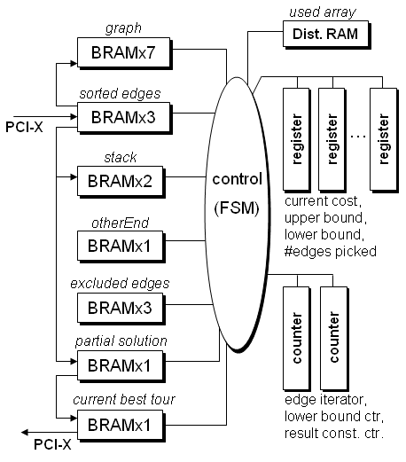
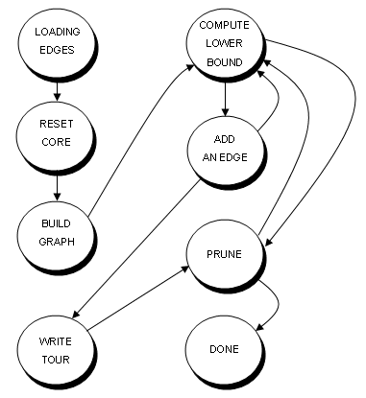
Hardware Median Core Design
Top-Level
Controller

Slide 17
Parallelizing the Median Computation
Exploit both fine- and coarse- grain parallelism
Fine-grain
Unroll loop for lower bound computation
Perform multiple iterations in parallel
Coarse-grain
Use parallel median cores for single median computation
Partition search space

Slide 18
Fine-Grain Parallelism
Lower bound unit:
v=2
e₀=11
e₁=-19
e₂=-49
used
table
used(v)
used(e₀)
used(e₁)
used(e₂)
if used(v) = 0 then
VALID_WEIGHTS= φ
for i = 0 to edge_count(v) - 1
if used(e_{i}) = 0 and
otherEnd(v) != e_{i} and
excluded_{i}(v) != 1 then
add weight_{i} to VALID_WEIGHTS
end if
end loop
if VALID_WEIGHTS is empty
lower_bound = lower_bound + 3
else
lower_bound = min(VALID_WEIGHTS)
end if
TSP graph representation:
1 (1,-4),w=0
-1 (-1,9),w=1 (-1,25),w=2
2 (2,11),w=2 (2,-19),w=2 (2,-49),w=2
-2 (-2,17),w=2 (-2,20),w=1
.
.
.
-19 (-19,2),w=2 (-19,-4),w=2 (-19,10),w=2
.
.
.
otherEnd
table
v=2
otherEnd(v)
v=2
excluded
table
excluded₀(v)
excluded₁(v)
excluded₂(v)
v=2
edge_count
table
3
11
-19
weight₀
weight₁
weight₂
2
2
2
2
2
2
2
-49

Slide 19
Coarse-Grain Parallelism
Parallelize search => partition TSP search space
Problems:
High amount of state information (communication overhead)
Dynamic load balancing would be complex (control overhead)
Solution: “virtually” partition the TSP search space
Search order determined by ordering of edge list
Use parallel median cores
Each core uses unique search order
All cores share a global upper bound value

Slide 20
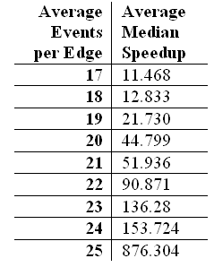
Experimental Results: Median Acceleration
Best performance was achieved:
20 lower bound units per core
2 cores
~ 50% of FPGA resources
Performance improves with size of search space
i.e. search time
Host-FPGA communication overhead
Average speedup for 1000 median computations

Slide 21
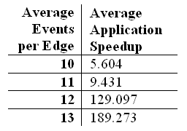
Experimental Results: Application Acceleration
Perform end-to-end reconstruction procedure
Dispatch all median computations to FPGA
Average speedup for 10 end-to-end reconstructions

Slide 22
Conclusions and Future Work
Achieved 100X end-to-end application speedup for distantly related data sets
Demonstrated that FPGAs can accelerate this class of application
Future Work:
Additional kernel designs (i.e. tree generation)
Implement heterogeneous mix of kernels on the FPGA according to evolution rate of input set

