Slide 1
Administrative Vision
Jason D. Bakos

Slide 2
About Me
Joined CSE in 2005 from U. Pittsburgh
Associate undergraduate director for Computer Engineering program
Research: computer architecture for high-performance and embedded computing
Recently recognized by steering committee of top US reconfigurable computing conference to serve as chair

Slide 3
CSE Faculty: 2005 and 2017
2005
2017
Lost:
Bonnell
Bowles
Davis
Eastman
Huhns
Liu
Quan
Stephens
Vargas
Gained:
Gay
Hu
Luo
O’Kane
Rekleitis
Terejanu
Thatcher
Tong
Yan
Bakos
Buell
Farkas
Fenner
Huang
Matthews
Nelakuditi
Rose
Tang
Valafar
Valtorta
Vidal
Wang
+9
13
+9

Slide 4
Leadership in the Future of CSE
CSE facing most significant change since 2000
CSE needs to adapt to capitalize
Will require leadership

Slide 5
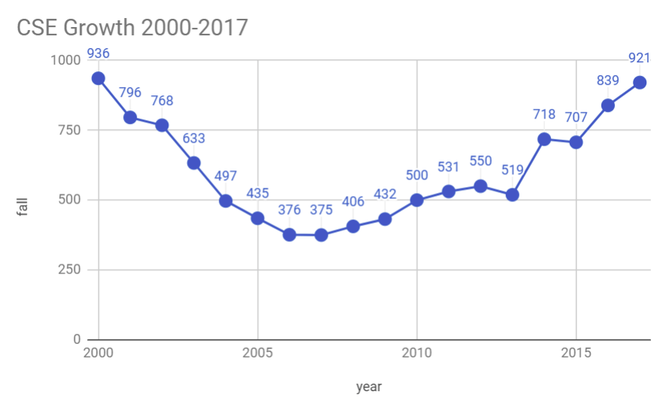
Enrollment

Slide 6
Say What?!
Dean (2015):
“Teaching needs may not play any role in searches for tenure stream faculty.”
“Graduate students may not serve as instructors of record for any course.”
CSE instructor corps (non-101/102):
2013: Pat
2014: +JJ, +Stiffler, +Pade
2015: +James
2016: -Stiffler, +Alberto
2017: -Pade, +Neema, +Jeremy, +1 more? …now at 6!

Slide 7
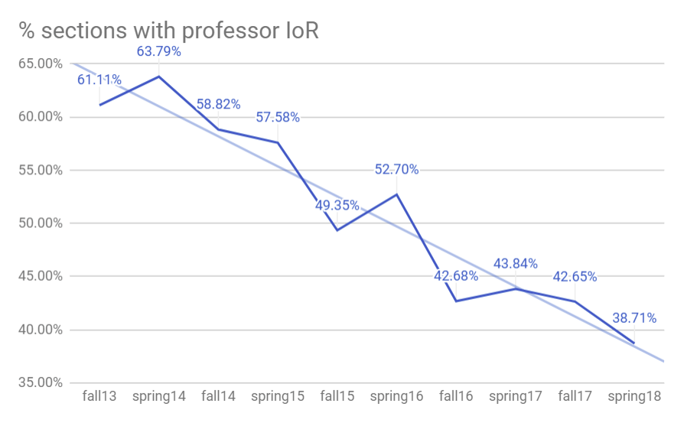
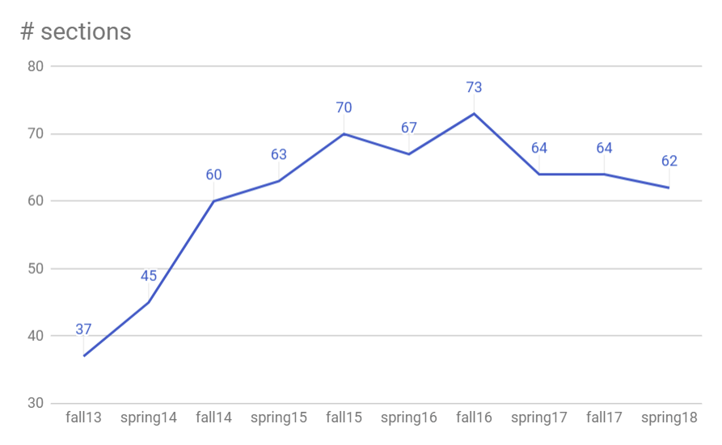
Undergrad Teaching (CSCE 100-500, non-service)
-40%!

Slide 8
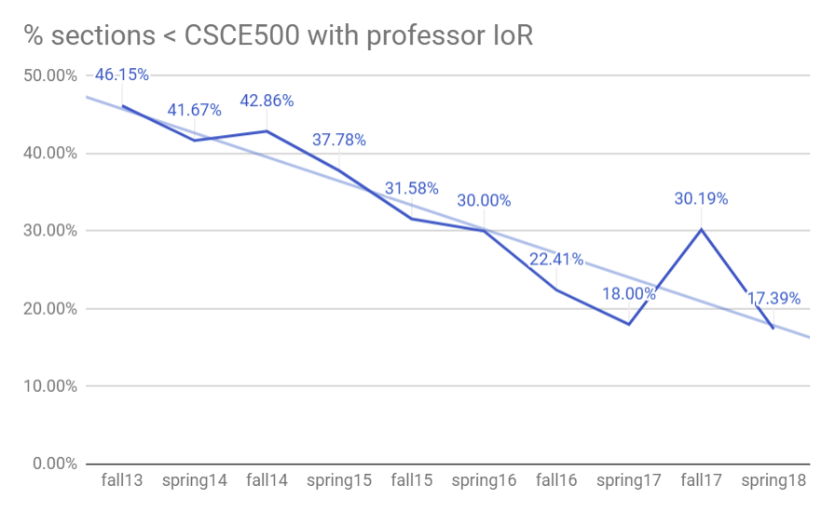
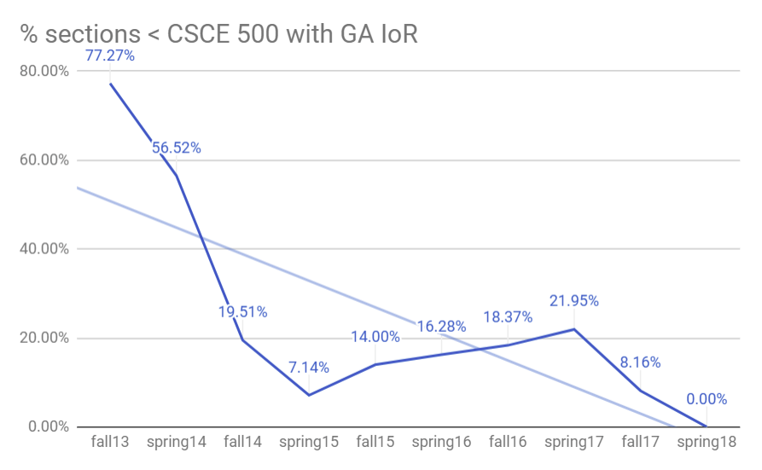
Undergrad Teaching (CSCE 100-400, non-service)
-63%!
What does this mean for us?

Slide 9
Dean's Prospective: Teaching
 | ChemE | EE | BiomedE | CSE | MechE | CivE | IIT
2000 | 211 | 212 |  | 936 | 290 | 214
profs (now) | 18 | 15 | 21 | 22 | 36 | 21 | 6
2013 | 343 | 300 | 312 | 519 | 718 | 350 | 186
2014 | 343 | 329 | 326 | 718 | 827 | 368 | 186
2015 | 368 | 308 | 370 | 707 | 929 | 372 | 185
2016 | 391 | 305 | 365 | 839 | 941 | 395 | 224
increase ‘13 to ‘16 | 14% | 2% | 17% | 62% | 31% | 13% | 20%
increase ‘00 to ‘16 | 46% | 44% |  | -12% | 224% | 85%
2017 admits | 250 | 128 | 486 | 631 | 686 | 321 | 17
admits/current | 64% | 44% | 133% | 75% | 73% | 81% | 8%

Slide 10
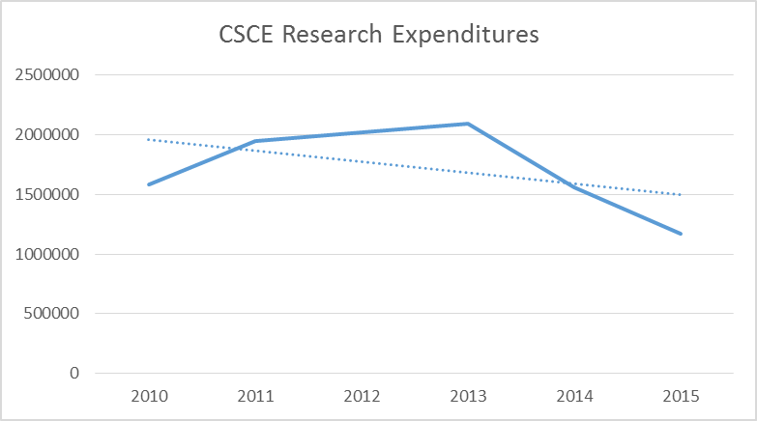
Dean's Prospective: Research

Slide 11
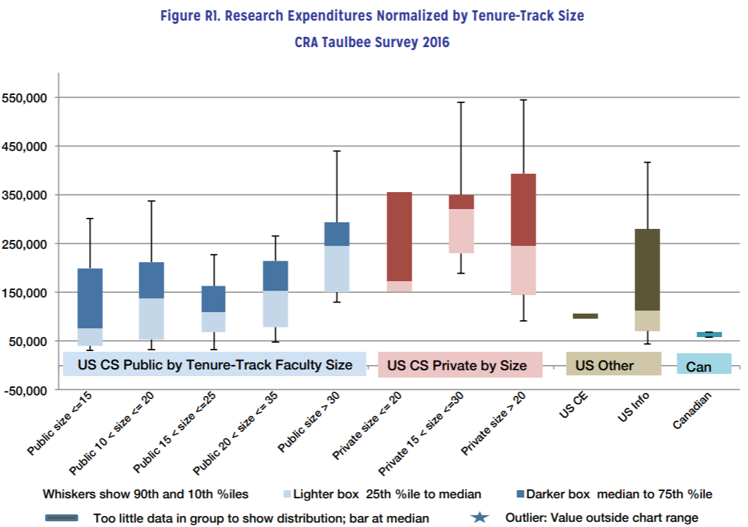
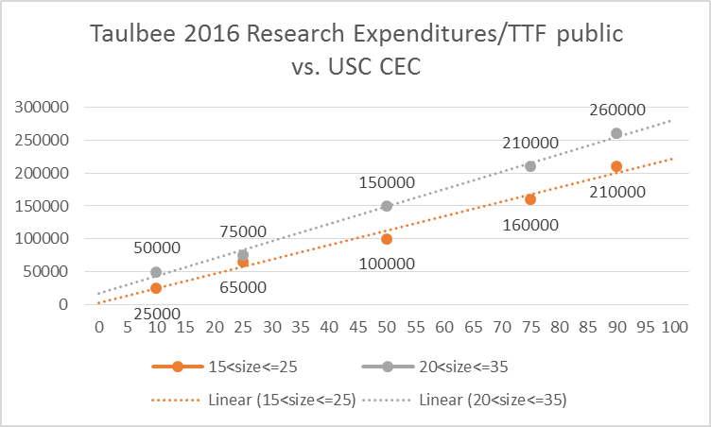
Dean’s Prospective: Research
ChemE
CSE
MechE
EE
CivilE
Dept. | Expend ('15) | Faculty ('17) | $/TT | Intersect (20,35]
Chemical | 4299997 | 18 | 238889 | 85
Mechanical | 7721321 | 36 | 214481 | 75
Electrical | 3025469 | 15 | 201698 | 70
Civil | 1598417 | 21 | 76115 | 27
CSE | 1166574 | 22 | 53026 | 15

Slide 12
CSE Research
2006: Quan CAREER
Marco/Mike AFRL $600K
Jijun/Moret NIH $500K
Srihari NSF $200K
Rose NIH $200K
Buell AFRL $200K
2008 Stimulus
2009: Bakos, Xu, Hu CAREER
2010: O’Kane CAREER
2012: Tong CAREER
2013: Max CAREER
2015: Xu, Rekleitis, O’Kane, Terejanu

Slide 13
CSE Research

Slide 14
CSE Proposals
Amount Requested | 2015 | 2016 | 2017 (to date)
0-199K | 28 | 24 | 18
200-399K | 10 | 10 | 7
400-599K | 10 | 12 | 5
600-799K | 2 | 1 | 2
800-999K | 2 | 2 | 1
1M+ | 0 | 1 | 2
total | 52 | 50 | 35
Agency 2015-2017 | %
NSF | 42%
NIH | 9%
internal | 30%
Other | 19%

Slide 15
Senior Faculty Research
As of Dec. 2017:
Senior faculty:
5 of 13 full professors have at least one active award
3 of 4 associate professors have at least one active award
How do we cultivate our successful junior faculty to become proportionally successful senior faculty?
i.e. $1M awards!

Slide 16
Strategy
Recipe for Growing Great Junior Faculty
into Super Senior Faculty

Slide 17
Recipe for Growing Great Junior Faculty into Super Senior Faculty
1. Graduate students

Slide 18
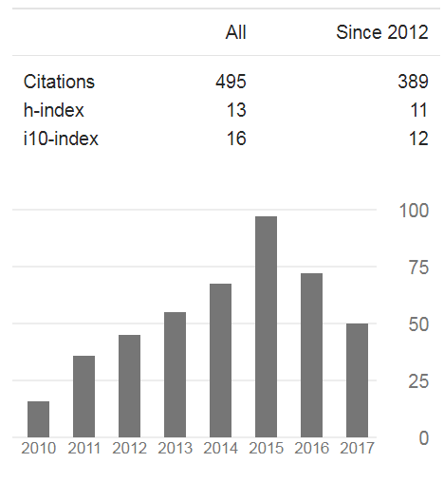
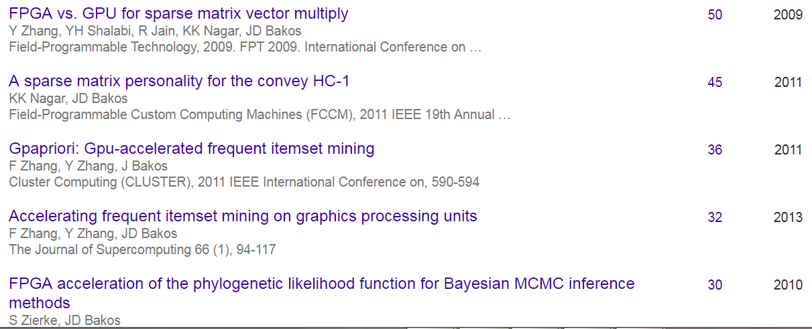
1. Graduate Students
Current HeRC group: 4 Ph.D. students, none can program at the CSCE 240 level

Slide 19
1. Graduate Students
Actively recruit good foreign students
Qiang Zeng: bbs.gter.net/forum-49-1.html, www.newsmth.net/nForum/#!board/AdvancedEdu
Increase stipends, find incentives for graduate students
Use departmental funds if necessary
A. Foster McKissick Trustee Account:
Established: June 4, 1965
Source: Endowment Income
Purpose: “Fellowship for graduate students in School of Engineering [sic]”
Balance: $162K
Status: Not currently used
Better recruiting of our our good undergraduates
Key: help them develop NSF Graduate Research Fellowship application in 2nd year!

Slide 20
Recipe for Growing Great Junior Faculty into Super Senior Faculty
2. Departmental strategic plan for hiring
…and research success for our current faculty!

Slide 21
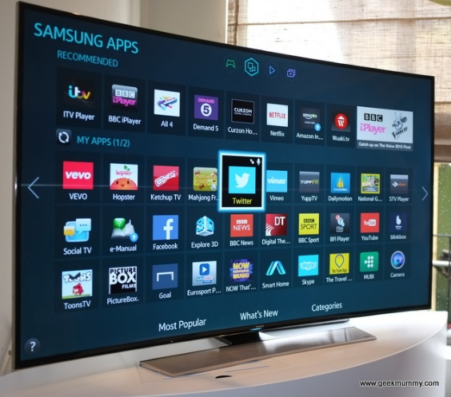
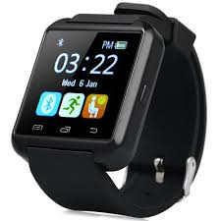
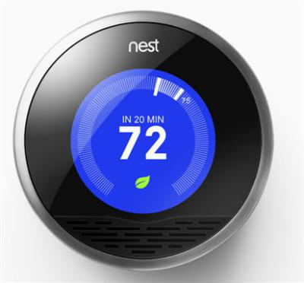
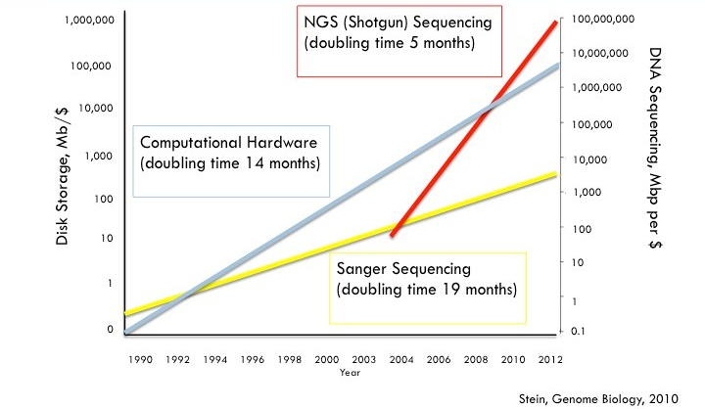
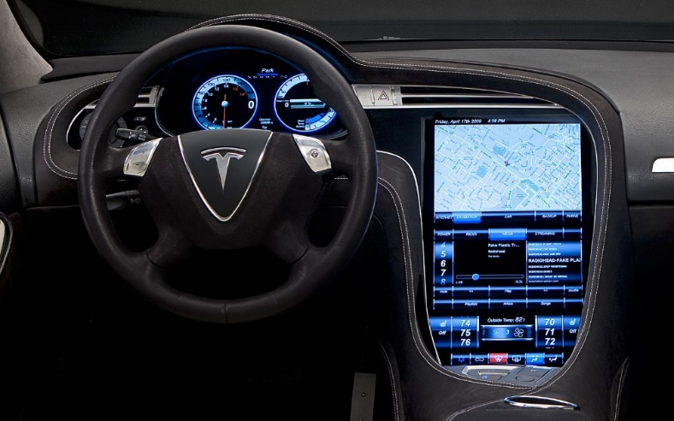
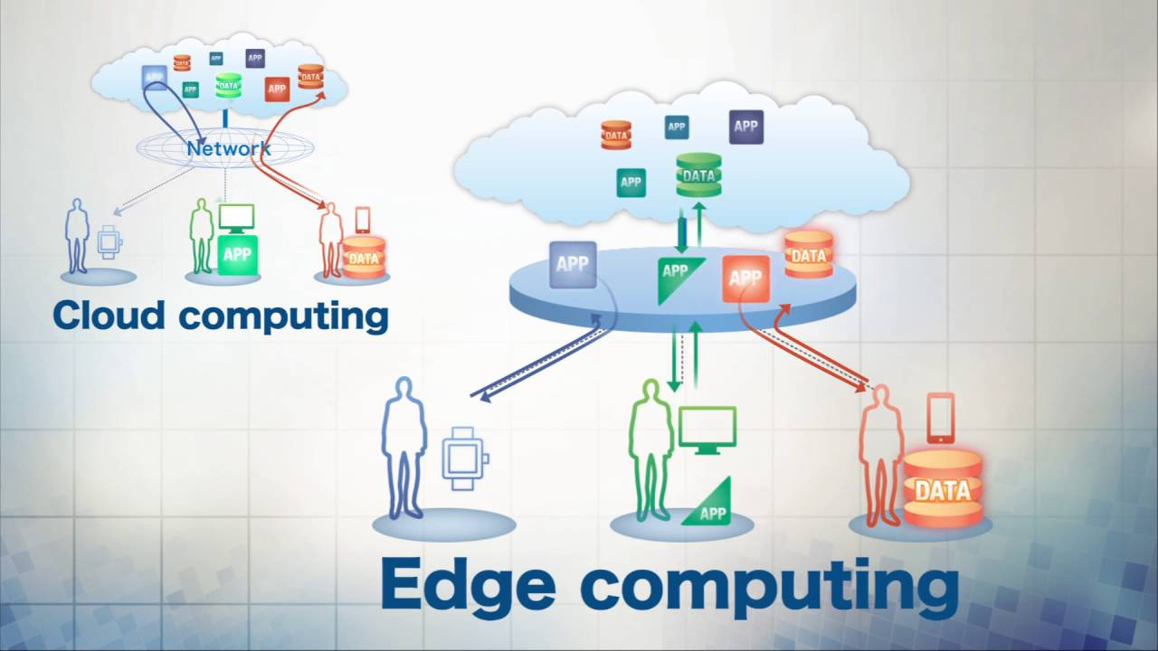
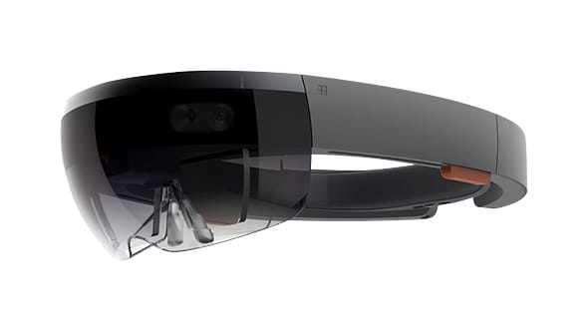
2. Strategic Planning: Hiring
Cyber-physical Systems
Data Science
Edge Computing/IoT

Slide 22
2. Strategic Planning: Hiring
Upcoming NSF CISE deadlines:
Dec. 11, 2017:
Computational and Data-Enabled Science and Engineering in Mathematical and Statistical Sciences (CDS&E-MSS) [scientific computing, data science, machine learning, HPC]
Dec. 13, 2017:
Secure and Trustworthy Cyberspace (SaTC) [security]
Jan. 8, 2018:
Scalable Parallelism in the Extreme [HPC]
Jan. 12, 2018:
NSF/Intel Partnership on Foundational Microarchitecture Research (FoMR) [architecture/HPC]
Oct. 15, 2018:
Computational and Data-Enabled Science and Engineering (CDS&E) [scientific computing, big data, machine learning, HPC]

Slide 23
2. Strategic Planning: Hiring
Objective: Develop strategy that includes funding plan for hires over next four years
Hard to predict what “hot” topics will persist, but:
Machine learning, cyber-physical systems, security, HPC
Won't this already reflect the current applicant pool?
Duncan: “create a department in which no one was totally alone but no one was duplicated”

Slide 24
Recipe for Growing Great Junior Faculty into Super Senior Faculty
3. Need departmental leadership for collaborative and large-scale proposals

Slide 25
3. Departmental Support for Proposals
Find (larger) funding opportunities, go to faculty and support proposal writing process
Goal:
Lead the development of least three MEDIUM or LARGE core proposals every cycle with multiple faculty members in and outside the department
Incentivise proposal writing ($$$)
Pair junior/senior faculty!!!

Slide 26
3. Departmental Support for Proposals
Bioinformatics group:
Tang, Rose, Valafar, Hu
Security group:
Farkas, Huang[, Xu]
Multi-agent systems group:
Valtorta, Huhns, Vidal
Robotics group:
O’Kane, Reklitis
Vision group:
Wang, Tong
Only one of the department’s currently active research awards has a co-PI from our department

Slide 27
Recipe for Growing Great Junior Faculty into Super Senior Faculty
4. Department investment in research

Slide 28
4. Invest in Research
Indirects?
NSF Grant Policy Manual Section 612.4:
General Purpose Equipment
Expenditures for general purpose equipment are normally unallowable unless the equipment is primarily or exclusively used in the actual conduct of research. NSF review and approval is required for all equipment purchases by small business or other commercial organizations.

Slide 29
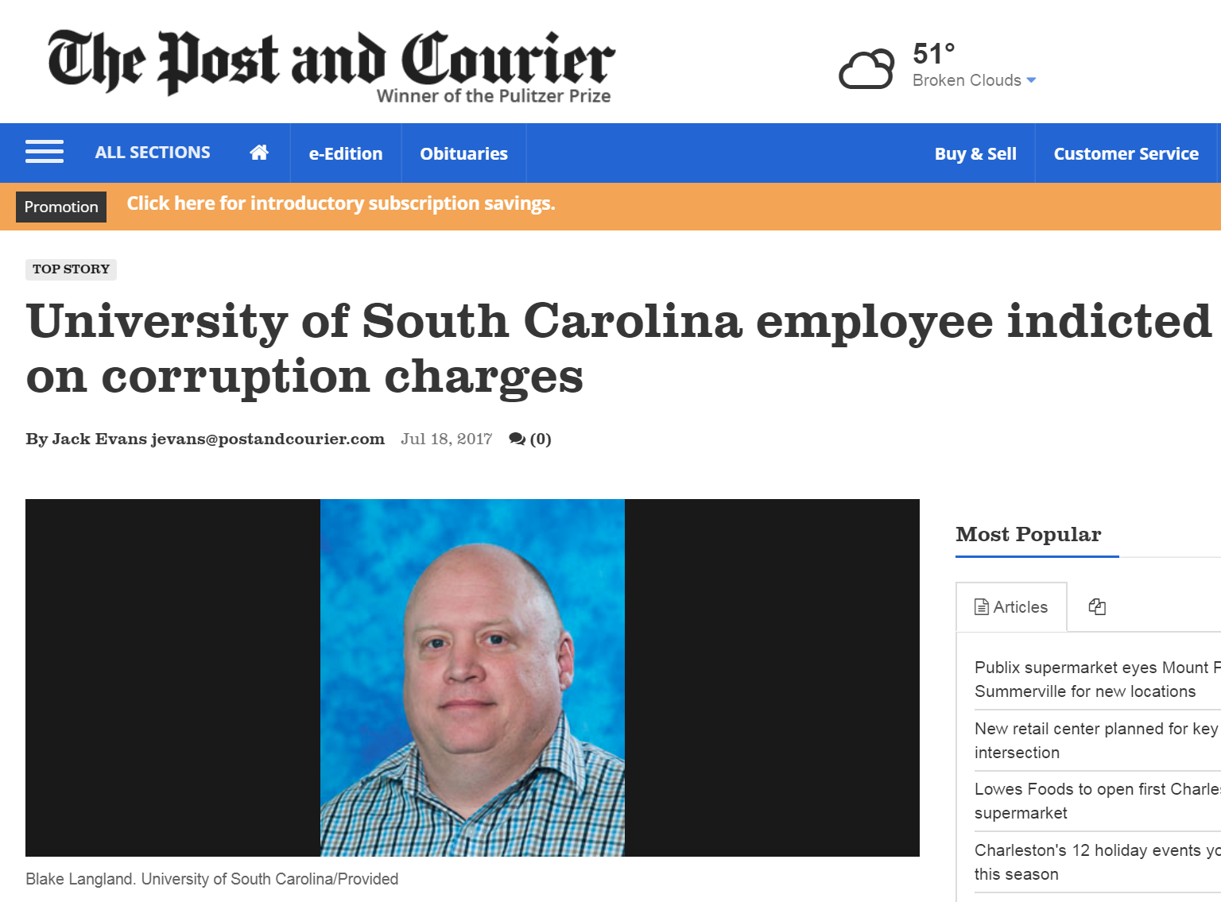

Slide 30
4. Departmental Investment in Research
My offenses:
Travel to/shipping material to conferences in which I did not publish
Lab infrastructure:
Projector
Lab door sign

Slide 31
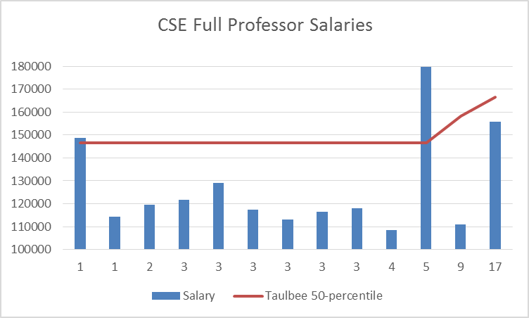
4. Departmental Investment in Research

Slide 32
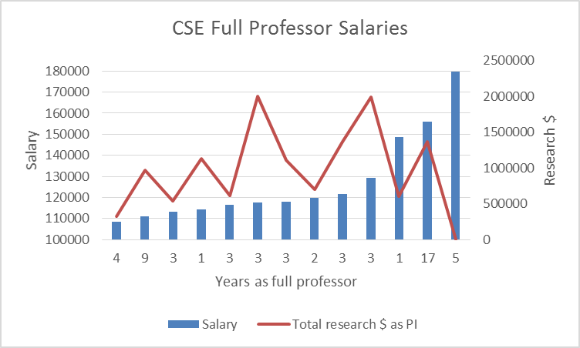
4. Departmental Investment in Research

Slide 33
Recipe for Growing Great Junior Faculty into Super Senior Faculty
5. Lessen adminstrative burden on faculty

Slide 34
Administrative Burden
I spent the previous four weeks doing almost nothing but reconciling errors in my NSF research account
Faculty time required to:
Make a credit card purchase: 2 hours
Add a single workstation to the college wired network: ½ day to 1 day
Reconcile grant expenditures against original budget: impossible
Administrate lab servers: 10-20% total time
Faculty meetings:
Recent discussions:
Shorelight: useless discussion
Frosting windows between corridor and faculty offices: don’t exist
Noiseproofing walls: punch list item!
Summer teaching offerings: individual choice of instructors!

Slide 35
Overview
Recipe for success:
Recruit good graduate students
Develop strategic hiring plan and sell it to the dean
Effectively mentor new faculty
Take active leadership role for developing large proposals, pair senior and junior faculty
Invest in faculty research development and lab infrastructure, adust salaries to reflect research success
Reduce administrative, purchasing, and accounting overheads
Publicize research successes!

