Slide 1
Trends in the Infrastructure of Computing: Processing, Storage, Bandwidth
CSCE 190: Computing in the Modern World
Dr. Jason D. Bakos

Slide 2
Lecture Outline
Introduction
Digital integrated circuits: from silicon to microprocessors
Trends in processing
Increasing microprocesor speed
Microarchitectural parallelism
High-performance computing
High-performance reconfigurable computing
Trends in bandwidth
Interconnects
Networks
Trends in storage

Slide 3
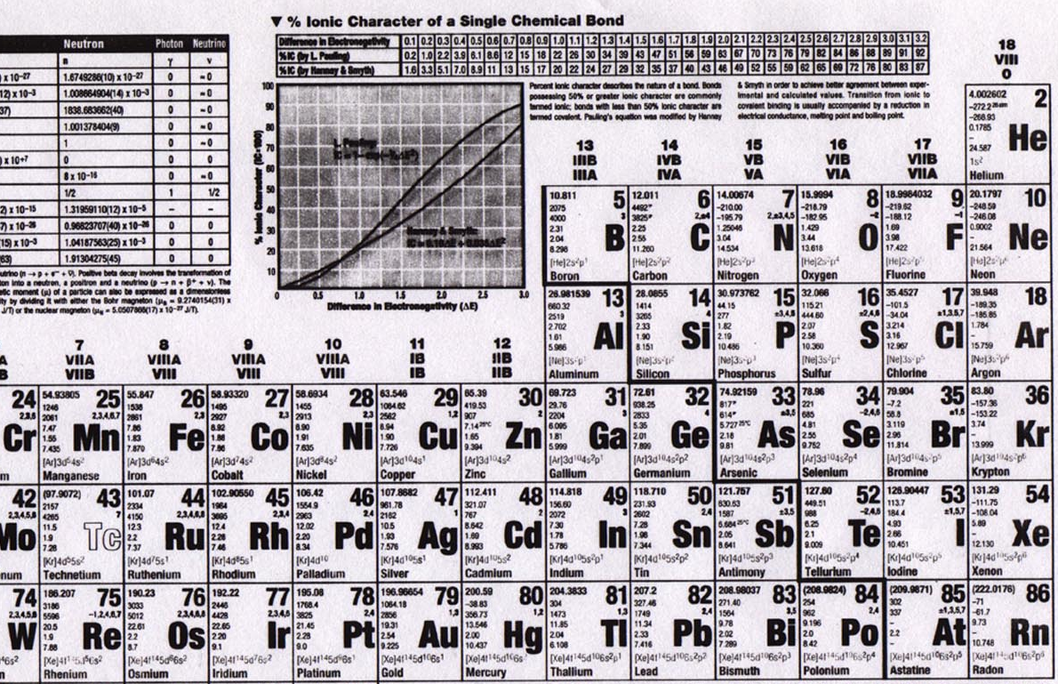
Elements

Slide 4
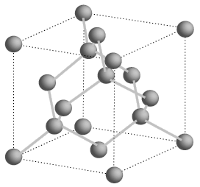
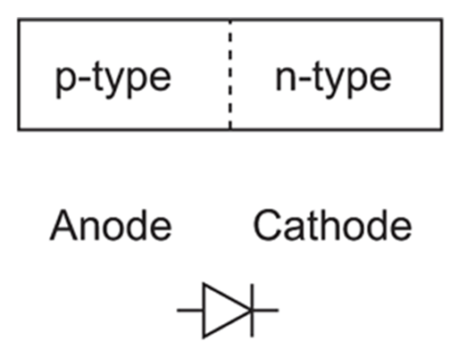
Semiconductors
Silicon is a group IV element (4 valence electrons, shells: 2, 8, 18, 32…)
Forms covalent bonds with four neighbor atoms (3D cubic crystal lattice)
Si is a poor conductor, but conduction characteristics may be altered
Add impurities/dopants (replaces silicon atom in lattice):
Makes a better conductor
Group V element (phosphorus/arsenic) => 5 valence electrons
Leaves an electron free => n-type semiconductor (electrons, negative carriers)
Group III element (boron) => 3 valence electrons
Borrows an electron from neighbor => p-type semiconductor (holes, positive carriers)
+
-
-
+
+ + +
+ + +
+ + +
+ + +
- - -
- - -
- - -
- - -
P-N junction
forward bias
reverse bias

Slide 5
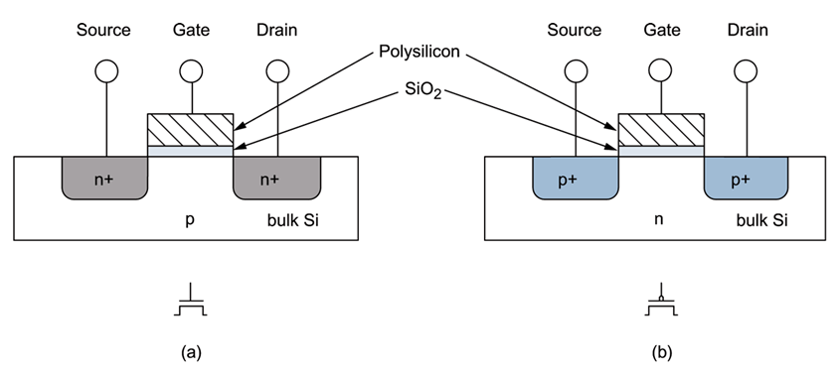
MOSFETs
negative voltage (rel. to body) (GND)
positive voltage (Vdd)
NMOS/NFET
+ + +
- - -
PMOS/PFET
current
- - -
+ + +
current
body/bulk
GROUND
channel
shorter length, faster transistor (dist. for electrons)
body/bulk
HIGH
(S/D to body is reverse-biased)
Metal-poly-Oxide-Semiconductor structures built onto substrate
Diffusion: Inject dopants into substrate
Oxidation: Form layer of SiO2 (glass)
Deposition and etching: Add aluminum/copper wires

Slide 6
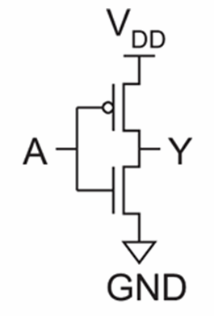
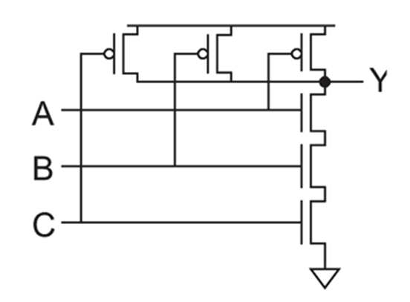
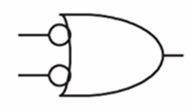
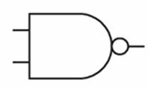
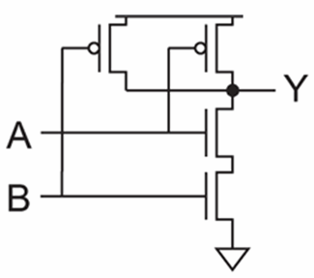
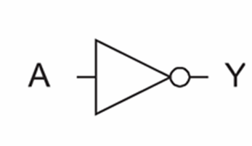
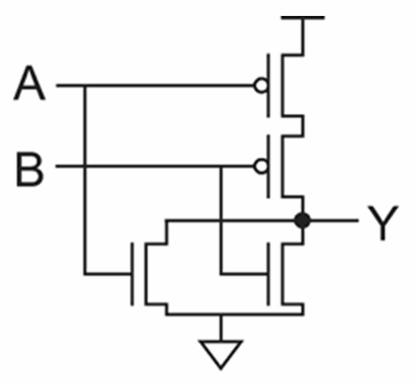
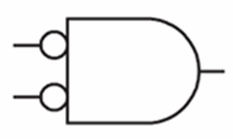
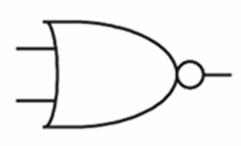
Logic Gates
inv
NAND2
NAND3
NOR2

Slide 7
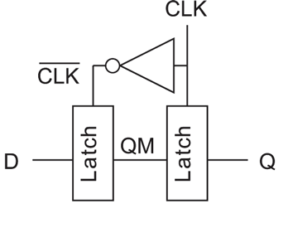
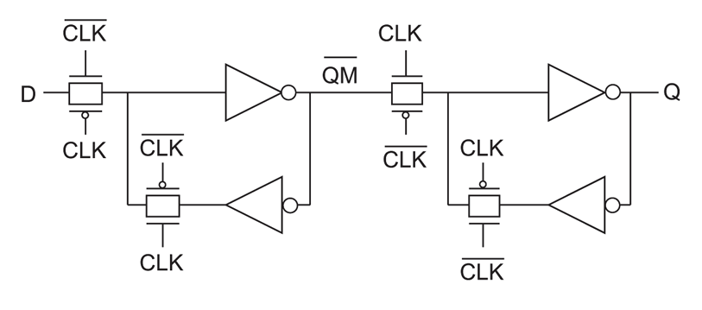
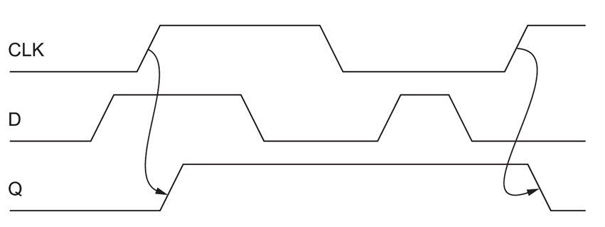
Latches
Positive edge-sensitive latch

Slide 8
IC Fabrication
Inverter cross-section
field oxide

Slide 9
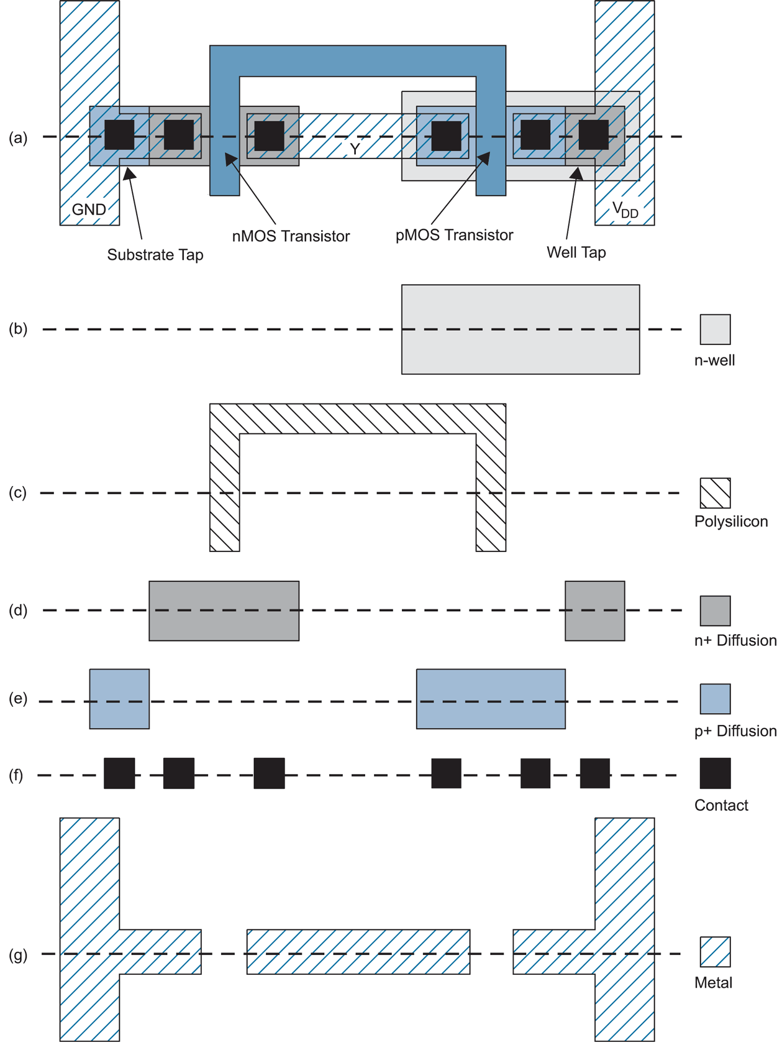
IC Fabrication
Chips are fabricated using set of masks
Photolithography
Inverter uses 6 layers:
n-well, poly, n+ diffusion, p+ diffusion, contact, metal
Basic steps
oxidize
apply photoresist
remove photoresist with mask
HF acid eats oxide but not photoresist
pirana acid eats photoresist
ion implantation (diffusion, wells)
vapor deposition (poly)
plasma etching (metal)

Slide 10
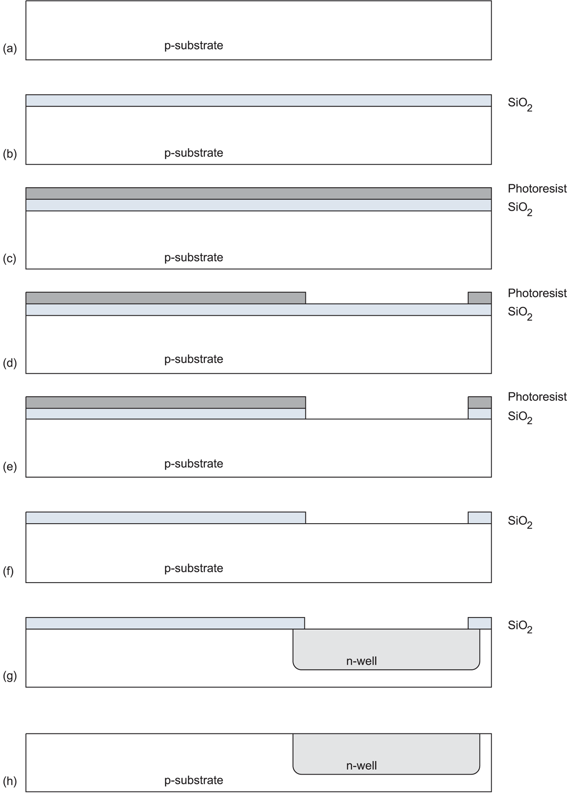
IC Fabrication
Furnace used to oxidize (900-1200 C)
Mask exposes photoresist to light, allowing removal
HF acid etch
piranha acid etch
diffusion (gas) or ion implantation (electric field)
HF acid etch

Slide 11
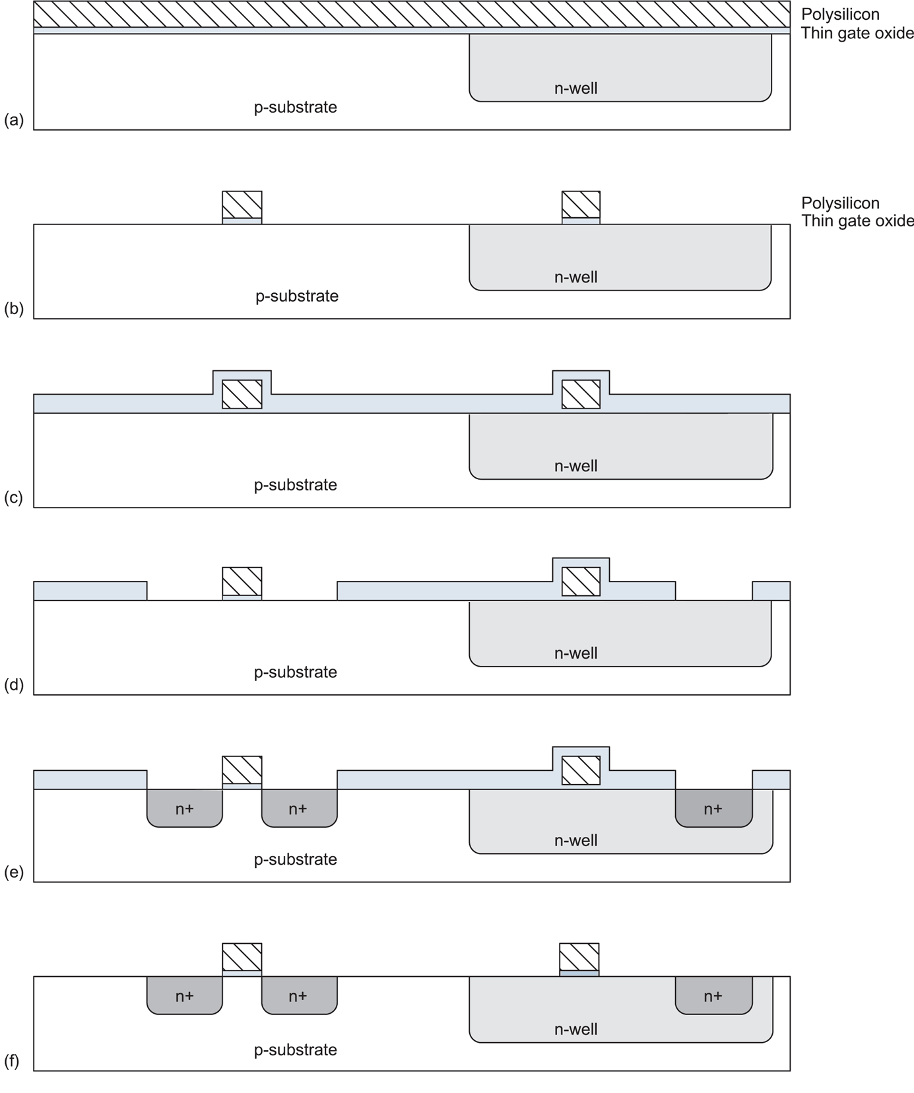
IC Fabrication
Heavy doped poly is grown with gas in furnace (chemical vapor deposition)
Masked used to pattern poly
Poly is not affected by ion implantation

Slide 12
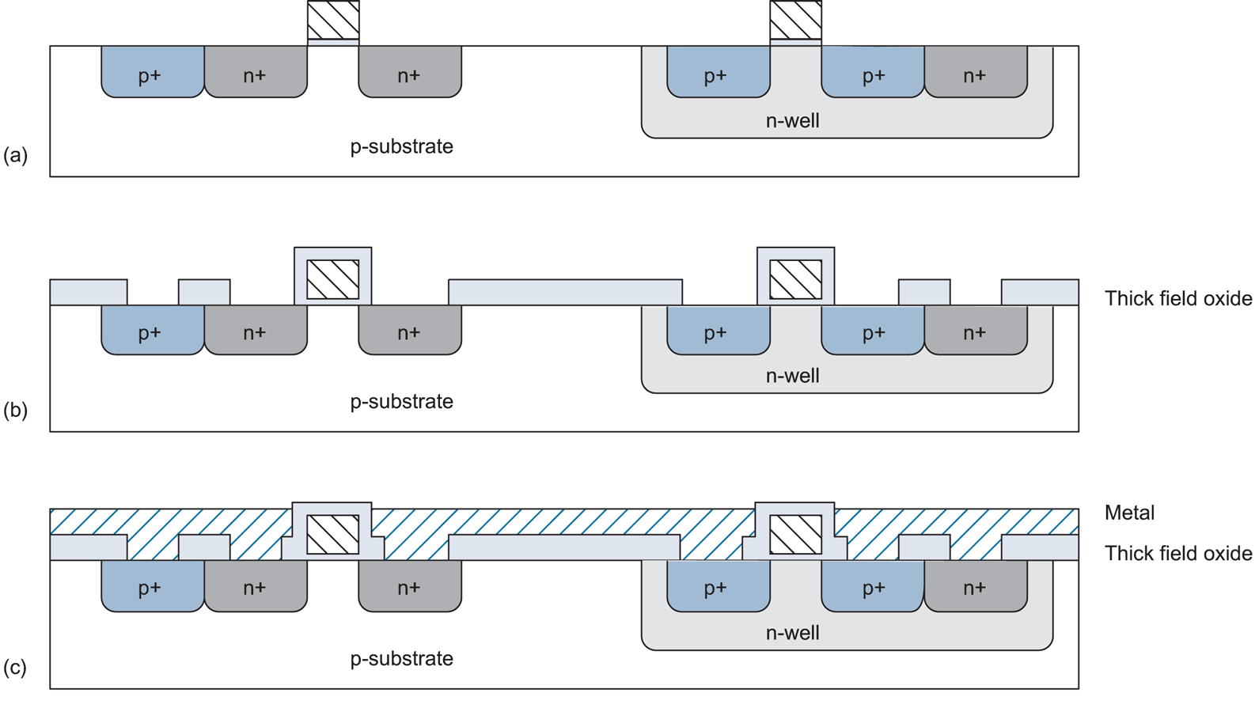
IC Fabrication
Metal is sputtered (with vapor) and plasma etched from mask

Slide 13
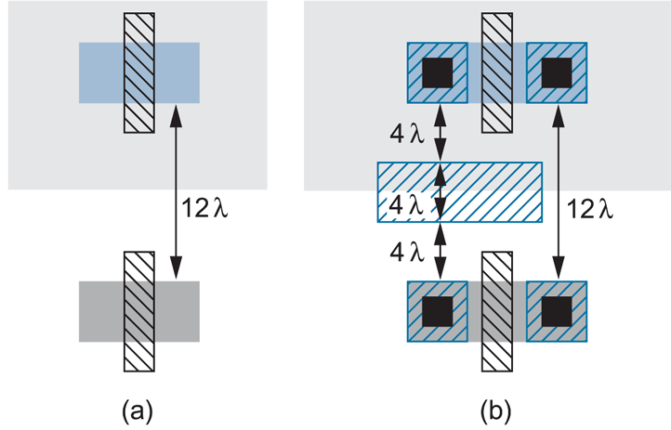
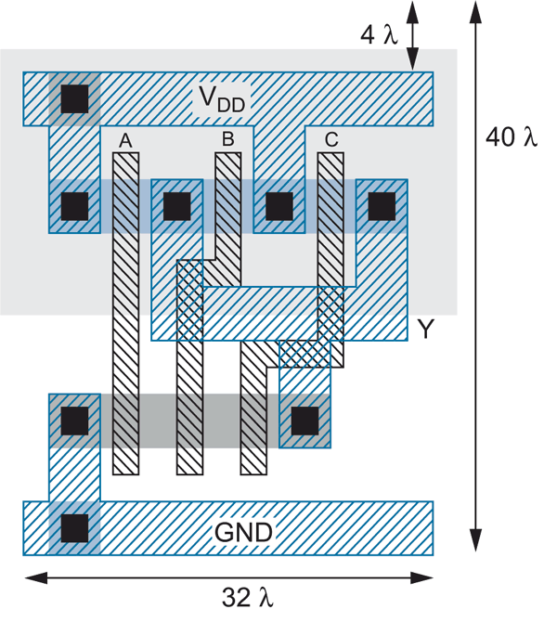
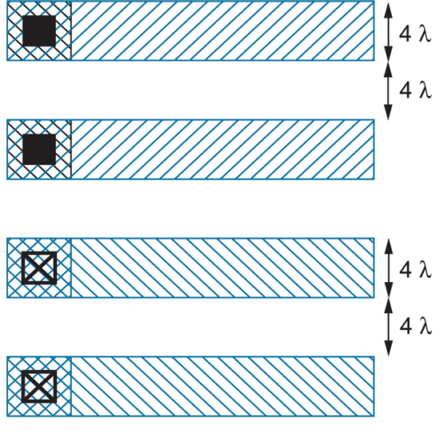
Layout
3-input NAND

Slide 14
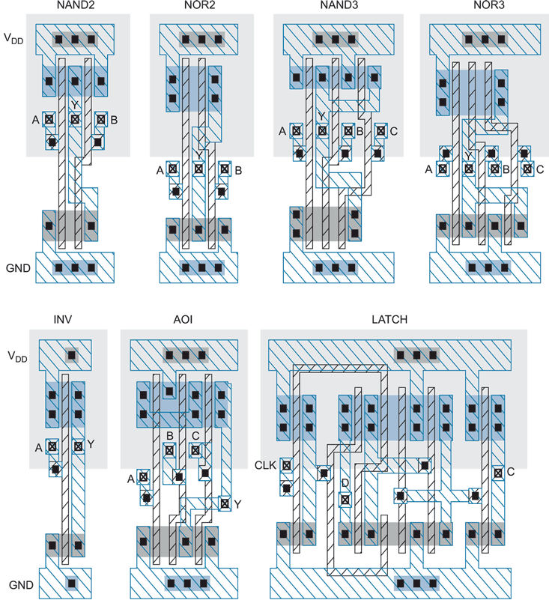
Cell Library (Snap Together)
Layout

Slide 15
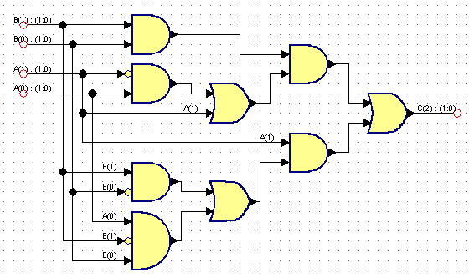
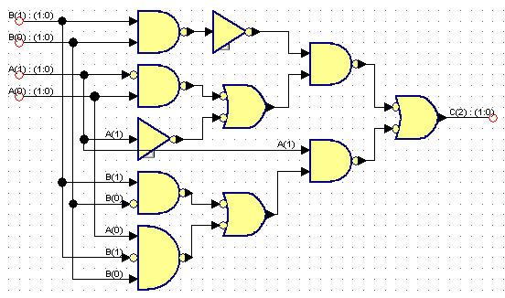
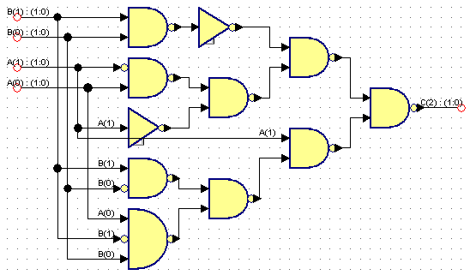
Logic Synthesis
Behavior:
S = A + B
Assume A is 2 bits, B is 2 bits, C is 3 bits
A | B | C
00 (0) | 00 (0) | 000 (0)
00 (0) | 01 (1) | 001 (1)
00 (0) | 10 (2) | 010 (2)
00 (0) | 11 (3) | 011 (3)
01 (1) | 00 (0) | 001 (1)
01 (1) | 01 (1) | 010 (2)
01 (1) | 10 (2) | 011 (3)
01 (1) | 11 (3) | 100 (4)
10 (2) | 00 (0) | 010 (2)
10 (2) | 01 (1) | 011 (3)
10 (2) | 10 (2) | 100 (4)
10 (2) | 11 (3) | 101 (5)
11 (3) | 00 (0) | 011 (3)
11 (3) | 01 (1) | 100 (4)
11 (3) | 10 (2) | 101 (5)
11 (3) | 11 (3) | 110 (6)

Slide 16
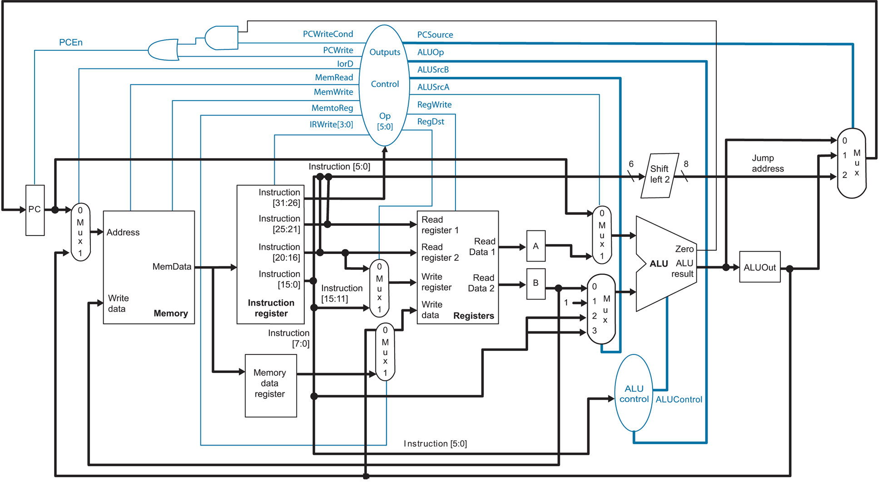
MIPS Microarchitecture

Slide 17
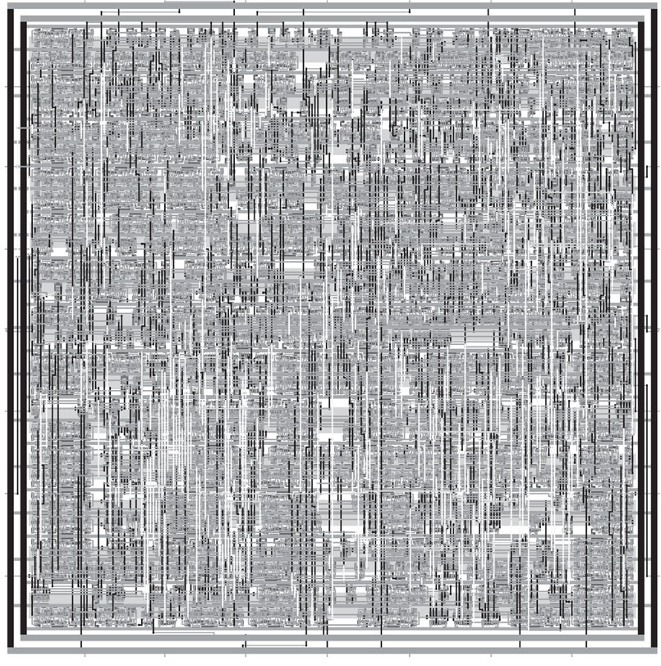
Synthesized and P&R’ed MIPS Architecture

Slide 18
Lecture Outline
Introduction
Digital integrated circuits: from silicon to microprocessors
Trends in processing
Increasing microprocesor speed
Microarchitectural parallelism
High-performance computing
High-performance reconfigurable computing
Trends in bandwidth
Interconnects
Networks
Trends in storage

Slide 19
Feature Size
Shrink minimum feature size…
Smaller L decreases carrier time and increases current
Therefore, W may also be reduced for fixed current
C_{g}, C_{s}, and C_{d} are reduced
Transistor switches faster (~linear relationship)

Slide 20
Minimum Feature Size
Year | Processor | Speed | Process
1982 | i286 | 6 - 25 MHz | 1.5 μm
1986 | i386 | 16 – 40 MHz | 1.5 - 1 μm
1989 | i486 | 16 - 133 MHz | .8 μm
1993 | Pentium | 60 - 300 MHz | .6 - .25 μm
1995 | Pentium Pro | 150 - 200 MHz | .5 - .35 μm
1997 | Pentium II | 233 - 450 MHz | .35 - .25 μm
1999 | Pentium III | 450 – 1400 MHz | .25 - .13 μm
2000 | Pentium 4 | 1.3 – 3.8 GHz | .18 - .065 μm
2005 | Pentium D | 2.66 – 3.6 GHz | .09 - .065 μm
2006 | Core 2 | 1.06 – 3 GHz | .065 μm
Upcoming milestones:
45 nm (Xeon 5400 Nov. 2007),
32 nm (2009-2010), 22 nm (2011-2012), 16 nm (2013)

Slide 21
Clock Speed
“Megahertz myth”:
In the late 1990’s and early 2000’s, the marketing arm of microprocessor companys overstated the corralation between clock speed and performance
Execution time =
instructions per program * cycles per instruction * seconds per cycle
Now we must add to the product:
(number of threads / number of cores)

Slide 22
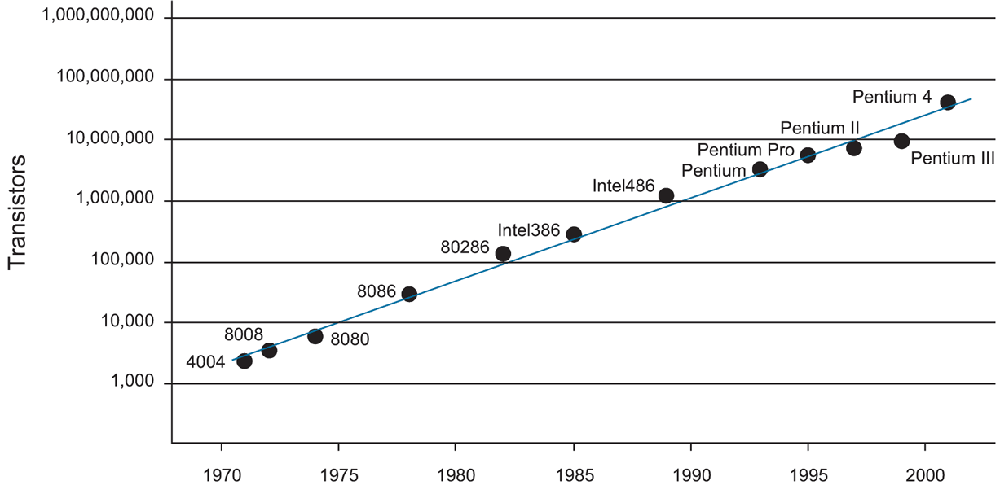
Integration Density Trends (Moore’s Law)
Pentium Core 2 Duo (2007) has ~300M transistors

Slide 23
Microprocessor Technology
Advances in fabrication (lithography, photoresist, metal layers)
…faster transistor switching (faster processor)
…smaller transistors/wires
…higher integration density
…more “real estate”
…architectural improvements!

Slide 24
Instruction Set Architecture
Example:
Motorola 6800 / Intel 8085 (1970s)
1-address architecture: ADDA <mem_addr>
(A) = (A) + (addr)
Intel x86 / IBM 360 (1980s)
2-address architecture: ADD EAX, EBX –or- ADD EAX,<mem_addr>
(A) = (A) + (B)
MIPS (1990s)
3-address architecture: ADD $2, $3, $4
($2) = ($3) + ($4)
Instruction-level Parallelism (2000s)

Slide 25
Machine Code Example
for (i=0;i<n;i++) a[i]=b[i]+10;
xor $2,$2,$2 # zero out index register (i)
lw $3,n # load iteration limit
sll $3,$3,2 # multiply by 4 (words)
la $4,a # get address of a (assume < 2¹⁶)
la $5,b # get address of b (assume < 2¹⁶)
j test
loop: add $6,$5,$2 # compute address of b[i]
lw $7,0($6) # load b[i]
addi $7,$7,10 # compute b[i]=b[i]+10
add $6,$4,$2 # compute address of a[i]
sw $7,0($6) # store into a[i]
addi $2,$2,4 # increment i
test: blt $2,$3,loop # loop if test succeeds

Slide 26
Microarchitectural Parallelism
Parallelism => perform multiple operations simultaneously
Instruction-level parallelism
Execute multiple instructions at the same time
Multiple issue
Out-of-order execution
Speculation
Thread-level parallelism (hyper-threading)
Execute multiple threads at the same time on one CPU
Threads share memory space and pool of functional units
Chip multiprocessing
Execute multiple processes/threads at the same time on multiple CPUs
Cores are symmetrical and completely independent but share a common level-2 cache

Slide 27
Parallel Processing
Parallel processing:
Shared memory
Symmetric multiprocessing
Multiple CPUs share a single memory space (usually NUMA)
Communicate through memory reference
Each CPU may have local but globally accessible memory
Requires expensive crossbar switch (16-processor => $500K)
Message-passing
No shared memory
CPUs communicate via explicit messages
MPI and OpenMP APIs
COTS processors and high-speed LAN switch
Scalable:
NASA Space Exploration Simulator has 10,240 CPUs (Intel Itanium 2) and requires 1 MW (Lake Murray generates 200 MW)
Laurence Livermore BlueGene/L has 65,536 dual-processor (700 MHz PowerPC) nodes and requires 1.5 MW
Hybrid systems

Slide 28
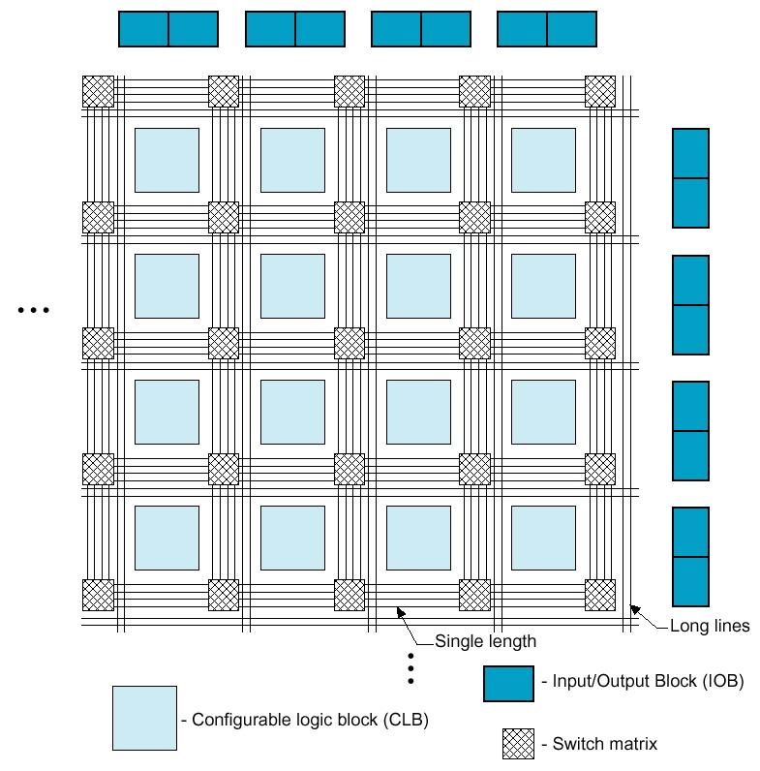
High-Performance Reconfigurable Computing
HPRC:
Use FPGA as co-processor
Example:
Application requires a week of CPU time
One computation consumes 99% of execution time
Kernel speedup | Application speedup | Execution time
50 | 34 | 5.0 hours
100 | 50 | 3.3 hours
200 | 67 | 2.5 hours
500 | 83 | 2.0 hours
1000 | 91 | 1.8 hours
Replaces software
Exploits parallelism

Slide 29
HPRC: Requirements, Pros, Cons
Application criteria:
computationally expensive
has a bottleneck computation
bottleneck computation is parallelizable
…and has low I/O and storage requirements
Advantages of HPRC:
Cost
FPGA card => ~ $15K
128-processor cluster => ~ $150K
+ maintenance + cooling + electricity + recycling
Disadvantage for HPRC:
Programming the FPGA

Slide 30
Lecture Outline
Introduction
Digital integrated circuits: from silicon to microprocessors
Trends in processing
Increasing microprocesor speed
Microarchitectural parallelism
High-performance computing
High-performance reconfigurable computing
Trends in bandwidth
Interconnects
Networks
Trends in storage

Slide 31
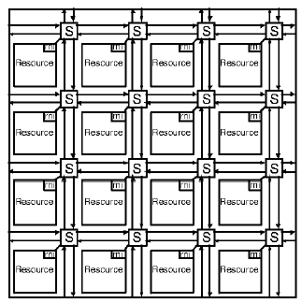
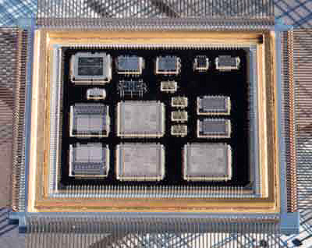
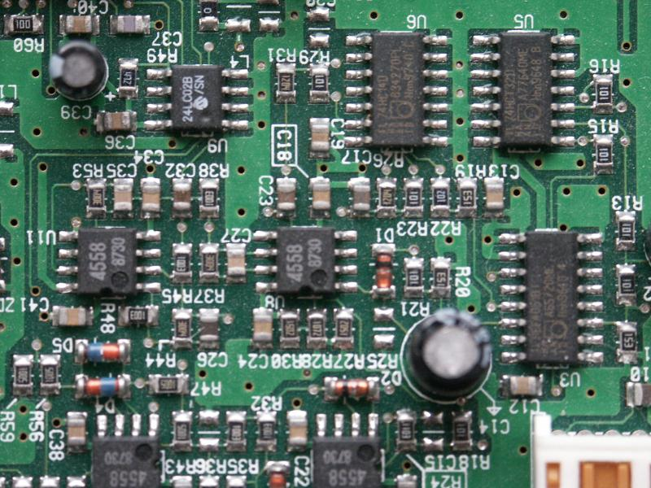
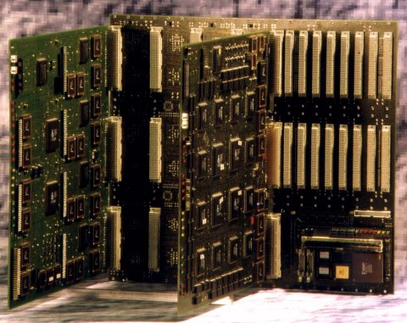
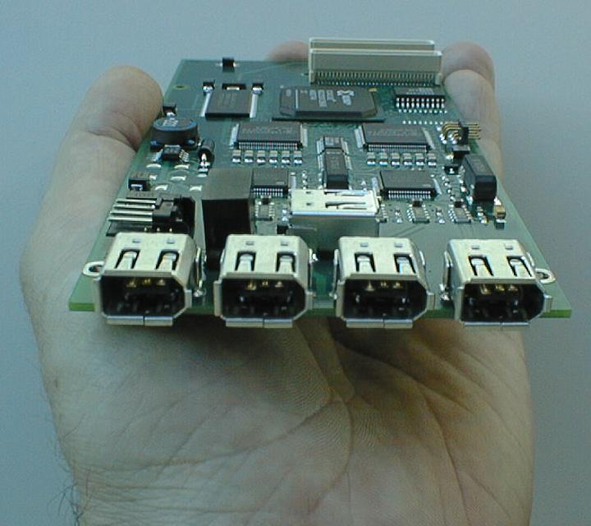
Interconnects
On-chip
Multi-Chip Module
Printed circuit boards
Backplanes
Pentium Core Duo
128 single-ended wires @ 8 Gbps/wire = 1024 Gbps
DVD in .04 s
Pentium D
64 single-ended wires @ 4 Gbps/wire = 256 Gbps
DVD in .15 s
Processor to RAM
32 single-ended wires @ 2 Gbps/wire = 64 Gbps
DVD in .6 s
PCIe
16 differential channels @ 2 Gbps/ch = 32 Gbps
DVD in 1.2 s
Peripherals
SATA
1 bi-directional differential channel @ 3 Gbps/ch
DVD in 12.6 s
USB 2.0
1 bi-directional differential channel @ .4 Gbps/ch
DVD in 94 s
Notes:
Peripheral and LAN interconnects have “marketing speeds” which typically do not consider phyical layer overhead and usually aggregate parallel and bidirectional channels!
1394b
1 bi-directional differential channel @ .8 Gbps/ch
DVD in 47 s

Slide 32
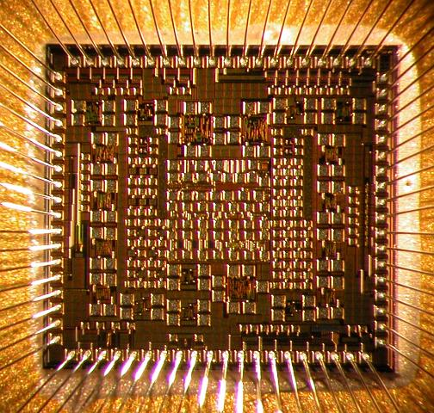
Challenges for System-Level Interconnects
Signal integrity
RLC effects
Noise (switching, RF, etc.)
Crosstalk
Synchronization/jitter/skew
Skin effect
Dielectric loss
Signal reflection
Area
I/O pads precious
Driver size
Packaged chip
Packaged chip
Source: Intel Corporation

Slide 33
Multi-Bit Differential Signaling (MBDS)
Single-ended channels
Differential (LVDS) channels
Data generally not encoded but can be modulated
i.e. pulse amplitude modulation (RAMBUS)
Data encoded as
{01} or {10}
Advantages
Low switching noise
Large GDP
Common-mode noise rejection
EM coupled transmission lines
Low noise => low voltage swing
Disadvantages
Wasteful in I/O pads

Slide 34
Multi-Bit Differential Signaling (MBDS)
Differential (LVDS) channels
Multi-Bit Differential (MBDS) channel
Data encoded as
{01} or {10}
Advantages
Low switching noise
Large GDP
Common-mode noise rejection
EM coupled transmission lines
Low noise => low voltage swing
Disadvantages
Wasteful in I/O pads
Scale up LVDS driver
Data encoded with fixed number of ones
“N-choose-M (nCm)” symbols
{0011}, {0101}, {0110}, {1001}, {1010}, {1100}
Advantages
Same transmission characteristics as differential
Higher information capacity

Slide 35
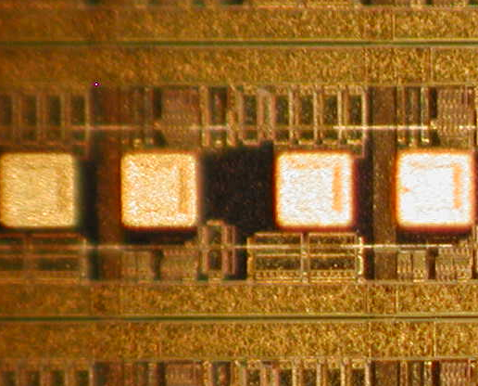
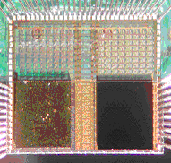
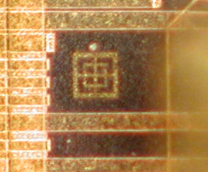
OE Conversion Technology
Area pads
Window
SoS die
VCSEL site
Assembled OE-chip
Passive alignment mark

Slide 36
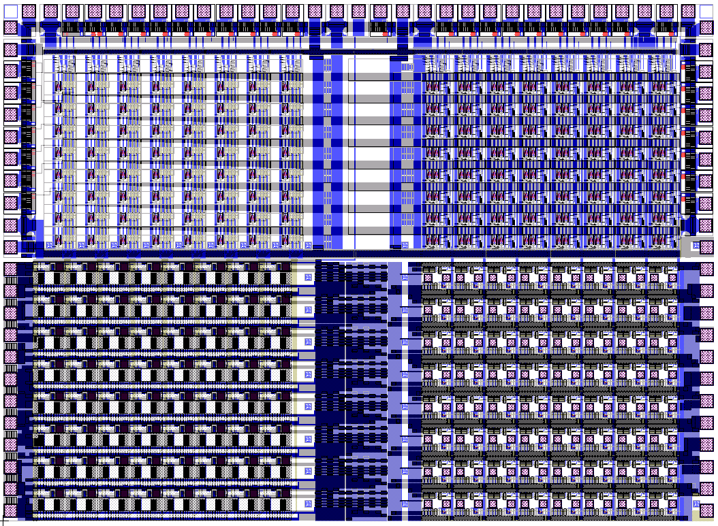
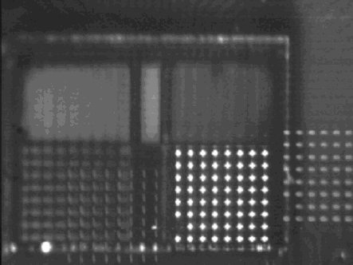
OE Crossbar Switch Chip
64 optical channels
8x8 at 250 μm pitch (1.75 x 1.75 mm)
~ 3 Gbps / channel => 192 Gbps

Slide 37
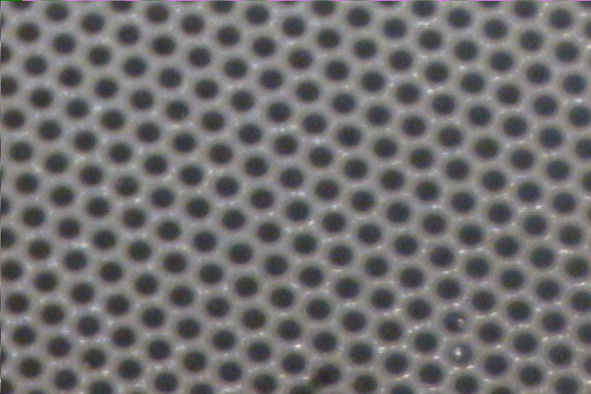
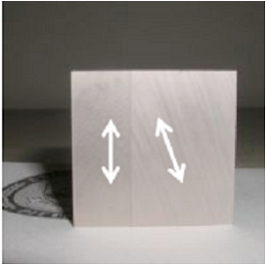
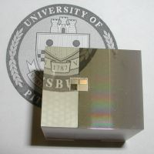
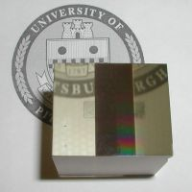
OE Interconnect using Fiber Image Guides
Dense lattice of fiber cores
5-20 um diameter, 2K-15K cores/mm²
Side
Top
Bottom

Slide 38
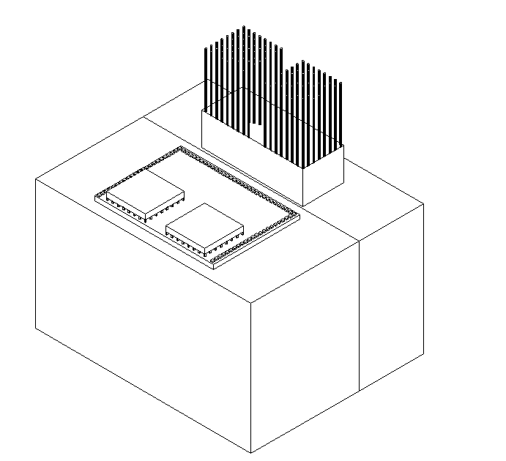
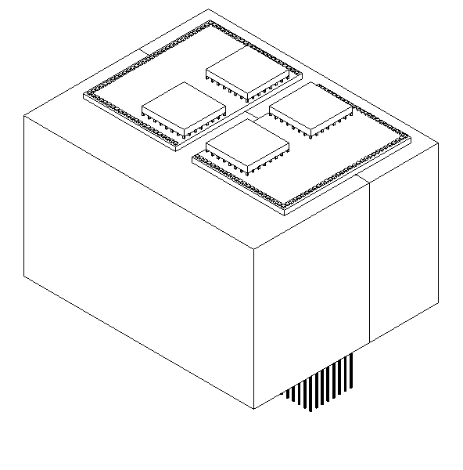
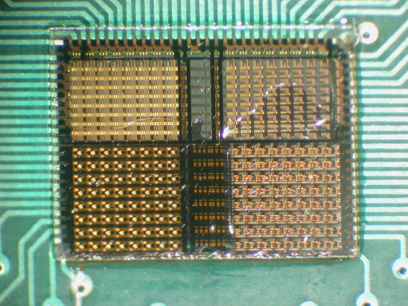
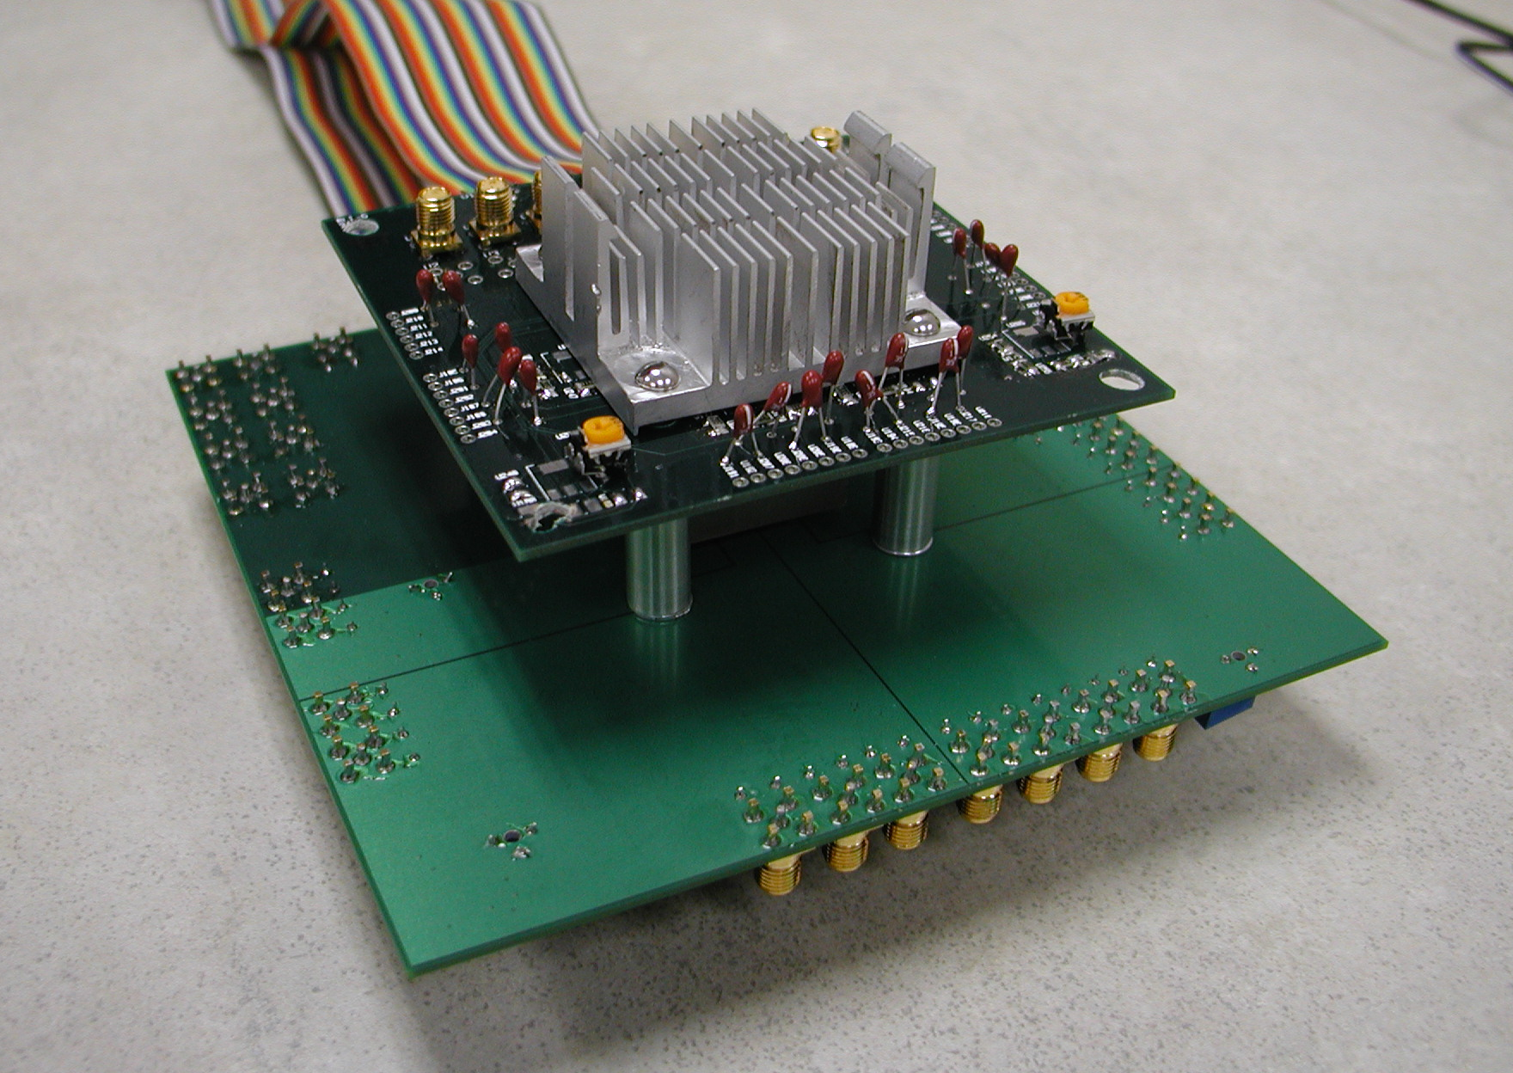
OE-MCM Demonstrator
IN
OUT
Chip 3
Chip 1
Chip 2
Chip 1
Chip 2
Chip 3

Slide 39
LANs
Peripheral and LAN switched interconnects are merging
LAN
Fibre Channel
For storage devices / SAN (1 – 12.75 Gbps)
16 port 1U 2.12 Gbps is $15K
Infiniband (copper or fiber)
2.5 Gbps
16 port is $10K
Myrinet (designed for clusters)
10 Gbps
16 port for $10K
1G/10G Ethernet

Slide 40
WANs
WAN
SONET
Synchronous optical networking
1 frame is transmitted every 125 μs (8 KHz)
Frame size depends on line speed:
OC-1 ~ 51.8 Mbps, frame size = 810 bytes
OC-48 ~ 2.5 Gbps (regional ISP backbone)
OC-192 ~ 10 Gbps (fastest backbone connection currently in use)
OC-768 ~ 40 Gbps (2007 -- short range only), interfaces include four Xilinx FPGAs
OC-1536 ~ 80 Gbps (no standards yet)
OC-3072 ~ 160 Gbps (no standards yet)

Slide 41
Lecture Outline
Introduction
Digital integrated circuits: from silicon to microprocessors
Trends in processing
Increasing microprocesor speed
Microarchitectural parallelism
High-performance computing
High-performance reconfigurable computing
Trends in bandwidth
Interconnects
Networks
Trends in storage

Slide 42
Memory

Slide 43
Array Architecture

Slide 44
SRAM
Static RAM cell
Reads:
bitlines are precharged high
one is pulled down by cell
sense amplifiers read small differences
Writes:
bitline or its complement are driven low
Challenge:
decoding

Slide 45
DRAM
Stores contents as charge on capacitor
Read:
bitline is pre-charged to Vdd/2
wordline raises, causing voltage change
value is re-written
Write:
bitline driven high or low

Slide 46
Flash Memory
Use floating gate and avalanche injection

Slide 47
Flash Technology
NOR ROM
fast
NAND ROM
dense but slow

Slide 48
Flash RAM
Solid-state disks (Slashdot)
Samsung announced 64 Gb (8GB) NAND flash chip w/30nm process
Opens the door for 128GB flash cards

