Slide 1
Trends in the Infrastructure of Computing: Processing, Storage, Bandwidth
CSCE 190: Computing in the Modern World
Dr. Jason D. Bakos

Slide 2
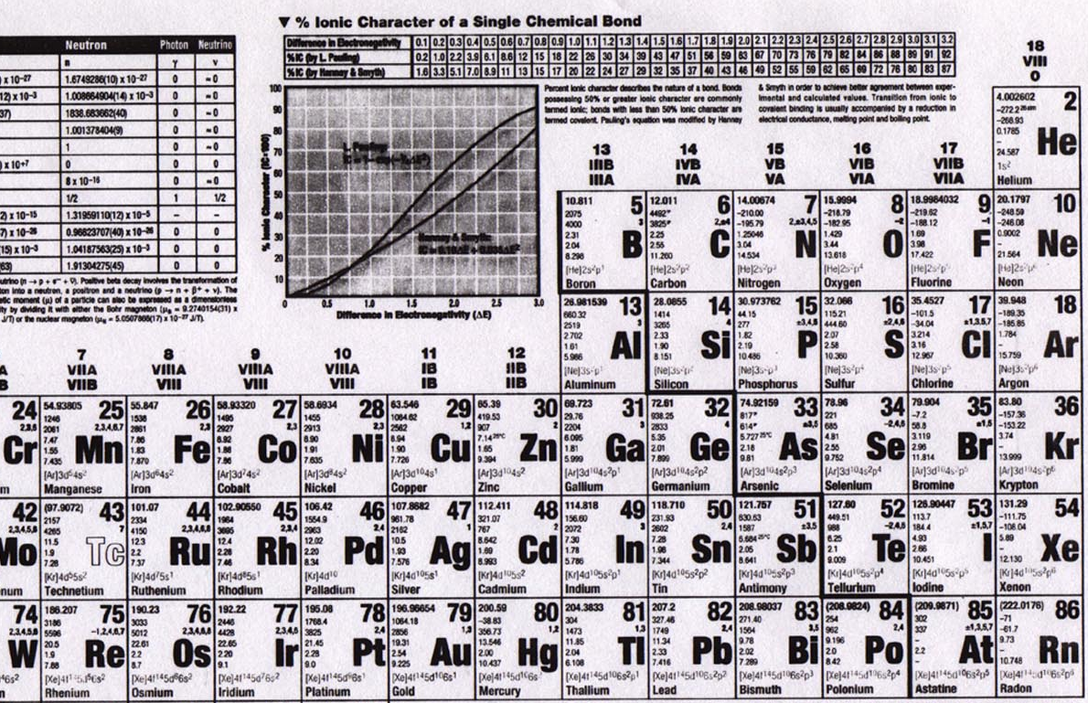
Elements

Slide 3
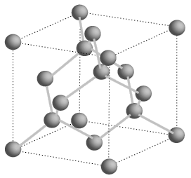
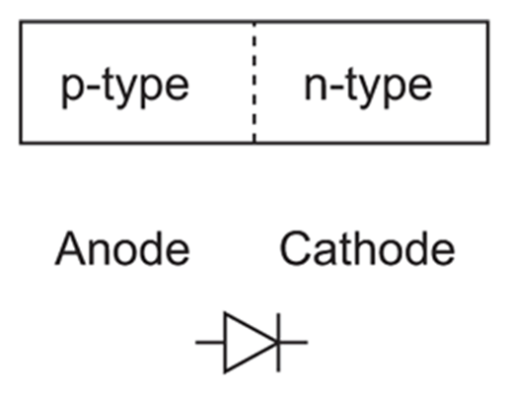
Semiconductors
Silicon is a group IV element (4 valence electrons, shells: 2, 8, 18, 32…)
Forms covalent bonds with four neighbor atoms (3D cubic crystal lattice)
Si is a poor conductor, but conduction characteristics may be altered
Add impurities/dopants (replaces silicon atom in lattice):
Makes a better conductor
Group V element (phosphorus/arsenic) => 5 valence electrons
Leaves an electron free => n-type semiconductor (electrons, negative carriers)
Group III element (boron) => 3 valence electrons
Borrows an electron from neighbor => p-type semiconductor (holes, positive carriers)
+
-
-
+
+ + +
+ + +
+ + +
+ + +
- - -
- - -
- - -
- - -
P-N junction
forward bias
reverse bias
Spacing=543 pm

Slide 4
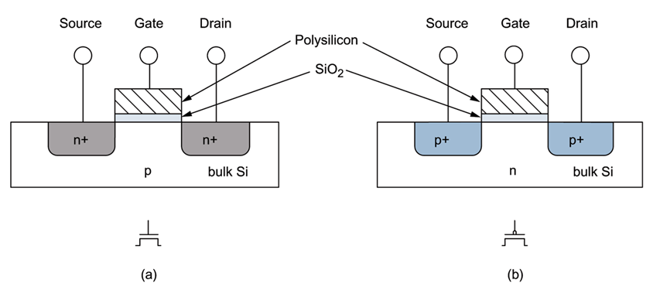
MOSFETs
negative voltage (rel. to body) (GND)
positive voltage (Vdd)
NMOS/NFET
+ + +
- - -
PMOS/PFET
current
- - -
+ + +
current
body/bulk
GROUND
channel
shorter length, faster transistor (dist. for electrons)
body/bulk
HIGH
(S/D to body is reverse-biased)
Metal-poly-Oxide-Semiconductor structures built onto substrate
Diffusion: Inject dopants into substrate
Oxidation: Form layer of SiO2 (glass)
Deposition and etching: Add aluminum/copper wires

Slide 5
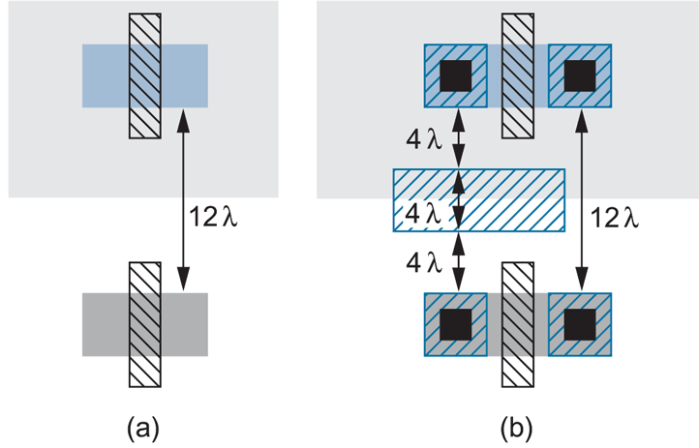
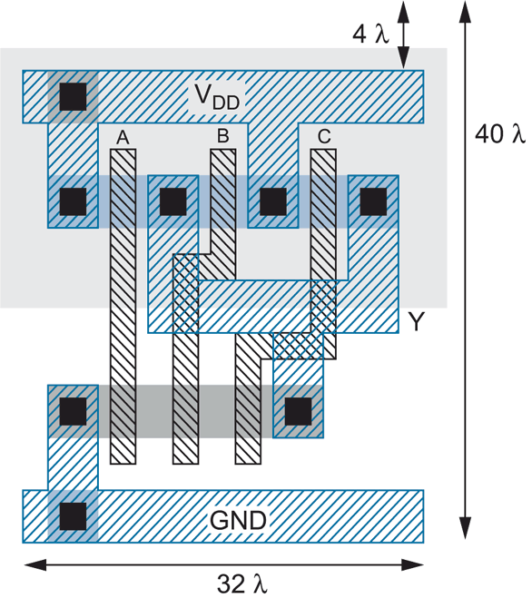
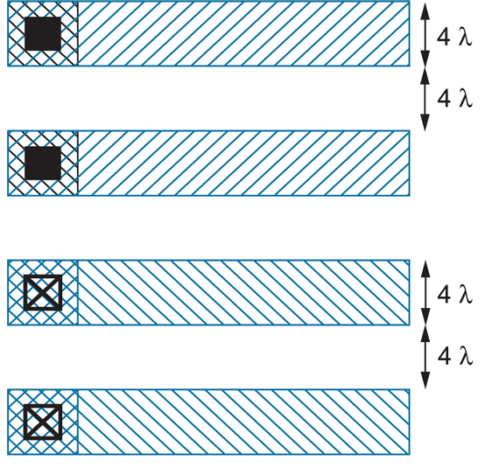
Layout
3-input NAND

Slide 6
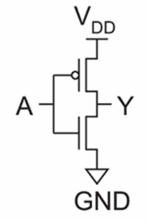
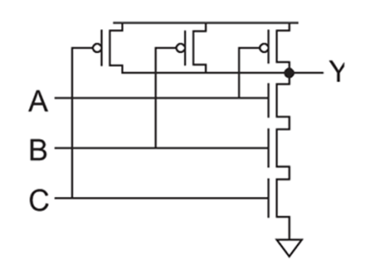
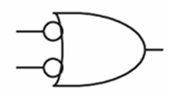
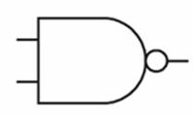
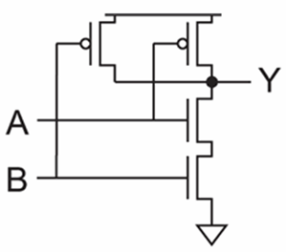
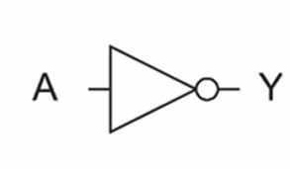
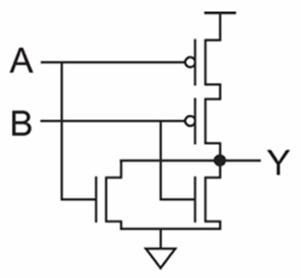
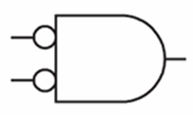
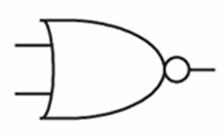
Logic Gates
inv
NAND2
NAND3
NOR2

Slide 7
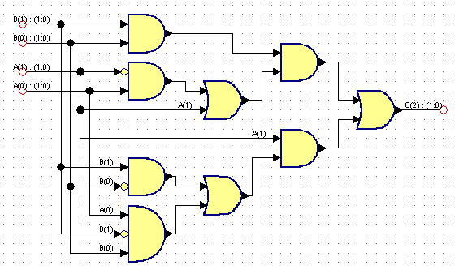
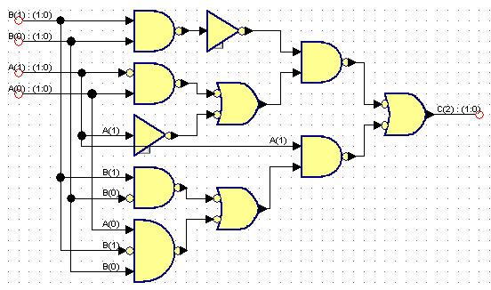
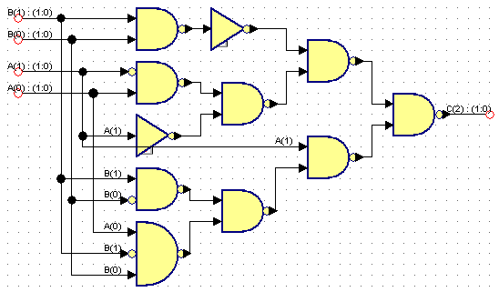
Logic Synthesis
Behavior:
S = A + B
Assume A is 2 bits, B is 2 bits, C is 3 bits
A | B | C
00 (0) | 00 (0) | 000 (0)
00 (0) | 01 (1) | 001 (1)
00 (0) | 10 (2) | 010 (2)
00 (0) | 11 (3) | 011 (3)
01 (1) | 00 (0) | 001 (1)
01 (1) | 01 (1) | 010 (2)
01 (1) | 10 (2) | 011 (3)
01 (1) | 11 (3) | 100 (4)
10 (2) | 00 (0) | 010 (2)
10 (2) | 01 (1) | 011 (3)
10 (2) | 10 (2) | 100 (4)
10 (2) | 11 (3) | 101 (5)
11 (3) | 00 (0) | 011 (3)
11 (3) | 01 (1) | 100 (4)
11 (3) | 10 (2) | 101 (5)
11 (3) | 11 (3) | 110 (6)

Slide 8
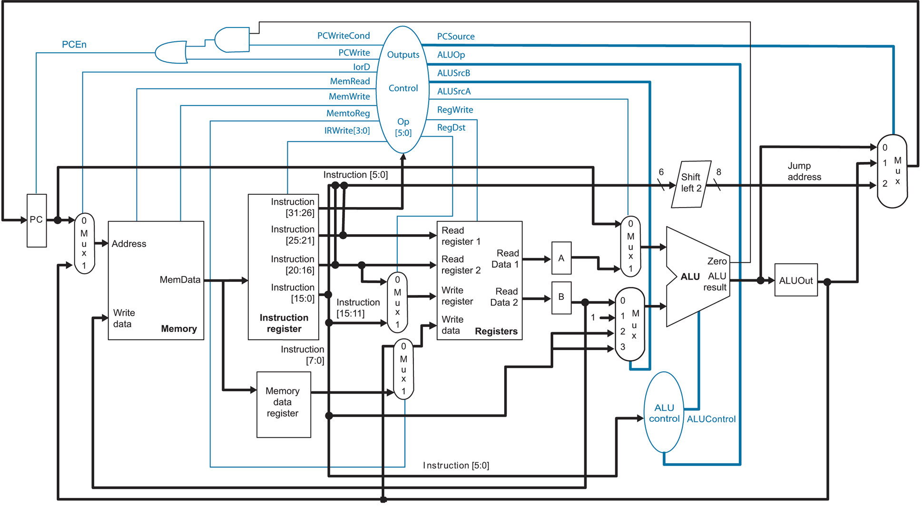
MIPS Microarchitecture

Slide 9
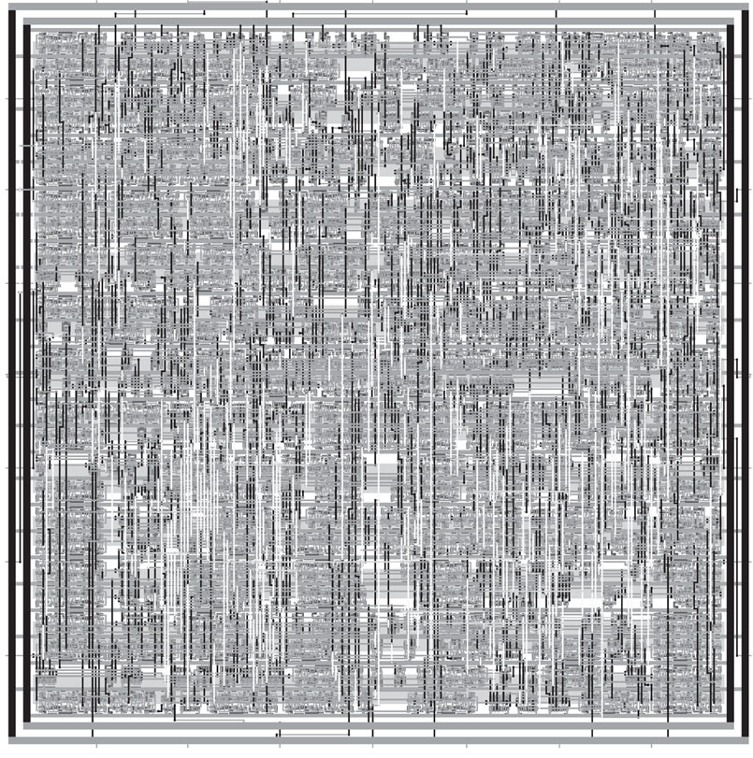
Synthesized and P&R’ed MIPS Architecture

Slide 10
Feature Size
Shrink minimum feature size…
Smaller L decreases carrier time and increases current
Therefore, W may also be reduced for fixed current
C_{g}, C_{s}, and C_{d} are reduced
Transistor switches faster (~linear relationship)

Slide 11
Minimum Feature Size
Year | Processor | Speed | Transistors | Process
1982 | i286 | 6 - 25 MHz | ~134,000 | 1.5 μm
1986 | i386 | 16 – 40 MHz | ~270,000 | 1 μm
1989 | i486 | 16 - 133 MHz | ~1 million | .8 μm
1993 | Pentium | 60 - 300 MHz | ~3 million | .6 μm
1995 | Pentium Pro | 150 - 200 MHz | ~4 million | .5 μm
1997 | Pentium II | 233 - 450 MHz | ~5 million | .35 μm
1999 | Pentium III | 450 – 1400 MHz | ~10 million | .25 μm
2000 | Pentium 4 | 1.3 – 3.8 GHz | ~50 million | .18 μm
2005 | Pentium D | 2 cores/package | ~200 million | .09 μm
2006 | Core 2 | 2 cores/die | ~300 million | .065 μm
2008 | Core i7 | 4 cores/die | ~800 million | .045 μm
2010 | “Sandy Bridge” | 8 cores/die | ?? | .032 μm

Slide 12
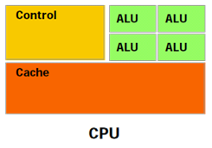
Real Estate

Slide 13
Heterogeneous Computing: Execution Model
instructions executed over time
49% of code
initialization
0.5% of run time
co-processor
“hot” loop
99% of run time
1% of code
49% of code
clean up
0.5% of run time

Slide 14
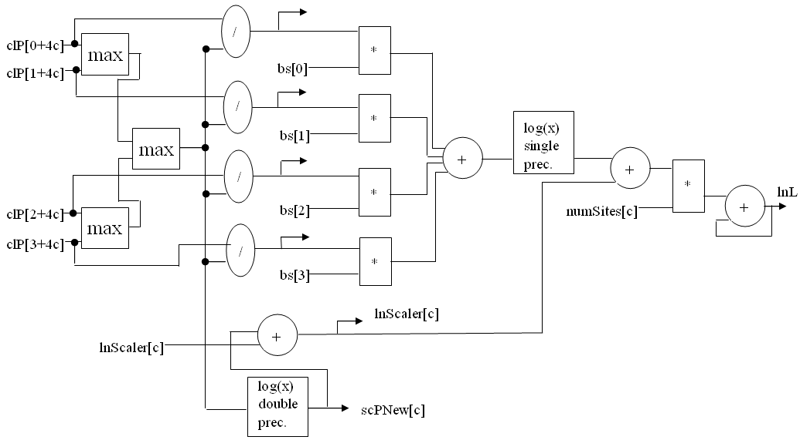
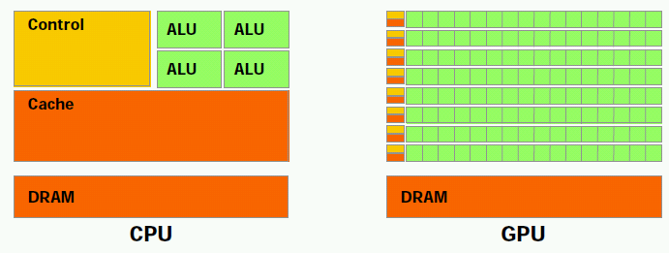
Co-Processor Design
FPGA design:

Slide 15
HC Execution Model
Host Memory
CPU
QPI
PCIe
On board
Memory
X58
Co-processor
~25 GB/s
~25 GB/s
~8 GB/s (x16)
?????
~100 GB/s for GeForce 260
host
add-in card
In general, co-processor can achieve 10x – 1000x computational throughput vs. CPU
Pay penaly for transferring memory between host memory and on-board memory
Add-in card can have arbitrary amount of memory bandwidth (use proprietray memory interface)

Slide 16
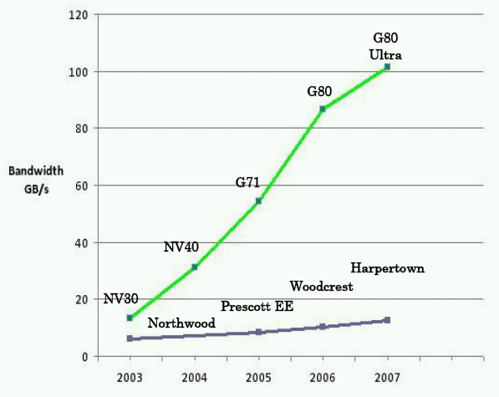
HC Execution Model

Slide 17
Heterogeneous Computing: Performance
Example:
Application requires a week of CPU time
One computation consumes 99% of execution time
Kernel speedup | Application speedup | Execution time
50 | 34 | 5.0 hours
100 | 50 | 3.3 hours
200 | 67 | 2.5 hours
500 | 83 | 2.0 hours
1000 | 91 | 1.8 hours

Slide 18
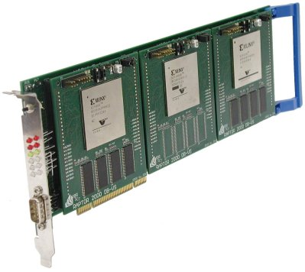
Heterogeneous Computing with FPGAs

Slide 19
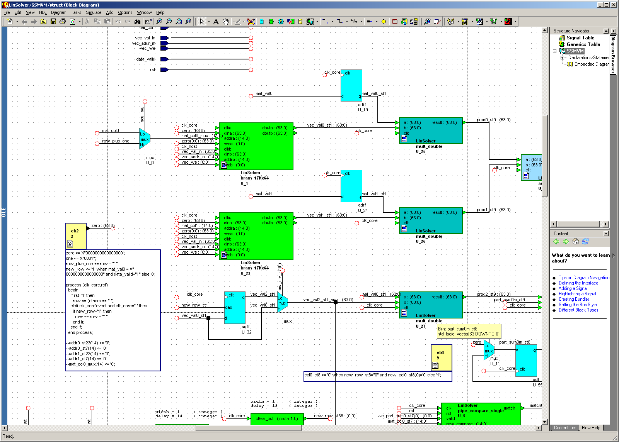
Programming FPGAs

Slide 20
Heterogeneous Computing with GPUs
Graphics Processor Unit (GPU)
Contains hundreds of small processor cores grouped hierarchically
Has high bandwidth to on-board memory and to host memory
Became “programmable” about two years ago
Gained hardware double precision about one year ago
Examples: IBM Cell, nVidia GeForce, AMD FireStream
Advantage over FPGAs:
Easier to program
Less expensive (gamers drove high volumes, decreasing cost)
Drawbacks:
Can’t necessarily outperform FPGAs for all types of computations
Characterizing this is an open research problem

Slide 21
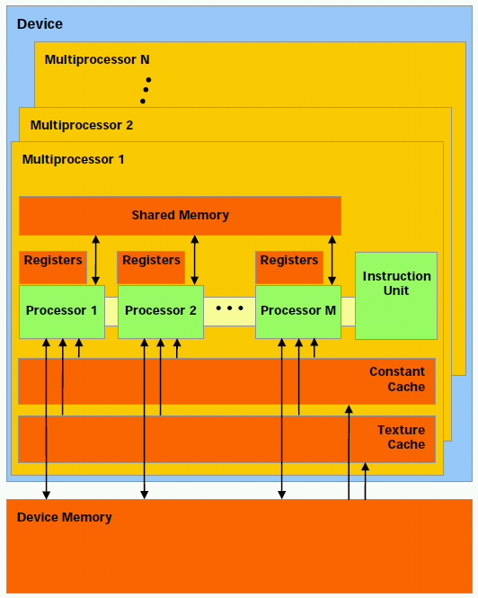
NVIDIA GPU Architecture

Slide 22
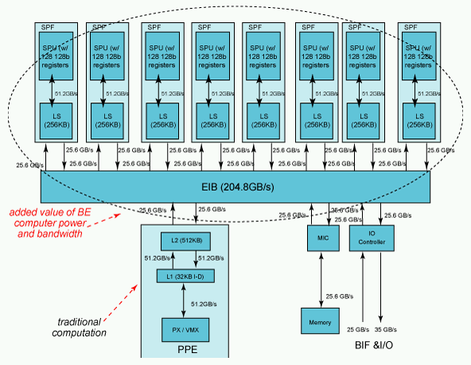
IBM Cell Architecture

Slide 23
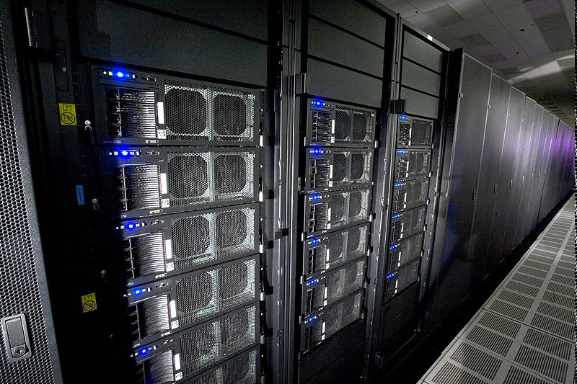
Heterogeneous Computing now Mainstream: IBM Roadrunner
Los Alamos, fastest computer in the world
6,480 AMD Opteron (dual core) CPUs
12,960 PowerXCell 8i GPUs
Each blade contains 2 Operons and 4 Cells
296 racks
1.71 petaflops peak (1.7 billion million fp operations per second)
2.35 MW (not including cooling)
Lake Murray hydroelectric plant produces ~150 MW (peak)
Lake Murray coal plant (McMeekin Station) produces ~300 MW (peak)
Catawba Nuclear Station near Rock Hill produces 2258 MW

Slide 24
Our Group
Past projects:
Custom FPGA accelerators and components:
computational biology
linear algebra
Multi-FPGA interconnection networks:
interface abstractions
adaptive routing algorithms
on-chip router designs
Current projects:
Design tools
Dynamic code analysis
Semi-automatic accelerator generation
GPU simulation and emulation for code tuning

