Slide 1
Trends in the Infrastructure of Computing: Processing, Storage, Bandwidth
CSCE 190: Computing in the Modern World
Dr. Jason D. Bakos

Slide 2
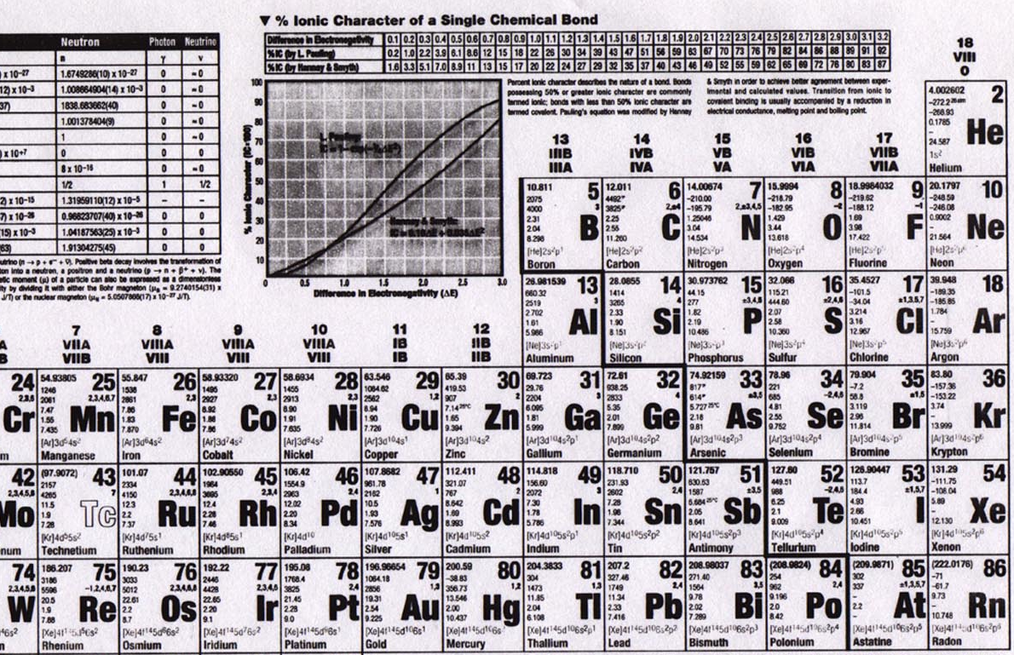
Elements

Slide 3
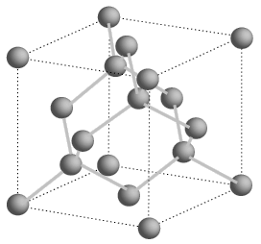
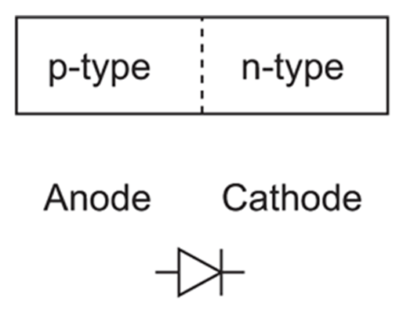
Semiconductors
Silicon is a group IV element (4 valence electrons, shells: 2, 8, 18, 32…)
Forms covalent bonds with four neighbor atoms (3D cubic crystal lattice)
Si is a poor conductor, but conduction characteristics may be altered
Add impurities/dopants (replaces silicon atom in lattice):
Makes a better conductor
Group V element (phosphorus/arsenic) => 5 valence electrons
Leaves an electron free => n-type semiconductor (electrons, negative carriers)
Group III element (boron) => 3 valence electrons
Borrows an electron from neighbor => p-type semiconductor (holes, positive carriers)
+
-
-
+
+ + +
+ + +
+ + +
+ + +
- - -
- - -
- - -
- - -
P-N junction
forward bias
reverse bias
Spacing=543 pm

Slide 4
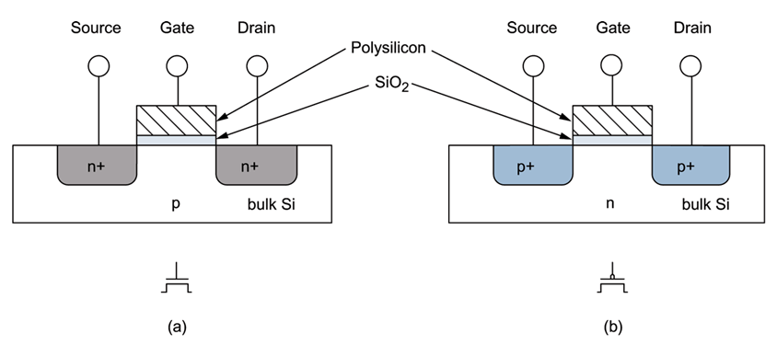
MOSFETs
negative voltage (rel. to body) (GND)
positive voltage (Vdd)
NMOS/NFET
+ + +
- - -
PMOS/PFET
current
- - -
+ + +
current
body/bulk
GROUND
channel
shorter length, faster transistor (dist. for electrons)
body/bulk
HIGH
(S/D to body is reverse-biased)
Metal-poly-Oxide-Semiconductor structures built onto substrate
Diffusion: Inject dopants into substrate
Oxidation: Form layer of SiO2 (glass)
Deposition and etching: Add aluminum/copper wires

Slide 5
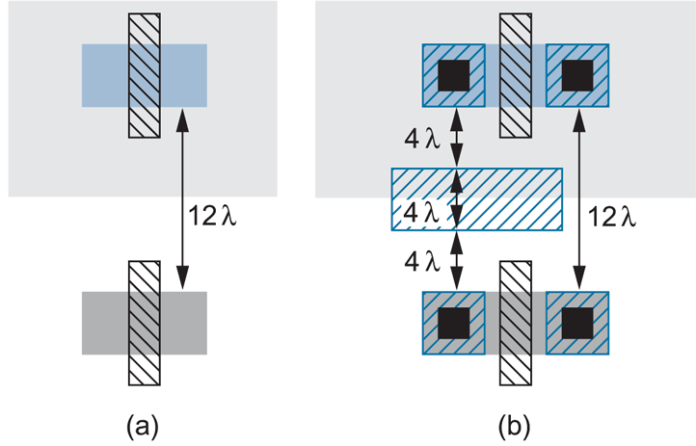
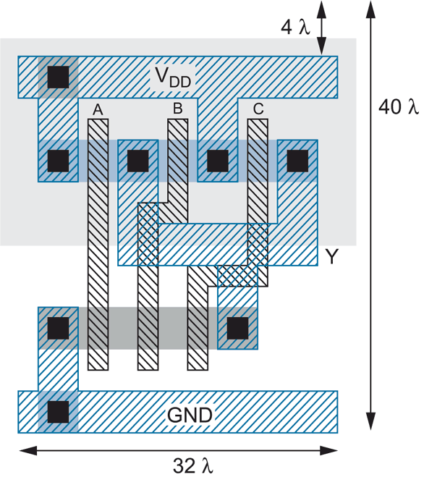
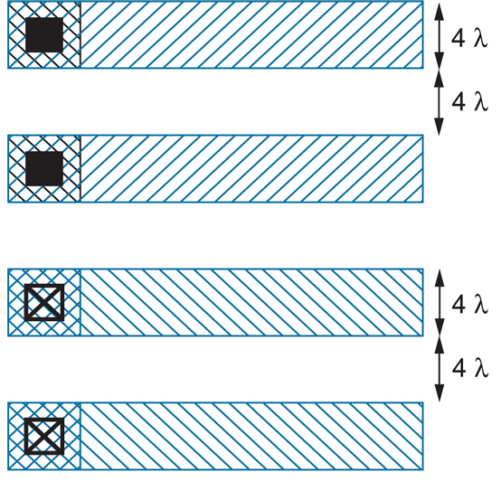
Layout
3-input NAND

Slide 6
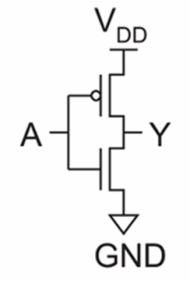
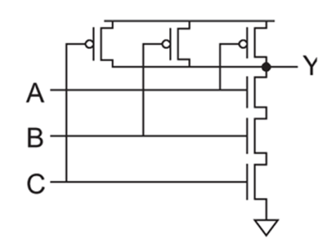
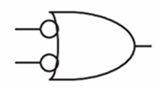
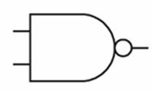
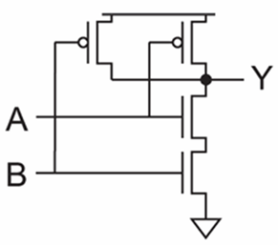
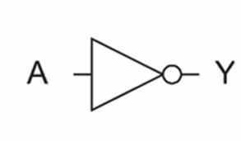
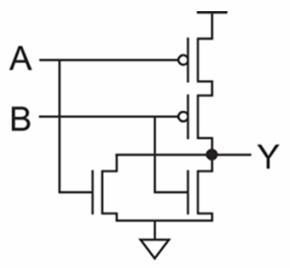
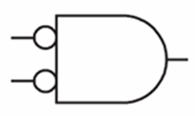
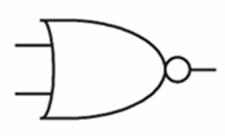
Logic Gates
inv
NAND2
NAND3
NOR2

Slide 7
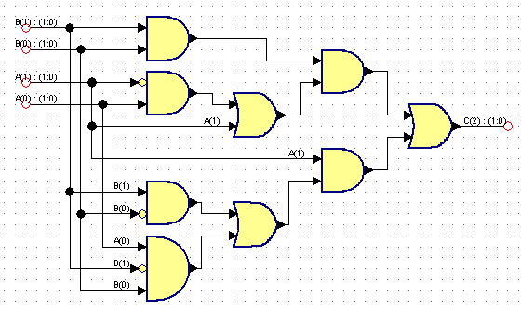
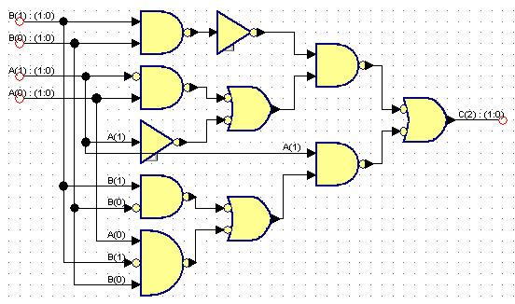
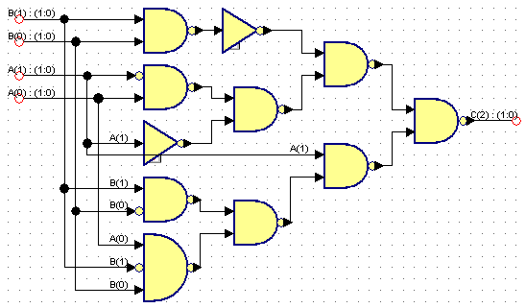
Logic Synthesis
Behavior:
S = A + B
Assume A is 2 bits, B is 2 bits, C is 3 bits
A | B | C
00 (0) | 00 (0) | 000 (0)
00 (0) | 01 (1) | 001 (1)
00 (0) | 10 (2) | 010 (2)
00 (0) | 11 (3) | 011 (3)
01 (1) | 00 (0) | 001 (1)
01 (1) | 01 (1) | 010 (2)
01 (1) | 10 (2) | 011 (3)
01 (1) | 11 (3) | 100 (4)
10 (2) | 00 (0) | 010 (2)
10 (2) | 01 (1) | 011 (3)
10 (2) | 10 (2) | 100 (4)
10 (2) | 11 (3) | 101 (5)
11 (3) | 00 (0) | 011 (3)
11 (3) | 01 (1) | 100 (4)
11 (3) | 10 (2) | 101 (5)
11 (3) | 11 (3) | 110 (6)

Slide 8
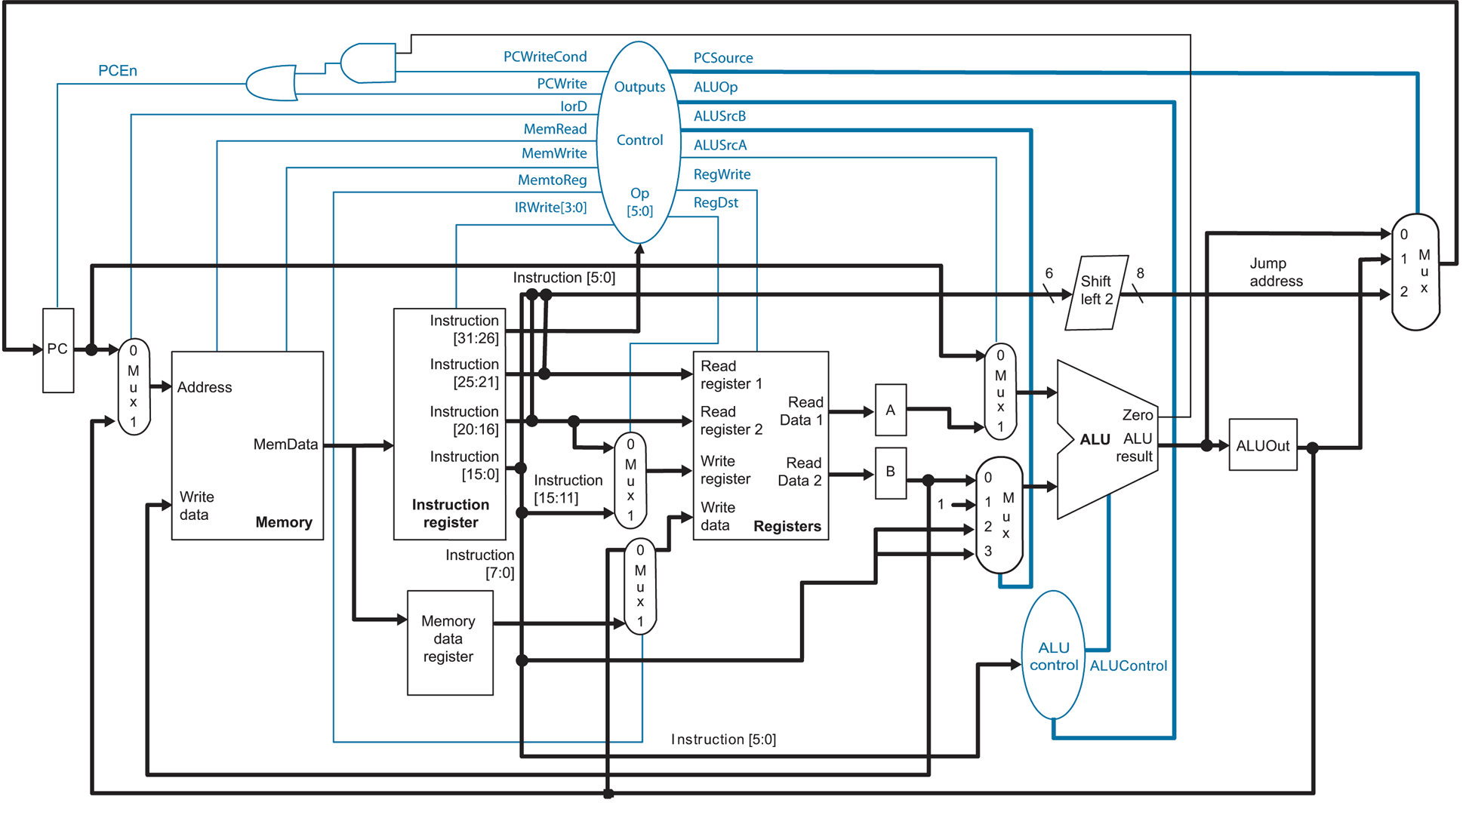
Microarchitecture

Slide 9
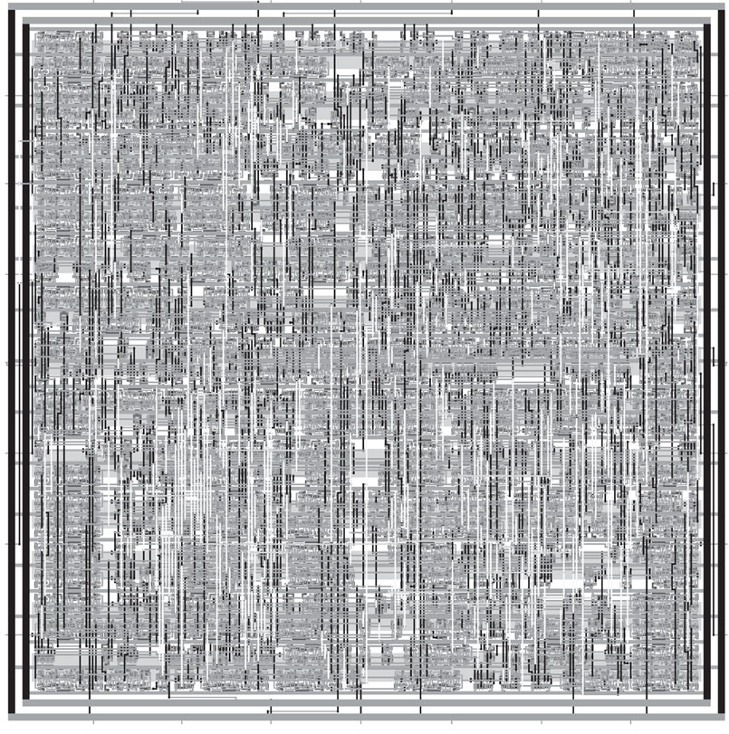
Synthesized and P&R’ed MIPS Architecture

Slide 10
Feature Size
Shrink minimum feature size…
Smaller L decreases carrier time and increases current
Therefore, W may also be reduced for fixed current
C_{g}, C_{s}, and C_{d} are reduced
Transistor switches faster (~linear relationship)

Slide 11
Minimum Feature Size
Year | Processor | Speed | Transistor Size | Transistors
1982 | i286 | 6 - 25 MHz | 1.5 μm | ~134,000
1986 | i386 | 16 – 40 MHz | 1 μm | ~270,000
1989 | i486 | 16 - 133 MHz | .8 μm | ~1 million
1993 | Pentium | 60 - 300 MHz | .6 μm | ~3 million
1995 | Pentium Pro | 150 - 200 MHz | .5 μm | ~4 million
1997 | Pentium II | 233 - 450 MHz | .35 μm | ~5 million
1999 | Pentium III | 450 – 1400 MHz | .25 μm | ~10 million
2000 | Pentium 4 | 1.3 – 3.8 GHz | .18 μm | ~50 million
2005 | Pentium D | 2 threads/package | .09 μm | ~200 million
2006 | Core 2 | 2 threads/die | .065 μm | ~300 million
2008 | Core i7 “Nehalem” | 8 threads/die | .045 μm | ~800 million
2011 | “Sandy Bridge” | 16 threads/die | .032 μm | ~1.2 billion
Year | Processor | Speed | Transistor Size | Transistors
2008 | NVIDIA Tesla | 240 threads/die | .065 μm | 1.4 billion
2010 | NVIDIA Fermi | 512 threads/die | .040 μm | 3 billion

Slide 12
CPU Design
FOR i = 1 to 1000
C[i] = A[i] + B[i]
Core 1
Core 2
CPU
Control
ALU
ALU
Control
ALU
ALU
ALU
ALU
ALU
ALU
time
L1 cache
L1 cache
Copy part of A onto CPU
L2 cache
L2 cache
Copy part of B onto CPU
ADD
ADD
ADD
ADD
L3 cache
Copy part of C into Mem
Copy part of A onto CPU
Copy part of B onto CPU
ADD
ADD
ADD
ADD
Copy part of C into Mem
…

Slide 13
Co-Processor Design
FOR i = 1 to 1000
C[i] = A[i] + B[i]
GPU
cache
ALU
ALU
ALU
ALU
ALU
ALU
ALU
ALU
Core 1
cache
ALU
ALU
ALU
ALU
ALU
ALU
ALU
ALU
Core 2
cache
ALU
ALU
ALU
ALU
ALU
ALU
ALU
ALU
Core 3
cache
ALU
ALU
ALU
ALU
ALU
ALU
ALU
ALU
Core 4
cache
ALU
ALU
ALU
ALU
ALU
ALU
ALU
ALU
Core 5
cache
ALU
ALU
ALU
ALU
ALU
ALU
ALU
ALU
Core 6
cache
ALU
ALU
ALU
ALU
ALU
ALU
ALU
ALU
Core 7
cache
ALU
ALU
ALU
ALU
ALU
ALU
ALU
ALU
Core 8

Slide 14
Heterogeneous Computing
General purpose CPU + special-purpose processors in one system
System I/O controller
Host Memory
CPU
QPI
PCIe
On board
Memory
X58
Co-processor
~25 GB/s
~25 GB/s
~8 GB/s (x16)
?????
~150 GB/s for GeForce 260
host
add-in card

Slide 15
Heterogeneous Computing
Combine CPUs and coprocs
Example:
Application requires a week of CPU time
Offload computation consumes 99% of execution time
49% of code
initialization
0.5% of run time
“hot” loop
99% of run time
2% of code
Kernel speedup | Application speedup | Execution time
50 | 34 | 5.0 hours
100 | 50 | 3.3 hours
200 | 67 | 2.5 hours
500 | 83 | 2.0 hours
1000 | 91 | 1.8 hours
49% of code
clean up
0.5% of run time
co-processor

Slide 16
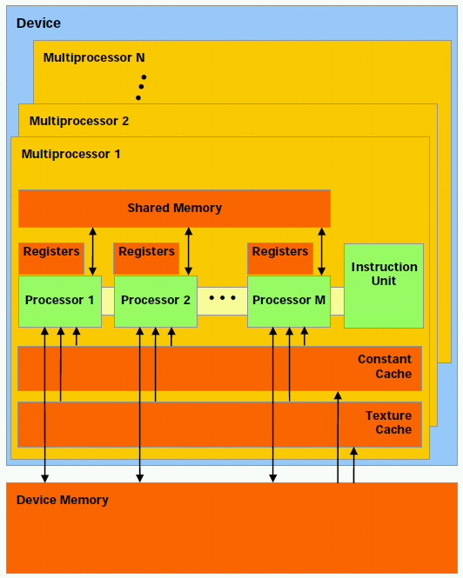
NVIDIA GPU Architecture
Hundreds of simple processor cores
Core design:
Only one instruction from each thread active in the pipeline at a time
In-order execution
No branch prediction
No speculative execution
No support for context switches
No system support (syscalls, etc.)
Small, simple caches
Programmer-managed on-chip scratch memory

Slide 17
Programming GPUs
HOST (CPU) code:
dim3 grid,block;
grid.x=((VECTOR_SIZE/512) + (VECTOR_SIZE%512?1:0));
block.x=512;
cudaMemcpy(a_device,a,VECTOR_SIZE * sizeof(double),cudaMemcpyHostToDevice);
cudaMemcpy(b_device,b,VECTOR_SIZE * sizeof(double),cudaMemcpyHostToDevice);
vector_add_device<<<grid,block>>>(a_device,b_device,c_device);
cudaMemcpy(c_gpu,c_device,VECTOR_SIZE * sizeof(double),cudaMemcpyDeviceToHost);
GPU code:
__global__ void vector_add_device (double *a,double *b,double *c) {
__shared__ double a_s,b_s,c_s;
a_s=a[blockIdx.x*blockDim.x+threadIdx.x];
b_s=b[blockIdx.x*blockDim.x+threadIdx.x];
c_s=a_s+b_s;
c[blockIdx.x*blockDim.x+threadIdx.x]=c_s;
}

Slide 18
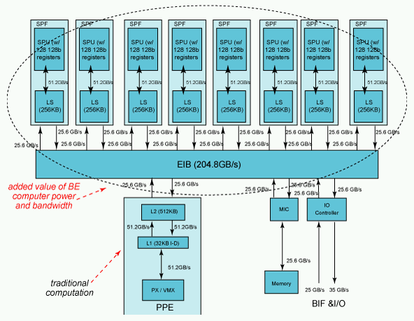
IBM Cell/B.E. Architecture
1 PPE, 8 SPEs
Programmer must manually manage 256K memory and threads invocation on each SPE
Each SPE includes a vector unit like the one on current Intel processors
128 bits wide

Slide 19
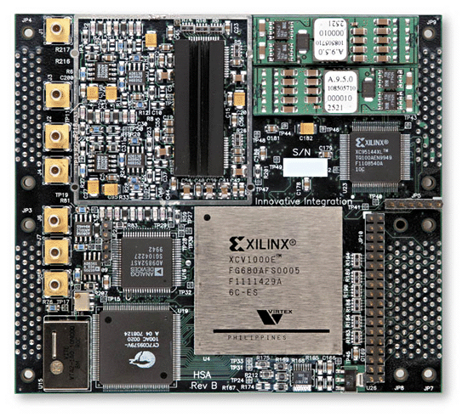
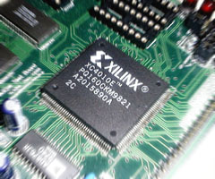
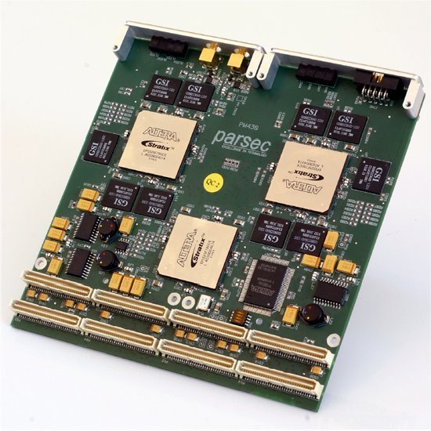
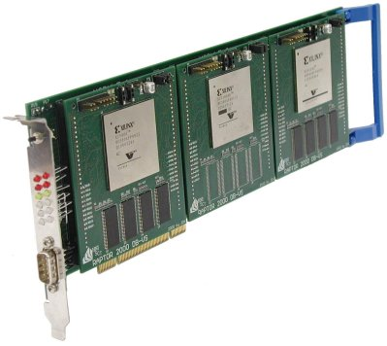
High-Performance Reconfigurable Computing
Heterogeneous computing with reconfigurable logic, i.e. FPGAs

Slide 20
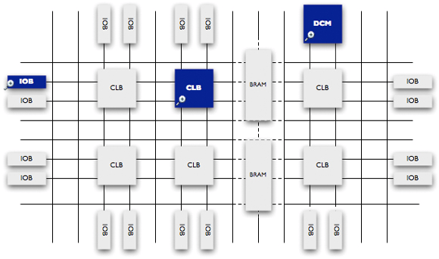
Field Programmable Gate Arrays

Slide 21
Heterogeneous Computing with FPGAs

Slide 22
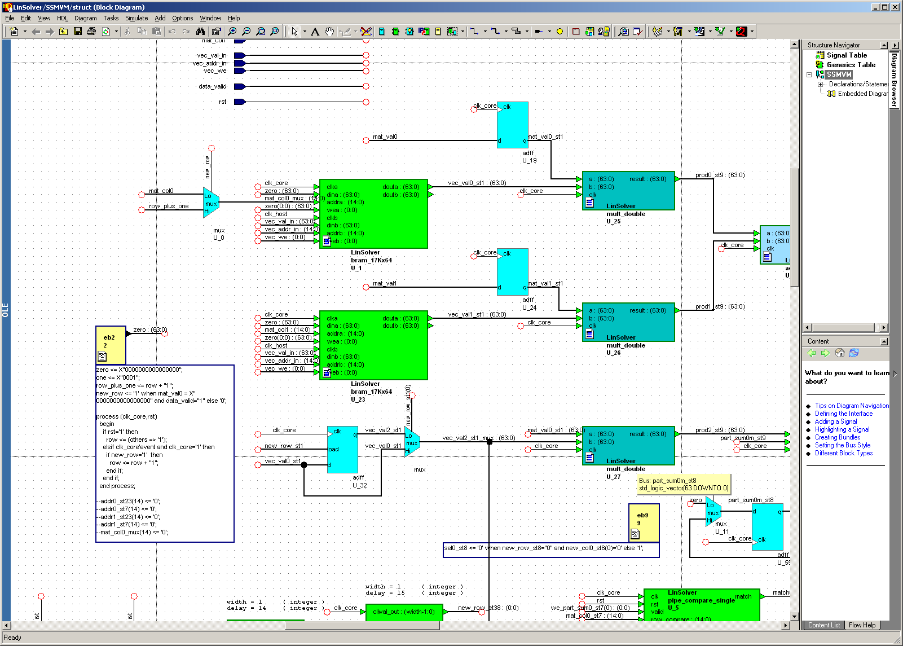
Programming FPGAs

Slide 23
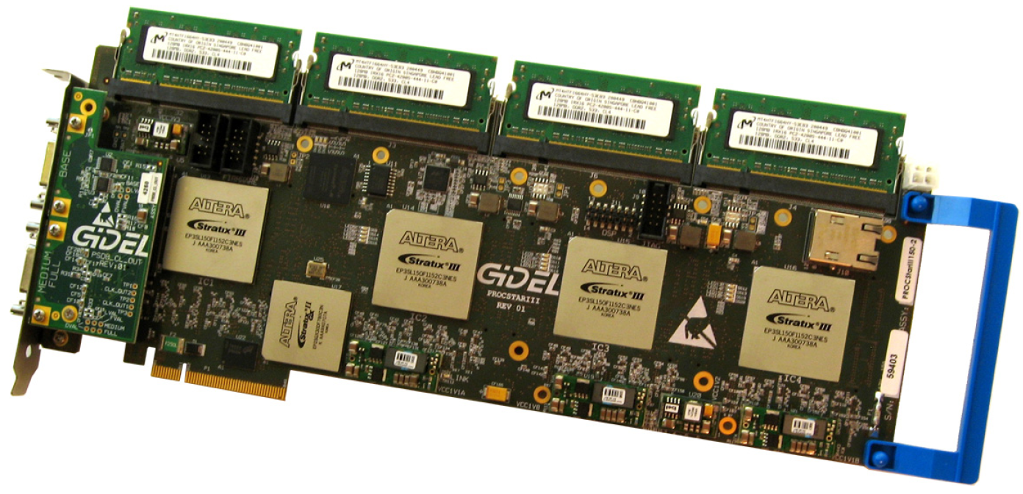
Heterogeneous Computing with FPGAs
Annapolis Micro Systems
WILDSTAR 2 PRO
GiDEL PROCSTAR III

Slide 24
Heterogeneous Computing with FPGAs
Convey HC-1

Slide 25
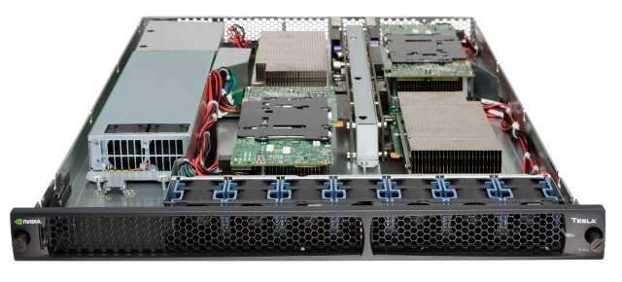
Heterogeneous Computing with GPUs
NVIDIA Tesla S1070

Slide 26
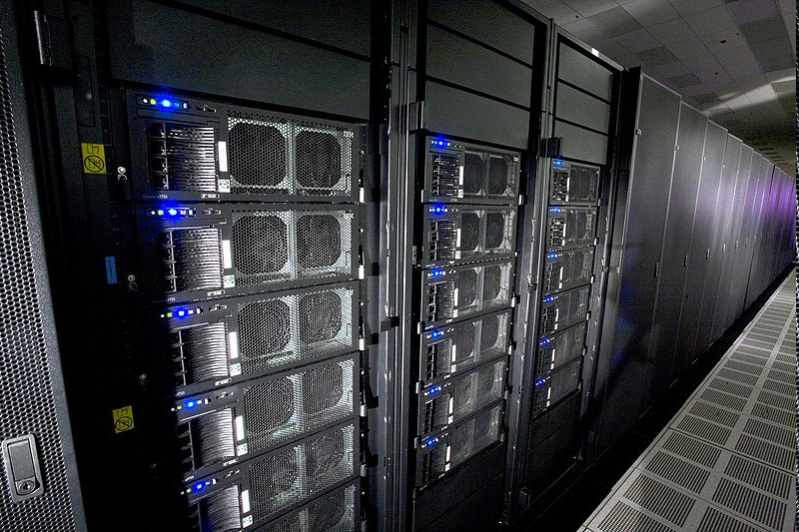
Heterogeneous Computing now Mainstream: IBM Roadrunner
Los Alamos, fastest computer in the world in 2008 (still in Top 10)
6,480 AMD Opteron (dual core) CPUs
12,960 PowerXCell 8i GPUs
Each blade contains 2 Operons and 4 Cells
296 racks
First ever petaflop machine (2008)
1.71 petaflops peak (1.7 billion million fp operations per second)
2.35 MW (not including cooling)
Lake Murray hydroelectric plant produces ~150 MW (peak)
Lake Murray coal plant (McMeekin Station) produces ~300 MW (peak)
Catawba Nuclear Station near Rock Hill produces 2258 MW

Slide 27
Conclusion
Even though integration levels continue to increase exponentially, processor makers still need to budget their real estate to target specific application targets
Use of heterogeneous computing is on the rise for both high performance computing and embedded computing

