Slide 1
Trends in the Infrastructure of Computing
CSCE 190: Computing in the Modern World
Dr. Jason D. Bakos

Slide 2
My Questions
How do computer processors work?
Why do computer processors get faster over time?
How much faster do they get?
What makes one processor faster than another?
What type of tradeoffs are involved in processor design?
Why is my cell phone so much slower than my laptop?
What is the relationship between processor performance and how programs are written?
Is this relationship dependent on the processor?

Slide 3
Talk Outline
Quick introduction to how computer processors work
The role of computer architects
CPU design philosophy and survey of state-of-the art CPU technology
Coprocessor design philosophy and survey of state-of-art coprocessor technology
Reconfigurable computing
Heterogeneous computing
Brief overview of my research

Slide 4
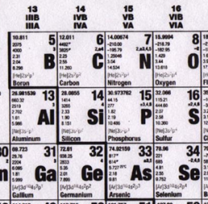
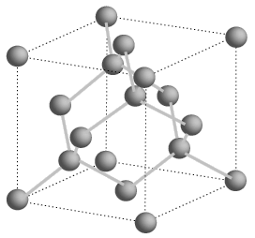
Semiconductors
Silicon is a group IV element
Forms covalent bonds with four neighbor atoms (3D cubic crystal lattice)
Si is a poor conductor, but conduction characteristics may be altered
Add impurities/dopants replaces silicon atom in lattice
Adds two different types of charge carriers
Spacing = .543 nm

Slide 5
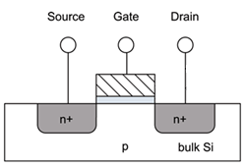
MOSFETs
Cut away side view
Metal-poly-Oxide-Semiconductor structures built onto substrate
Diffusion: Inject dopants into substrate
Oxidation: Form layer of SiO2 (glass)
Deposition and etching: Add aluminum/copper wires

Slide 6
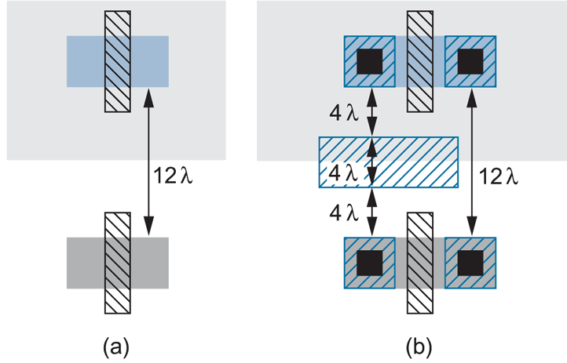
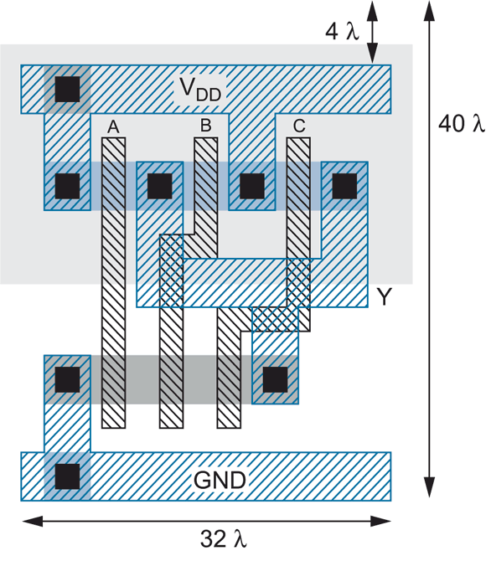
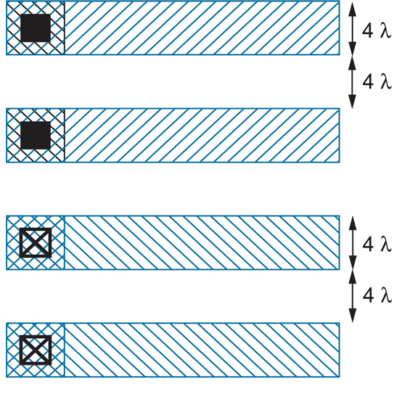
Layout
3-input NAND

Slide 7
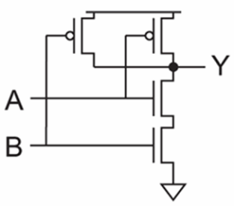
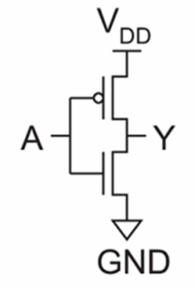
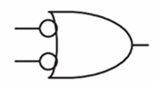
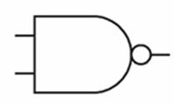
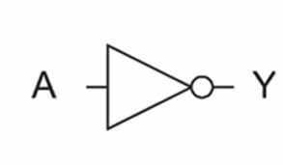
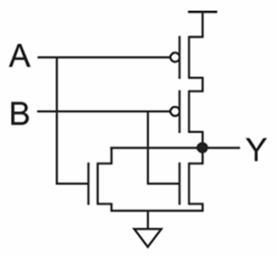
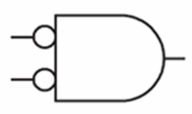
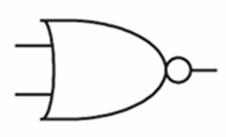
Logic Gates
inv
NAND2
NOR2

Slide 8
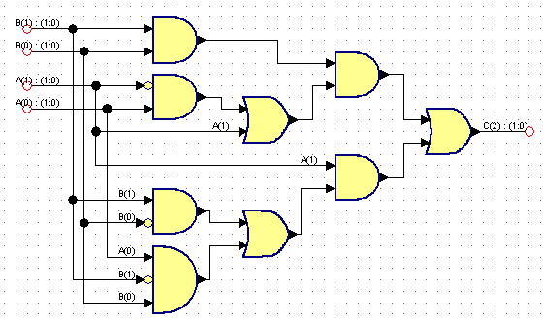
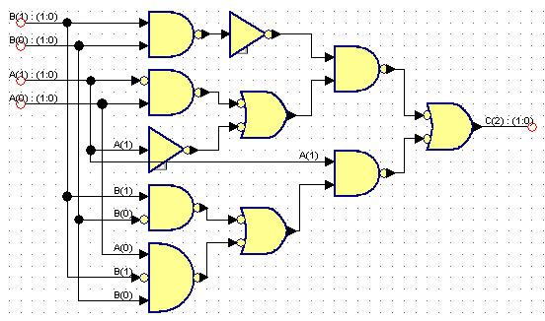
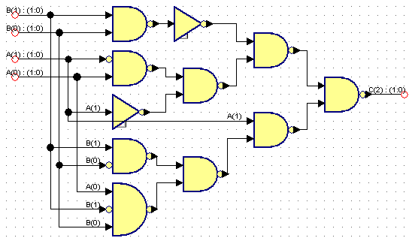
Logic Synthesis
Behavior:
S = A + B
Assume A is 2 bits, B is 2 bits, C is 3 bits
A | B | C
00 (0) | 00 (0) | 000 (0)
00 (0) | 01 (1) | 001 (1)
00 (0) | 10 (2) | 010 (2)
00 (0) | 11 (3) | 011 (3)
01 (1) | 00 (0) | 001 (1)
01 (1) | 01 (1) | 010 (2)
01 (1) | 10 (2) | 011 (3)
01 (1) | 11 (3) | 100 (4)
10 (2) | 00 (0) | 010 (2)
10 (2) | 01 (1) | 011 (3)
10 (2) | 10 (2) | 100 (4)
10 (2) | 11 (3) | 101 (5)
11 (3) | 00 (0) | 011 (3)
11 (3) | 01 (1) | 100 (4)
11 (3) | 10 (2) | 101 (5)
11 (3) | 11 (3) | 110 (6)

Slide 9
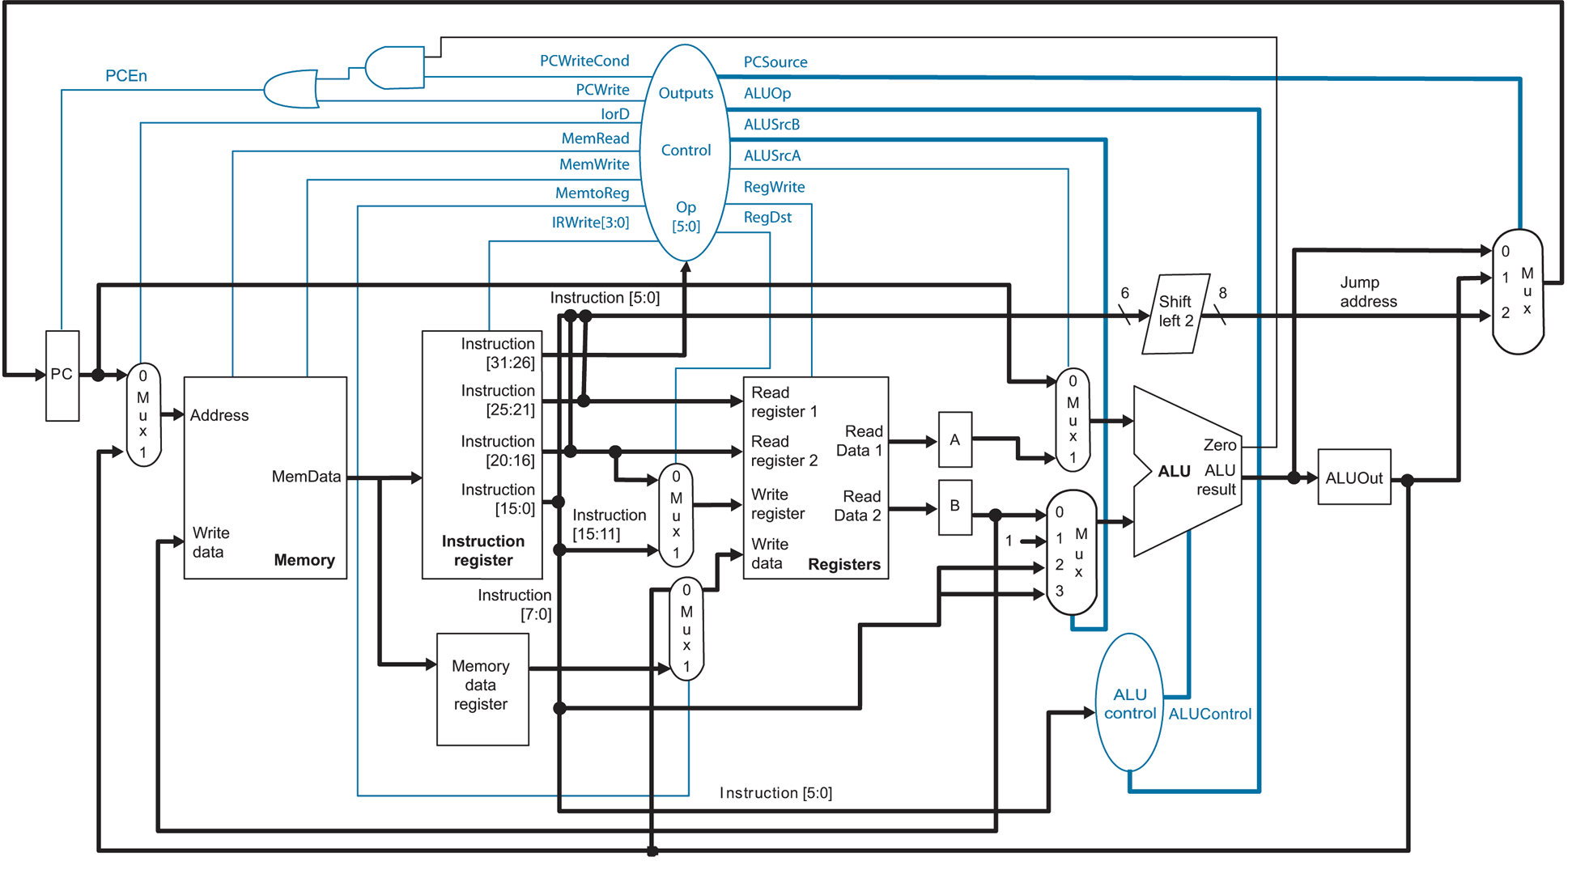
Microarchitecture

Slide 10
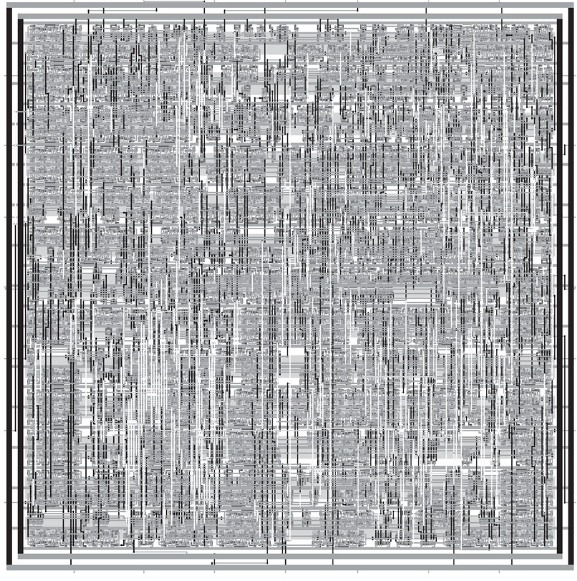
Synthesized and P&R’ed MIPS Architecture

Slide 11
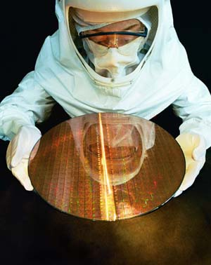
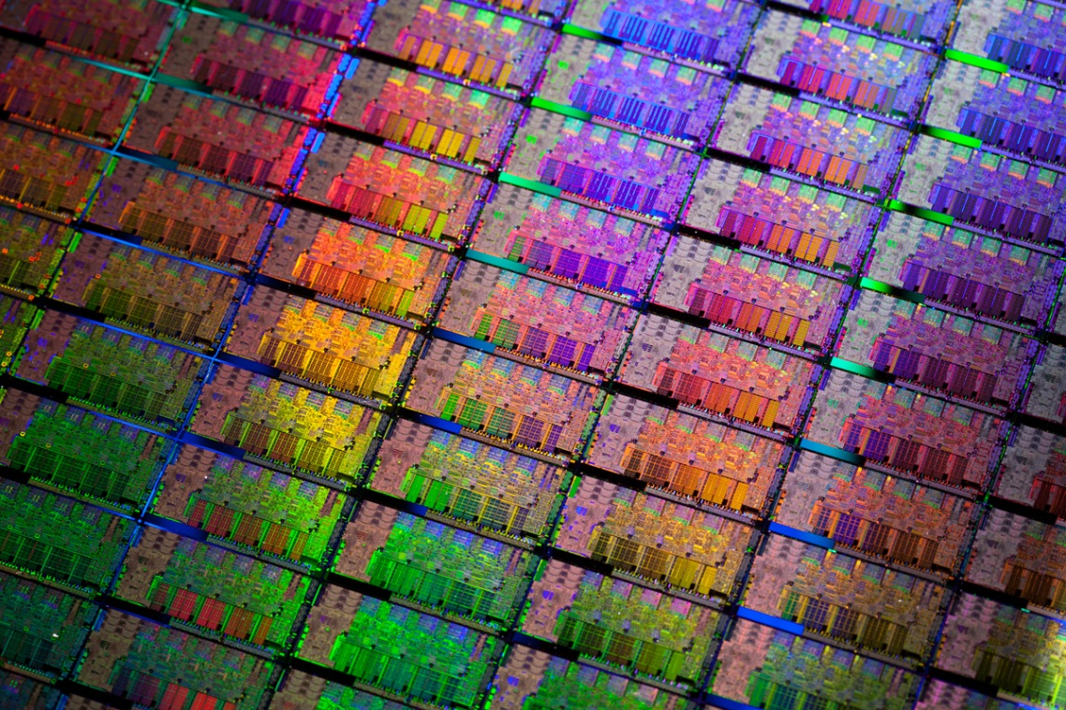
Si Wafer

Slide 12
Feature Size
Shrink minimum feature size…
Smaller L decreases carrier time and increases current
Therefore, W may also be reduced for fixed current
C_{g}, C_{s}, and C_{d} are reduced
Transistor switches faster (~linear relationship)

Slide 13
Minimum Feature Size
Year | Processor | Performance | Transistor Size | Transistors
1982 | i286 | 6 - 25 MHz | 1.5 μm | ~134,000
1986 | i386 | 16 – 40 MHz | 1 μm | ~270,000
1989 | i486 | 16 - 133 MHz | .8 μm | ~1 million
1993 | Pentium | 60 - 300 MHz | .6 μm | ~3 million
1995 | Pentium Pro | 150 - 200 MHz | .5 μm | ~4 million
1997 | Pentium II | 233 - 450 MHz | .35 μm | ~5 million
1999 | Pentium III | 450 – 1400 MHz | .25 μm | ~10 million
2000 | Pentium 4 | 1.3 – 3.8 GHz | .18 μm | ~50 million
2005 | Pentium D | 2 threads/package | .09 μm | ~200 million
2006 | Core 2 | 2 threads/die | .065 μm | ~300 million
2008 | “Nehalem” | 8 threads/die | .045 μm | ~800 million
2009 | “Westmere” | 8 threads/die | .045 μm | ~1 billion
2011 | “Sandy Bridge” | 12 threads/die | .032 μm | ~1.2 billion
2012 | “Ivy Bridge” | 16 threads/die | .022 μm | ~1.4 billion
Year | Processor | Speed | Transistor Size | Transistors
2008 | NVIDIA Tesla (GT200) | 240 threads/die | .065 μm | 1.4 billion
2010 | NVIDIA Fermi (GF110) | 512 threads/die | .040 μm | 3.0 billion
2012 | NVNDIA Kepler (GK104) | 1536 threads/die | .028 μm | 3.5 billion

Slide 14
The Role of Computer Architects
Given a blank slate (silicon substrate)
Budget: 2 billion transistors:
Transistors ⬄ Area
Choose your components:
Component | Cost
Control Logic and Cache
Cache | 50K transistors/1KB + 10K transistors/port
Out-of-order instruction scheduler and dispatch | 200K transistors/core
Speculative execution | 400K transistors/core
Branch predictor | 200K transistors/core
Functional Units
Integer and load/store units | 100K transistors/unit/core
Floating-point unit | 1M transistors/unit/core
Vector/SIMD floating-point unit | 100M transistors/64b width/unit/core
2 cm
2 cm
multiplier
adder

Slide 15
The Role of Computer Architects
Problem:
Cost of fabricating one chip: Hundreds of millions of dollars
Additional cost of fabricating hundreds of thousands of copies of same chip: FREE
Strategy for staying in business:
Sell LOTS of chips
How to sell many chips:
Make sure it works well for a wide range of applications (e.g. CPUs)
Maximize performance of each thread, target small number of threads
Works well for one application, but has a large market (e.g. GPUs, DSPs, smart phone processors, controllers for manufacturing)

Slide 16
CPU Design Philosophy
Processors consist of three main componets:
Control logic
Cache
Functional units
Premise:
Most code (non scientific) isn’t written to take advantage of multiple cores
Devote real estate budget to maximizing performance of each thread
Control logic: reorders operations within a thread, speculatively execution
Cache: reduces memory delays for different access patterns
CPUs do achieve higher performance when code is written to be multi-threaded
But CPUs quickly run out of functional units

Slide 17
CPU Design
FOR i = 1 to 1000
C[i] = A[i] + B[i]
Core 1
Core 2
CPU
Control
ALU
ALU
Control
ALU
ALU
ALU
ALU
ALU
ALU
Thread 1
Thread 2
time
L1 cache
L1 cache
Copy part of A onto CPU
L2 cache
L2 cache
Copy part of B onto CPU
ADD
ADD
ADD
ADD
L3 cache
Copy part of C into Mem
Copy part of A onto CPU
Copy part of B onto CPU
ADD
ADD
ADD
ADD
Copy part of C into Mem
…

Slide 18
Intel Sandy Bridge Architecture
Four cores, each core has 256-bit SIMD unit
Integrated GPU (IGU) with 12 execution units

Slide 19
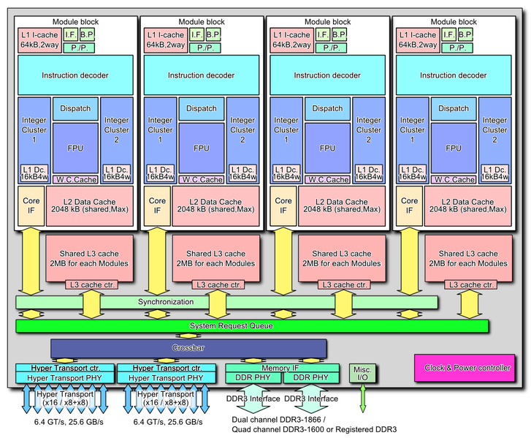
AMD Bulldozer Architecture
Next generation AMD architecture
Designed from scratch
Four cores, each core:
Executes 2 threads with dedicated logic
Contains two 128-bit FP multiply-add units
Decoupled L3 caches

Slide 20
Graphical Processor Units (GPUs)
Basic idea:
Originally designed for 3D graphics rendering
Success in gaming market
Devote real estate to computational resources
As opposed to control and caches to make naïve and general-purpose code run fast
Achieves very high performance but:
Extremely difficult to program
Program must be split into 1000s of threads
Only works well for specific types of programs
Lacks functionality to manage computer system resources
Now widely used for High Performance Computing (HPC)

Slide 21
Co-Processor (GPU) Design
FOR i = 1 to 1000
C[i] = A[i] + B[i]
GPU
cache
ALU
ALU
ALU
ALU
ALU
ALU
ALU
ALU
Core 1
threads
cache
ALU
ALU
ALU
ALU
ALU
ALU
ALU
ALU
Core 2
cache
ALU
ALU
ALU
ALU
ALU
ALU
ALU
ALU
Core 3
cache
ALU
ALU
ALU
ALU
ALU
ALU
ALU
ALU
Core 4
cache
ALU
ALU
ALU
ALU
ALU
ALU
ALU
ALU
Core 5
cache
ALU
ALU
ALU
ALU
ALU
ALU
ALU
ALU
Core 6
cache
ALU
ALU
ALU
ALU
ALU
ALU
ALU
ALU
Core 7
cache
ALU
ALU
ALU
ALU
ALU
ALU
ALU
ALU
Core 8
Thread
Thread
Thread
Thread
Thread
Thread
Thread
Thread
Thread
Thread
Thread
Thread
Thread
Thread
Thread
Thread

Slide 22
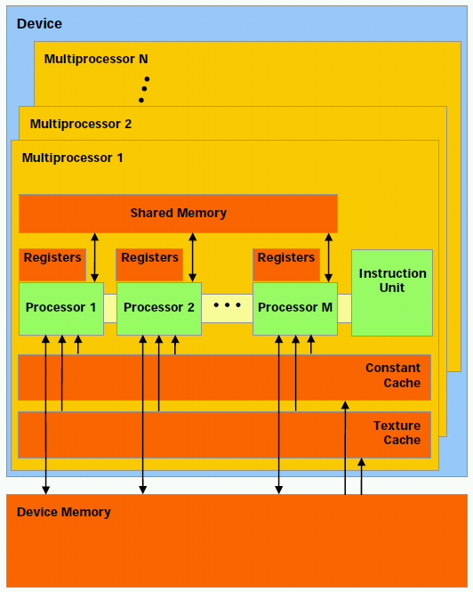
NVIDIA GPU Architecture
Hundreds of simple processor cores
Core design:
Executes each individual thread very slowly
Each thread can only perform one operation at a time
No operating system support
Able to execute 32 threads
Has 8 cores

Slide 23
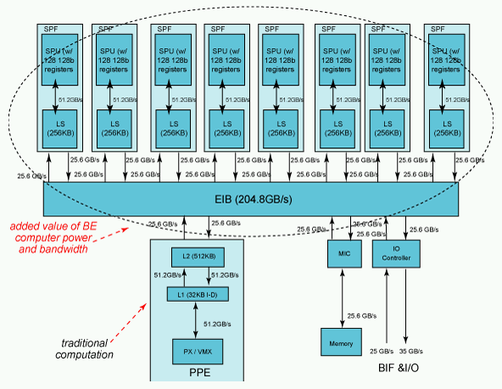
IBM Cell/B.E. Architecture
1 PPE, 8 SPEs
Programmer must manually manage 256K memory and threads invocation on each SPE
Each SPE includes a vector unit like the one on current Intel processors
128 bits wide (4 ops)

Slide 24
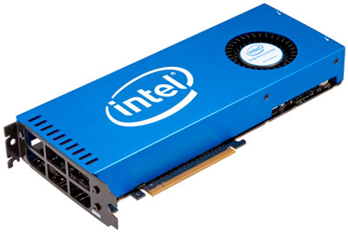
Intel Phi Coprocessor
PCIe coprocessor card
Used like a GPU
“Many Integrated Core”
32 x86 cores, 128 threads
512 bit SIMD units
Coherent cache among cores
2 GB onboard memory
Uses Intel ISA

Slide 25
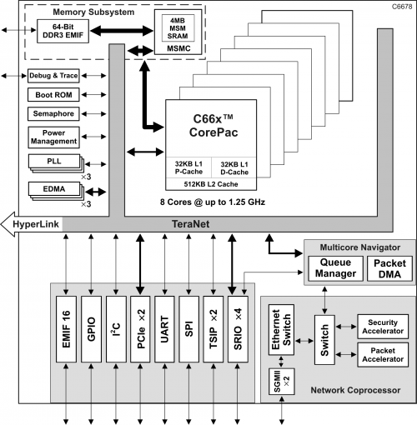
Texas Instruments C66x Architecture
Originally designed for signal processing
8 decoupled cores
No shared cache
Can do floating-point or fixed-point
Can do fixed-point much faster
Possible coprocessor for HPC
Less watts per FLOP

Slide 26
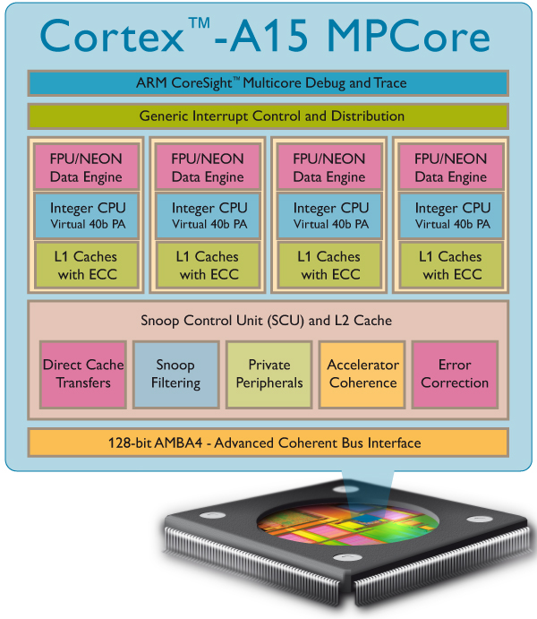
ARM Cortex-A15 Architecture
Originally designed for embedded (cell phone) computing
Out-of-order superscalar pipelines
4 cores per cluster, up to 2 clusters per chip
Possible coprocessor for HPC?
LOW POWER
FLOPS/watt

Slide 27
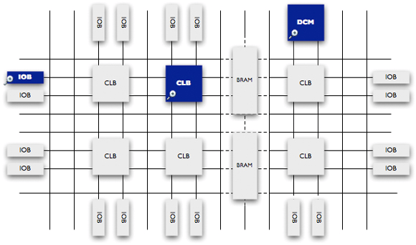
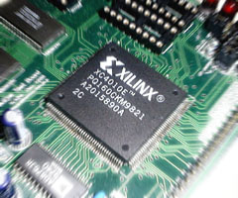
Field Programmable Gate Arrays
FPGAs are blank slates that can be electronically reconfigured
Allows for totally customized architectures
Drawbacks:
More difficult to program than GPUs
10X less logic density and clock speed

Slide 28
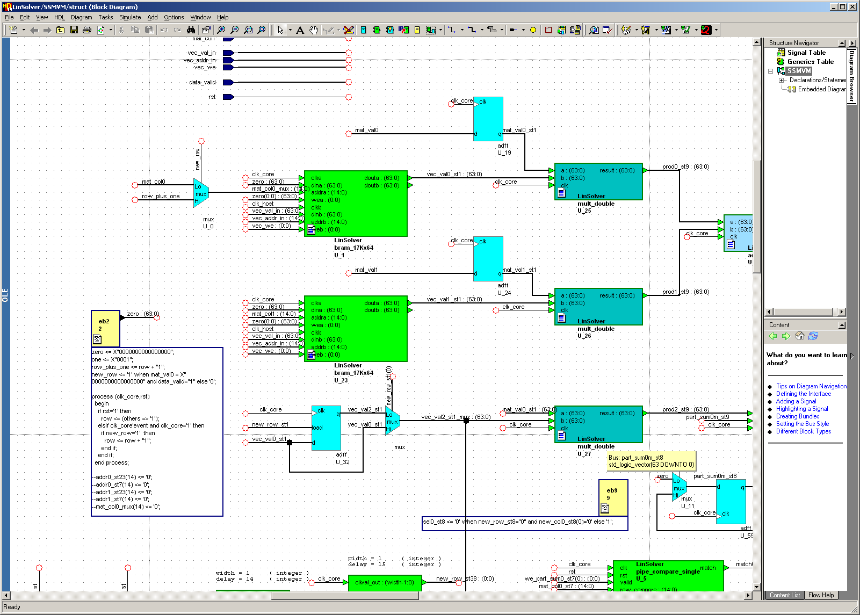
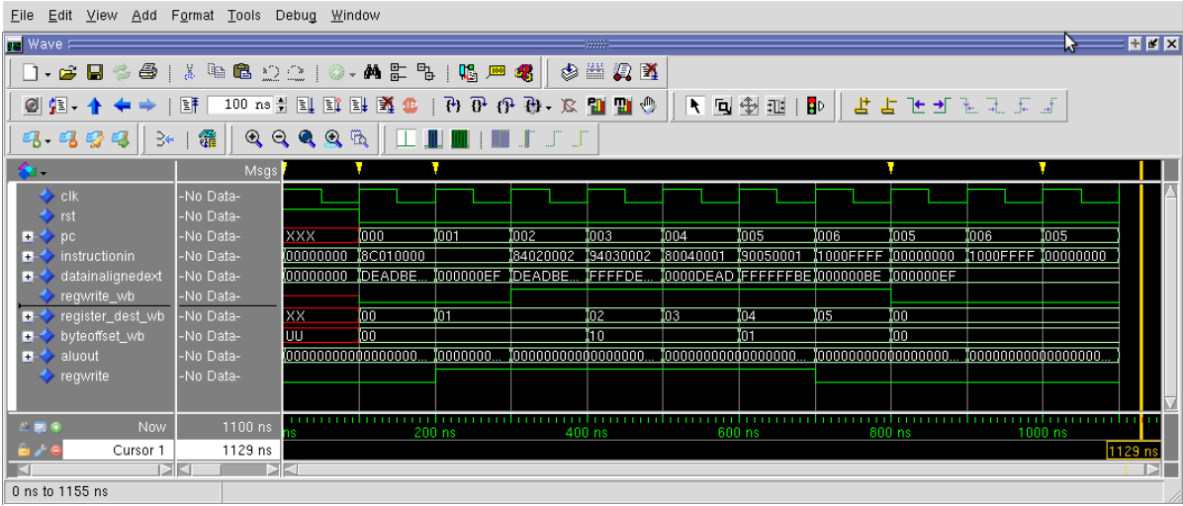
Programming FPGAs

Slide 29
Heterogeneous Computing
Combine CPUs and coprocs
Example:
Application requires a week of CPU time
Offload computation consumes 99% of execution time
49% of code
initialization
0.5% of run time
“hot” loop
99% of run time
2% of code
Kernel speedup | Application speedup | Execution time
50 | 34 | 5.0 hours
100 | 50 | 3.3 hours
200 | 67 | 2.5 hours
500 | 83 | 2.0 hours
1000 | 91 | 1.8 hours
49% of code
clean up
0.5% of run time
co-processor

Slide 30
Heterogeneous Computing
General purpose CPU + special-purpose processors in one system
Use coprocessors to execute code that they can execute fast!
Allow coprocessor to have its own high speed memory
Possible bottleneck!
Host Memory
CPU
QPI
PCIe
On board
Memory
X58
Co-processor
25 GB/s
25 GB/s
8 GB/s (x16)
150 GB/s
host
add-in card

Slide 31
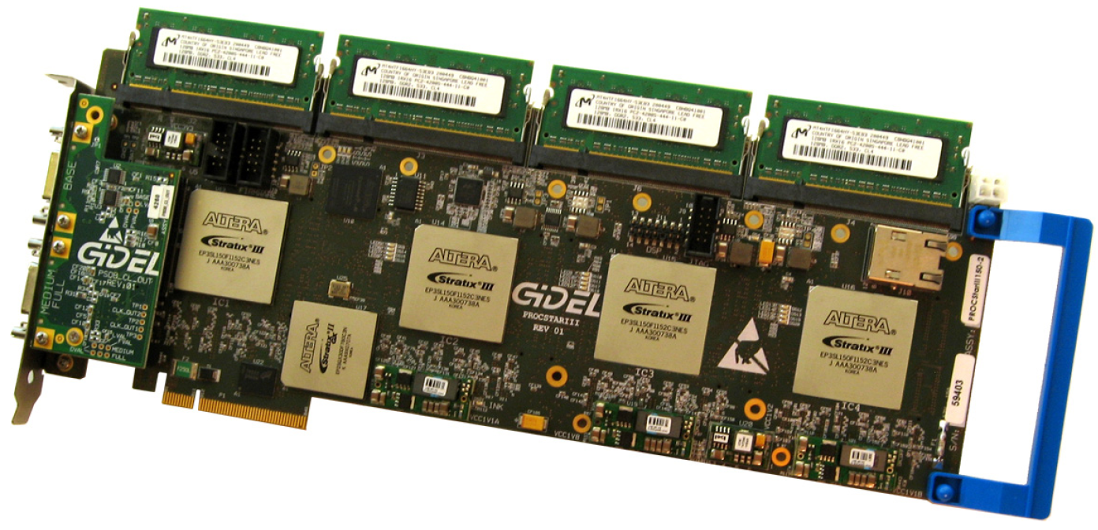
Heterogeneous Computing with FPGAs
Annapolis Micro Systems
WILDSTAR 2 PRO
GiDEL PROCSTAR III

Slide 32
Heterogeneous Computing with FPGAs
Convey HC-1

Slide 33
AMD Fusion Architecture
Integrate GPU-type coprocessor onto CPU
Put a small RADEON GPU onto the CPU
Allows to accelerate smaller programs than PCIe-connected coprocessor
Targeted for embedded but AMD hopes to scale to servers

Slide 34
My Research
Developed custom FPGA coprocessor architectures for:
Computational biology
Sparse linear algebra
Data mining
Written GPU optimized implementations for:
Computational biology
Logic synthesis
Data mining
General purpose graph traversals
Generally achieve 50X – 100X speedup over general-purpose CPUs

Slide 35
Current Research Goals
Develop high level synthesis (compilers) for specific types of FPGA-based computers
Based on:
Custom pipeline-based architectures
Multiprocessor soft-core systems on reconfigurable chips (MPSoC)
Develop code tuning tools for GPU code based on runtime profiling analysis

