Slide 1
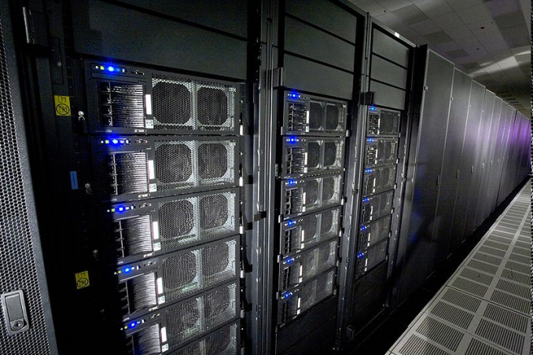
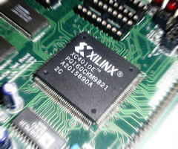
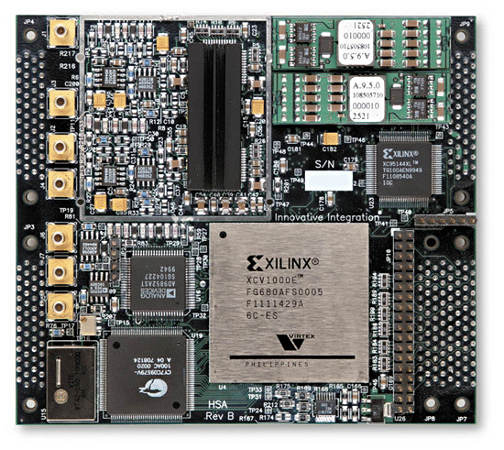
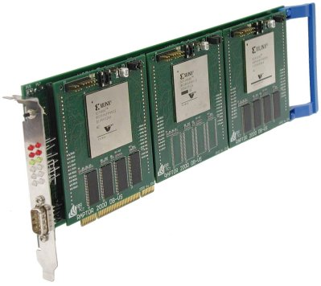
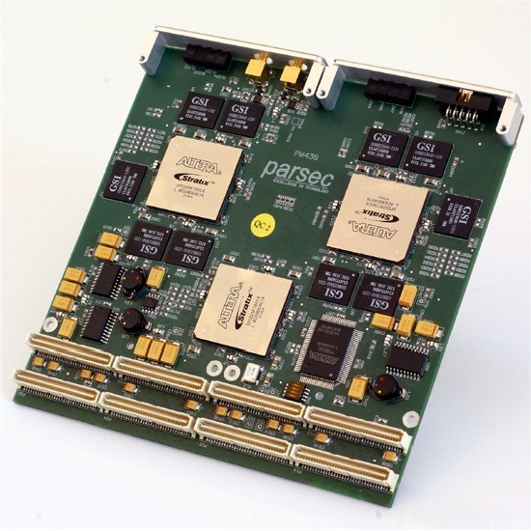
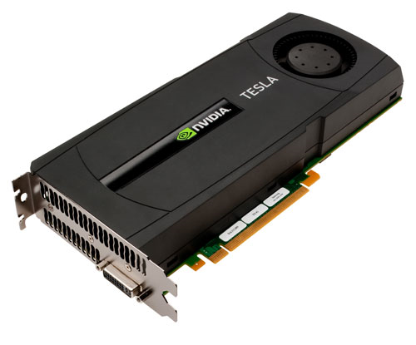

Heterogeneous Computing at USC
Dept. of Computer Science and Engineering
University of South Carolina
Dr. Jason D. Bakos
Assistant Professor
Heterogeneous and Reconfigurable Computing Lab (HeRC)
This material is based upon work supported by the National Science Foundation under Grant Nos. CCF-0844951 and CCF-0915608.

Slide 2
Heterogeneous Computing
Subfield of computer architecture
Mix general-purpose CPUs with “specialized processors” for high-performance computing
Specialized processors include:
  Field Programmable Gate Arrays (FPGAs)
  Graphical Processing Units (GPUs)
Our goals:
  Adapt scientific and engineering applications to heterogeneous programming and execution models
  Leverage our experience to build development tools for these models

Slide 3
Heterogeneous Computing
Example:
  Application requires a week of CPU time
  Offload computation consumes 99% of execution time
49% of code
initialization
0.5% of run time
“hot” loop
99% of run time
2% of code
Kernel speedup | Application speedup | Execution time
50 | 34 | 5.0 hours
100 | 50 | 3.3 hours
200 | 67 | 2.5 hours
500 | 83 | 2.0 hours
1000 | 91 | 1.8 hours
49% of code
clean up
0.5% of run time
co-processor

Slide 4
My Group
Applications work
  Computational biology:
    Computational phylogeny reconstruction (FPGA)
    Sequence alignment (GPU)
  Numerical linear algebra
    Sparse matrix-vector multiply (FPGA)
  Data mining:
    Frequent itemset mining (GPU)
  Electronic design automation:
    Logic minimization heuristics (GPU)
Tools
  Automatic CPU/coprocessor partitioning for legacy code
  Performance modeling
  Bandwidth-constrained high-level synthesis

Slide 5
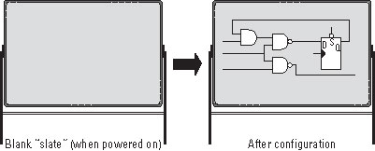
Field Programmable Gate Arrays
Programmable logic device
Contains:
  Programmable logic gates, RAMs, multipliers, I/O interfaces
  Programmable interconnect

Slide 6
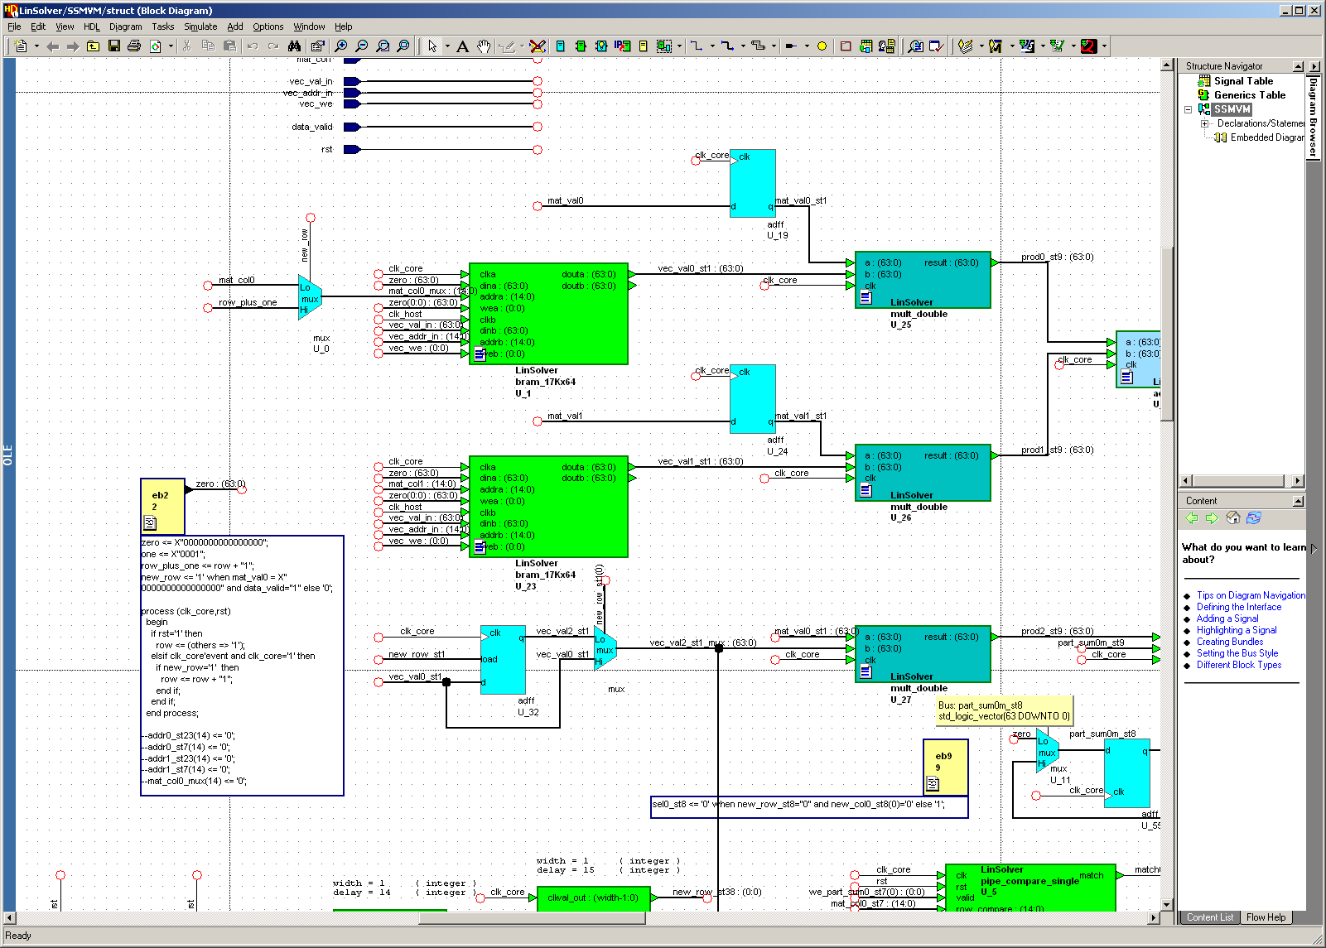
Programming FPGAs

Slide 7
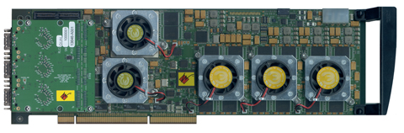
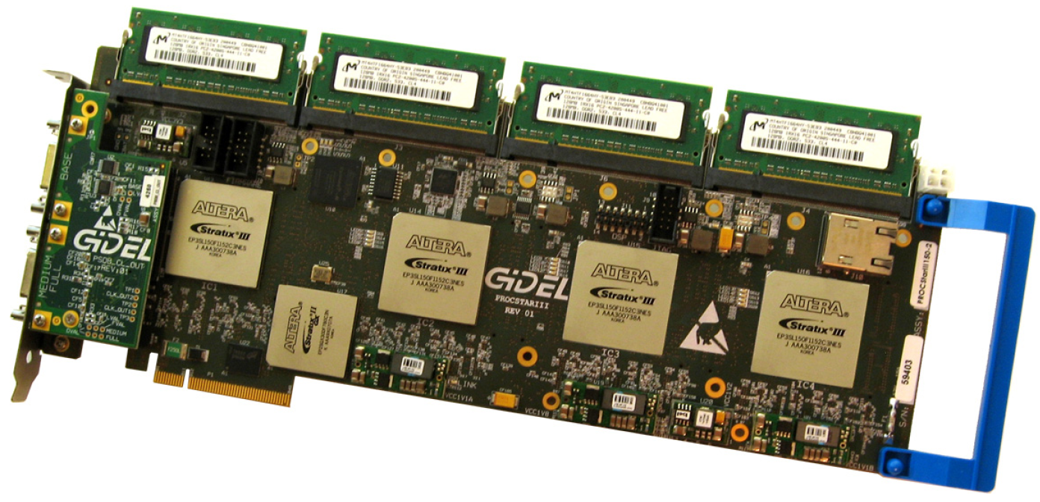
FPGA Platforms
Annapolis Micro Systems
WILDSTAR 2 PRO
GiDEL PROCSTAR III

Slide 8
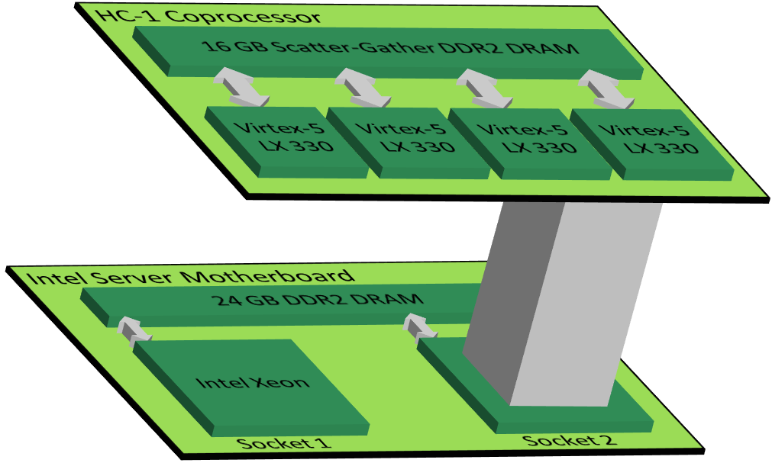
Convey HC-1

Slide 9
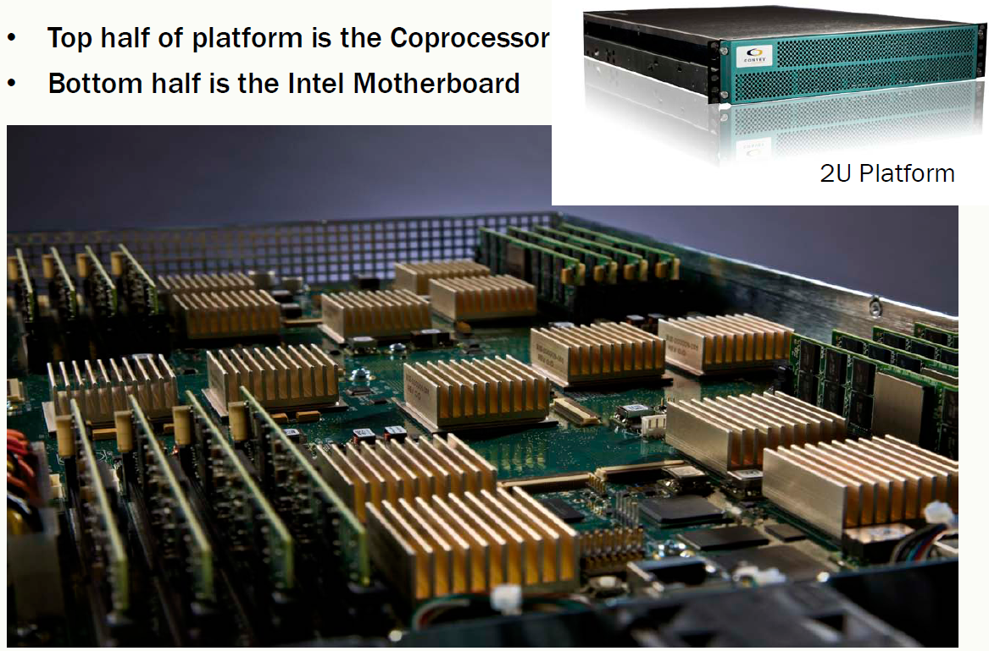
Convey HC-1

Slide 10
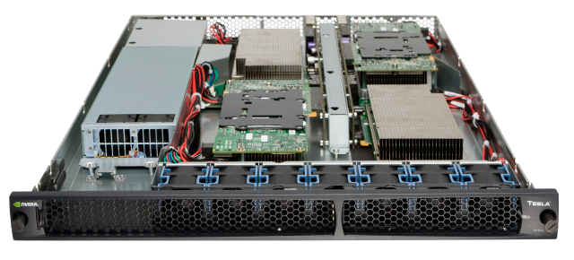
GPU Platforms
NVIDIA Tesla S1070

Slide 11
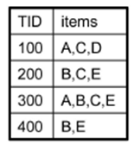
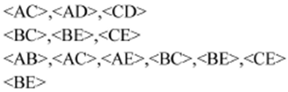
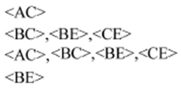
GPU Acceleration of Data Mining
2-itemsets:
2-itemsets with threshold 2:
3-itemsets with threshold 2:
3-itemsets:
<ABC>, <ABE>, <ACE>, <BCE>
<BCE>
Key enabling techniques:
  GPU-mappable data structures
Our GPU accelerated implementation achieves a 20X speedup over state-of-the-art serial implementations

Slide 12
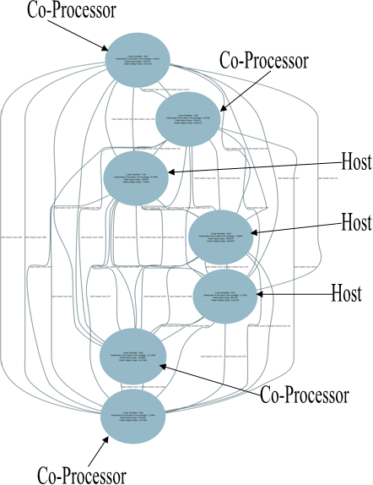
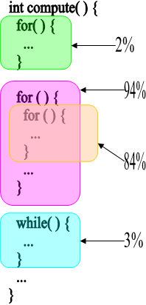
Automated Task Partitioning
for(i = 0; i < 10; i++)
{
A[i] = ...
}
10
for(i = 0; i < 10; i++)
{
... = A[i]
}

Slide 13
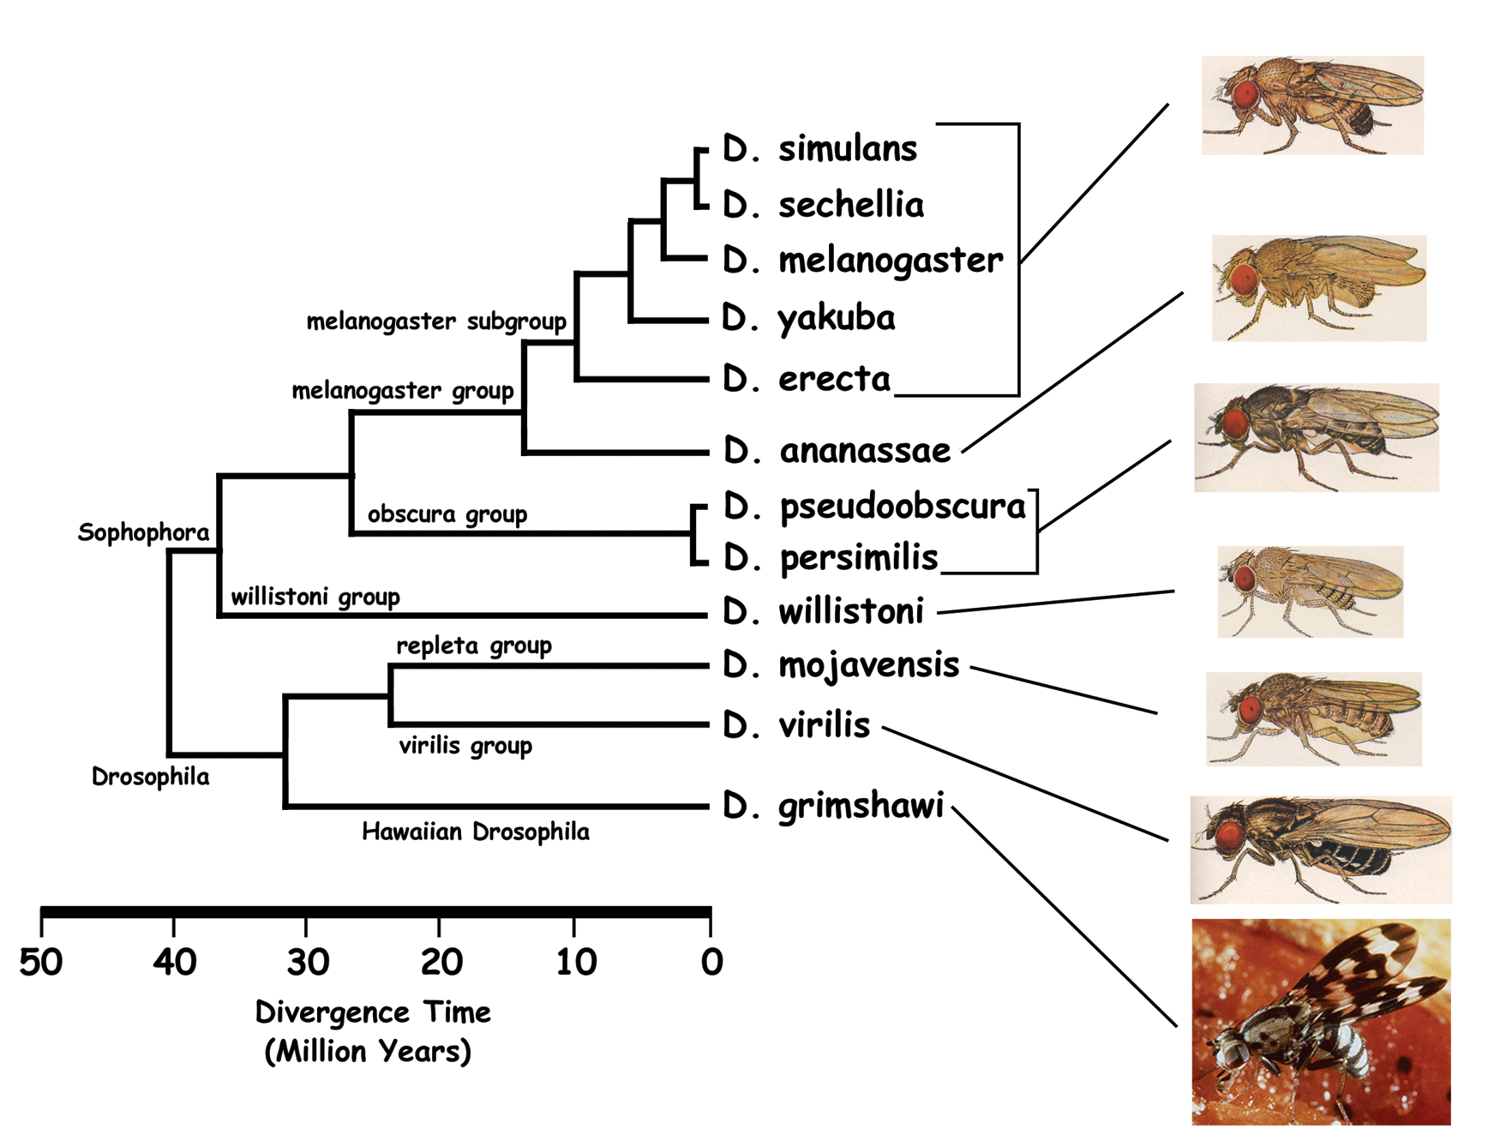
Phylogenic Reconstruction
genus Drosophila
654,729,075 possible trees with 12 leaves
200 trillion possible trees for 16 leaves
2.2 x 10²⁰ possible trees for 20 leaves

Slide 14
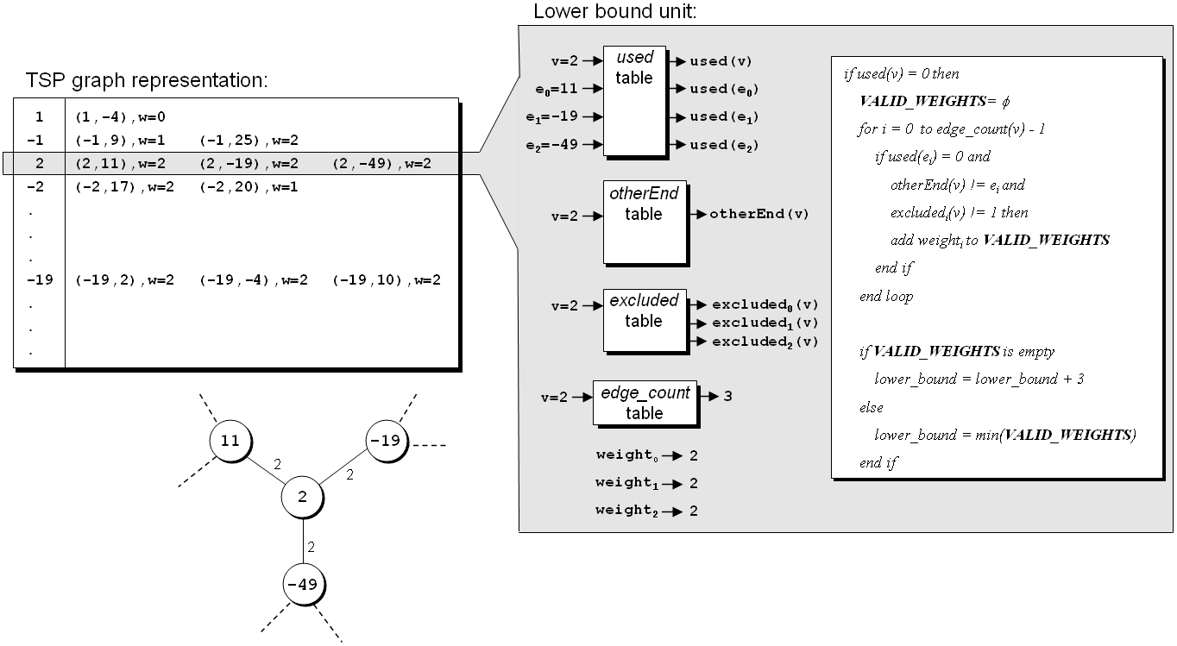
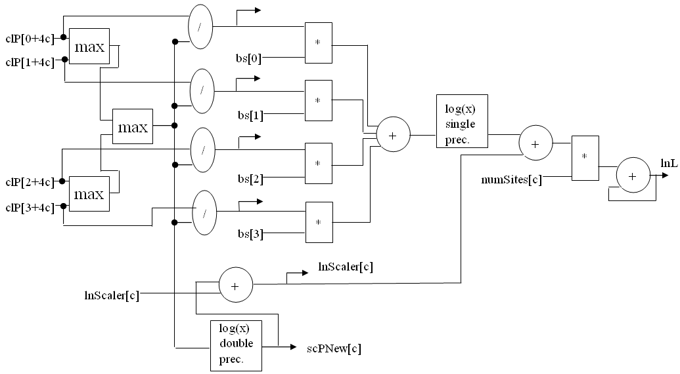
Our Projects
FPGA-based co-processors for computational biology:
GRAPPA: MP reconstruction of whole genome data based on gene-rearrangements
MrBayes: Monte Carlo-based reconstruction based on likelihood model for sequence data
1000X speedup!
10X speedup!

Slide 15
Sparse Matrix Arithmetic
Sparse matrices are large matrices that contain mostly zero-values
  Common in many scientific and engineering applications
Often represent a linear system and are thus multiplied by a vector when using an iterative linear solver
  Compressed Storage Row (CSR) representation:
1 | -1 | 0 | -3 | 0
-2 | 5 | 0 | 0 | 0
0 | 0 | 4 | 6 | 4
-4 | 0 | 2 | 7 | 0
0 | 8 | 0 | 0 | -5
val | = | (1 | -1 | -3 | -2 | 5 | 4 | 6 | 4 | -4 | 2 | 7 | 8 | -5)
col | = | (0 | 1 | 3 | 0 | 1 | 2 | 3 | 4 | 0 | 2 | 3 | 1 | 4)
ptr | = | (0 | 3 | 5 | 8 | 11 | 13)

Slide 16
Sparse Matrix-Vector Multiply
Code for Ax = b
  A is matrix stored in val, col, ptr
  row = 0
  for i = 0 to number_of_nonzero_elements do
    if i = ptr[row+1] then row=row+1, b[row]=0.0
    b[row] = b[row] + val[i] * x[col[i]]
  end
non-affine (indirect) indexing
recurrence (reduction)

Slide 17
Indirect Addressing
Technique:
Can scale up the number of these processing elements until you run out of memory bandwidth
Processing element (PE)
val
val
CSR stream
x
Σ
col
RAM
vec
segmented local cache

Slide 18
Double Precision Accumulation
Problem:
  New values arrive every clock cycle, but adders are deeply pipelined
  Causes a data dependency
Partial sums
Control
Mem
Mem

Slide 19
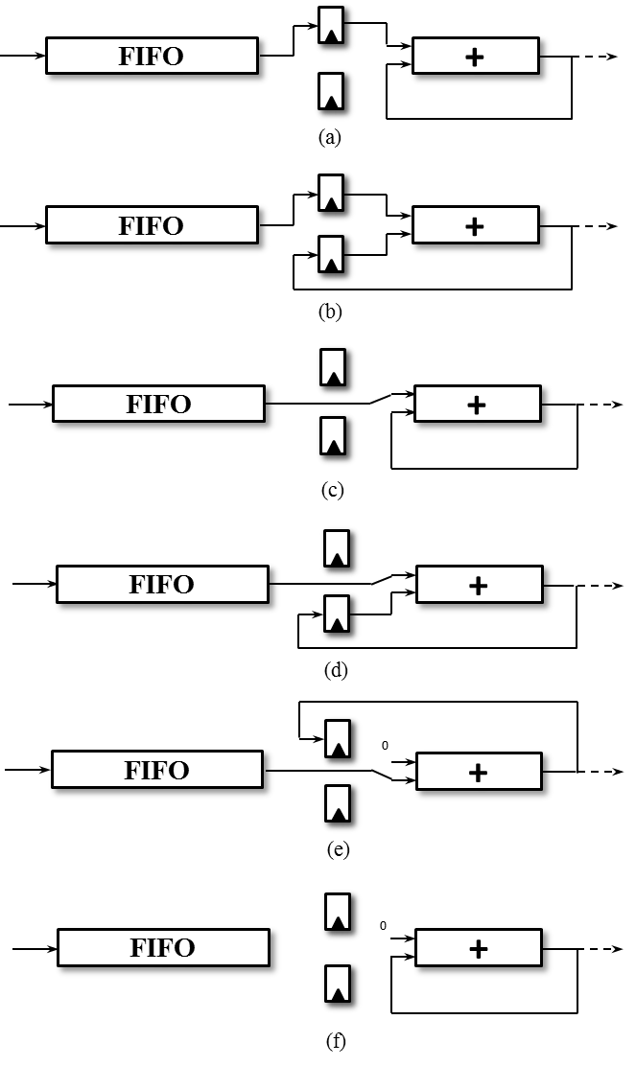

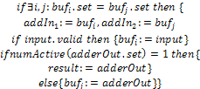

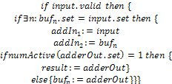
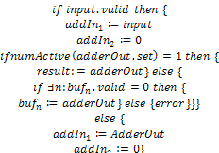
Reduction Rules

Slide 20
Sparse Matrix-Vector Multiply
32 PEs on the Convey HC-1
  Each PE can achieve up to 300 MFLOPs/s
  32 PE gives an upper bound of 9.6 GFLOPs/s
The HC-1 coprocessor has 80 GB/s of memory bandwidth
  Gives a performance upper bound of ~7.1 GFLOPs/s
In our implementation, we achieved up to 50% of this peak, depending on the matrix tested
  Depends on:
    Vector cache performance
    On-chip contention for memory interfaces

Slide 21
Maximizing Memory Bandwidth
128
1024
96 (val/col)
PE
…
8 x 128 bit memory channels
4096 bit, 42 x 96 bit shift register
64 x 1024 bit onchip memory

Slide 22
Summary
Manually accelerated several applications on using FPGA and GPU-based coprocessors
Working to develop tools for to make it easier to take advantage of heterogeneous platforms

Slide 23
GPU Acceleration of Sequence Alignment
DNA/protein sequence, e.g.
  TGAGCTGTAGTGTTGGTACCC => TGACCGGTTTGGCCC
Goal: align the two sequences against substitutions and deletions:
  TGAGCTGTAGTGTTGGTACCC
  TGAGCTGT----TTGGTACCC
Used for sequence comparison and database search
Our work focuses on pairwise alignment of large databases for noise removal in meta-genomic sequencing

Slide 24
High-Level Synthesis
Bandwidth-constrained high-level synthesis
Example: 16-input expression:
out = (AA1 * A1 + AC1 * C1 + AG1 * G1 + AT1 * T1) *
(AG2 * A2 + AC2 * C2 + AG2 * G2 + AT2 * T2)

Slide 25
GPU Acceleration of Two Level Logic Minimization
A’B’CD
A | B | C | D | out
0 | 0 | 0 | 0 | 1
0 | 0 | 1 | 0 | 1
0 | 1 | 1 | 1 | 1
0 | 1 | 1 | 0 | 1
1 | 1 | 1 | 1 | 0
1 | 0 | 1 | 1 | 0
0 | 1 | 0 | 1 | 0
anything else |  |  |  | X
A’B’C’D
A’B’
A’B’D’
A’B’CD
A’B’CD’
A’C
A’BC
(ACD)’
(A’BC’D)’
Key enabling techniques:
  Novel reduction algorithms optimized for GPU execution
Achieves 10X speedup over single-thread software

