Slide 1
Optoelectronic Multi-Chip Module Demonstrator System
Jason D. Bakos
Donald M. Chiarulli, Steven P. Levitan
University of Pittsburgh, USA

Slide 2
Talk Overview
Chip-to-chip optoelectronic interconnection and packaging
“Optoelectronic Multi-Chip Modules”
Based on fiber image guides
Forms interconnect medium and structure of package
Goal:
Tightly integrated, rugged, and easily manufacturable (passive alignment)
Fabrication and assembly of a demonstrator prototype
Goal:
Characterize OE behavior of system
Top
Bottom

Slide 3
OE-MCM Demonstrator System
64-channel optical crossbar switch as 3-element OE-MCM
Each identical element
Has 8x8 array of detectors and VCSELs at 250 um
Implements eight independent 8-channel switches (“rows”)
Each chip aligned orthogonal to its adjacent chip
2D fiber ribbon cable (8x8) carries optical data in/out of MCM
FIG
Chip 1
FIG
Chip 2
FIG
Chip 3
FIG
2D fiber ribbon cable
2D fiber ribbon cable
3-stage switch architecture

Slide 4
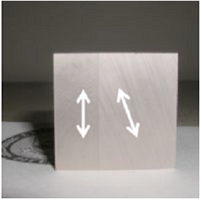
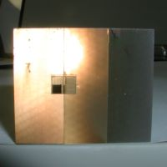
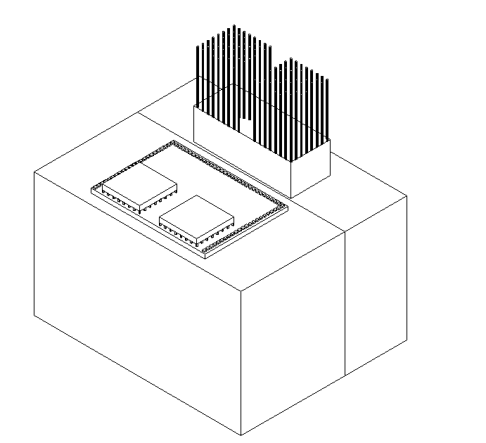
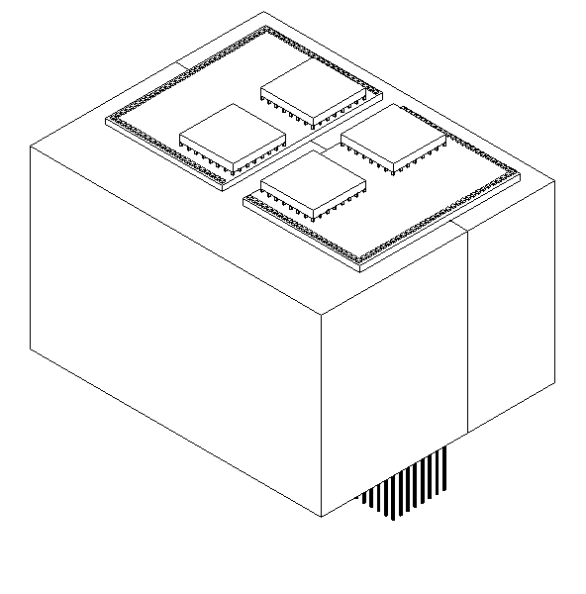
OE-MCM Interconnect Topology
IN
OUT
Chip 3
Chip 1
Chip 2
Chip 1
Chip 2
Chip 3

Slide 5
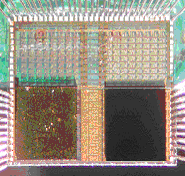
OE-MCM Fabrication and Bonding
Digital/analog on CMOS chip
Flip-chip bond OE chips to CMOS die
Epoxy assembled elements to sides of image guide glass
Bump-bond CMOS chips to PCB (supplies, electronic I/O)
Assembled “switch chip”
MCM cross section
8x8 channel array

Slide 6
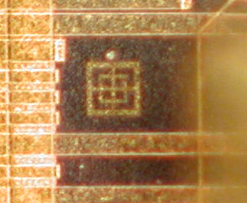
OE Element Fabrication
CMOS chip has optically transparent substrate
Peregrine Semiconductor UTSi process
VCSELs and detector arrays FC bonded to top surface
Metal alignment marks on die
Area pads
Window
VCSEL site
Passive alignment mark

Slide 7
Receiver/VCSEL arrays
Bottom view of chip showing detectors
Bottom view of chip showing VCSEL array

Slide 8
Switch Chip Layout and Floorplan
Switching logic and switch configuration memory
Receiver section
Driver section
Chip layout
4 x 5.5 mm
Padframe
Alignment marks

Slide 9
Switch Chip Design
Address
One 8x8 switch “row”
Config data
DFF
DFF
DFF
Receiver
CM
DFF
DFF
DFF
Detector
Power amp
Pads
TIA
Detector
Power amp
Pads
TIA
…
.
.
.
.
.
.
.
.
.
Detector
TIA
Power amp
Pads
Decoder
DFF
DFF
VCSEL
DFF
DFF
Pads
Driver
DFF
VCSEL
Driver
…
Pads
DFF
DFF
.
.
.
.
.
.
DFF
VCSEL
Pads
Driver
DFF
DFF
DFF
(Electrical test pads on die)
DFF

Slide 10
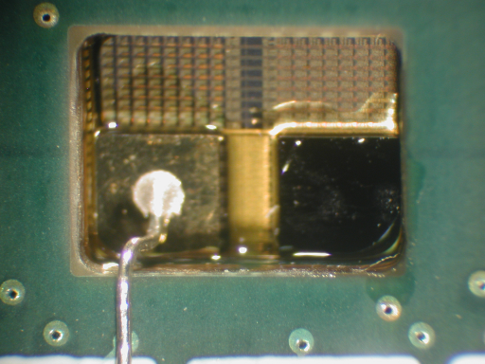
Chip-on-Board Mounting
Bottom of SoS chip bump-bonded to PCB
Top of chip showing detector/VCSEL arrays (through PCB cavity)

Slide 11
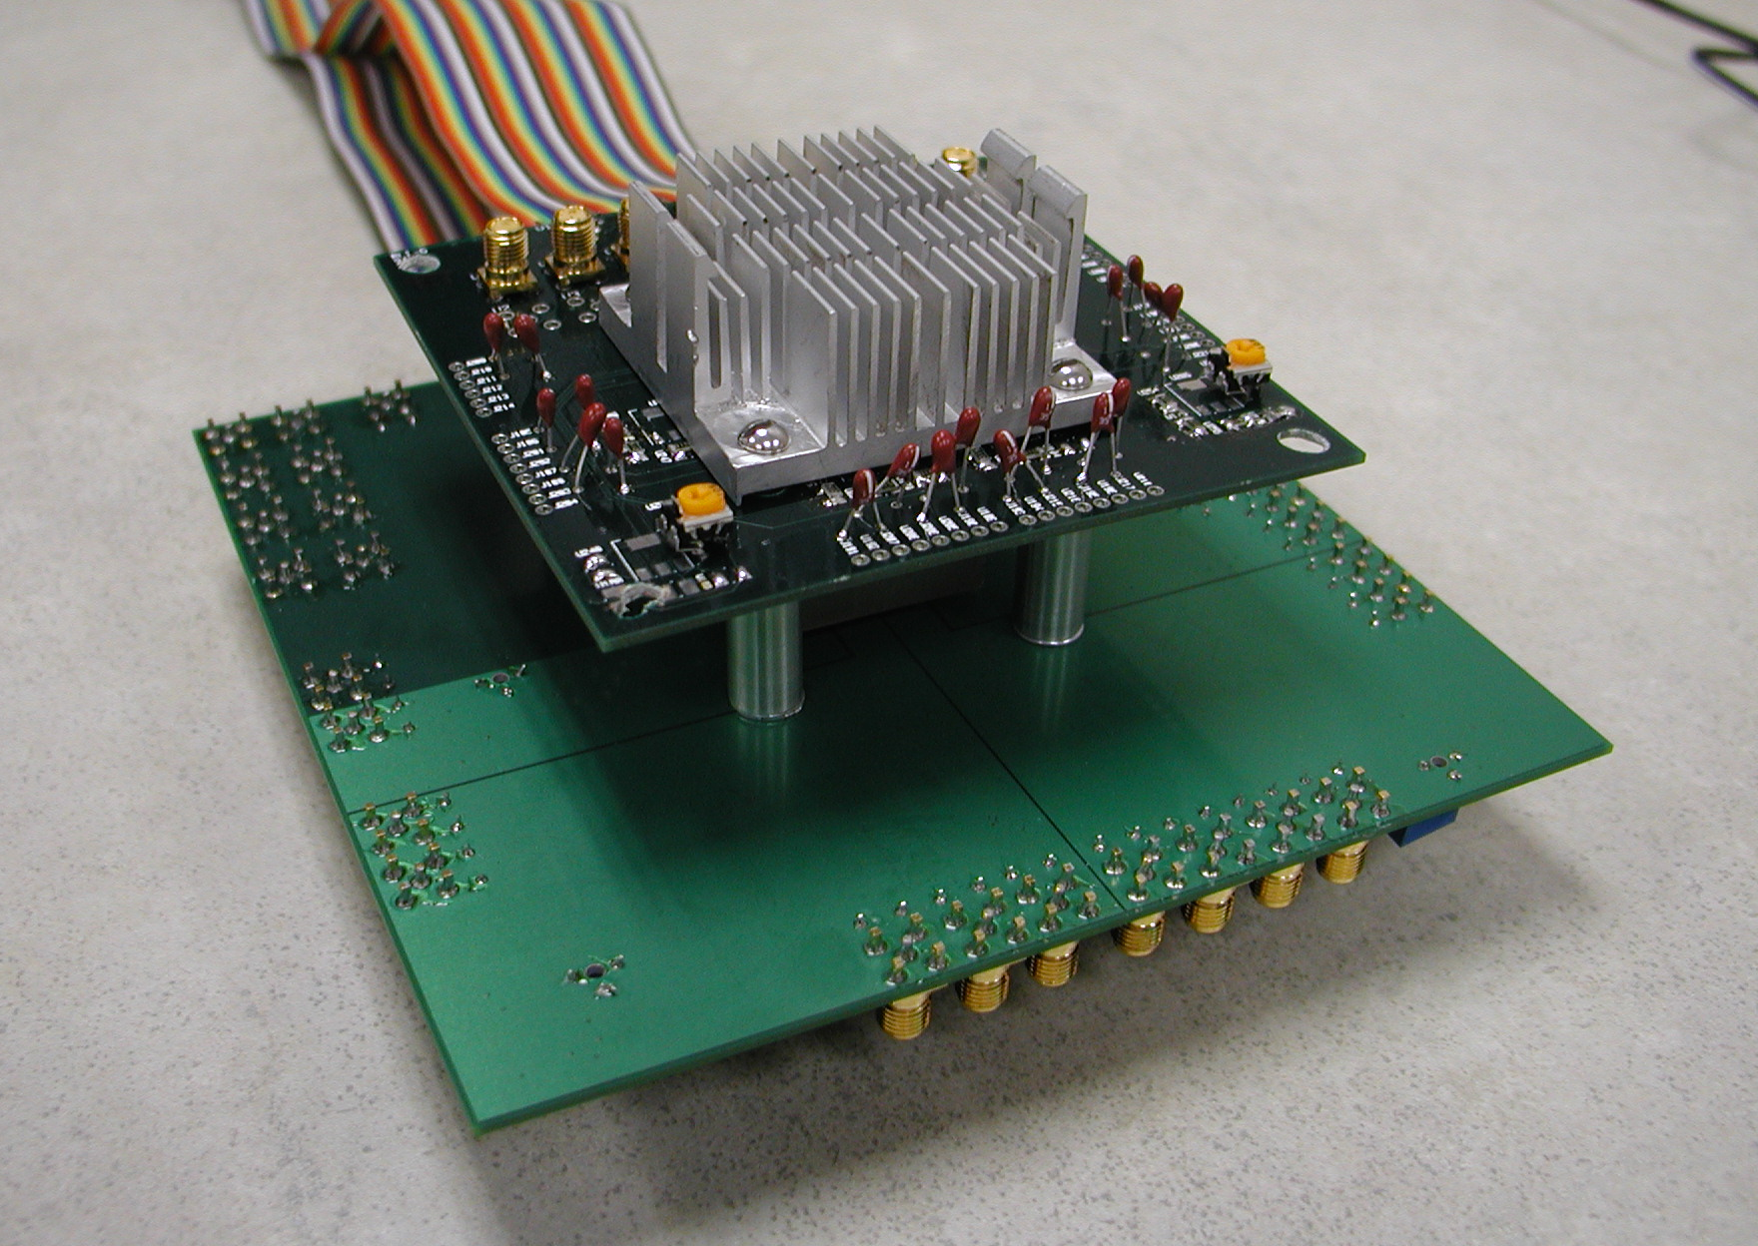
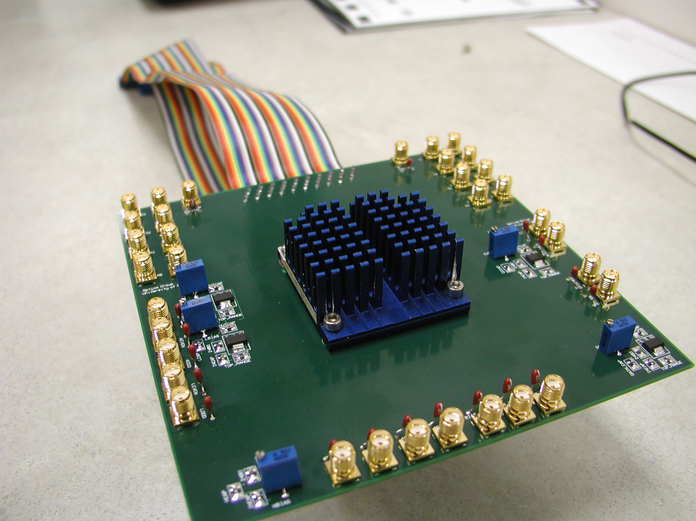
OE-MCM System
Switch MCM demonstrator
Large heat sinks are used to dissipate heat from CMOS, VCSELs, and receivers
Switch is electronically configured through ribbon cables
SMA cables used for electronic test I/O
See this at the hardware demo!

Slide 12
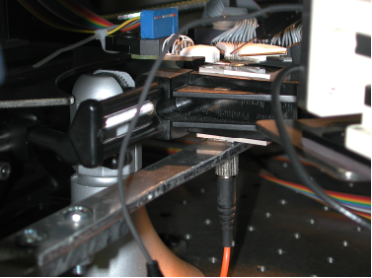
Channel Test
Current results:
Optical input coupled to optic from VCSEL
Output measured at test pin
Single chip/single channel tested at 500MHz
Bandwidth limitation due to laser source
Test setup
500 MHz eye diagram

Slide 13
Conclusion and Future Work
FIG-based OE-MCMs
FIG: interconnect medium and structure
Tightly integrated and easily manufacturable
Fabrication and characterization of OE-MCM demonstrator
Currently in progress
Proof-of-concept for FIG-based OE-MCM technology

Slide 14
Acknowledgements
Thank you:
SoS COOP run
UTSi fab run
Peregrine Semiconductor
Bonding and support
Schott Fiber Optics
Fiber image guides and support

