Slide 1
Research Plan
Jason D. Bakos
Optics/Microelectronics Group
Department of Computer Science
University of Pittsburgh

Slide 2
Outline
Further development of high-performance signaling technology
Techniques for optical/RF interconnect:
Data encoding
Testing, characterization of LHECC technique
Signal modulation
Multi-level (n-PAM) signaling over MBDS
Analog circuit techniques
Driver pre-emphasis, receiver equalization/filtering
Mixed-signal single-chip RF/optical devices

Slide 3
Need for System-Level Signaling
Interconnect/switching technology for NoC/CM:
OO/SE, SS/VLIW (ILP), single-chip symmetric multithreading are now industry standard techniques
Single-chip multiprocessor (CMP) architectures becoming next big wave
Multi-core architectures and applications form large part of ISCA papers
System-on-chip (IP) design becoming big, pushed by IT vendors
Efficient network-on-chip technologies needed
I/O pads will become largest resource constraint in chip design
Chip area grows quadratically, pad frame grows linearly
High-performance multiplexing/SerDes

Slide 4
Directions for Current Research
Multi-Bit Differential (MBDS) channel
MBDS
nCm channel code properties
Extra symbols
Inherent redundancy
Used for error control
Future directions:
Multi-level signaling for more code density
ECC extension
nCm logic for fault tolerant logic devices (soft errors)
Apply to optoelectronic signaling (output of TIAs)
Data encoded with fixed number of ones
“N-choose-M (nCm)” symbols
{0011}, {0101}, {0110}, {1001}, {1010}, {1100}
Advantages
Low switching noise
Large GDP
EM coupled transmission lines
Low noise => low voltage swing
Same noise rejection as differential
Higher information capacity

Slide 5
System-Level Interconnect
Next generation system-level interconnect
Guided-wave and free space optoelectronic signaling (dense optical channels)
High-speed electrical signaling
Packaging/manufacturability technology
Aggressive driver/receiver design, modulation/coding techniques, equalization techniques
Aggressive driver/receiver design, modulation/coding techniques
Fiber image guide, free-space, MEMs techniques

Slide 6
Other Goals
Mixed-signal design
Combine analog and digital components, as in two previous projects
Examples:
Signaling technology
analog: drivers/receivers
digital: switching/encoding technology
Intelligent sensors
analog: MEMs sensors, OE-conversion, micro-antenna arrays
digital: preprocessing of data

Slide 7
Future Goals
NSF money is in defense / military / homeland security projects
Many NSF grants seek low-cost single-chip devices:
Single-chip imaging NB EHF phased-array RADAR / passive WB EHF sensors
Single-chip radio
Single-chip smart wireless sensors (MEMs)
Single-chip biological analyzers (MEMs)
Patch antenna array
Ceramic Carrier (LTCC)
Substrate
solder bumps
Individual Tx / Rx Circuits

Slide 8
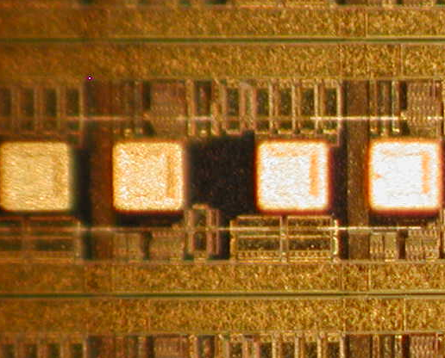
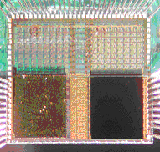
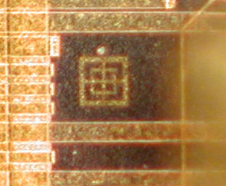
OE Conversion Technology
Area pads
Window
SoS die
VCSEL site
Passive alignment mark
Assembled “switch chip”

Slide 9
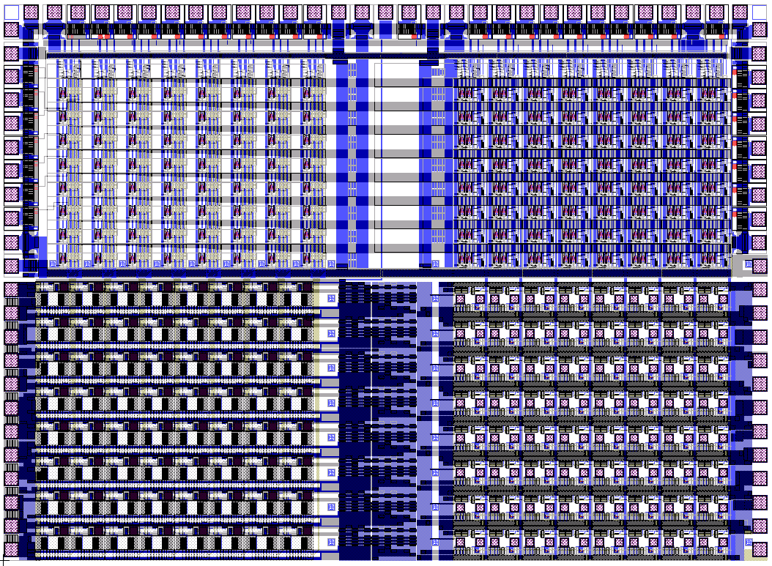
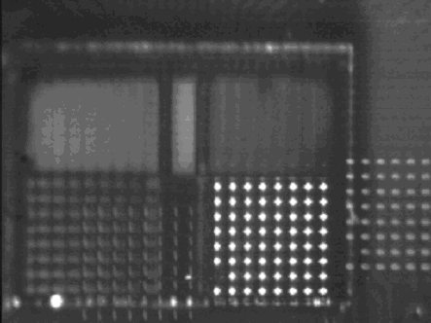
OE Crossbar Switch Chip

Slide 10
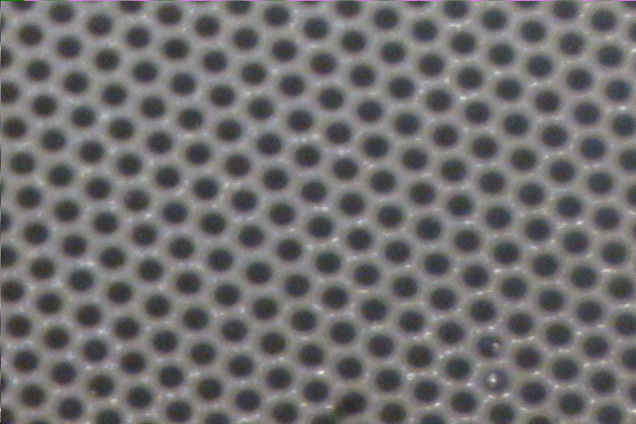
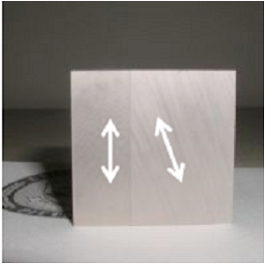
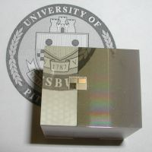
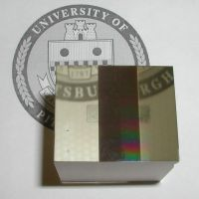
OE Interconnect using Fiber Image Guides
Dense lattice of fiber cores
5-20 um diameter, 2K-15K cores/mm²
Side
Top
Bottom

Slide 11
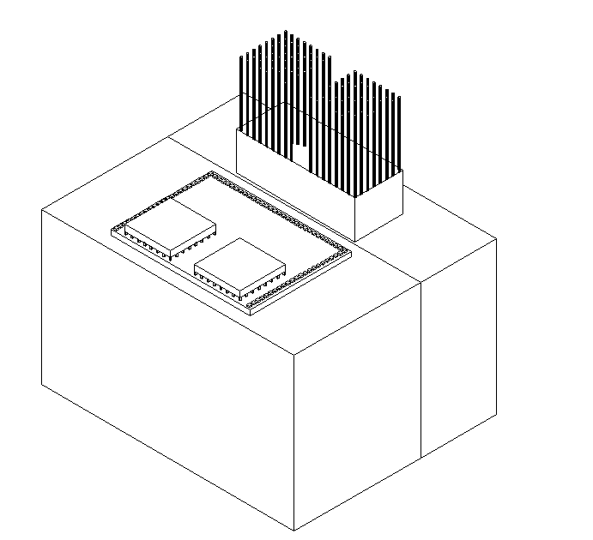
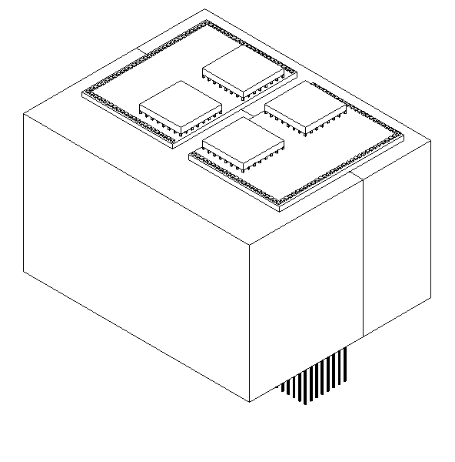
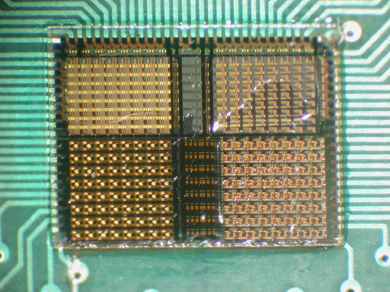
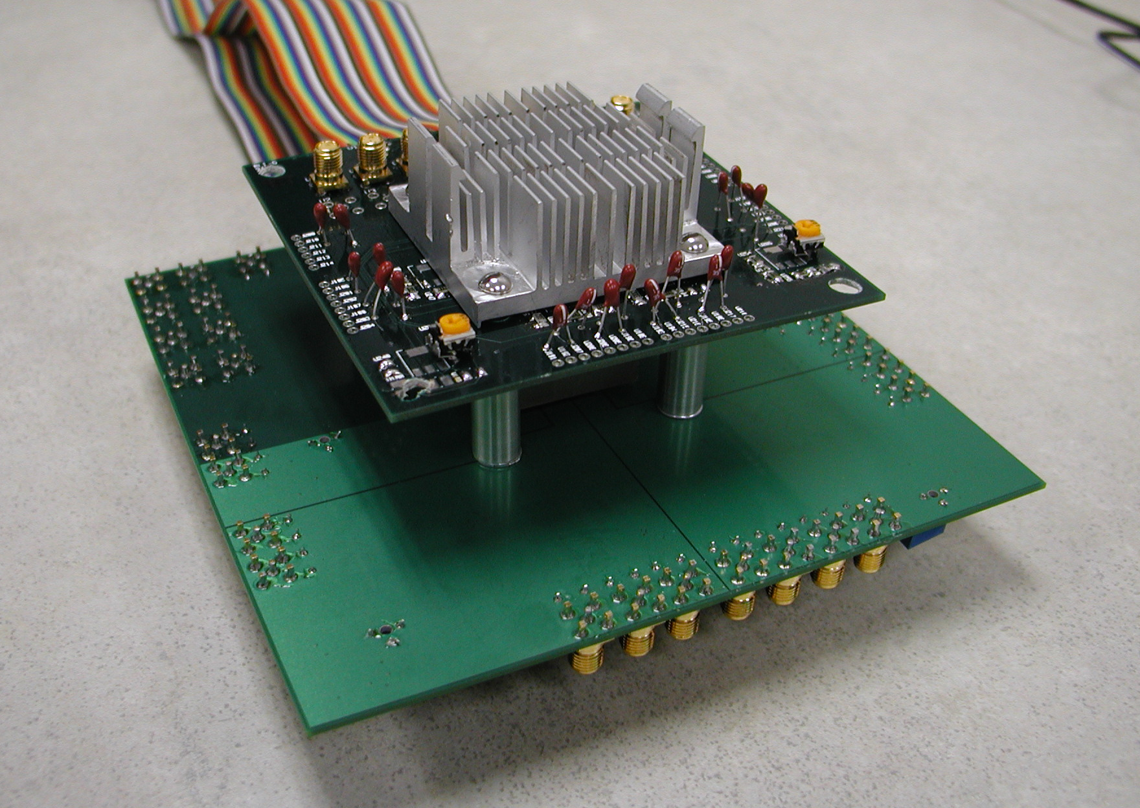
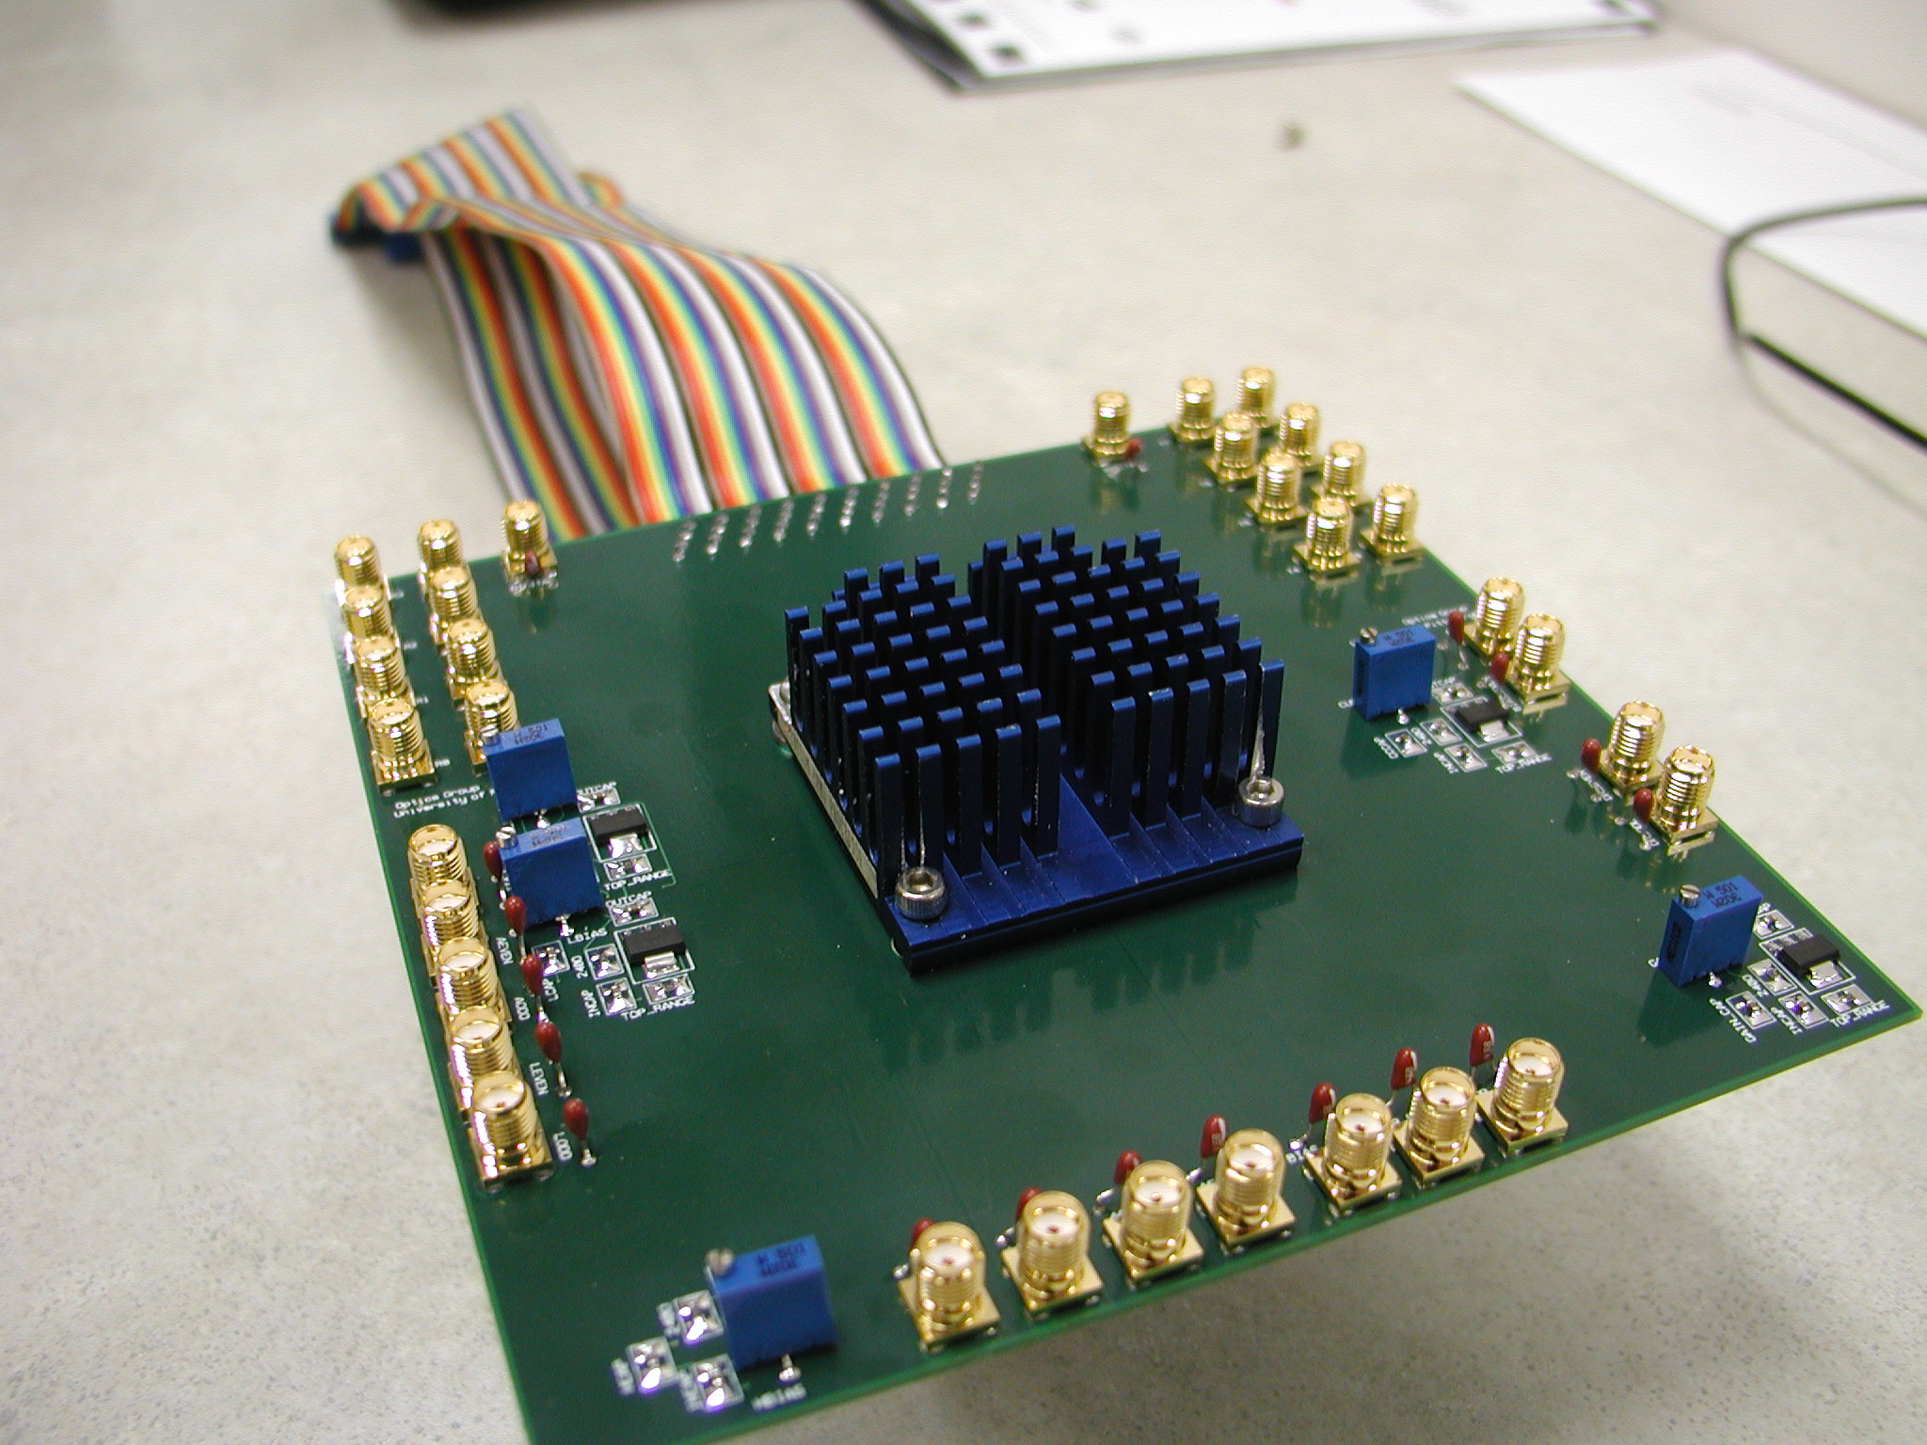
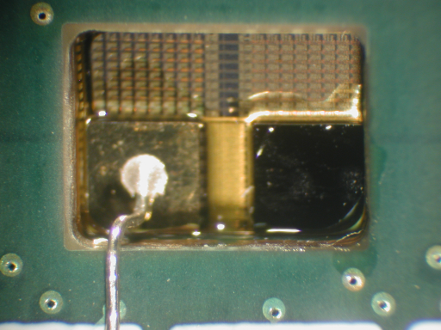
OE-MCM Demonstrator
IN
OUT
Chip 3
Chip 1
Chip 2
Chip 1
Chip 2
Chip 3

Slide 12
Resources Required
Design tools
CAD tools: Mentor, Cadence, Synopsys
Chip testing and characterization laboratory
High-speed digital scopes/communication analyzers
TEK TDS8000 20G backplane (ref), ~12K
TEK 80E02 12.5G 2ch module (ref), ~8K
High-speed signal/waveform/word generators
TEK AWG710 (dem), ~35K
Precision power supplies
HP E3630A 3out (new), ~600
Probe station, ~8K+
Microprobes
Microscopes, digital imaging equipment
Vibration-isolated table

Slide 13
Funding Sources
NSF
CAREER Award
Directorates:
CSR, CNCI, EPDT, IS, NeTS, CISE, EHR, ENG
DoD
DARPA (FedBizOpps), ARL, AFOSR, NRL
COS
OIDA
SPIE Career Award (500K)
(International Society for Optical Engineering)

Slide 14
Summary
GOALS:
Develop, fabricate, and test devices
Establish hardware testing lab
Form collaboration for larger grants
Within department or outside department

