Slide 1
Heterogeneous Computing
Dr. Jason D. Bakos

Slide 2
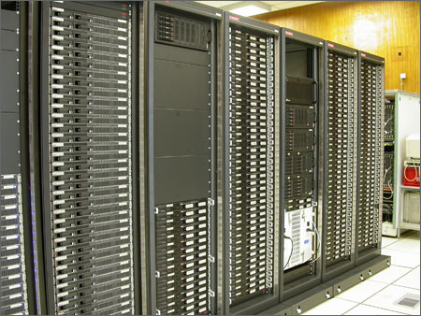
“Traditional” Parallel/Multi-Processing
Large-scale parallel platforms:
Individual computers connected with a high-speed interconnect
Programs are dispatched from a head node
Upper bound for speedup is n, where n = # processors
How much parallelism in program?
System, network overheads?

Slide 3
Heterogeneous Computing
Computer system made up of interconnected parallel processors of mixed types
Generally includes:
One or more general-purpose processor(s)
Acts as the “host”
One or more special-purpose processor(s)
Acts as the “co-processors”
Advantage:
Accelerates each general-purpose processor by a factor of 10 to 1000
One co-processor add-in board can replace 10s to 1000s of processors in a traditional parallel computer

Slide 4
Heterogeneous Execution Model
instructions executed over time
49% of code
initialization
0.5% of run time
co-processor
“hot” loop
99% of run time
1% of code
49% of code
clean up
0.5% of run time

Slide 5
Heterogeneous Computing: Performance
Move “bottleneck” computations from software to FPGA
Use FPGA as co-processor
Example:
Application requires a week of CPU time
One computation consumes 99% of execution time
Kernel speedup | Application speedup | Execution time
50 | 34 | 5.0 hours
100 | 50 | 3.3 hours
200 | 67 | 2.5 hours
500 | 83 | 2.0 hours
1000 | 91 | 1.8 hours

Slide 6
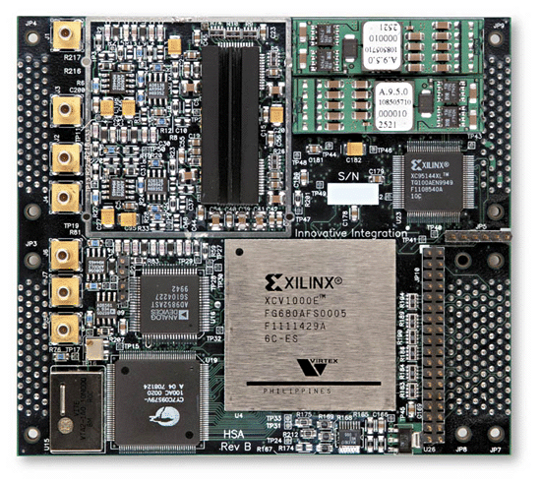
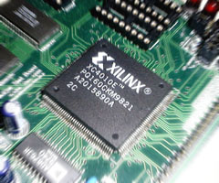
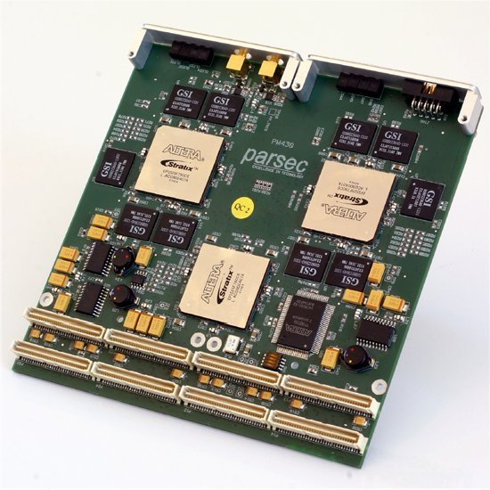
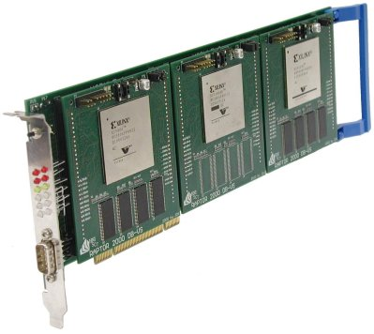
High-Performance Reconfigurable Computing
Heterogeneous computing with reconfigurable logic, i.e. FPGAs

Slide 7
High-Performance Reconfigurable Computing
Advantage of HPRC:
Cost
FPGA card => ~ $15K
128-processor cluster => ~ $150K
+ maintenance + cooling + electricity + recycling
Challenges:
Programming the FPGA
Identifying kernels
Optimizing accelerator design

Slide 8
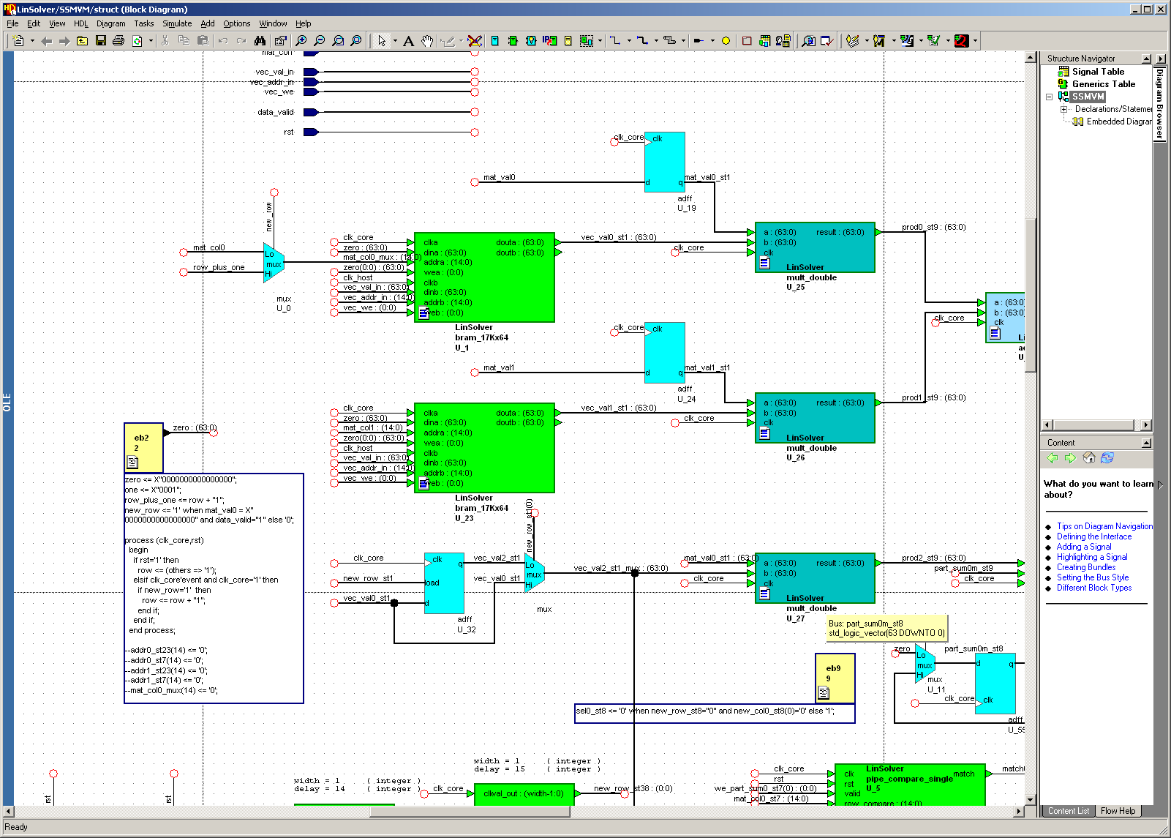
Programming FPGAs

Slide 9
Heterogeneous Computing with GPUs
Graphics Processor Unit (GPU)
Contains hundreds of small processor cores grouped hierarchically
Has high bandwidth to on-board memory and to host memory
Became “programmable” about two years ago
Gained hardware double precision about one year ago
Examples: IBM Cell, nVidia GeForce, AMD FireStream
Advantage over FPGAs:
Easier to program
Less expensive (gamers drove high volumes, decreasing cost)
Drawbacks:
Can only do floating point fast (computations that map well to shaders)?

Slide 10
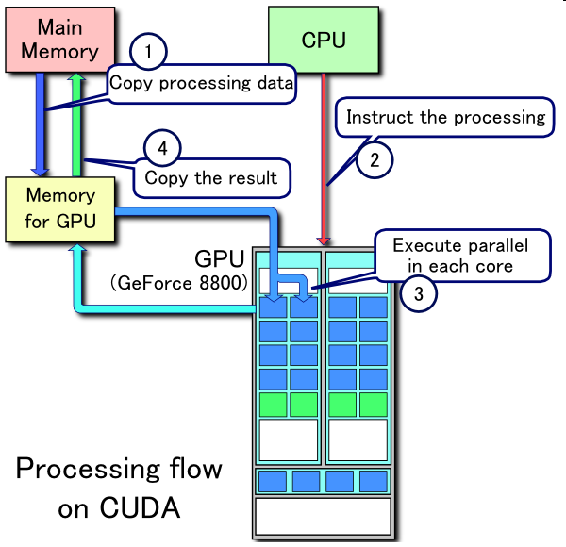
Heterogeneous Computing with GPUs

Slide 11
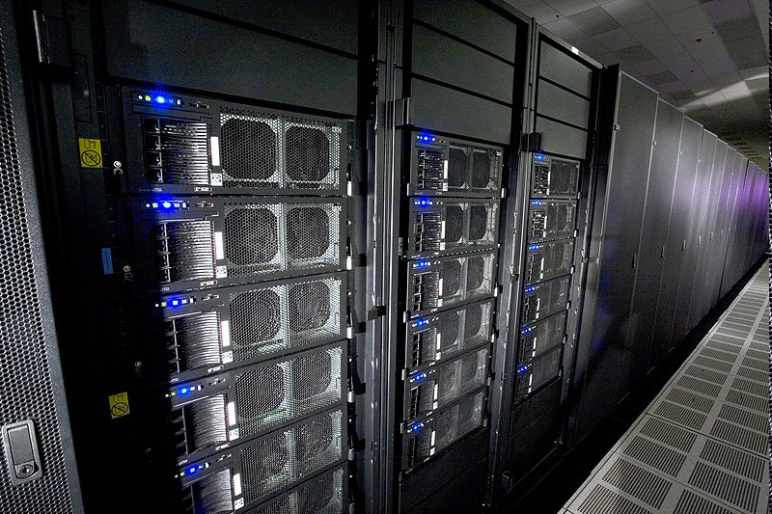
Heterogeneous computing is mainstream: IBM Roadrunner
Los Alamos, fastest computer in the world
6,480 AMD Opteron (dual core) CPUs
12,960 PowerXCell 8i GPUs
Each blade contains 2 Operons and 4 Cells
296 racks
1.71 petaflops peak (1.7 billion million fp operations per second)
2.35 MW (not including cooling)
Lake Murray hydroelectric plant produces ~150 MW (peak)
Lake Murray coal plant (McMeekin Station) produces ~300 MW (peak)
Catawba Nuclear Station near Rock Hill produces 2258 MW

Slide 12
Open Questions
What characteristics make a particular program amenable to acceleration?
Are FPGA-based co-processors better suited for some types of computations than GPU-based co-processors?
How can we develop efficient and effective methodologies for adapting general-purpose codes to heterogeneous systems?

Slide 13
Our Group
Past projects:
Custom FPGA accelerators:
computational biology
linear algebra
Multi-FPGA interconnection networks:
interface abstractions
adaptive routing algorithms
on-chip router designs
Current projects:
Design tools
Dynamic code analysis
Semi-automatic accelerator generation
Assessing GPU accelerators versus FPGA accelerators for various computations
Accelerators for solving large systems of ODEs

