Slide 1
Next Generation Interconnection Technology for High-Performance Computer Systems
Jason D. Bakos
Department of Computer Science
University of Pittsburgh

Slide 2
Talk Outline
Brief introduction to system interconnection technology
Examples
Challenges
Electrical and optoelectronic signaling
High-performance interconnection technology research at Pitt
Optoelectronic Multi-Chip Modules (OE-MCM)
Multi-Bit Differential Signaling (MBDS)
Dissertation research
Lightweight Hierarchical Error Control Codes (LHECC)

Slide 3
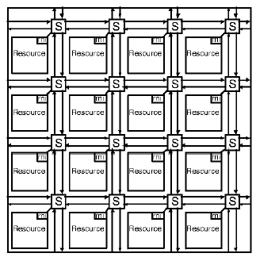
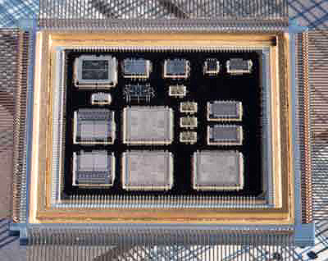
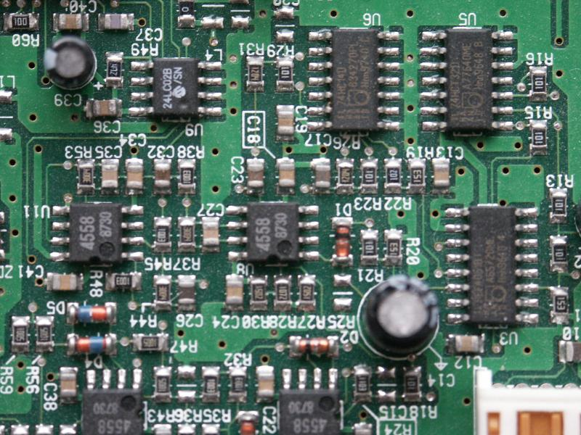
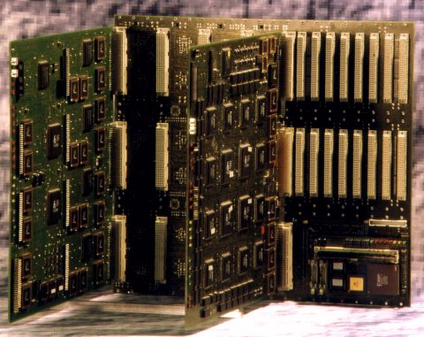
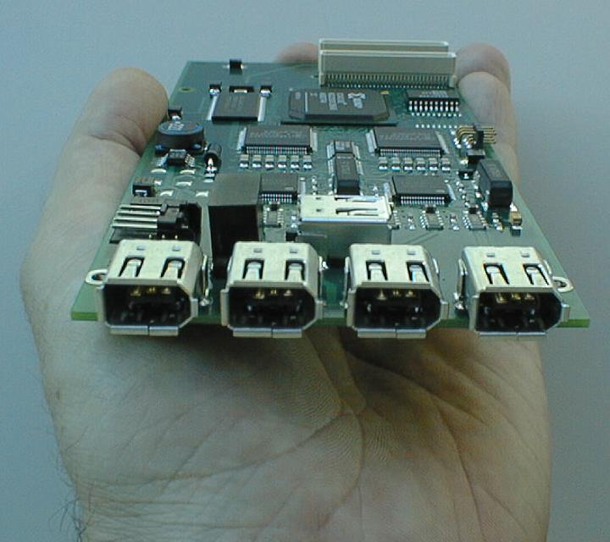
System Interconnect
Network-on-chip
Multi-Chip Modules
System-level interconnect
Short-haul
High-performance
Printed circuit boards
Backplanes
Peripherals

Slide 4
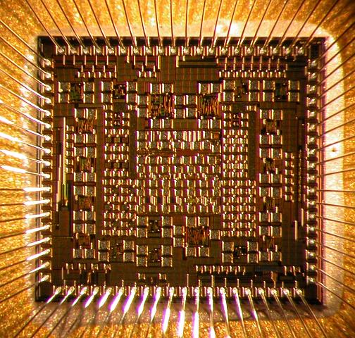
Challenges for System Interconnect
Signal integrity
Capacitance/inductance
Noise
Timing/jitter
Area
I/O pads precious
Driver size
Packaged chip
Packaged chip
Source: Intel Corporation

Slide 5
Electrical Signaling
Single-ended
1 wire per bit
Disadvantages
Requires shared reference
Susceptible to noise
Switching noise
Differential (LVDS)
2 wires per bit
Data encoded as {01} or {10}
Advantages
Large GDP
EM coupled transmission lines
Low switching noise
Low noise => low voltage swing
Disadvantages
Wasteful in I/O pads

Slide 6
Optoelectronic Signaling
Optical signaling
Used in long-haul signaling
Chip-level optical signaling
Dense high-speed channel arrays
Orthogonal to die
OE conversion
Vertical Cavity Surface Emitting Lasers (VCSEL)
Gallium-Arsenide (GaAs)
“direct-bandgap”
High-speed photodetectors
GaAs
Issues:
Packaging
Manufacturability
Top-emitting laser
area pads
GaAs die
Incoming laser
area pads
GaAs die
driver circuitry
receiver circuitry
photodetector array
VCSEL array
flip-chip bonds

Slide 7
Optoelectronic Architectures
“Free Space”
“Guided Wave”
mirror
microlens
photodetector
VCSEL
Si die
Si die
PCB
waveguide
VCSEL
photodetector
Si die
Si die
PCB

Slide 8
Talk Outline
Brief introduction to system interconnection technology
Examples
Challenges
Electrical and optoelectronic signaling
High-performance interconnection technology research at Pitt
Optoelectronic Multi-Chip Modules (OE-MCM)
Multi-Bit Differential Signaling (MBDS)
Dissertation research
Lightweight Hierarchical Error Control Codes (LHECC)

Slide 9
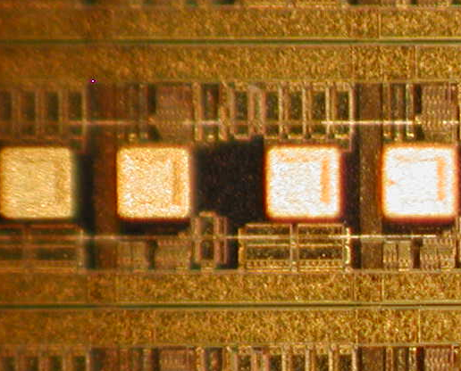
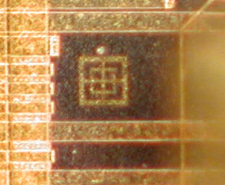
OE Conversion Technology
Area pads
Window
VCSEL site
Passive alignment mark

Slide 10
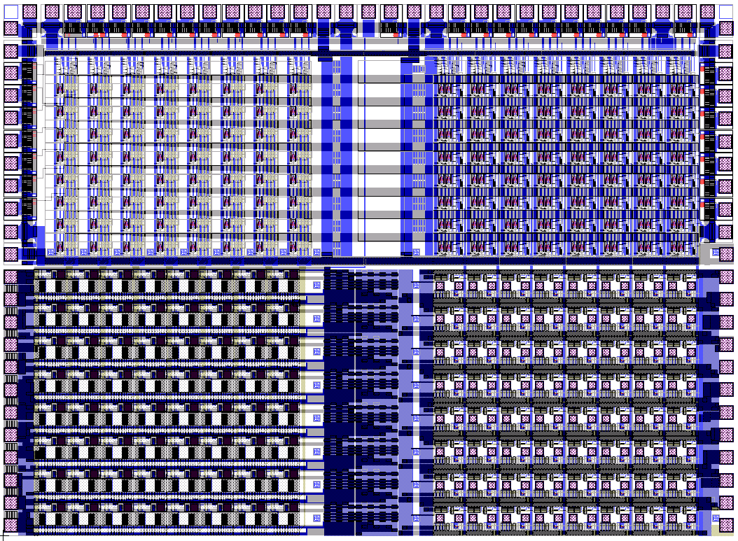
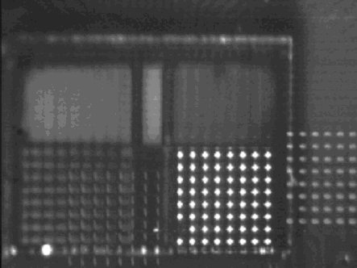
OE Crossbar Switch Chip

Slide 11
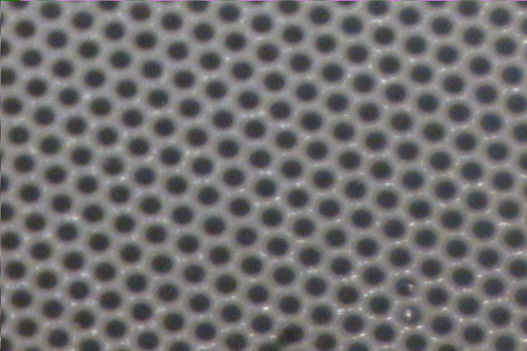
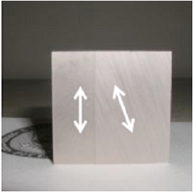
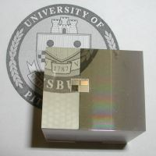
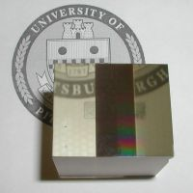
OE Interconnect using Fiber Image Guides
Dense lattice of fiber cores
5-20 um diameter, 2K-15K cores/mm²
Side
Top
Bottom

Slide 12
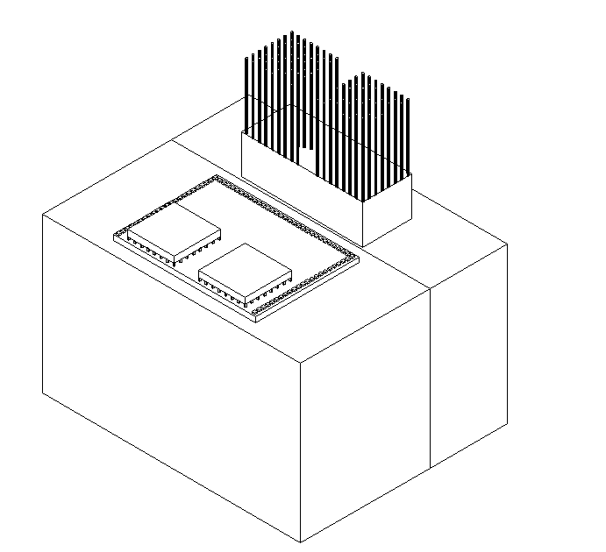
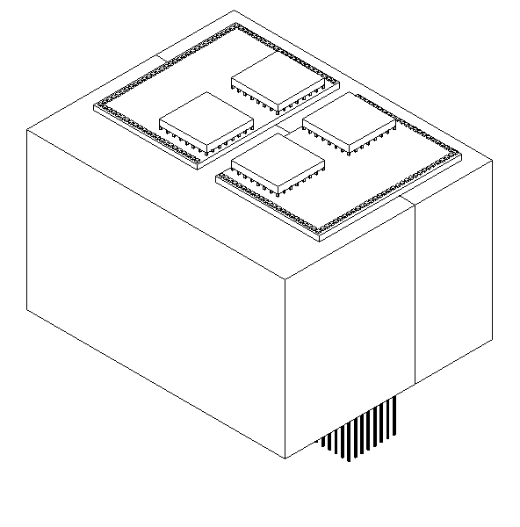
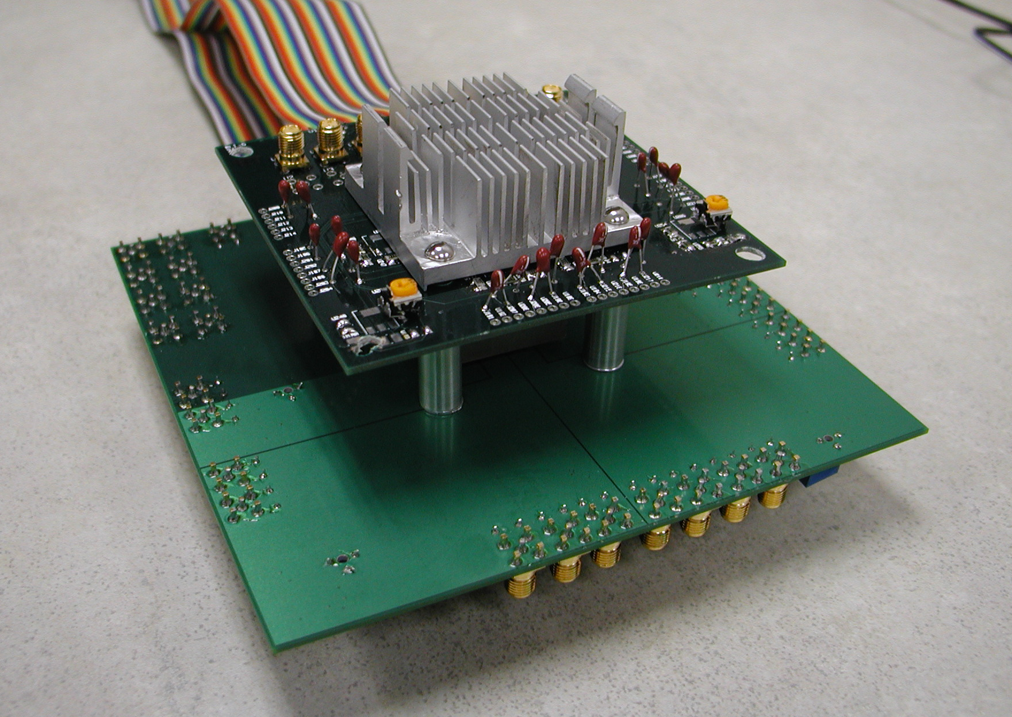
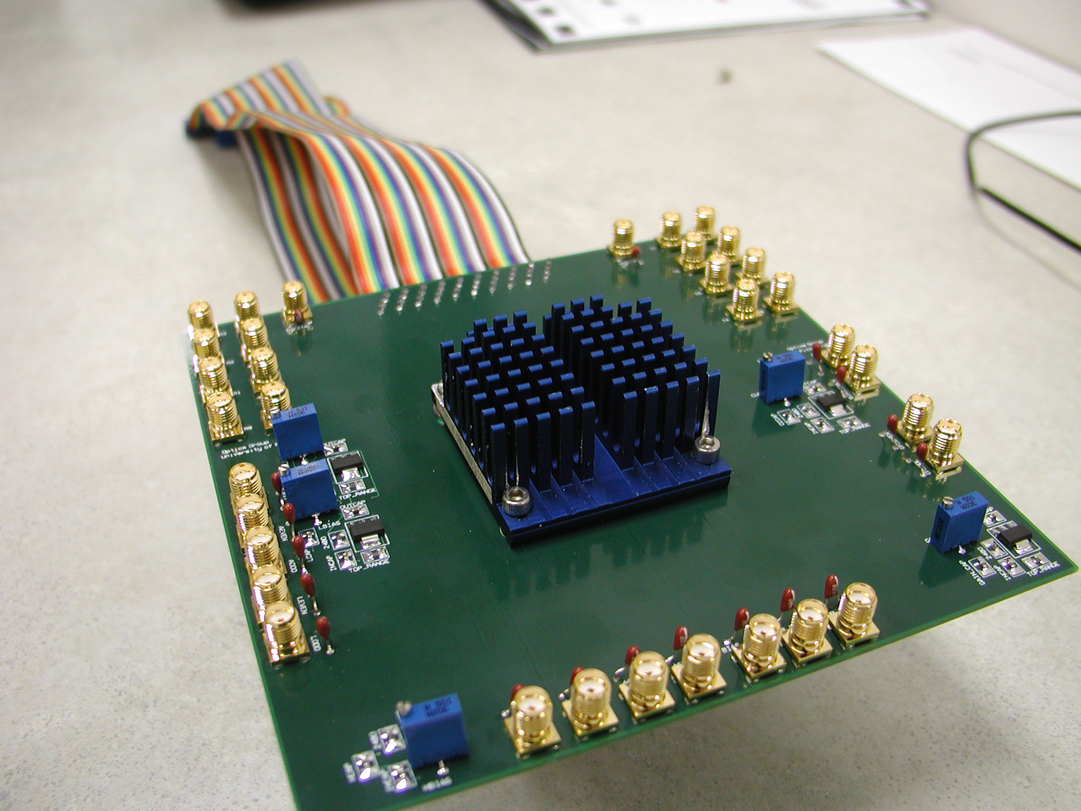
OE-MCM Demonstrator
IN
OUT
Chip 3
Chip 1
Chip 2
Chip 1
Chip 2
Chip 3

Slide 13
Multi-Bit Differential Signaling (MBDS)
Differential (LVDS) channel
Multi-Bit Differential (MBDS) channel
Current-mode drivers
Data encoded as
{01} or {10}
Advantages
Low switching noise
Large GDP
Coupled transmission lines
Low noise => low voltage swing
Disadvantages
Two connections for each bit
Wasteful in I/O pads
Data encoded with fixed number of ones
“N-choose-M (nCm)” symbols
{0011}, {0101}, {0110}, {1001}, {1010}, {1100}
Advantages
Same noise rejection as differential
Higher information capacity

Slide 14
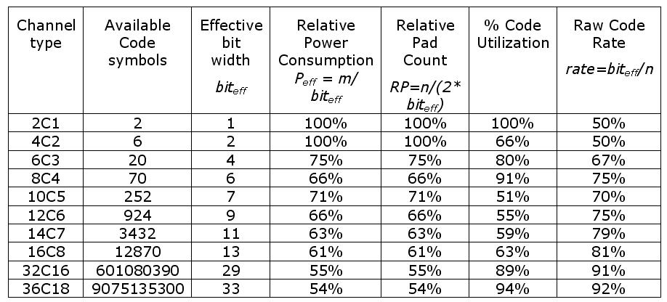
“N choose M (nCm)” Encoding
Code set size
Effective bits
EXAMPLE
6-wire MBDS channel
code size = 20 codes
effective bits = 4
equivalent to 8-wire differential channel
25% fewer pads (8 versus 6)
25% less power (4 1-bits on versus 3)

Slide 15
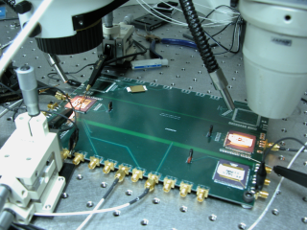
MBDS Test Chip
Test setup
.5 um SiGe chip implementing
2, 4, 6, 8-wide MBDS drivers and receivers
Test board with 8” channels
MBDS -> MBDS receivers
MBDS -> commercial LVDS receivers
Tested at 700 Mb/s

Slide 16
Talk Outline
Brief introduction to system interconnection technology
Examples
Challenges
Electrical and optoelectronic signaling
High-performance interconnection technology research at Pitt
Optoelectronic Multi-Chip Modules (OE-MCM)
Multi-Bit Differential Signaling (MBDS)
Dissertation research
Lightweight Hierarchical Error Control Codes (LHECC)

Slide 17
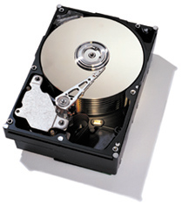
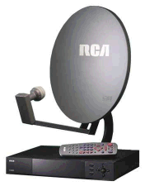
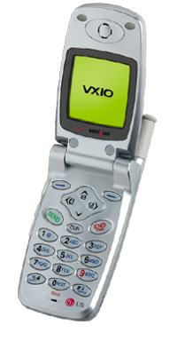
Error Correction Codes
Error correction codes used to increase signal integrity
Noisy communication channels
Ex: wired/wireless signaling, storage mediums
Examples:
Cellular networks, deep-space signaling, digital TV/HDTV transmission, hard/optical disks
ECC codes require information overhead
Acceptable for very noisy channels
Minimize by applying code over large blocks of data
Examples:
11 bytes for hard disks, 187 bytes for HDTV

Slide 18
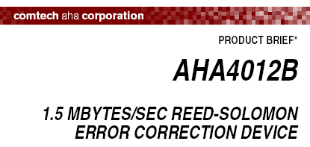
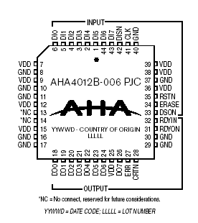
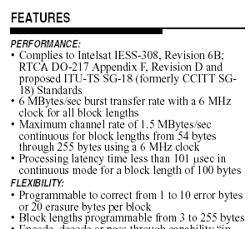
ECC Introduction
ECC encoding over large blocks requires
Memory
Computation
Encoding/decoding performed using software or dedicated ASICs
Decoding performed at low speeds (megabits at most)
Traditional ECC techniques not practical for off-chip interfaces
Memory, real estate
Need new class of ECC code for system interconnect
Encode/decode with small space
Small block size
Low overhead
Possible with MBDS signaling?

Slide 19
nCm Encoding: Inherent Error Detection
Most types of bit errors can be detected at receiver
Odd-number of bit errors
1011
1101
0111
1110
0011
0001
1000
0010
0100
1 error
3 errors
Even-number of bit errors
0011
1111
1001
1010
0101
0110
0000
2 errors

Slide 20
nCm Encoding: Inherent Error Detection
Channel | P(detect 2-bit error) | P(detect 4-bit error) | P(detect 6-bit error)
4c2 | 33%
6c3 | 40% | 40%
8c4 | 43% | 49% | 43%

Slide 21
nCm Encoding: Unused Code Space
Each nCm code set has unmapped code words
Use this to offset overhead required for error control
4c2 symbol set => binary value
0011
00
0101
01
0110
10
1001
11
1010
?
1100
?
6 cw
6 cw
36 combinations
5 bits
Use multiple MBDS channels in parallel
4c2
4c2
2 bits
2 bits
Do not use nCm symbols that are counteractive to ECC
Req’d number of channels for extra bit

Slide 22
Need for Error Control Coding
Single or multiple bit errors in nCm symbols invalidates entire corresponding binary message
Some types of errors fool receivers
Need error control code that:
Works over nCm-encoded channels
Uses properties of nCm channel code to minimize overhead
Solution:
Encode data over parallel MBDS channels
Establish rules governing nCm symbols selected to encode data
6 bits
00110011
00111011
????

Slide 23
Hierarchical Encoding
Use nCm symbols to build code set which conforms to binary distance for ECC
start with raw binary data
Raw binary data
Encode portion of data, set rules for nCm symbol selection
Symbolic ECC block
high-level code
Encode remainder of data using nCm symbols
Code word over parallel MBDS channels
low-level code

Slide 24
Low-Level Code
nCm code sets have distance=2
t = floor((d-1)/2)
Set new distance by partitioning into equal-size subsets
Maximize number of symbols/subset
Example:
4c2, distance=4
Subsets:
0 => {0011, 1100}
1 => {0101, 1010}
2 => {0110, 1001}
If subset is known, bit errors may be corrected
Example: 0111, subset=2
Correct to 0110
1100
0101
1001
0011
0110
1010

Slide 25
High-Level Code: Linear Block Codes
Can correct:
erasures
errors
block size=n
k data symbols
n-k parity symbols
Checksum
Requires 1 parity symbol
Can correct 1 erasure
Near-MDS code
Corrects erasures:
Number of parity symbols - 1
Corrects errors:
(Number of parity symbols – 1) / 2
Restrictions:
Symbol base must be prime or power of a prime
If symbol base = p^{m}, max block size = p^{m+1} - 1
MDS code (Reed-Solomon)
Can correct erasures:
Number of parity symbols
Can correct errors:
Number of parity symbols / 2
Restrictions:
Symbol base must be prime or power of a prime
Max block size = symbol base + 1

Slide 26
Encoding LHECC
b bits
01010010010010010100
(s-data)
(c-data)
0101001001
0010010100
base conv. 2->s
base conv. 2->c
Data symbols
Parity symbols
Data as nCm symbols
Parity as nCm symbols

Slide 27
Example #1: Encoding
Assume 3 x 4c2 channels
Low level
s=3, c=2
High level
(3,2) checksum code
s-data
s^{k} = 9 cw (3 bits)
c-data
c^{n} = 8 cw (3 bits)
code rate = 6 bits / 12 wires
“Free” ECC
Encode 111101…
111₂ = 21₃
2
1
Compute checksum parity…
2
1
0
Encode 101…
bit
1
0
1
grp.
2
1001
1
0101
0
1100

Slide 28
Example #1: Decoding
Decoder:
If invalid code word is detected
Determine subset
Use minimum distance decoder
Assume bit error occurs…
grp.
2
1
0
?
1
0
cw
1001
0101
1100
1101
0101
1100
X + 1 = 0 (mod 3), X = 2
Symbol in error must be 0110 or 1001
dist(1101,0110) = 3, dist(1101,1001) = 1
Corrected symbol is 1001

Slide 29
LHECC Advantages
LHECC codes provide correction and additional detection to MBDS links
LHECC codes are lightweight:
Parity symbols in high-level only consume portion of nCm symbol data
Requires less parity symbols in high-level code (vs. traditional codes)
Takes advantage of inherent properties of nCm channel code
LHECC encoders/decoders require only a few hundred logic gates
Pipelined and operate at core speed
MBDS driver
MBDS receiver
binary
encoder
MBDS driver
MBDS receiver
decoder
binary
MBDS driver
MBDS receiver

Slide 30
Link Modeling
encoded code words
(CMOS digital)
encoded code words out (100K load)
Input is sampled at midpoint
Replicated for each channel in the link
Consistent sequence of random code words transmitted
Driver input
cw_{n-1}
cw_{n}
cw_{n+1}
Outputs sampled at t(input) + latency
Receiver output
cw_{n-1}
cw_{n}
cw_{n+1}
latency

Slide 31
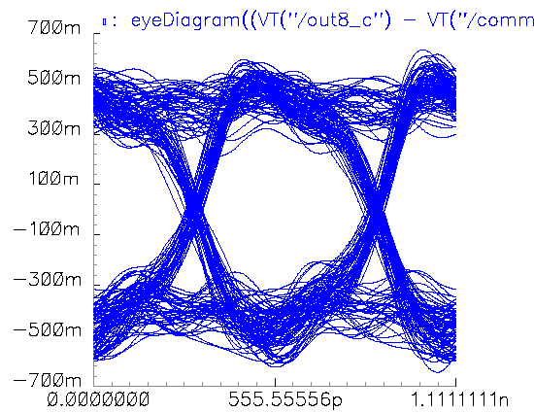
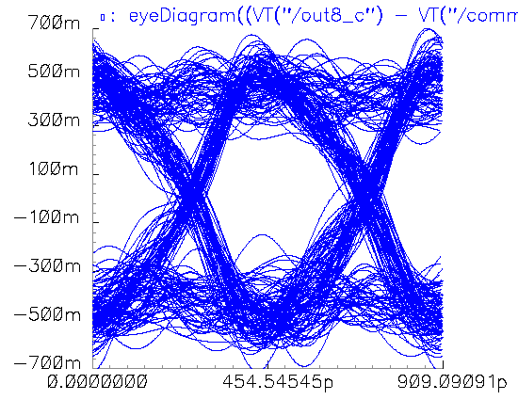
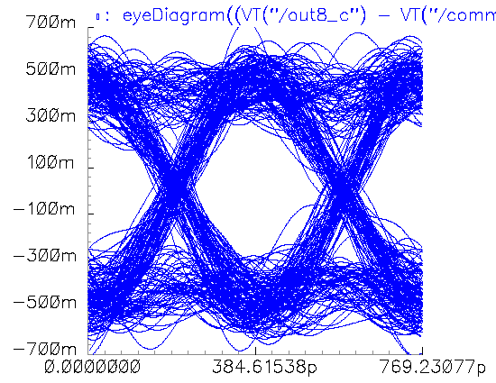
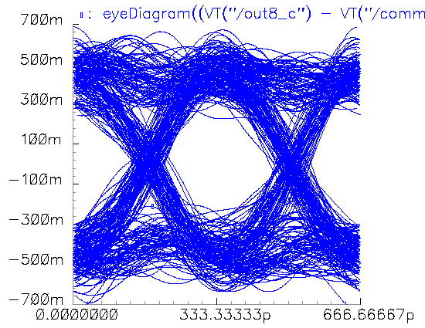
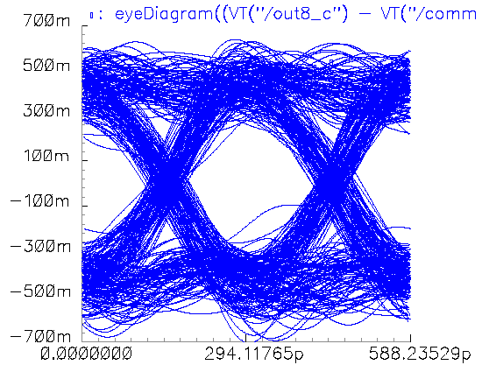
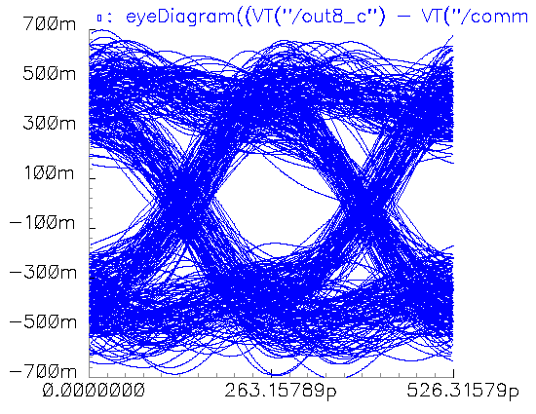
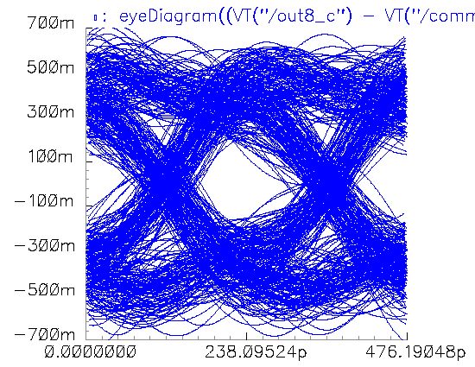
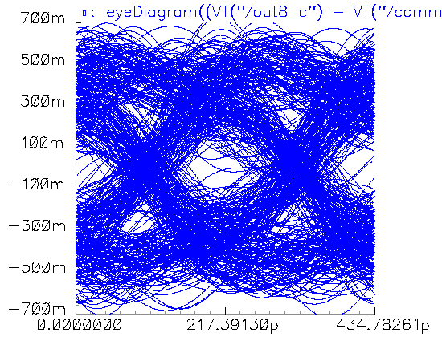
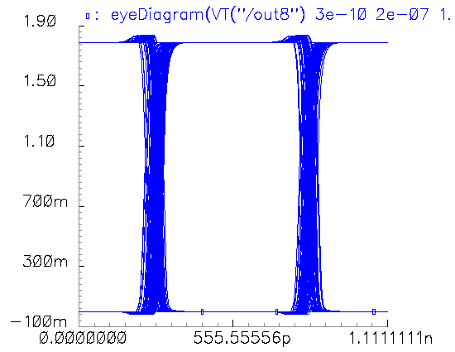
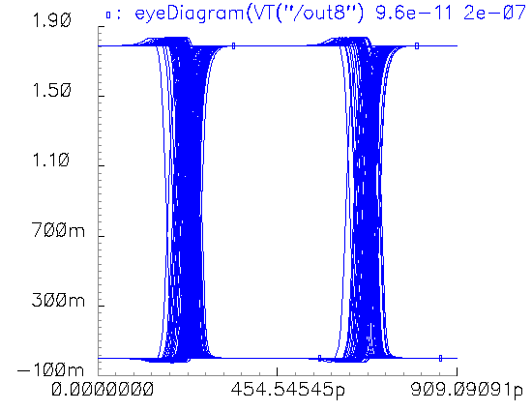
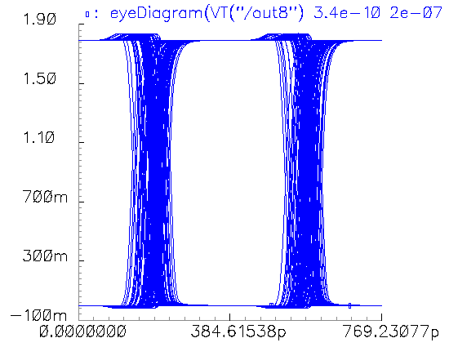
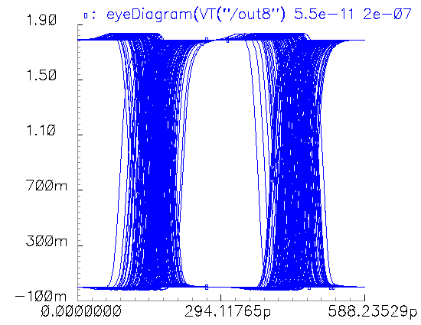
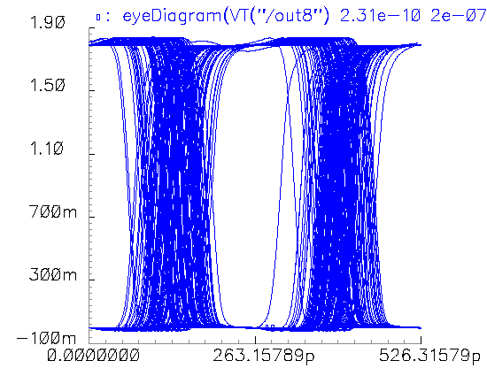
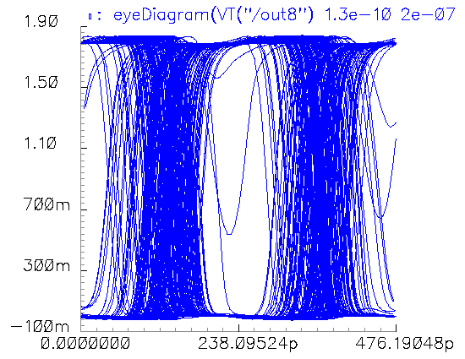
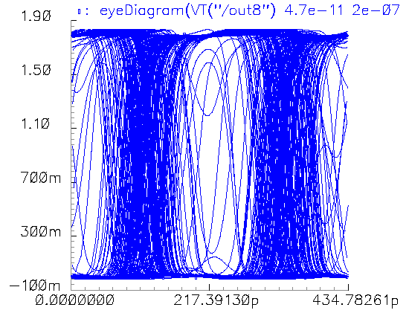
Error Source Modeling
Goal: Capture link behavior in the presence of modeled error sources
Determine relative error results for links with and without LHECC support
Error sources from link model:
Jitter
Transmission line attenuation, crosstalk
Noise from transistors
Input to receiver
1.8 GCW/s
2.2 GCW/s
2.6 GCW/s
3.0 GCW/s
3.4 GCW/s
3.8 GCW/s
4.2 GCW/s
4.6 GCW/s
Receiver output

Slide 32
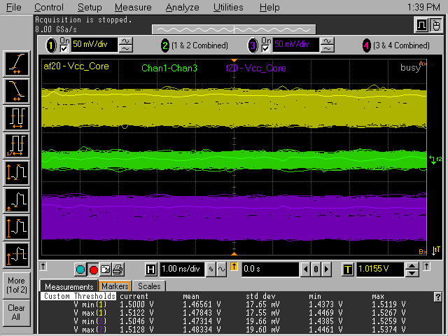
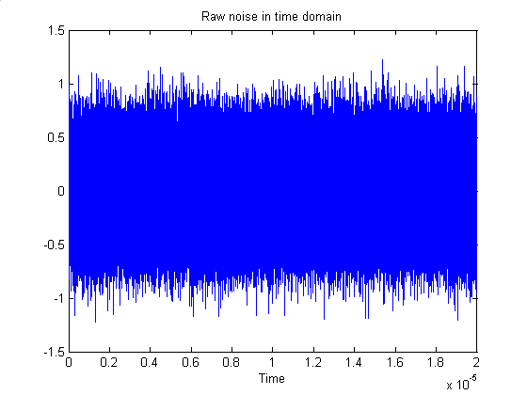
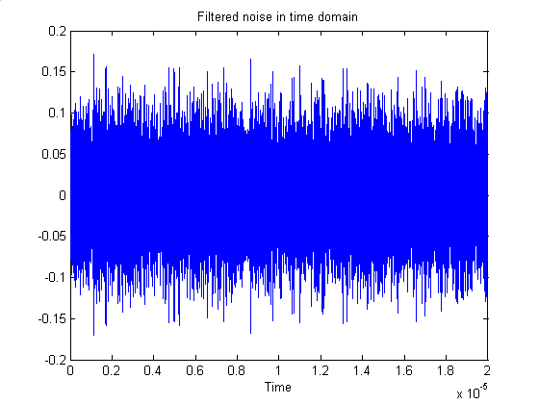
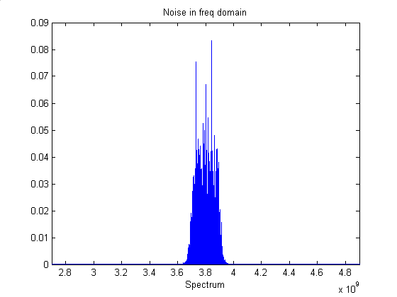
Supply Noise
Add independent V_{dd} noise to driver and receiver
Intel: measured supply noise on a busy 1.5 V Pentium 4 processor
17-20 mV standard deviation
To generate:
Assume links operating at core switching frequency
Generate white Gaussian noise
Sampled at 20 GHz for 20 us
Apply passband butter filter to noise, 200 MHz band centered on op. frequency
stdev=.275
stdev=.0388

Slide 33
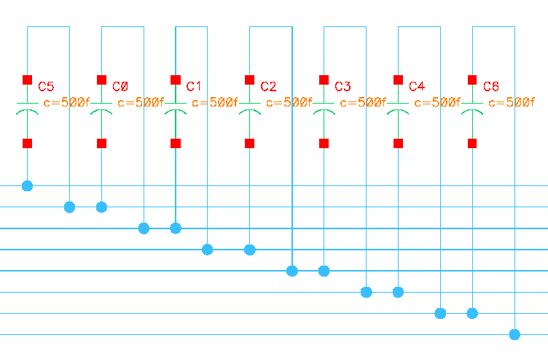
Fringe Capacitance in Driver
Assume layout parasitics and packaging add capacitance effects in driver current-steering legs
Where it hurts drivers most
Adds additional crosstalk

Slide 34
Experimental results (no noise)
 | detects+errors |  | errors
 | base freq. | differential | base freq. | differential
3x4c2 | 3.8 GHz | 400 MHz | 4.2 GHz | 600 MHz
3x6c3 | 3.2 GHz | 600 MHz | 3.8 GHz | 800 MHz
3x8c4 | 2.8 GHz | 800 MHz | 3.6 GHz | 800 MHz

Slide 35
Experimental results (supply noise)
 | detects+errors |  | errors
 | base freq. | differential | base freq. | differential
3x4c2 | 3.6 GHz | 400 MHz | 4.0 GHz | 600 MHz
3x6c3 | 3.0 GHz | 600 MHz | 3.6 GHz | 1 GHz
3x8c4 | 2.8 GHz | 600 MHz | 3.4 GHz | 1 GHz

Slide 36
Experimental results (fringe capacitance)
 | detects+errors |  | errors
 | base freq. | differential | base freq. | differential
3x4c2 | 3.4 GHz | 400 MHz | 3.8 GHz | 600 MHz
3x6c3 | 3.0 GHz | 600 MHz | 3.6 GHz | 400 MHz
3x8c4 | 3.0 GHz | 600 MHz | 3.6 GHz | 400 GHz

Slide 37
Conclusions
System-level interconnect
Next-generation interconnect
optoelectronic (high density channel arrays)
serialized electrical using encoding techniques
LHECC over MBDS channels offers lightweight error control
Increases signal integrity, reliability, noise immunity, and maximum transmission rate
Utilizes small encoders and decoders

