Slide 1
OpenVX Graph Acceleration
Jesse Villarreal, Lucas Weaver, Kedar Chitnis (TI)
Jason D. Bakos and Madushan Abeysinghe (USC)
Prior work by Yang Gao (Ph.D.), Fan Zhang (Ph.D.),
Konstantin Rubin, Benjamin Morgan (B.S.) , Shaun Gause (M.S.)
Heterogeneous and Reconfigurable Computing Group

Slide 2
Heterogeneous and Reconfigurable Computing Group
Domain-Specific Processors (FPGA, GPU, DSP)
Tools
Applications
TI collaboration since 2013
2013-2016 (Shannon/Hawking):
HPC and Vision applications
DSL for auto-tuning
Automatic scratchpad allocation
2017-current (ADAS TDA2x):
Computer vision

Slide 3
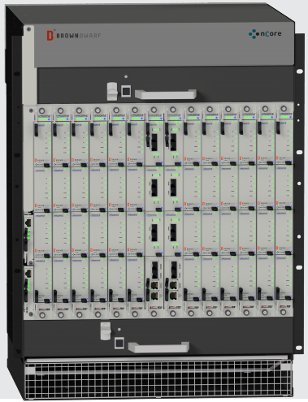
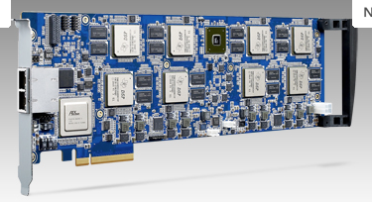
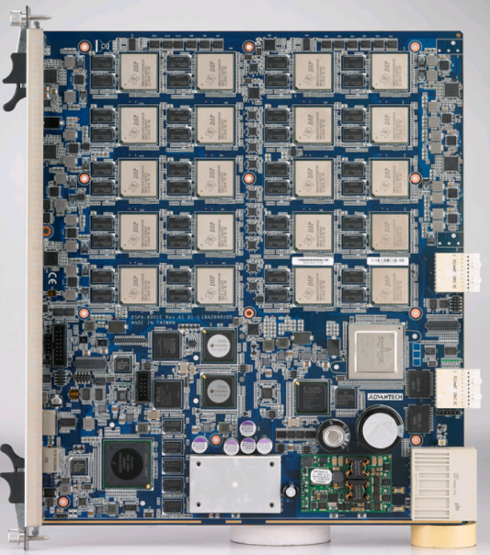
HPC and Vision Applications
8xShannon Advantech
16xShannon Advantech
144x(Hawking+Shannon)
nCore
Shannon 45nm (8 c66x, 2012): 128 spGflops@10 Watts -> 12.8 Gflops/Watt peak
Nvidia K20x 28nm (2013): 3.95 spTflops@225 Watts -> 17.6 Gflops/Watt peak
Intel 22nm Xeon Phi 5110p: 2.12 spTflops@225 Watts -> 9.4 spTflops/Watt
i7 Ivy Bridge (22nm): 448 spGflops@77 Watts -> 5.8 spGflops/Watt

Slide 4
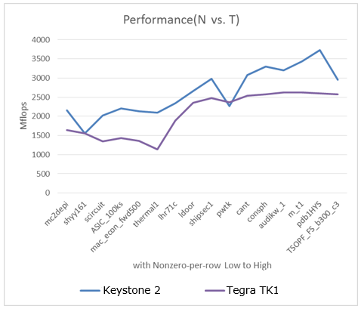
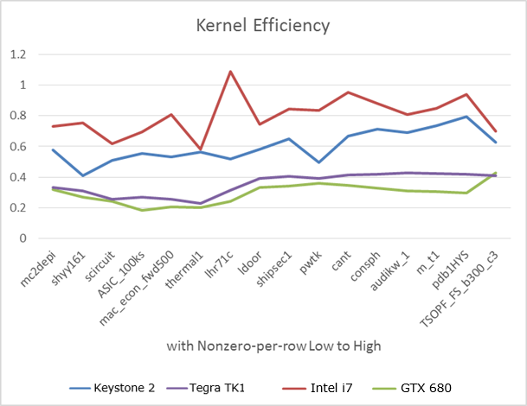
HPC and Vision Applications
Sparse Matrix-Vector Multiply
Symmetric Sparse Matrix-Vector Multiply
Developed tiled approach to limit slowdown to 30 to 40% vs. non-symmetric

Slide 5
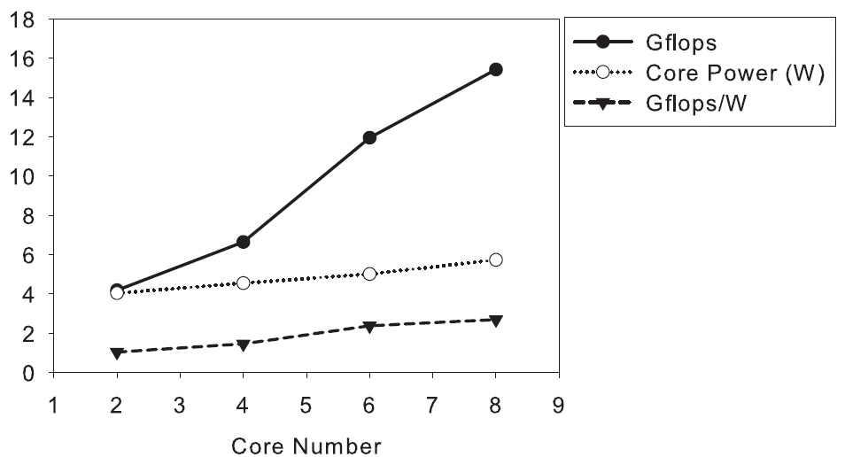
HPC and Vision Applications
Dense Lucas-Kanade Optical Flow
Platform | C66x Shannon | CortexA9 | Intel i7-2600 | K20
Actual Gflops/ Peak Gflops | 12% | 7% | 4% | 3%
Gflops | 15.4 | 0.7 | 17.1 | 108.6
Power (W) | 5.7 | 4.8 | 52.5 | 79.0
Gflops/W | 2.69 | 0.2 | 0.3 | 1.4

Slide 6
DSL for Auto-Tuning Stencil Loops
PIA
LLVM IR
Assembly Code
Executable
Unroll
SIMD
Align
STENCIL(foo)
$t = A[-1,0] * @c1 +
A[0,0] * @c2 +
A[0,1] * @c3;
C = 1.0 / $t;
END
Kernel | Baseline II | Optimized II | Strategy
Matrix Add | 2 | 1.5 | Unroll 2x+SIMD
1x3 Mean | 2 | 2
3x3 Mean | 5 | 4.5 | Unroll 6x
Jacobi | 3 | 2.5 | Unroll 2x or 4x
Gaussian | 4 | 4
Sobel | 5 | 4.25 | Unroll 8x
Harris Corner | 27 | 14 | Unroll 2x+SIMD
Lucas Kanade | 15 | 9.5 | Unroll 2x+SIMD
%size_x = N
loop:
%j = phi i32 [ 0, %beforeloop ], [ %next_j, %loop]
%1 = add i32 %j, %0
%I0a = getelementptr inbounds float* %I0, i32 %1
%I0v = load float* %I0a, align 4
%I1a = getelementptr inbounds float* %I1, i32 %1
%I1v = load float* %I1v, align 4
%r = fadd float %I0v, %I1v
%O0a = getelementptr inbounds float* %O0, i32 %1
store float %r, float* %O0a, align 4
%next_j= add i32 %j, 1
%2 = icmp slt i32 %next_j, %size_x
br i1 %2, label %loop label %afterloop
afterloop:

Slide 7
Automatic Scratchpad Allocation
SpMV: 5 arrays (val, col, ptr, y, prod) and 4 allocation targets (L1S, L2S, MSMC, cache)
4⁵=1024 possible configurations
Non-zeros per row | val | col | ptr | y | prod | Gflops | Norm. Perf | Note
3 | S S L2 C | L2 L2 L2 C | L2 L2 C C | L2 L2 C C | L1 L2 S C | 2.26 1.84 1.23 1.44 | 1.57 1.28 0.85 1 | Best Median Worst¹ All cache
151 | L2 S C C | S C C C | L2 L2 C C | L2 L2 C C | L2 S L2 C | 3.76 3.55 2.66 2.51 | 1.50 1.41 1.06 1 | Best Median Worst¹ All cache
L1:level 1 SPRAM, L2:level 2 SPRAM, S:MSMC, C:cache
1: The worst amongst the configurations with SPRAM

Slide 8
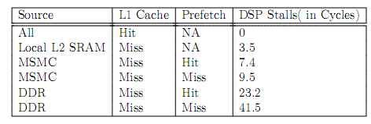
Automatic Scratchpad Allocation
$$T_{all}=T_{compute}+T_{EDMA}$$
$H_{i}$, $M_{i}$: prefetch hit, miss from XMC
(isolate specific arrays)
$$T_{compute}=T_{pure}+T_{MSMC}+T_{L2S}+T_{DDR}$$
$$T_{MSMC}=\sum_{i}^{M}{\left(H_{i}×{SH}_{MSMC}+M_{i}×{SM}_{MSMC}\right)}$$
${SH}_{x}$, ${SM}_{x}$: datasheet
$$T_{L2S}=\sum_{i}^{L2}{\left[\left(H_{i}+M_{i}\right)×S_{L2}\right]}$$
$$T_{DDR}=\sum_{i}^{D}{\left[\left(H_{i}×{SH}_{DDR}+M_{i}×{SM}_{DDR}\right)×α×β(r)\right]}$$
$$T_{EDMA}=\sum_{i}^{M+L2}{\frac{C_{tile}}{B}}$$

Slide 9
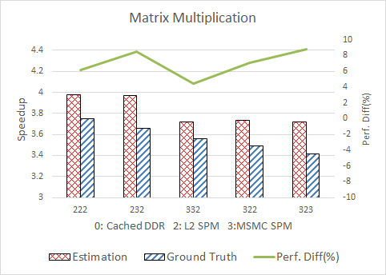
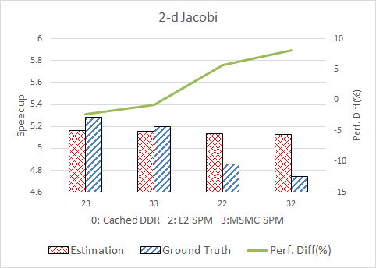
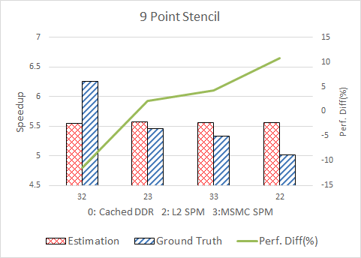
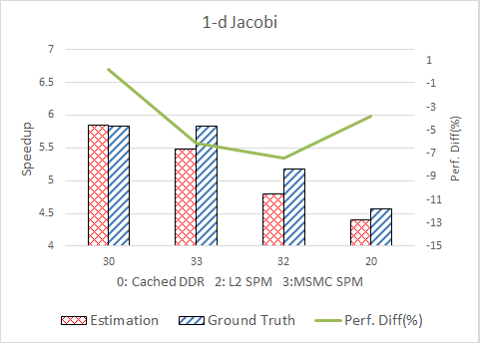
Automatic Scratchpad Allocation

Slide 10
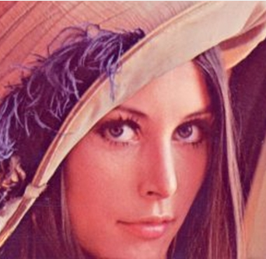
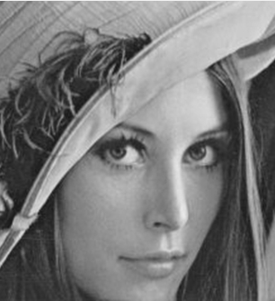
OpenVX/BAM on ADAS TDA2x
ADAS TDA2x: 2-core C66x @750 MHz
BAM: L2S/DMA only
OpenVX: pixel-by-pixel vision primitives
Offloaded kernels executed sequentially
vxColorConvertNode
vxGaussian3x3Node
vxChannelExtractNode

Slide 11
OpenVX and BAM (current work)

Slide 12
OpenVX and BAM (current work)
(out)
(process)
(in)

Slide 13
DMA and Scratchpad
time
input ping buffer
tile n+1
tile n+1
tile n+1
input pong buffer
tile n
tile n
tile n
tile n+2
tile n+2
tile n
tile n
output ping buffer
tile n-1
tile n+1
tile n+1
tile n-1
tile n-1
output pong buffer
tile n
tile n
tile n+2
tile n
processor
trigger
process tile n
idle
trigger
process tile n+1
idle
trigger
process tile n+2
DMA controller
idle
write tile n-1 to DRAM
read tile n+1 from DRAM
idle
write tile n to DRAM
read tile n+2 from DRAM
idle
write tile n+1 to DRAM
max(trigger+compute,trigger+DMA)
max(compute,DMA)

Slide 14
Factor 1: Tile Size
2.11X
1.58X
best compute
best DMA
best max(DMA,compute)

Slide 15
Factor 2: Scratchpad Access Pattern
DRAM -> scratchpad (A)
DRAM -> scatchpad (E)
scatchpad -> DRAM (F)
scratchpad -> DRAM (B)
vxColorConvertNode
ex. time = X
vxGaussian3x3Node
ex. time = Z
DRAM -> scratchpad (C)
vxChannelExtractNode
ex. time = Y
scratchpad -> DRAM (D)
time = max(C+D,Y)
scratchpad buffers: 2, size = scratchpad/4

Slide 16
Factor 2: Scratchpad Access Pattern
DRAM -> scratchpad (A)
DRAM -> scatchpad (E)
scatchpad -> DRAM (F)
scratchpad
vxColorConvertNode
ex. time = X
vxGaussian3x3Node
ex. time = Z
scratchpad
vxChannelExtractNode
ex. time = Y
time = max(A+D,(X+Y)/λ)
scratchpad -> DRAM (D)
scratchpad buffers: 3, size = scratchpad/6

Slide 17
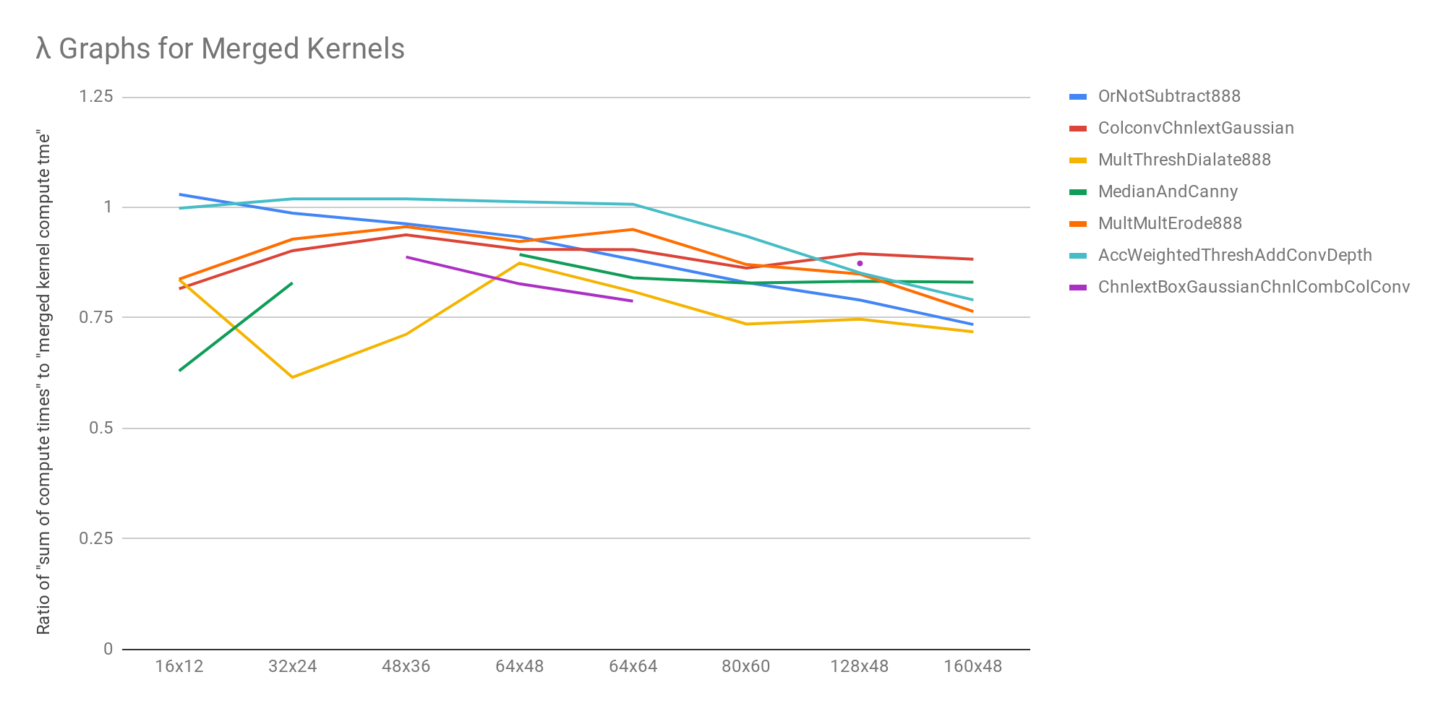
Lambda
λ Values for Merged Kernels (Observed)

Slide 18
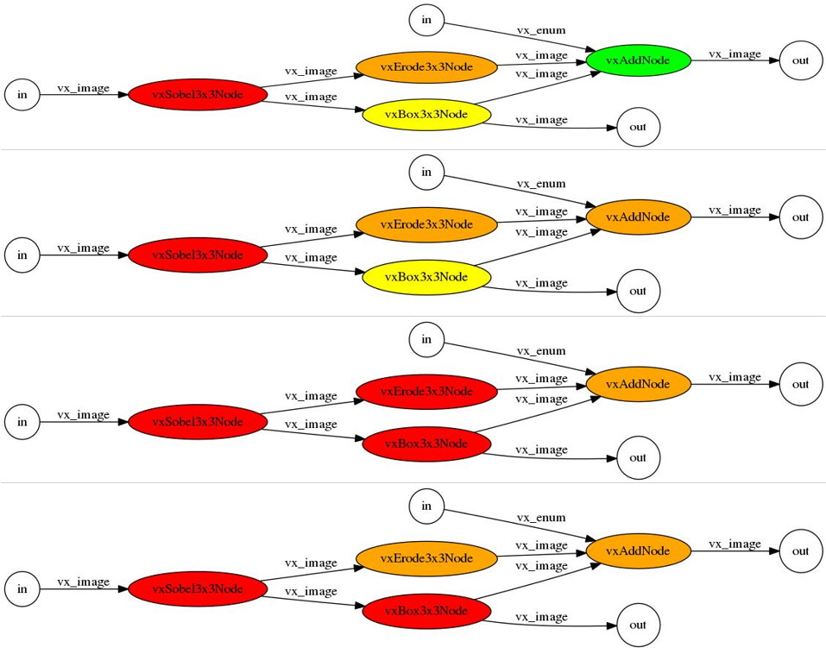
Graph Partitioning
$$B_{n}=\sum_{k=0}^{n−1}{\left(\begin{matrix}n−1 \\ k\end{matrix}\right)}B_{k}$$
$$B_{0}=1$$
B₆ = 203
B₇ = 877
B₈ = 4140
B₉ = 21147
B₁₀ = 115975
B₁₁ = 678570
B₁₂ = 4213597

Slide 19
Performance Considerations
Problem:
Group size determines:
Number of DMA transactions
Maximum tile size
Tile size determines:
DMA bandwidth
Compute throughput
Graph time = sum of group times
Approach:
Train memory performance model and compute model to optimize grouping and tile size together

Slide 20
DMA/Memory System Performance Model
Characterize:
19 kernels (originally 35), 25 tile sizes, all possible pixel depths (per kernel)
1460 total test cases (culled from 2819 original tests)
Features:
input tile width, height in pixels (TIW, TIH)
output tile width, height in pixels (TOW, TOH)
total input, output width (tile width x pixel size x number of inputs) (TTIW, TTOW)
total input, output size, TTIW*TIH (TIS, TOS)
number of inputs, outputs (NI, NO)
pixel depth (PD)
stencil neighborhood width, height (SNW, SNH)
Best accuracy: TTIW, TIH, TTOW, TOH

Slide 21
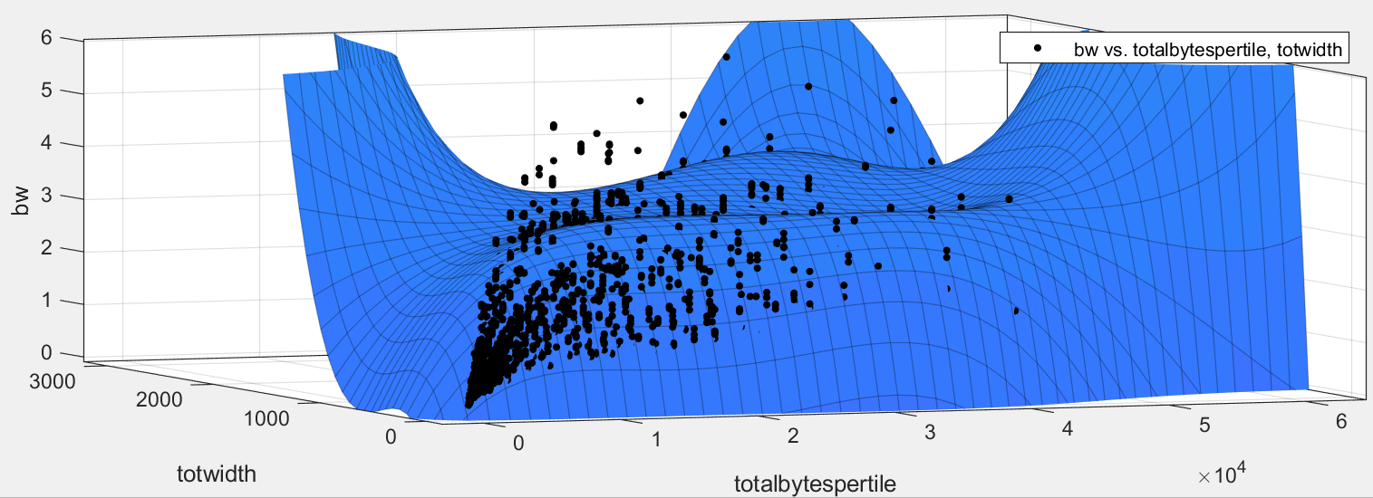
Curve-Fitted Memory Model

Slide 22
Equivalence Classes
Feature combinations | #Classes/ Ave. Size | Ave. /max. stddev of class b/w | Mean error of classes
TTIW, TTOW, TIH, TOW, NI, NO, TIS, TOS | 500 2.9 | 6.7 MB/s 100 MB/s | 114 MB/s
TIW, TIH, NI, NO, TIS, TOS, SNW, SNH | 500 2.9 | 6.7 MB/s 100 MB/s | 219 MB/s
TTIW, TIH, TTOW, TOH | 448 3.3 | 17 MB/s 340 MB/s | 100 MB/s

Slide 23
Performance Models
DMA: linear interpolant model of DMA b/w
Find nearest 5 observations
Calculate weights
$w_{i}=\frac{\frac{1}{{distance}_{i}}}{\sum_{j}{\frac{1}{distance_{j}}}}$
Calculate weighted average
RMS training error = 32 MB/s
RMS testing error = 248 MB/s
Range = 189 MB/s to 4.33 GB/s
Compute: lookup kernel names and nearest tile WxH prod
in_width=8,
out_width=6,
in_height=48,
out_height=46
356 MB/s
in_width=16,
out_width=14,
in_height=48,
out_height=46
8.5
723 MB/s
w=.17
6.3
w=.23
in_width=16,
out_width=8,
in_height=48,
out_height=48
6.3
in_width=16,
out_width=10,
in_height=48,
out_height=42
w=.23
616 MB/s
8.0
w=.18
8.0
w=.18
in_width=16,
out_width=16,
in_height=48,
out_height=48
in_width=8,
out_width=8,
in_height=48,
out_height=48
742 MB/s
423 MB/s

Slide 24
Model Accuracy and Performance
0.13 cycles/pixel
(compute)
0.44 cycles/pixel
(compute)
0.25 cycles/pixel (compute)
Compute bound:
0.81 cycles/pixel
DMA bound:
3 x 1600x1200x1 DMA @ 4.33 GB/s @ 750 MHz
0.48 cycles/pixel

Slide 25
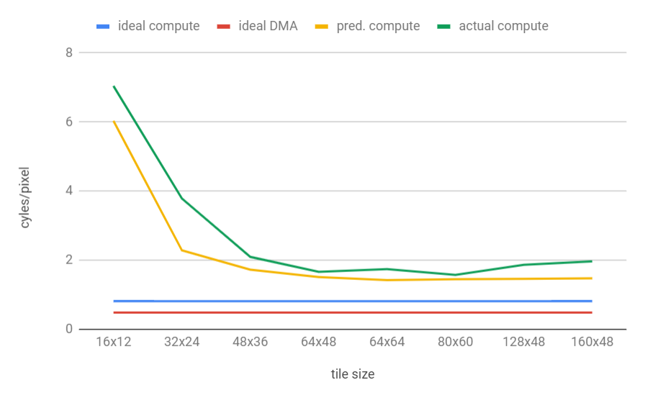
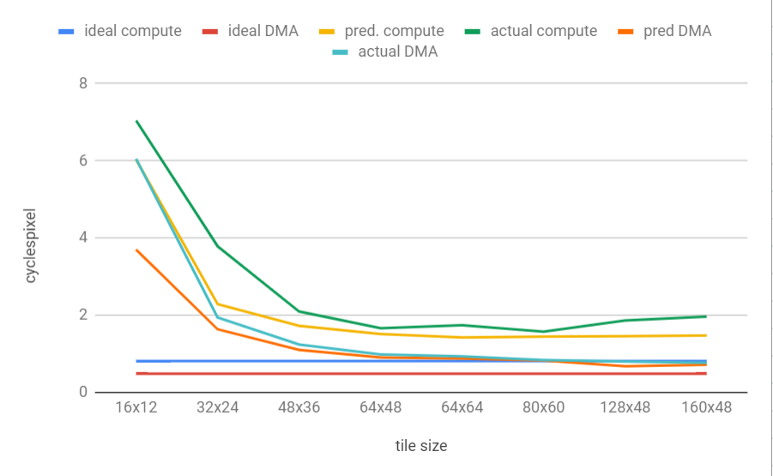
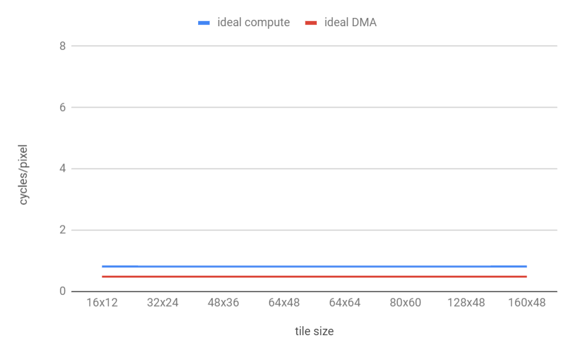
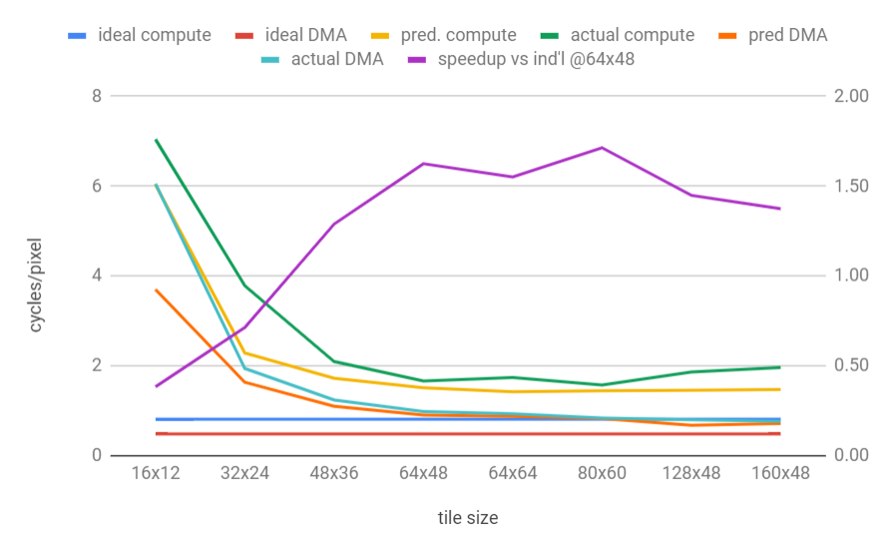
Impact of Tile Size on Merged Kernels
1.71

Slide 26
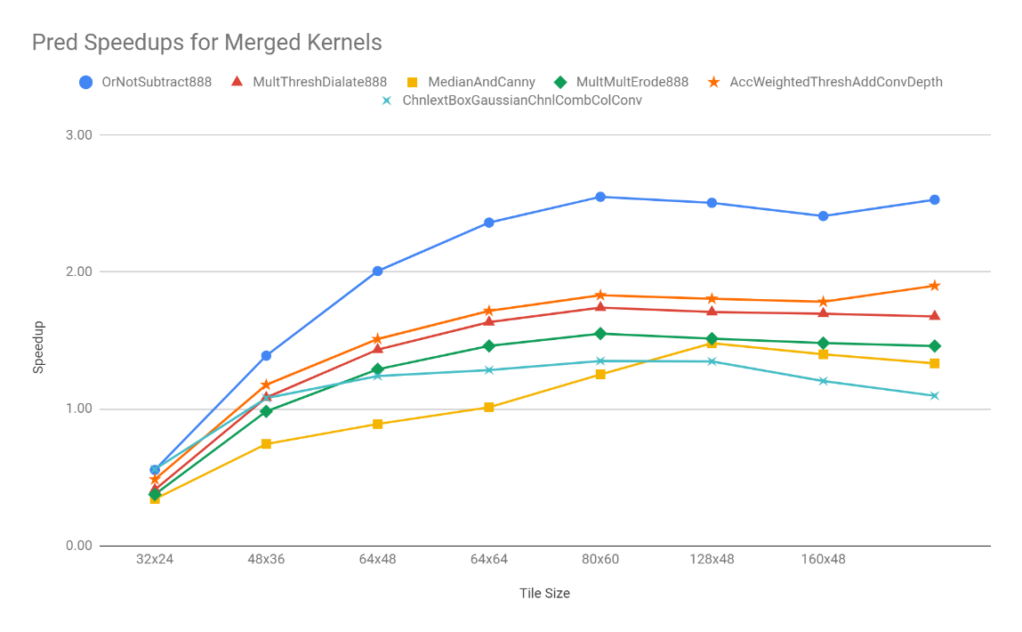
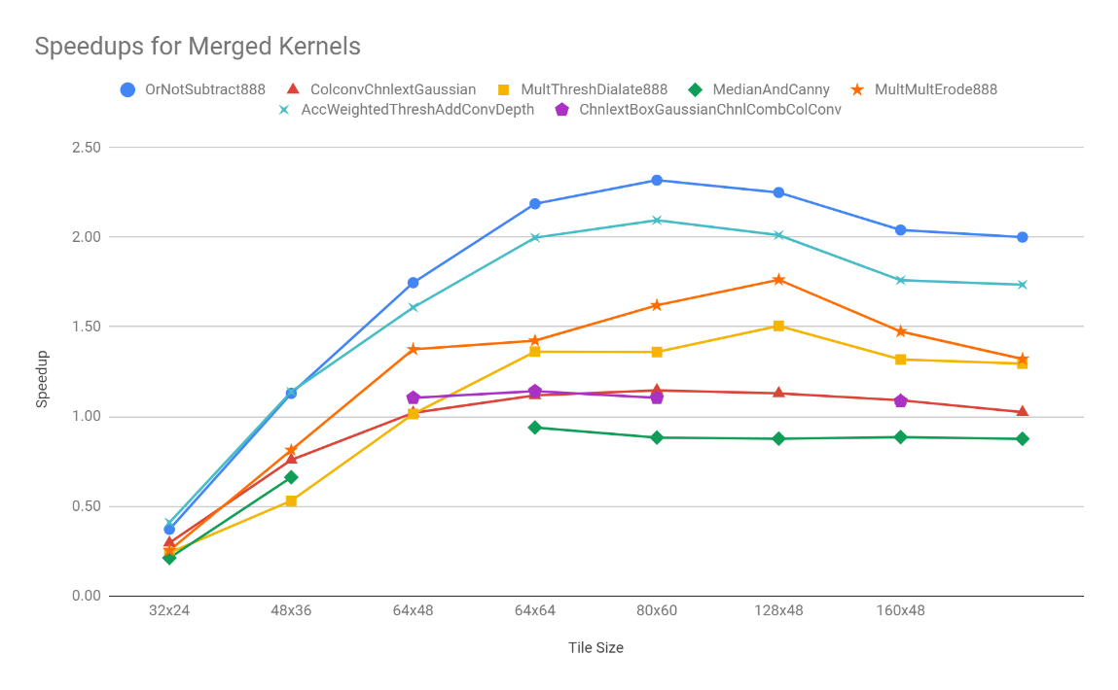
Speedups
Predicted Speedups
Actual Speedups

Slide 27
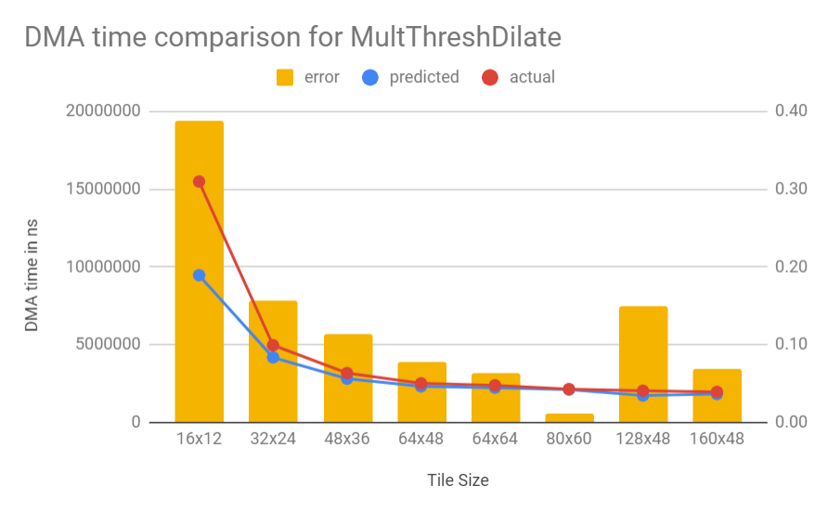
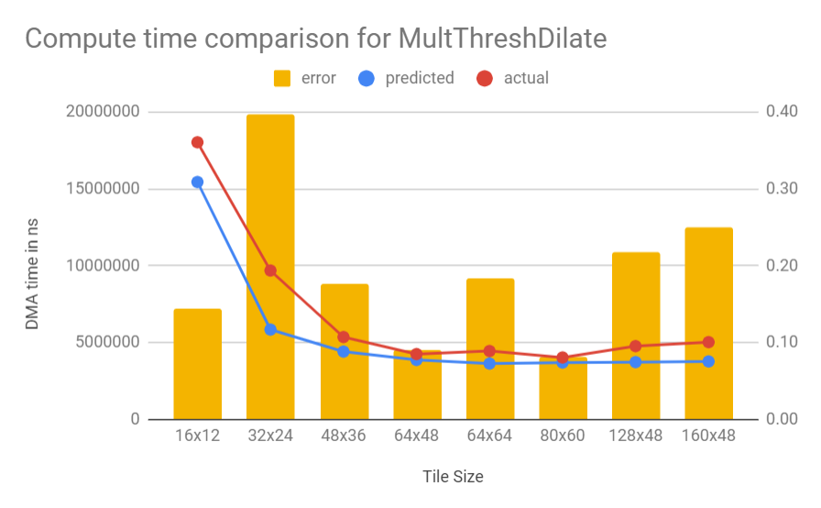
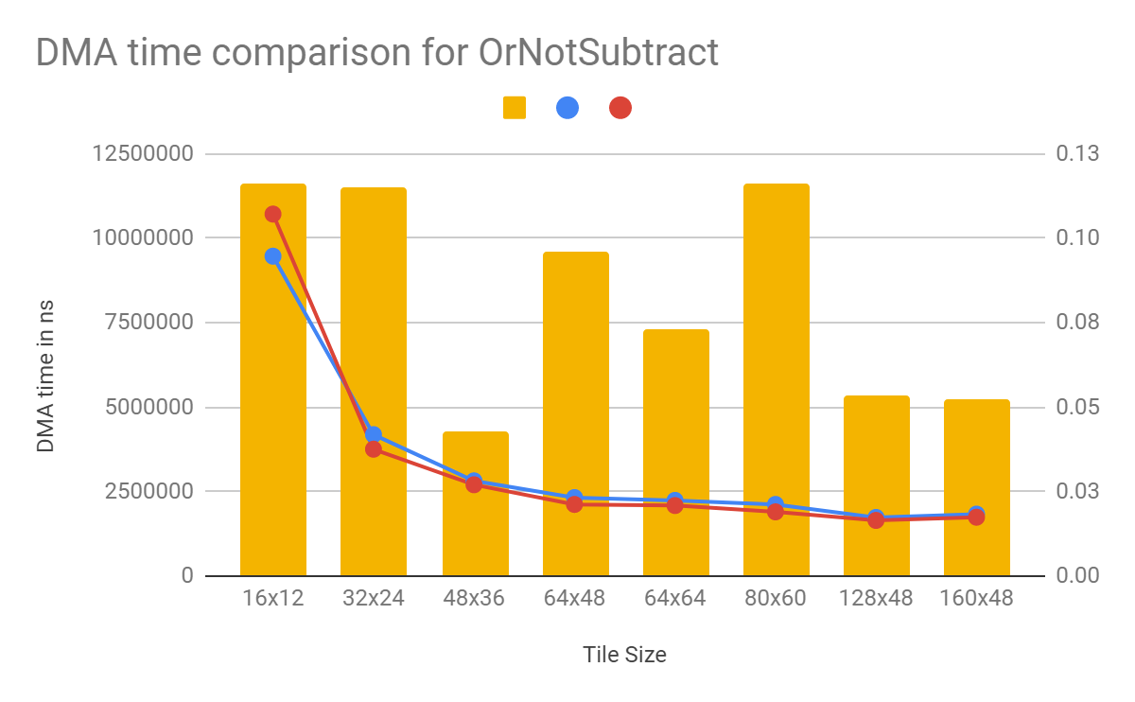
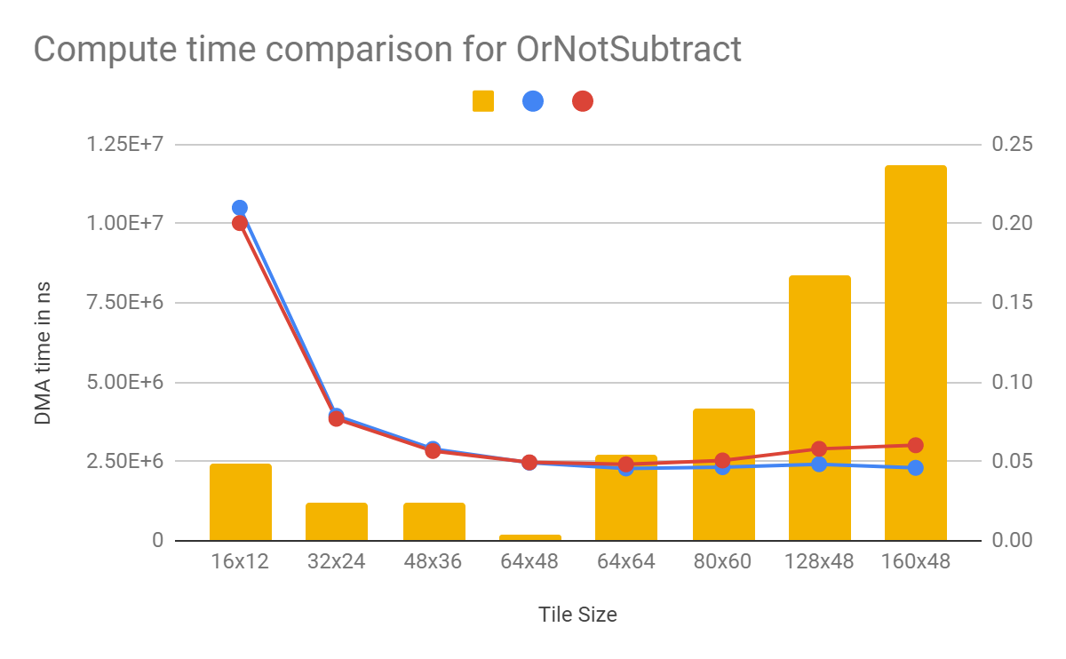
Model Accuracy

Slide 28
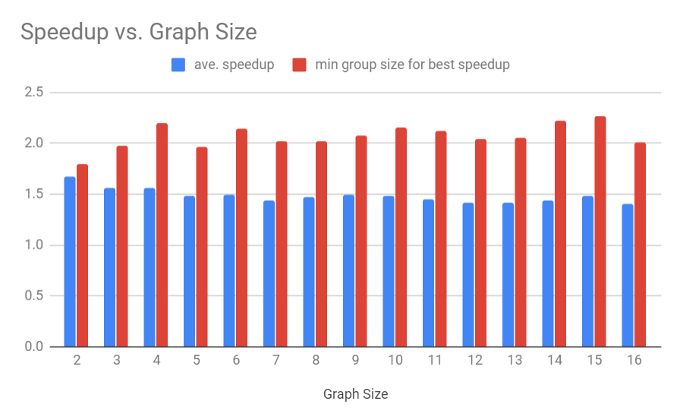
Randomly Generated Graphs
For each graph
For each grouping
For each allocable tile size (constrained by scratchpad capacity)…
Find predicted speedup (vs individual nodes with 64x48 tiles)

Slide 29
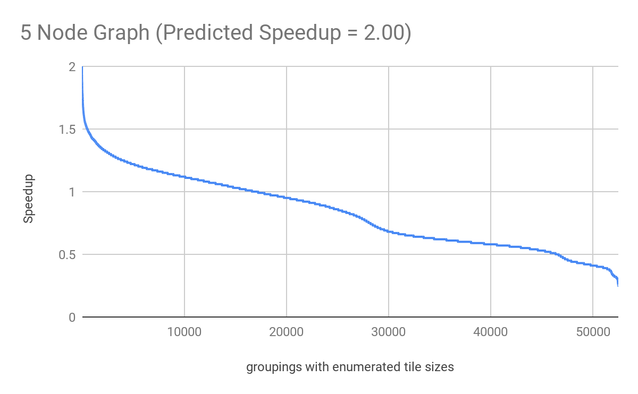
Speedup Distribution
Speedups above 1.5 = 0.95%
Speedups between 1 and 1.5 = 30.74%
Speedups below 1 = 68.30%

Slide 30
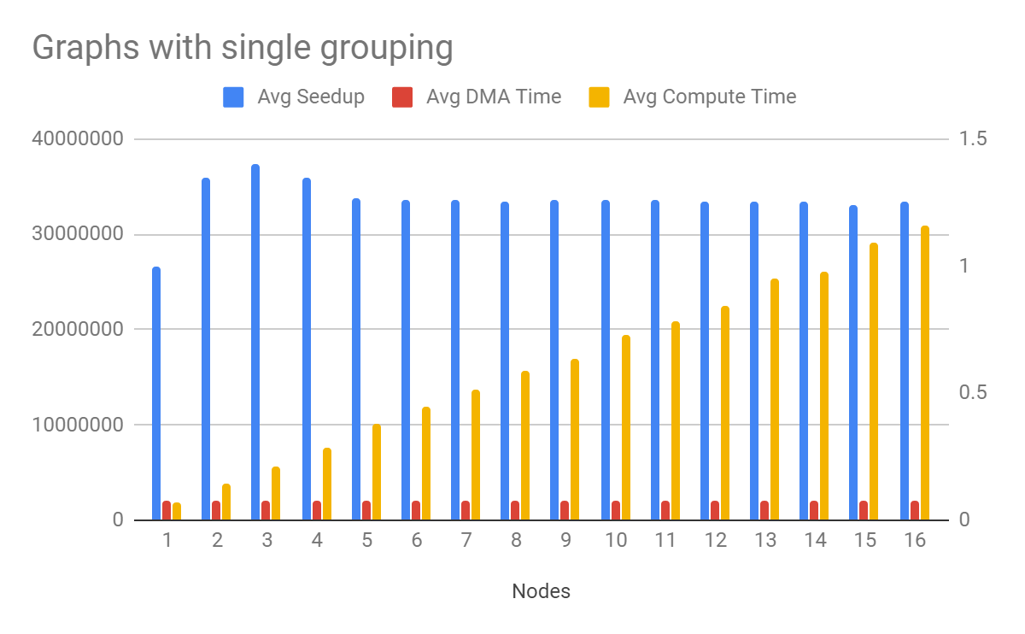
Compute/DMA Makeup

Slide 31
Impact of Tile Size
Total time for 128x48 = 9.47 ms
Group 1 DMA for 128x96 = 1.63 ms
Group 2 compute for 160x48 = 7.37 ms
Total time = 1.63 + 7.37 =9.00 ms

Slide 32
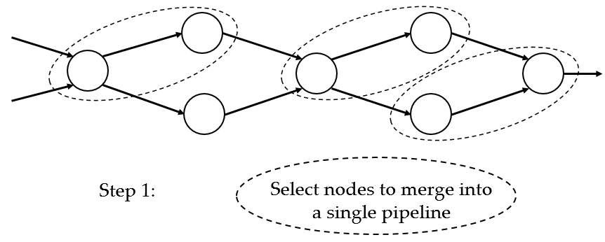
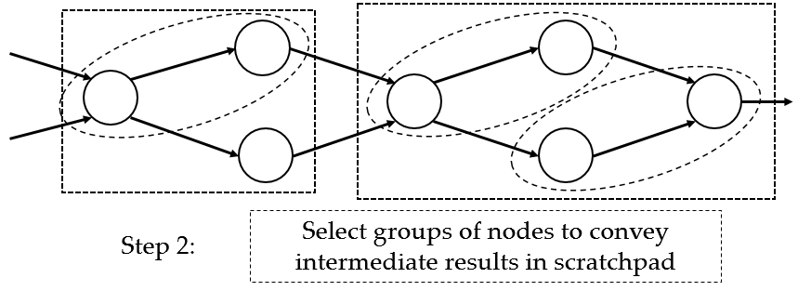
Current Work
A
Executed code:
for (i=[pixel in A])
C[i]=not A[i]
for (i=[pixel in B])
D[i]=not B[i]
for (i=[pixel in C])
E[i]=C[i]+D[i]
Requires 2 intermediate buffers C, D
Each loop achieves low IPC
Ideal code:
for (i=[pixel in A]) {
temp1=not A[i];
temp2=not B[i];
E[i] = temp1+temp2;
}
No intermediate buffers
Loop achieves higher IPC
vxNot
C
vxAdd
E
B
D
vxNot

Slide 33
Thank you!

