Slide 1
Research Overview and Administrative Vision
Jason D. Bakos, Professor
Department of Computer Science and Engineering
Heterogeneous and Reconfigurable Computing Group

Slide 2
Heterogeneous and Reconfigurable Computing Group
Objective: develop technologies to improve computer performance and efficiency

Slide 3
Heterogeneous and Reconfigurable Computing Group
Processor Generation | Max. Clock Speed (GHz) | Peak Integer IPC | Max. Number of Cores | Max. DRAM Bandwidth (GB/s) | Peak Floating Point (Gflop/s) | Max. L3 cache (MB)
Core (2006) | 3.33 | 4 | 4 | 25.6 | 107 | 8
Penryn (2007) | 3.33 | 4 | 4 | 25.6 | 107 | 8
Westmere (2010) | 3.60 | 4 | 6 | 25.6 | 173 | 12
Ivy Bridge (2013) | 3.70 | 4 | 6 | 25.6 | 355 | 15
Broadwell (2015) | 3.80 | 4 | 6 | 25.6 | 365 | 30

Slide 4
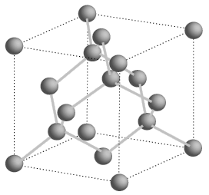
Moore’s Law?
Processor Generation | Transistor size (nm) | Number of transistors (millions)
Core (2006) | 65 | 105
Penryn (2007) | 45 | 228
Westmere (2010) | 32 | 382
Ivy Bridge (2013) | 22 | 624
Broadwell (2015) | 14 | 1300
Cannonlake (2017) | 10 | 2600
?? (2020) | 7 | 5200
?? (2022) | 5 | 10400
?? (2025) | 3 | 20800
?? (2027) | 1 | 41600
Si atom spacing = 0.5 nm

Slide 5
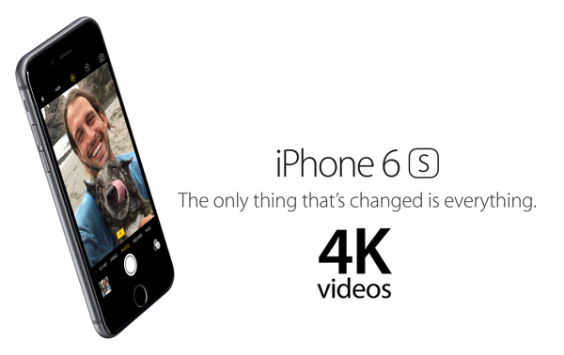
New Capabilities
What about 4K video on a phone?
What about game graphics?

Slide 6
Intel Sandy Bridge (2011)

Slide 7
Intel Haswell (2013)

Slide 8
Intel Skylake (2015)

Slide 9
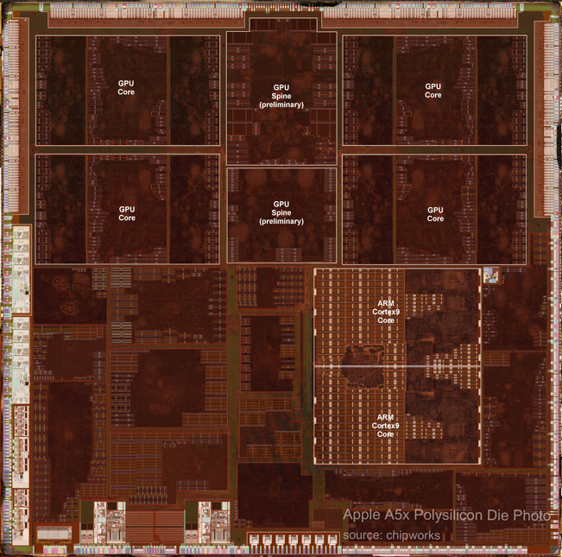
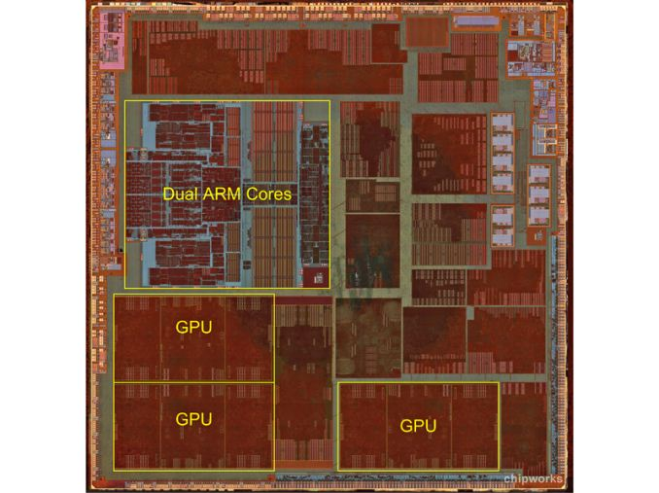
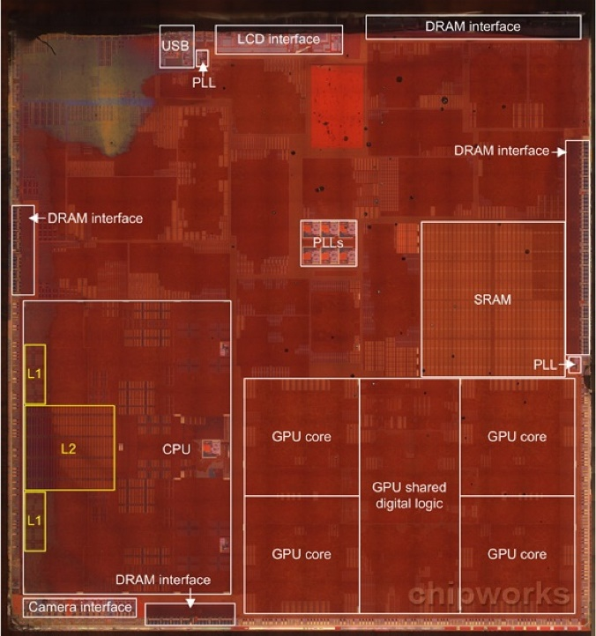
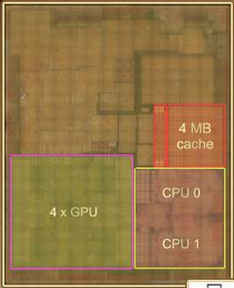
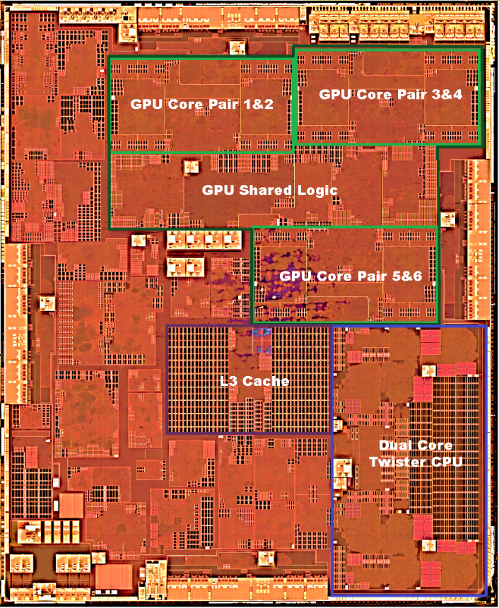
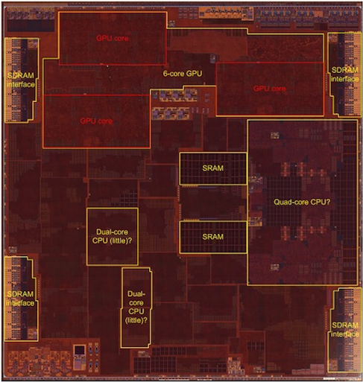
All Modern CPUs are Heterogeneous
Apple A5x
Apple A6
Apple A7
Apple A8
Apple A9
Apple A10

Slide 10
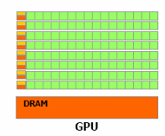
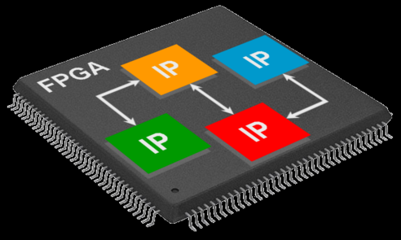
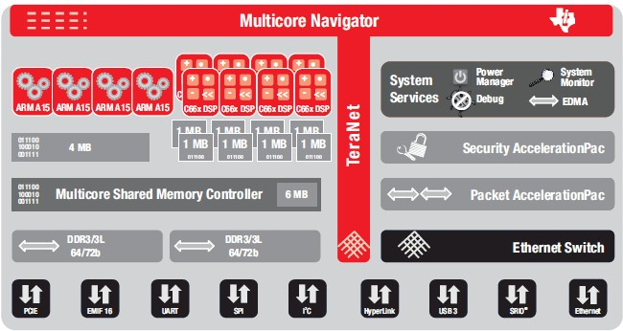
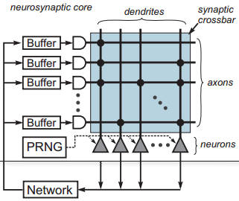
Specialized Processors?
That's great news for video and graphics
…not so great for scientific, engineering, financial, and data analytics code
For these, we need emerging processing technology

Slide 11
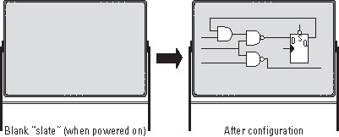
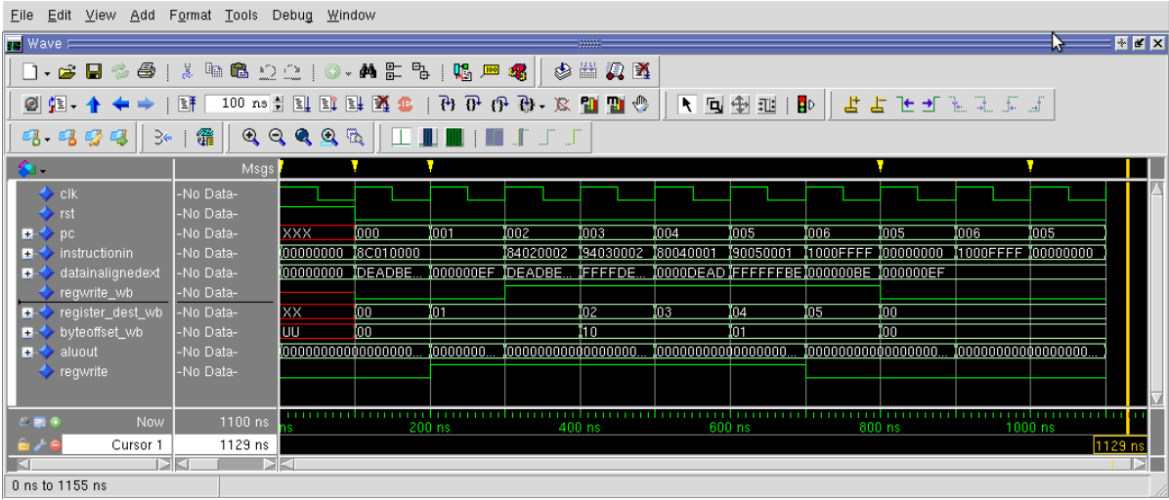
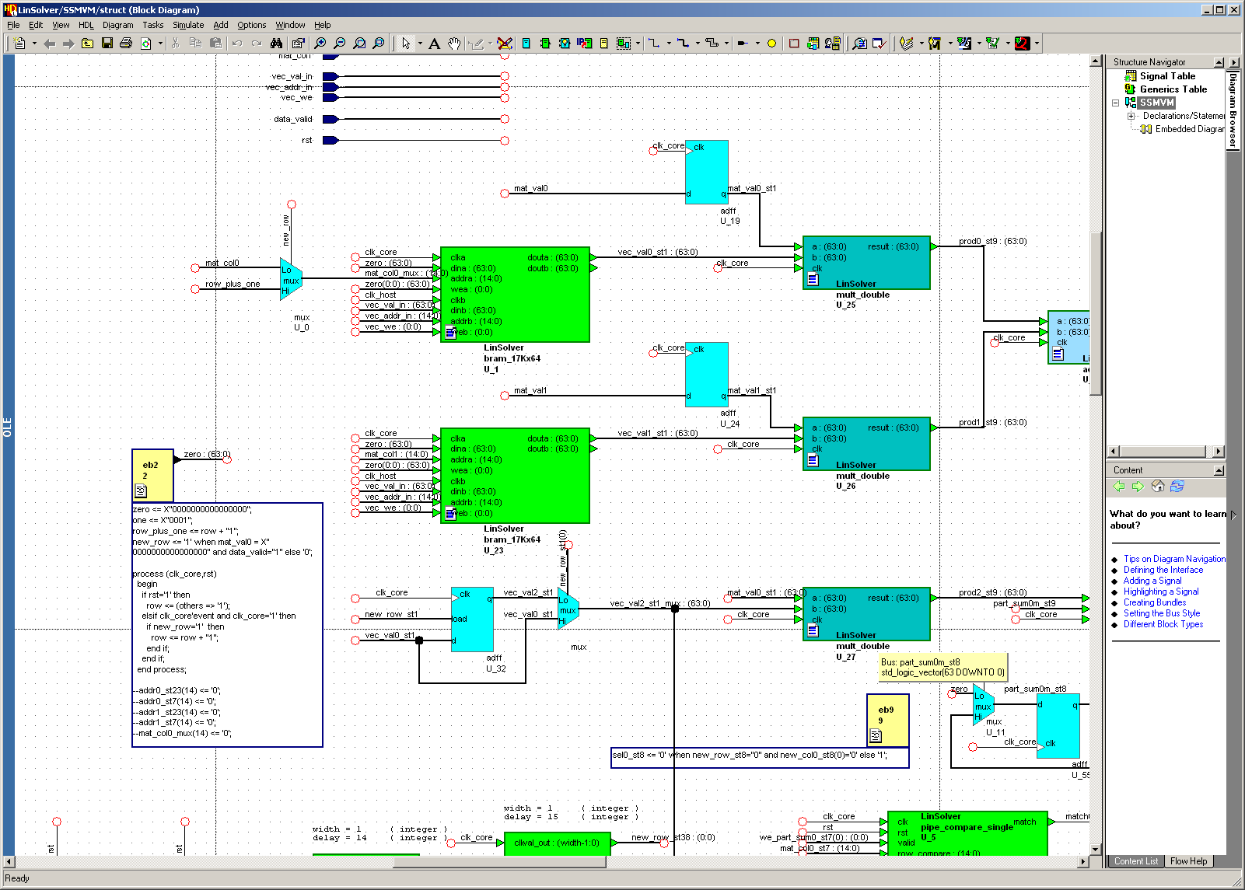
Field Programmable Gate Arrays (FPGAs)

Slide 12
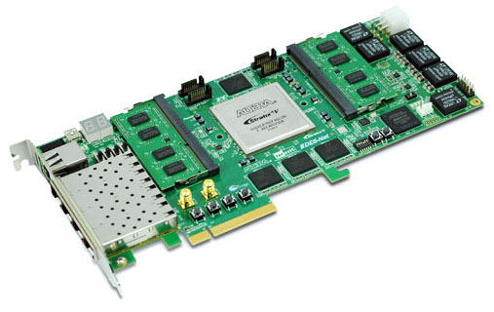
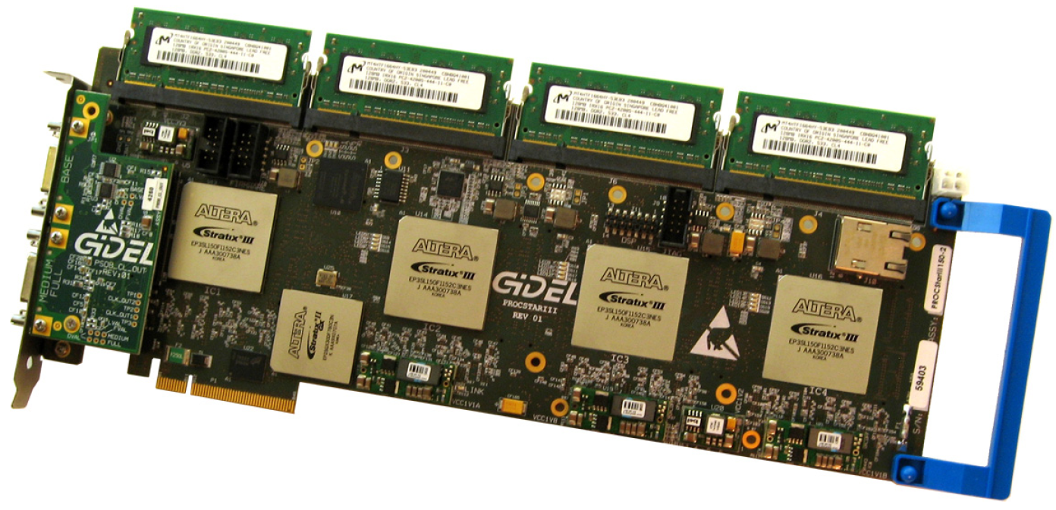
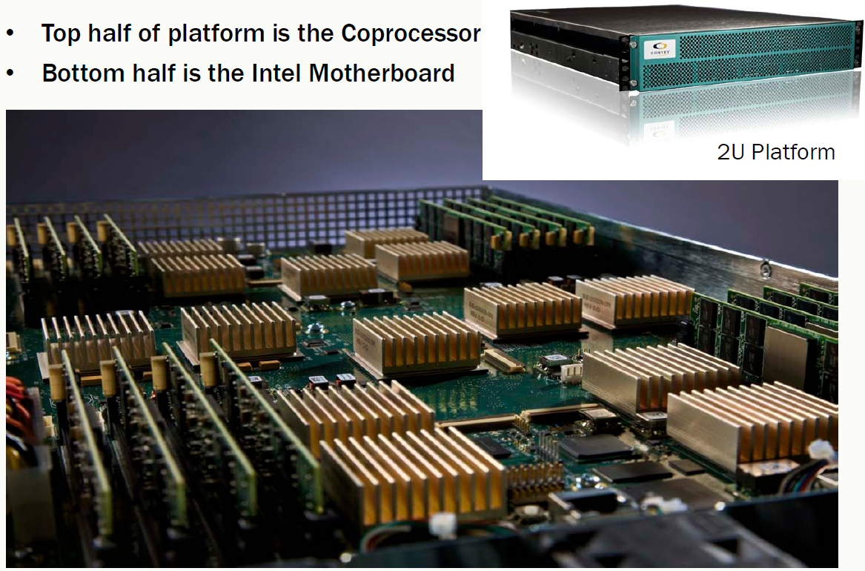
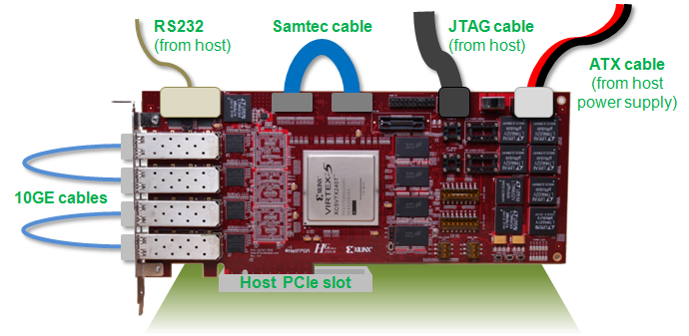
Computing with FPGAs
High resource utilization, spatial parallelism, customized memory structures, low latency I/O
Our contributions:
Computational biology: phylogeny reconstruction, genomic database search (BMCBIO 2013, IEEE TPDS 2012, BMCBIO 2010, FCCM 2007, BIBE 2007)
Sparse linear algebra (FCCM 2011, ICFPT 2009, FCCM 2009)
Synthesis of I/O-constrained floating-point pipelines (ReConFig 2013, IJRC 2013, Nagar dissertation)
Interface synthesis for massively parallel memory systems (FCCM 2013, Jin dissertation)
Current projects:
Distributed controller architectures for medium-voltage DC power electronic systems (ONR 2015-2017)
Overlay design for automata processing (NSF 2014-2017)

Slide 13
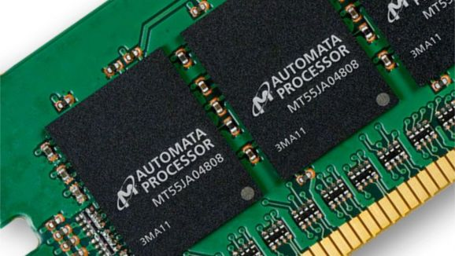
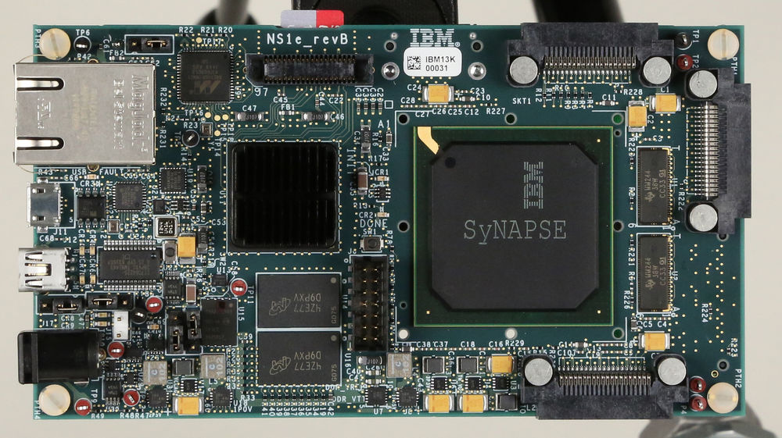
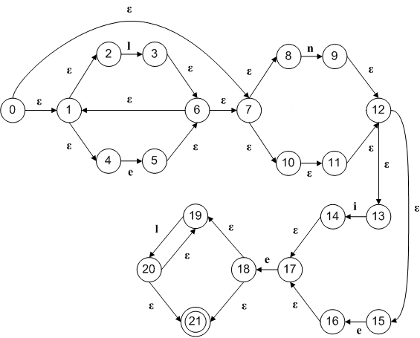
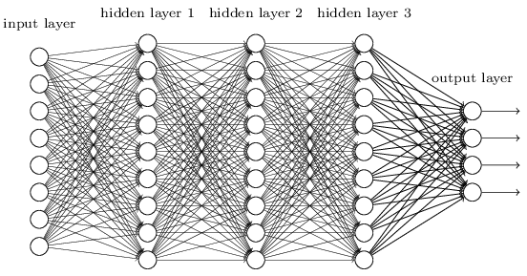
Processor-in-Memory Architectures
Micron Automata Processor
IBM "TrueNorth" Neuromorphic Processor

Slide 14
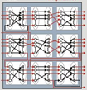
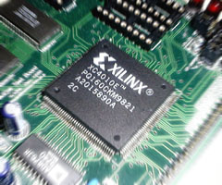
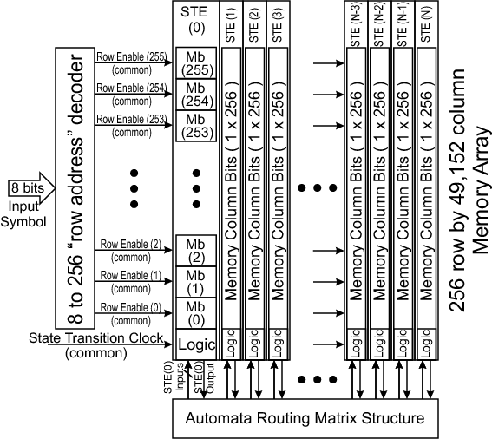
Current Work: FPGA Overlays

Slide 15
Recent Work: FPGA-Based BLAST
Genomic databases large and growing fast
NCBI BLAST widely used for database search
Must scan perform entire database for each query
I/O (disk) bound
Query
Downstream processing
Database
Database’
kernel

Slide 16
Background
BLAST Filter:
1) Decompose query
2) Identify seeds
AACBBAV
AAC
ACB
CBB
BBA
BAV
3) Identify High Scoring Pairs (HSPs):
AAC
ACB
CBB
BBA
BAV
4) Look for HSPs of the same total length in each DB record
Existing FPGA implementations are direct implementations of software

Slide 17
Our Approach
Database
Preprocess
BRAM
DRAM
Disk
Pattern match: HSPs
Indices of likely matches
Downstream processing
Query
FPGA+DRAM
CPU+disk

Slide 18
Filter Design
Index
(List of HSPs in database)
Table of Contents
Suffix Table
HSP / Length | Start | Length
ACBC-8 | 0 | 1
ACCV-9 | 1 | 1
CBBC-6 | 2 | 1
CBCV-7 | 3 | 1
Record | Start
0 | 2
0 | 2
0 | 4
0 | 4
 | AC | BC | CB | CV
AC | 0 | 1 | 0 | 1
BC | 0 | 0 | 0 | 0
CB | 0 | 1 | 0 | 1
CV | 0 | 0 | 0 | 0
Disk
(10X size of DB)
On-chip
(128 KB)
DRAM
(160 MB)

Slide 19
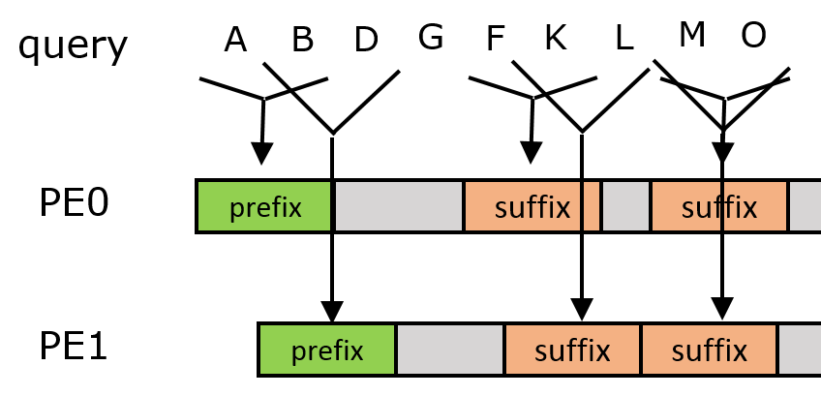
Filter Design
Multiple PEs
Each detects HSP patterns within fixed windows
When found, schedule access to DRAM
All PEs together synthesized as single pipeline
Performs at WCET

Slide 20
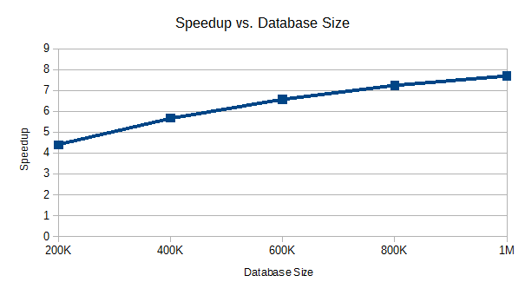
Results
FPGA Performance
# PEs | II | Pipeline Depth | Throughput (Mchars/s)
12 | 12 | 40 | 9.2
16 | 16 | 44 | 8.4
20 | 20 | 48 | 7.7
24 | 24 | 52 | 7.1
28 | 28 | 56 | 6.6
32 | 32 | 60 | 6.2
36 | 36 | 64 | 5.8
40 | 40 | 68 | 5.4
44 | 44 | 72 | 5.1
CPU Baseline Performance
vs. NCBI BLAST
Threads | upper bound Thrp't. (Mc/s) | lower bound Thrp't. (Mc/s)
1 | 8.7 | 2.4
2 | 11.5 | 3.9
3 | 8.3 | 4.6
4 | 7.0 | 4.6
5 | 6.1 | 3.7
6 | 5.0 | 3.6
7 | 4.7 | 3.4
8 | 4.2 | 3.1
Faster for high-hit rate queries despite having less than half DRAM b/w
4-8X speedup overall

Slide 21
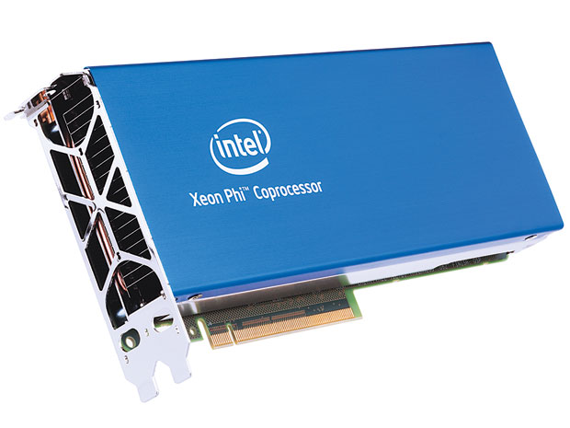
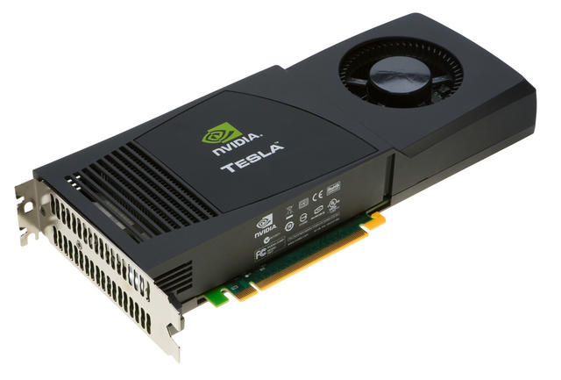
Other Emerging Processors
Many-core Processors:
High memory bandwidth, but the program must be amenable to execution across thousands of parallel threads
Previous contributions:
All-to-all sequence alignment (IEEE D&T 2014, SAAHPC 2012)
Frequent itemset mining (J. Supercomputing 2013, CLUSTER 2011)

Slide 22
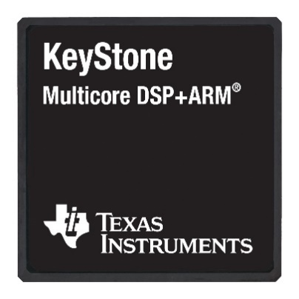
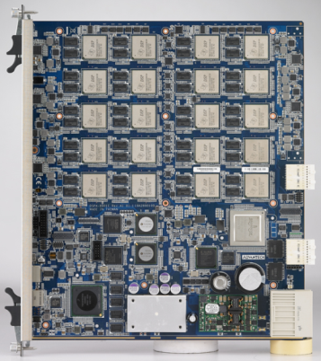
Heterogeneous and Reconfigurable Computing Lab
Digital Signal Processors:
Highly energy efficient, but programmer must explicitly allocate and manage on-chip memory
Previous contributions:
Real-time optical flow (HPEC 2014, SC 2013)
Sparse linear algebra (HPEC 2014, ASAP 2013)
Domain-specific language for structured grid operations (Zhang dissertation 2014)
Automated scratchpad allocation and management (Gao dissertation 2014)
Current work:
Smart processor allocation for vision pipelines (TI project, 2017-2019)

Slide 23
Administrative Vision
Jason D. Bakos

Slide 24
Administrative Objectives
Support the faculty
Improve the prestige of the department (and university)
Goals are related:
e.g. level of faculty support is a significant factor in USNWR rankings

Slide 25
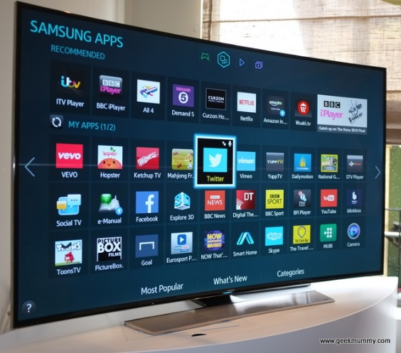
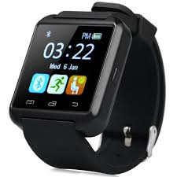
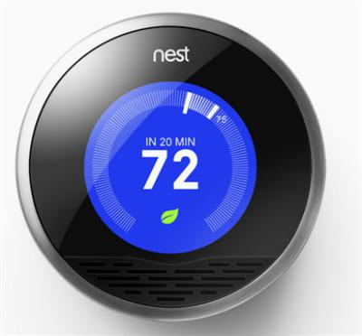
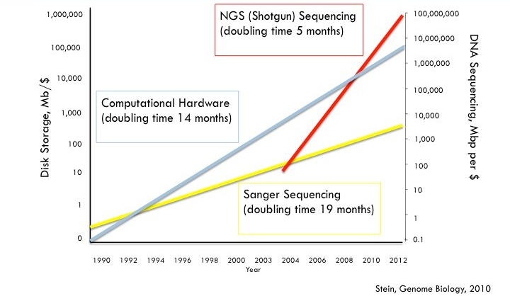
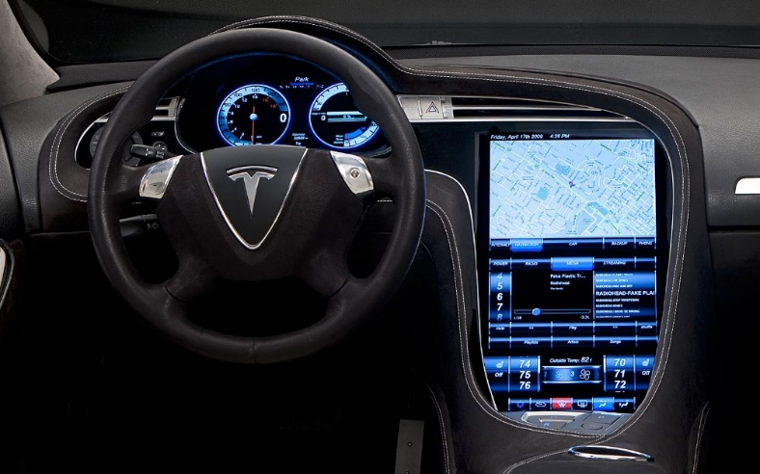
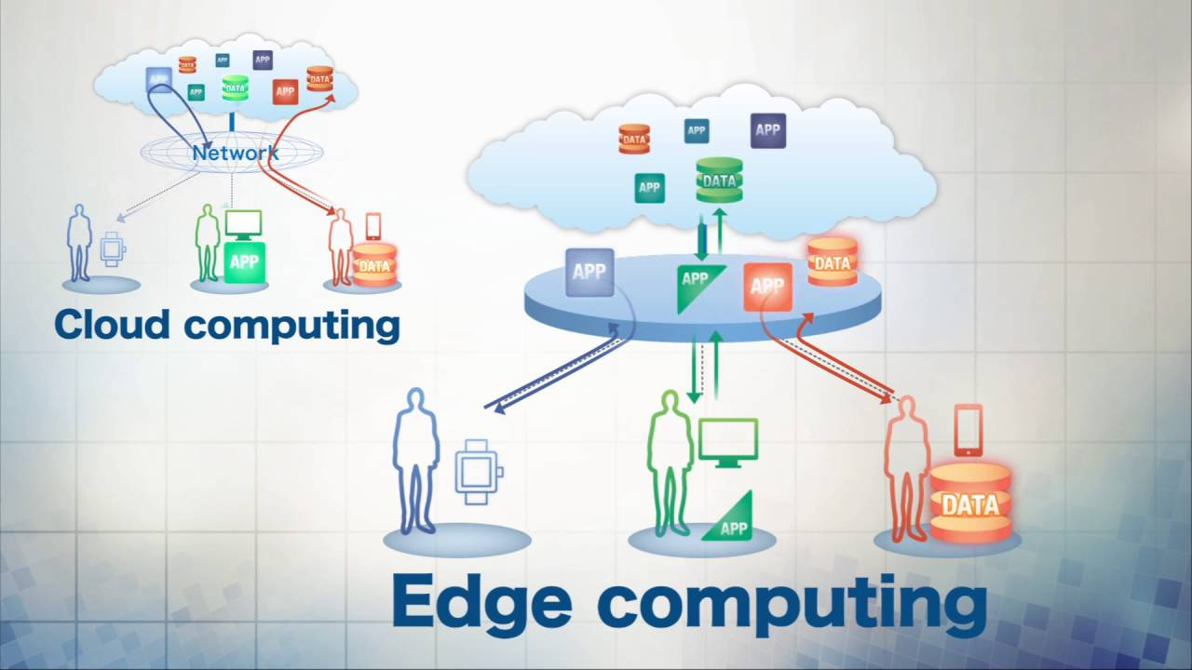
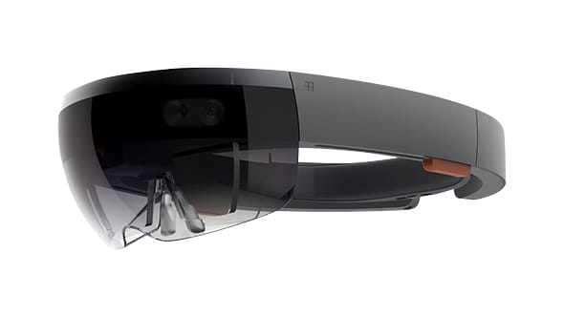
A Good Time to be a CS Major…
Cyber-physical Systems
Data Science
Edge Computing/IoT

Slide 26
Job Outlook vs. Engineering
Job growth during 2014-2024:
Computer and information technology: 12%
Civil engineering: 8%
Mechanical engineering: 5%
Chemical engineering: 2%
Electrical engineering: 0%
Computing jobs will account for 71% of all the STEM jobs by 2022
Source: U.S. Bureau of Labor Statistics

Slide 27
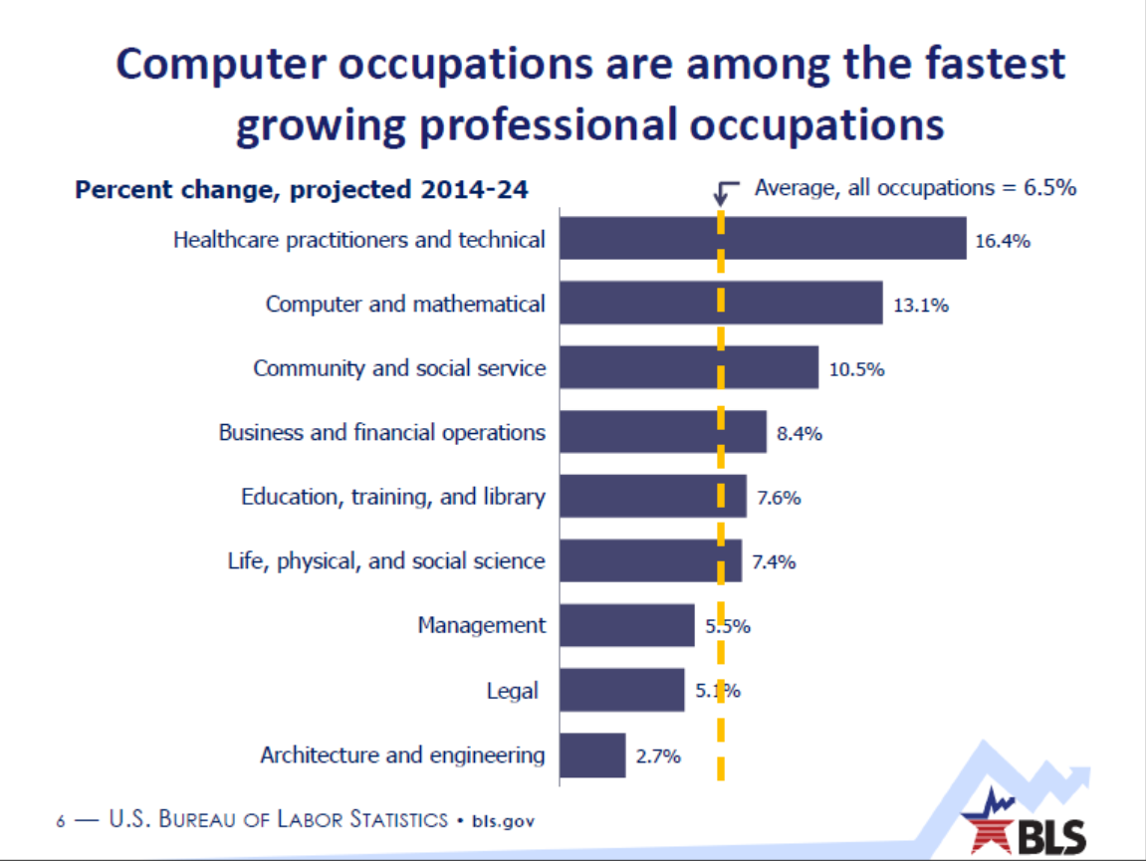
Jobs Outlook vs. Others
Source: M. Wolf, U.S. Bureau of Labor Statistics, as presented at the 2016 Workshop on the Growth of Computer Science Undergraduate Enrollments

Slide 28
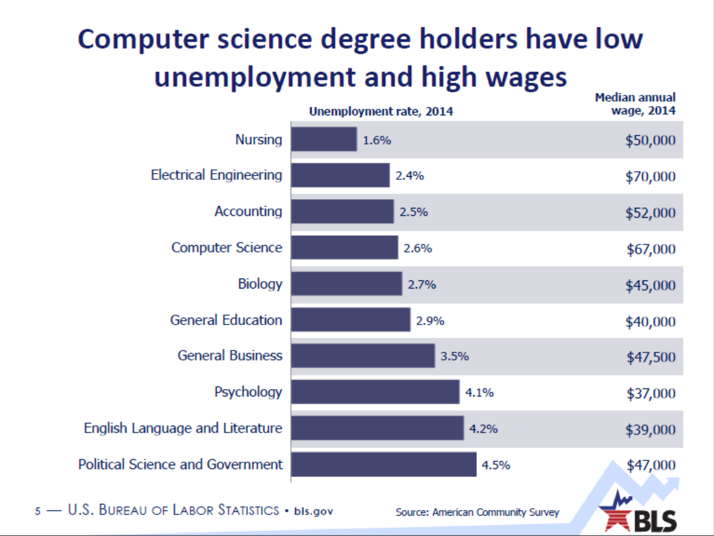
Unemployment and Salary
Source: M. Wolf, U.S. Bureau of Labor Statistics, as presented at the 2016 Workshop on the Growth of Computer Science Undergraduate Enrollments

Slide 29
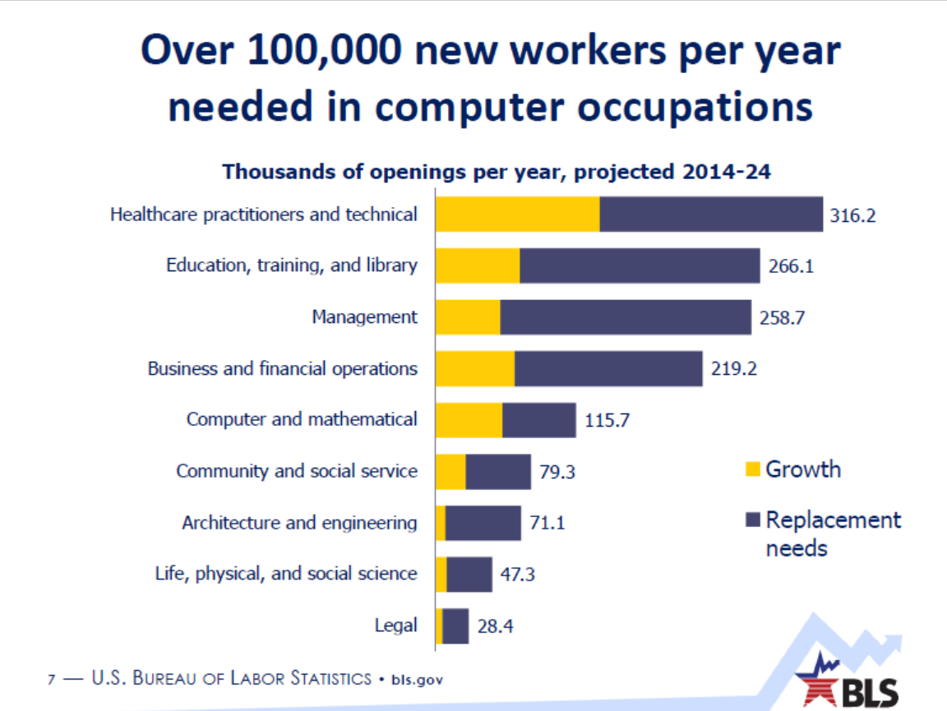
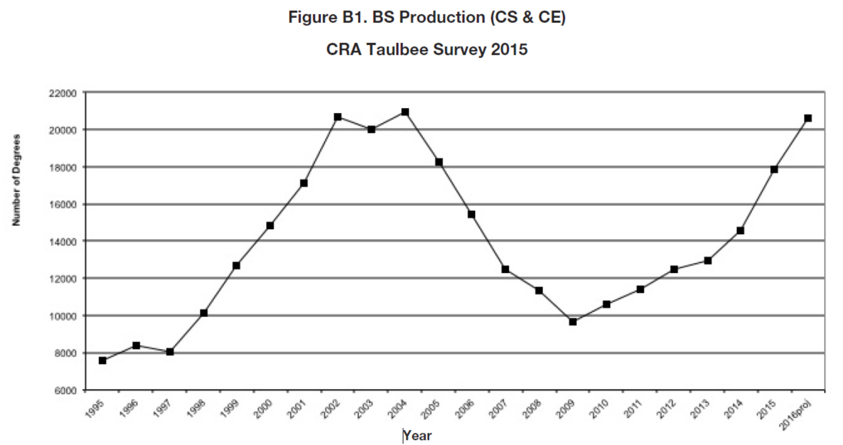
New CS Positions Per Year
Taulbee survey (n=178 Ph.D. granting CS depts.):
17,401 CS B.S. degrees awarded in 2015
98,377 total BS enrollment in 2015
Source: M. Wolf, U.S. Bureau of Labor Statistics, as presented at the 2016 Workshop on the Growth of Computer Science Undergraduate Enrollments

Slide 30
CS Job Satisfaction
CNN Best Jobs in America 2016 (growth, salary, satisfaction)
#1: Mobile App Developer
#9: Database Analyst
US News 100 Best Jobs 2016 (salary, challenge, stress level, advancement, satisfaction)
#8: Computer Systems Analyst
#13: Software Developer
#29: IT Manager
#35: Computer Network Architect
#52: Information Security Analyst
#60: Computer Support Specialist

Slide 31
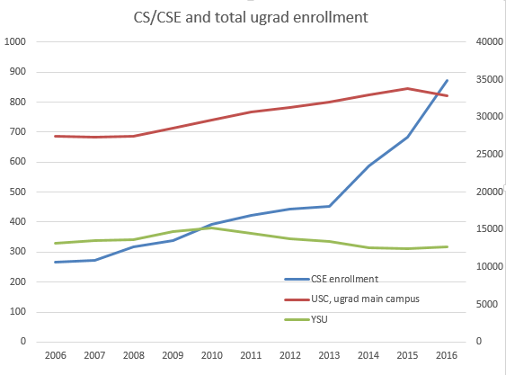
CS Enrollment
Sources:
1. USC Office of Institutional Research, Assessment, and Analytics
2. Youngstown State University, Fiscal Year 2017 Operating Budget

Slide 32
State of CSIS (and YSU)
Faculty Salary (7% of US News Rating)
 | YSU FY 2016 | 2015 Taulbee Survey 50th percentile
Assistant Professor | 74,993 (n=2) | 97,599 (+30%)
Associate Professor | 88,780 (n=5) | 110,450 (+24%)
Full Professor | 137,604 (n=1) | 152,687 (+11%)
Reverse compression???
Sources:
1. CRA Taulbee Survey, public U.S. universities CS dept., overall average 9 mo. Salary
2. Youngstown State University, Fiscal Year 2017 Operating Budget

Slide 33
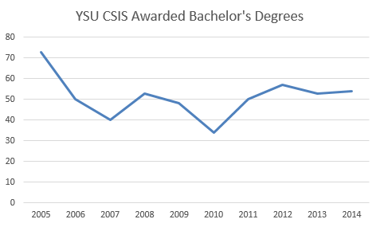
Faculty Size
2015 Taulbee Survey: 3.6 bachelors awarded per TT faculty
Assuming 10 faculty at YSU
Taulbee: Ave. of 28.3 TT faculty in US Public CS departments
 | Faculty-Student Ratio (1% of US News Rating)
Kent State (CS) | 21:1
U. Akron (CS) | 19:1
Cleveland State (EECS) | 18:1
U. Toledo (EECS) | 20:1
Wright State (CSE) | 22:1
Ohio State (CSE) | 19:1
YSU (CSIS) | 17:1 (45:1 for CSIS)
Sources:
1. Ohio Commission on Higher Education, 2. Taulbee Survey, 3. National Center for Education Statistics

Slide 34
Faculty Size
 | Assistant | Associate | Full | Instructor | Total
Kent State (CS) | 2 | 1 | 3 | 2 | 8
U. Akron (CS) | 3 | 2 | 3 | 3 | 11
Cleveland State (EECS) | 3 | 7 | 10 | 2 | 22
U. Toledo (EECS) | 4 | 4 | 6 | 1 | 15
Wright State (CSE) | 7 | 4 | 4 | 3 | 18
Ohio State (CSE) | 10 | 13 | 15 | 16 | 54
YSU (CSIS) | 2 | 5 | 1 | 2 | 10
Source: Departmental websites

Slide 35
ABET and Ph.D. Programs
Computer Science at: | ABET Accedited?
Kent State (CS) | NO
U. Akron (CS) | Computer Engineering
Cleveland State (EECS) | Computer Engineering (EAC)
U. Toledo (EECS) | Computer Science and Engineering (EAC,CAC)
Wright State (CSE) | Computer Engineering (EAC) Computer Science (CAC)
Ohio State (CSE) | Computer Science and Engineering (EAC,CAC)
YSU (CSIS) | NO
Ph.D. in CS?
YES
NO
DRE
YES
YES
YES
NO
Sources:
abet.org
Departmental websites

Slide 36
Retention
 | FT 6yr Graduation Rate (18% of US News Rating) | FT First Year Retention Rate (4.5% of USNews Rating)
Kent State | 56% | 81%
U. Akron | 40% | 74%
Cleveland State | 39% | 71%
U. Toledo | 42% | 72%
Wright State | 40% | 67%
Ohio State | 83% | 94%
YSU | 30% | 75%
Source: National Center for Education Statistics (US Dept. of Education)

Slide 37
Selectivity and Student-Faculty Ratio
 | SAT math scores (25th percentile) (8.13% of US News Rating) | Acceptance Rate (1.25% of US News Rating) | % Accepted that admitted (1.25% of US News Rating)
Kent State | 470 | 85% | 32%
U. Akron | 450 | 97% | 27%
Cleveland State | 450 | 64% | 27%
U. Toledo | 470 | 93% | 34%
Wright State | 450 | 96% | 45%
Ohio State | 610 | 49% | 35%
YSU | 410 | 71% | 36%
Source: National Center for Education Statistics

Slide 38
TODO List
Increase faculty salaries
Increase faculty size
ABET accreditation
Ph.D program
Make CSIS more attractive to good students
Increase retention

Slide 39
…but how?

Slide 40
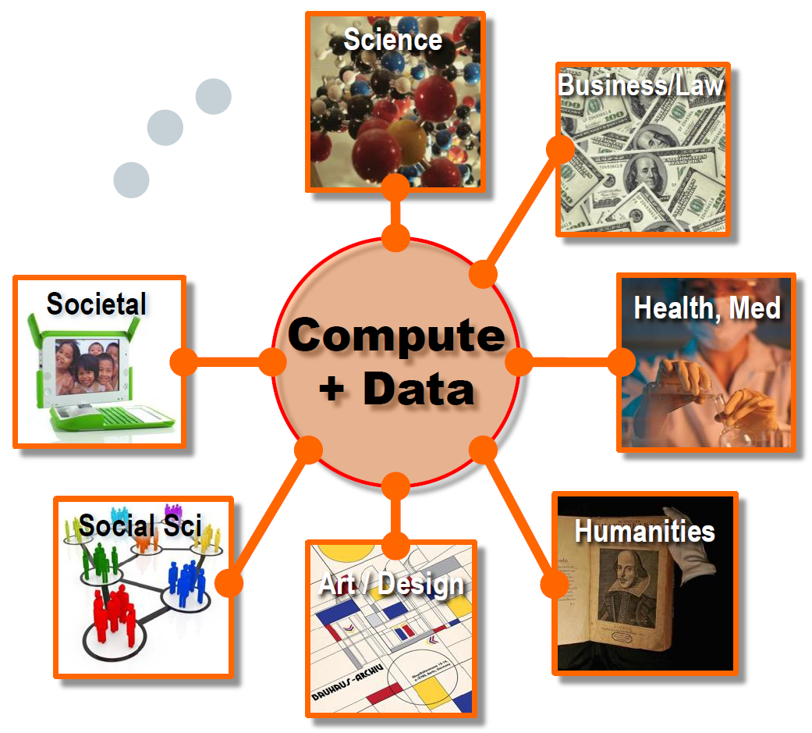
CSIS as an Curricular "Hub"

Slide 41
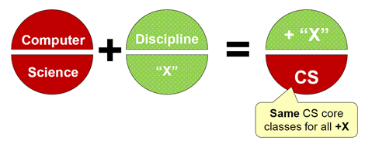
CSIS as an Curricular "Hub"
CS part is 36 hours
UIUC (16):
CS+Math, CS+Statistics, CS+Anthropology, CS+Astonomy, CS+Chemistry, CS+Linguistics, CS+Advertising, CS+Music, CS+Philosophy, CS+CropSci, CS+Education, CS+Ecomonics, CS+English, CS+Art/Design, CS+Business, CS+GeoScience
CS+X (at UIUC) now:
29% of all CS at UIUC,
50% of admitted freshman in 2016 class,
28% female
Source: R. Rutenbar, Dept. of CS at UIUC, as presented at the 2016 Workshop on the Growth of Computer Science Undergraduate Enrollments

Slide 42
Outcomes
More (and better) students, more classes, more revenue
Summer teaching offerings
Other ideas:
Advertise successes
Industrial advisory board (and funded projects)
Outreach to HS's
Alumni outreach
Space?

Slide 43
New Faculty
Assistant-level
Make T&P expectations clear
Give good feedback
Reduced teaching load
Mentoring program
Assistance with development of CAREER proposals
Associate-level
Make T&P expectations clear
Encourage more service
Help develop teaching
Enourage continued research performance
Full-level
Recognize accomplishments
Leverage experience for mentoring of junior faculty
Incentivize continued research performance

Slide 44
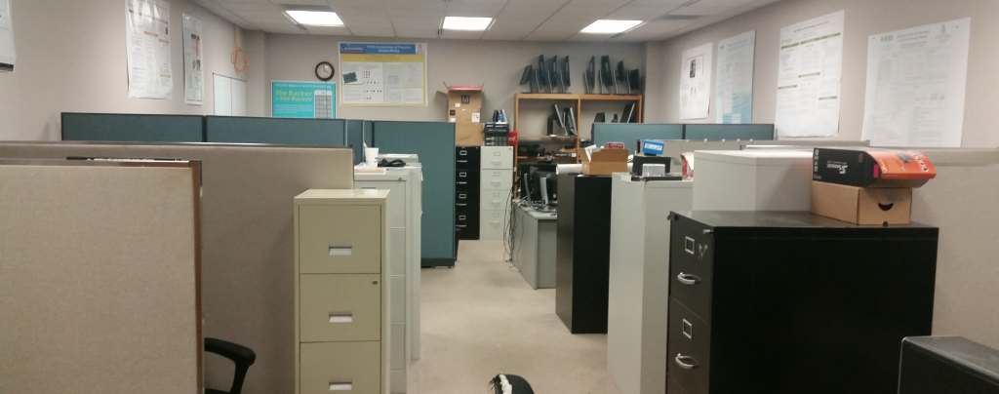
Thank you!
Graduate Students:
Madushan Abeysinghe
Lacie Cochran
Krishna Kalusani
Rasha Karakchi
Ivan Panchenko
Konstantin Rubin
Undergraduate Students:
Charles Daniels
Joshua Livingston
Viraj Patel
Scottie Scott
Manal "Mae" Khawaja

